Slide 1
How to Study for and Pass the PMI Program Management Professional (PgMP) Certification
The PMI Program Management Professional (PgMP) certification is one of the most prestigious credentials in project and program management. Designed for experienced professionals who manage multiple related projects, it demonstrates strategic alignment, leadership, and advanced program management expertise. This presentation will guide you through the process of preparing for and successfully passing the PgMP exam.
kW
by Kimberly Wiethoff

Slide 2
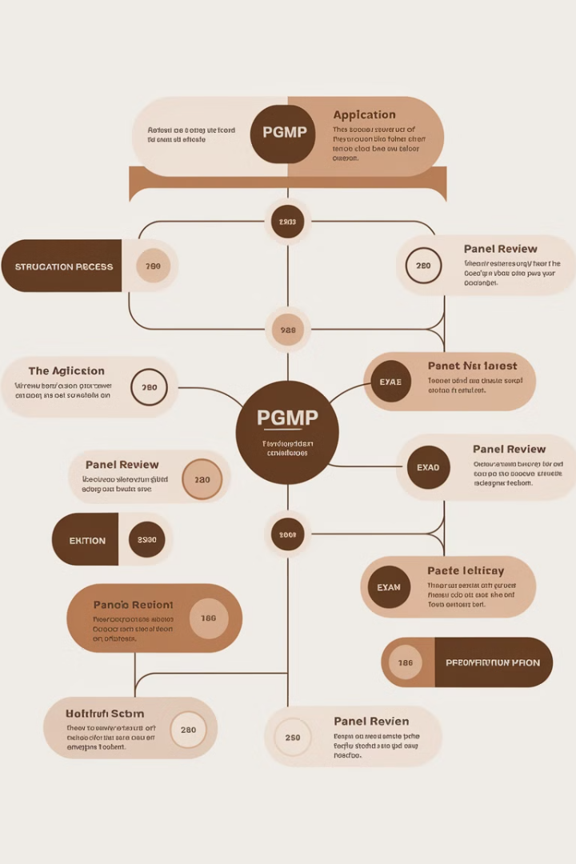
Understanding the PgMP Certification
1
Program Management Focus
2
Certification Process
To earn this certification, you must pass a Panel Review (peer review of your application) and the Exam (a rigorous, multiple-choice test covering PMI's Standard for Program Management framework).
Unlike the PMP, which focuses on project management, the PgMP is about managing programs—a collection of related projects that contribute to broader organizational goals.
3
Exam Structure
The exam consists of 170 questions over four hours, focusing on five performance domains: Program Strategy Alignment, Benefits Management, Stakeholder Engagement, Governance, and Program Life Cycle.

Slide 3
Essential Study Materials
PMI's Standard for Program Management (4th Edition)
PMBOK Guide (7th Edition)
Study Guides & Prep Books
While not the main focus, key project management principles still apply.
Books by Ginger Levin and Dr. Muhammad Mashhood Alam are highly recommended.
This is the core reference for the exam. Read it thoroughly and understand how program management differs from project management.
Exam Simulators
Use mock exams to familiarize yourself with the question format and time constraints.

Slide 4
Creating an Effective Study Plan
1
Foundation (Months 1-2)
Read the Standard for Program Management twice, taking detailed notes. Compare concepts to real-world experiences.
2
Deep Dive (Months 3-4)
Focus on understanding the five domains and how they interconnect. Practice mapping program activities to organizational strategy. Study benefits realization and stakeholder management in depth.
3
Exam Practice (Months 5-6)
Take full-length practice exams under timed conditions. Review incorrect answers and identify weak areas. Revisit challenging topics and refine understanding.

Slide 5
Mastering Key Concepts: Think Beyond Projects
Program Thinking
1
Understand how multiple projects contribute to long-term business benefits
2
Stakeholder Engagement
Managing executives, sponsors, and cross-functional teams at a program level
3
Benefits Realization
Focus on how projects deliver business value
4
Governance & Risk Management
Program-level governance structures, risk frameworks, and compliance
The PgMP exam tests program thinking, requiring you to understand how multiple projects contribute to long-term business benefits. It heavily emphasizes managing stakeholders at a program level and focuses on how projects deliver business value rather than just deliverables.

Slide 6
Exam Day Strategy: Time Management
—
Minutes per Question
With 170 questions in 4 hours, you have about 1.4 minutes per question. Don't get stuck—mark difficult ones and return later.
Effective time management is crucial for success in the PgMP exam. Stay time-conscious throughout the exam. If you encounter a difficult question, don't spend too much time on it. Mark it for review and move on to ensure you have time to answer all questions. Remember, all questions carry equal weight, so it's better to answer more questions than to spend too much time on a few difficult ones.

Slide 7
Exam Day Strategy: Think Like a Program Manager
Program-Level Perspective
Strategic Alignment
Focus on how program decisions align with organizational strategy and contribute to overall business objectives.
Approach every question from a program-level perspective, not just project management. Consider the broader organizational context and long-term benefits.
Holistic View
Consider the interconnections between different projects within a program and how they collectively contribute to program success.

Slide 8
Exam Day Strategy: Eliminate Wrong Answers
Use Process of Elimination
Compare Remaining Choices
Identify Obvious Incorrect Answers
If unsure, use the process of elimination to increase your chances of selecting the correct answer.
Read Carefully
Analyze the remaining options and choose the one that best aligns with program management principles.
Many questions have tricky wording, so read each question and answer choice carefully.
Start by eliminating answers that are clearly wrong or irrelevant to program management.

Slide 9
Exam Day Strategy: Trust Your Preparation
Confidence in Your Study
Stay Calm
Apply Your Knowledge
If you've followed a comprehensive study plan and taken practice exams, you're well-prepared for the real thing. Trust in your preparation and approach the exam with confidence.
Maintain a calm and focused mindset throughout the exam. Take deep breaths if you feel stressed and remember that you've put in the work to succeed.
Draw on your real-world experience and the knowledge you've gained during your preparation. Apply program management principles to each question.

Slide 10
The Value of PgMP Certification
Expertise Validation
Career Enhancement
1
Validates high-level program management expertise
Enhances career prospects and leadership opportunities
2
Professional Growth
4
Strategic Skills
Demonstrates commitment to continuous professional development
3
Proves your ability to drive strategic business outcomes
The PgMP certification is a valuable investment in your career. It not only validates your expertise in program management but also opens doors to new opportunities and demonstrates your ability to drive strategic business outcomes.

Slide 11
Program Strategy Alignment
Understand Organizational Goals
Align Program Objectives
Monitor Strategic Alignment
Communicate Strategic Value
Gain a deep understanding of the organization's strategic objectives and how programs contribute to them.
Ensure that program objectives are directly linked to and support the organization's strategic goals.
Continuously assess and adjust program activities to maintain alignment with evolving organizational strategies.
Effectively communicate how the program delivers strategic value to stakeholders at all levels.

Slide 12
Program Benefits Management
1
Identify Benefits
Clearly define and document the expected benefits of the program, both tangible and intangible.
2
Plan Benefits Realization
Develop a comprehensive plan for how and when benefits will be realized throughout the program lifecycle.
3
Monitor and Measure
Continuously track and measure the realization of benefits, adjusting the program as necessary to ensure delivery.
4
Sustain Benefits
Implement strategies to ensure that realized benefits are sustained beyond the program's completion.

Slide 13
Program Stakeholder Engagement
Identify Stakeholders
Analyze Stakeholder Interests
Comprehensively identify all stakeholders impacted by or influencing the program.
Understand the needs, expectations, and influence of each stakeholder group.
1
2
Manage Stakeholder Relationships
Develop Engagement Strategies
4
3
Continuously nurture and manage relationships with stakeholders throughout the program lifecycle.
Create tailored strategies to effectively engage and communicate with different stakeholder groups.

Slide 14
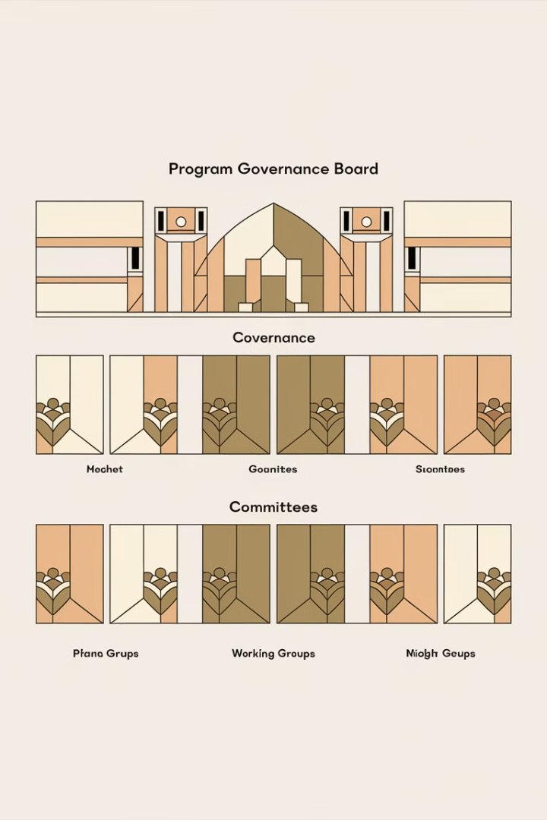
Program Governance
Establish Governance Structure
Define clear roles, responsibilities, and decision-making processes for program governance.
Implement Control Mechanisms
Develop and implement effective control mechanisms to monitor program performance and ensure alignment with organizational objectives.
Manage Program Decisions
Facilitate and manage decision-making processes at the program level, ensuring alignment with governance frameworks.
Ensure Compliance
Ensure the program adheres to relevant organizational policies, standards, and regulatory requirements.

Slide 15
Program Life Cycle Management
Initiating
1
Define the program vision, objectives, and high-level scope. Secure stakeholder buy-in and initial resources.
2
Planning
Develop comprehensive program plans, including component projects, resources, and risk management strategies.
Executing
3
Coordinate and oversee the execution of component projects, ensuring alignment and integration.
4
Controlling
Monitor program performance, manage risks, and implement necessary changes to keep the program on track.
Closing
5
Formally close the program, ensure benefits realization, and capture lessons learned for future programs.

