Slide 1
A Project Manager's Guide to Implementing Salesforce
Implementing Salesforce can be a game-changer for organizations, providing a centralized platform for managing customer relationships, sales processes, and analytics. However, a successful implementation requires careful planning, stakeholder alignment, and a strategic approach. This guide outlines key considerations for project managers leading a Salesforce implementation.
kW
by Kimberly Wiethoff

Slide 2
Define Clear Objectives
Enhance CRM
Automate Workflows
Improve Analytics
Integrate Systems
Improve customer relationship management by centralizing data and interactions. This helps in understanding customer needs and preferences, leading to better service and increased satisfaction.
Enhance reporting and analytics capabilities to gain insights into business performance. Data-driven decisions lead to optimized strategies, improved resource allocation, and better overall results.
Integrate Salesforce with existing systems to create a unified platform. Seamless integration ensures data consistency, eliminates redundancies, and enhances cross-departmental collaboration.
Automate sales and marketing workflows to streamline operations and reduce manual tasks. Automated processes ensure consistency, improve efficiency, and free up resources for strategic initiatives.

Slide 3
Engage Stakeholders Early
1
Sales and Marketing Teams
2
Customer Service Representatives
Involve sales and marketing teams to align Salesforce with their needs. Their input ensures the platform supports their daily activities and strategic goals, driving user adoption.
Engage customer service representatives to improve customer support processes. Their involvement ensures Salesforce enhances their ability to resolve issues and provide excellent service.
3
IT and Security Teams
4
Executive Sponsors
Include IT and security teams to address technical and compliance requirements. Their expertise ensures the implementation is secure, reliable, and aligned with organizational policies.
Secure executive sponsorship to provide leadership support and resources. Their backing ensures the project has the necessary visibility and commitment to succeed.

Slide 4
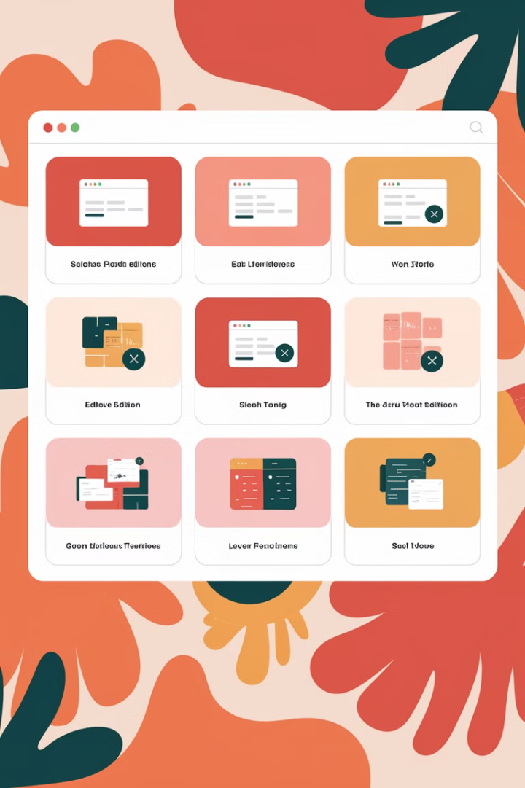
Choose the Right Edition and Features
Sales Cloud
Focuses on sales process automation, lead management, and opportunity tracking, enhancing sales team efficiency and effectiveness.
Service Cloud
Provides tools for customer service, case management, and support automation, improving customer satisfaction and retention.
Marketing Cloud
Enables personalized marketing campaigns, email automation, and customer journey mapping, enhancing marketing effectiveness and engagement.
Einstein AI
Integrates AI-powered analytics for predictive insights, personalized recommendations, and automated decision-making, improving business outcomes.

Slide 5
Plan for Data Migration and Integration
Data Cleansing
Data Mapping
Integration
Cleanse and deduplicate data to ensure accuracy and consistency. High-quality data is essential for reliable reporting and effective decision-making.
Map existing data fields to Salesforce objects to ensure seamless data transfer. Accurate mapping prevents data loss and ensures data integrity.
Integrate with third-party applications to create a unified ecosystem. Seamless integration enhances data flow and improves cross-functional collaboration.

Slide 6
Develop a Customization and Configuration Strategy
1
Custom Fields
Define custom fields to capture specific data relevant to your business. Tailored fields ensure Salesforce meets your unique requirements.
2
Page Layouts
Customize page layouts to optimize user experience and data entry. Streamlined layouts improve efficiency and reduce errors.
3
Validation Rules
Implement validation rules to ensure data quality and compliance. Automated rules prevent incorrect data entry and enforce business policies.
4
Role-Based Access
Configure role-based access control to protect sensitive data. Granular permissions ensure only authorized users can access specific information.

Slide 7
Establish Governance and Compliance
User Roles
Define user roles and permissions to enforce data security. Clear roles ensure appropriate access and prevent unauthorized modifications.
Data Security
Enforce data security and compliance with regulations like GDPR and HIPAA. Secure data handling protects customer privacy and avoids legal issues.
System Updates
Establish governance for ongoing system updates to maintain stability. Managed updates prevent disruptions and ensure compatibility.

Slide 8
Provide Comprehensive Training
Role-Based Training
Offer role-based training for different teams to address specific needs. Tailored training ensures relevance and improves knowledge retention.
2
Hands-On Training
Conduct hands-on training sessions for end users. Practical experience ensures users are comfortable and proficient with the system.
1
Documentation
Provide documentation and on-demand resources for continuous learning. Readily available resources support ongoing user development.
3

Slide 9
Create a Change Management Plan
1
Communicate Benefits
2
Address Concerns
3
Provide Support
Communicate benefits and expected outcomes to gain user buy-in. Addressing concerns proactively reduces resistance. Providing ongoing support post-launch ensures a smooth transition and sustained adoption. A change management plan facilitates a positive user experience, increases adoption rates, and ensures the successful integration of Salesforce into the organization's workflows.

Slide 10
Test Thoroughly Before Deployment
1
Unit Testing
2
UAT
3
Performance Testing
Conduct unit testing to validate individual components. User acceptance testing (UAT) ensures system readiness. Performance and security testing ensures system stability. Thorough testing identifies and resolves issues, reduces risks, and ensures a successful launch. Pilot rollouts before full-scale deployment validate functionality, performance, and user satisfaction in a real-world environment.

Slide 11
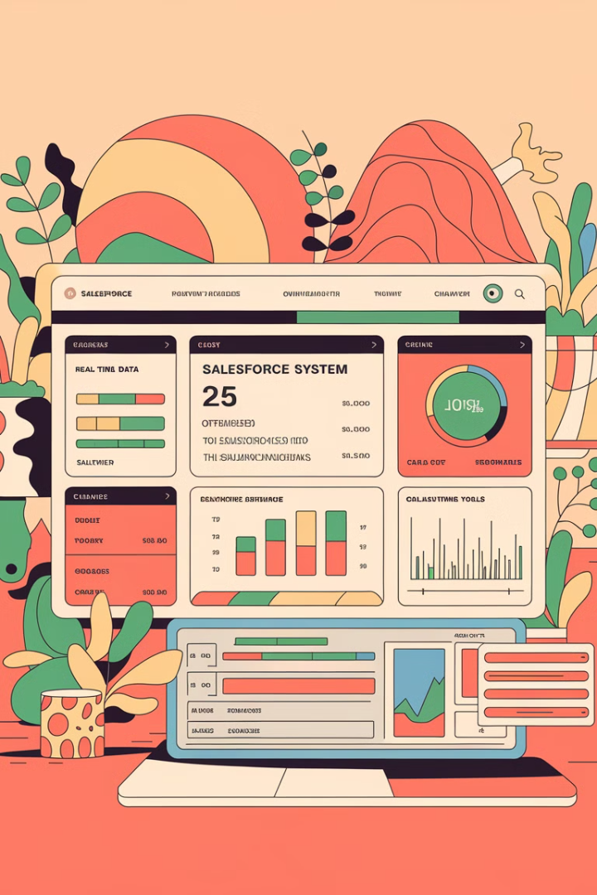
Monitor, Optimize, and Evolve
3
100%
Audits
Feedback
Regular system audits and health checks identify areas for improvement.
Continuous improvement based on user feedback enhances user satisfaction.
Future
Roadmaps
Roadmaps for future enhancements and integrations drive ongoing value.

Slide 12
Data Cleansing Best Practices
Standardize Data
Remove Duplicates
Establish consistent data formats and naming conventions to eliminate inconsistencies and improve data quality. Standardizing data makes it easier to analyze and report on.
Implement deduplication rules and processes to eliminate duplicate records. Removing duplicates improves data accuracy and reduces storage costs.

Slide 13
Customization Strategy Essentials
1
Align with Business Needs
Ensure customizations align with specific business requirements. Tailored solutions provide the most value and improve user adoption.
2
Minimize Complexity
Minimize complexity to simplify maintenance and reduce the risk of errors. Simple solutions are easier to manage and update.

Slide 14
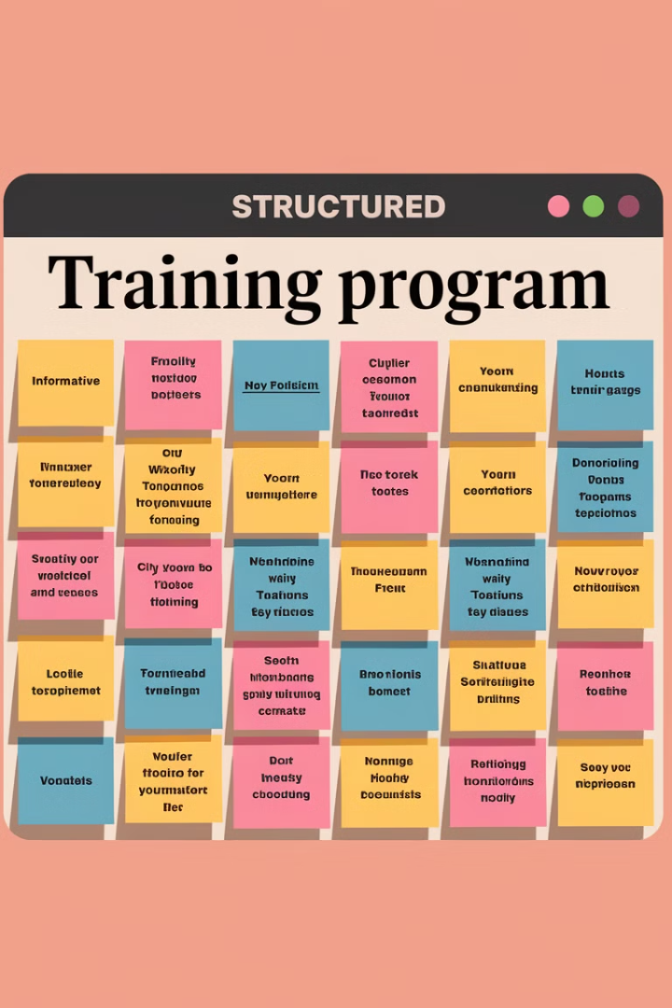
Training Program Structure
Module 1
Introduction to Salesforce
Module 2
Sales Process Automation
Module 3
Service Cloud Essentials
A structured training program includes an introduction to Salesforce, sales process automation, and service cloud essentials. Comprehensive training ensures users are proficient and can maximize the platform's capabilities. This structured approach facilitates learning and improves user adoption.

Slide 15
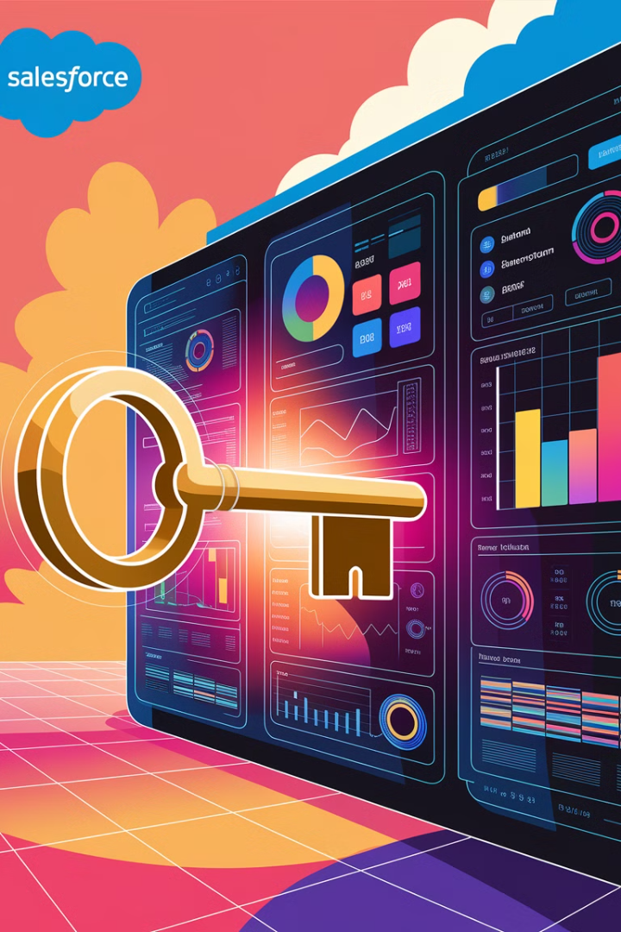
Key Takeaways
Strategic Planning
Data Management
Careful planning and stakeholder alignment are crucial for success.
Effective data management ensures data quality and reliability.
Continuous Improvement
Continuous monitoring and optimization drive ongoing value.

