Slide 1
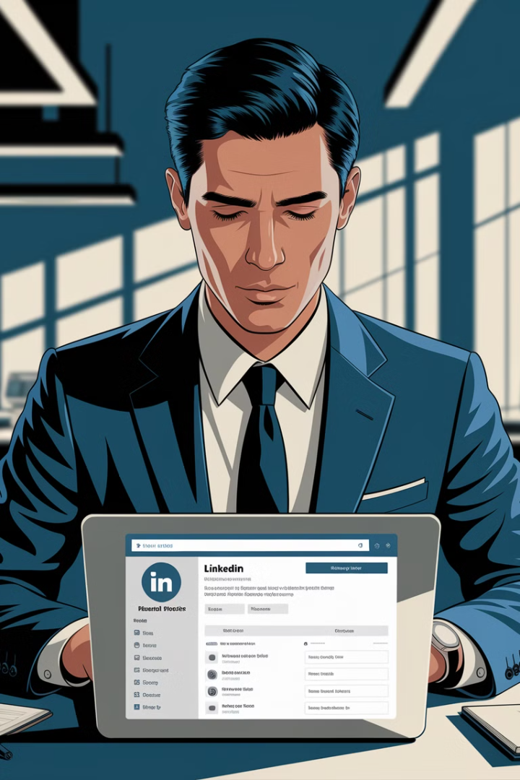
Optimize Your LinkedIn Profile for Recruiter Calls
LinkedIn is more than just an online resume—it's a powerful tool for job seekers to attract recruiters and land interviews.
Many professionals fail to optimize their profiles, reducing their chances of being discovered by recruiters who rely on search algorithms.
kW
by Kimberly Wiethoff

Slide 2
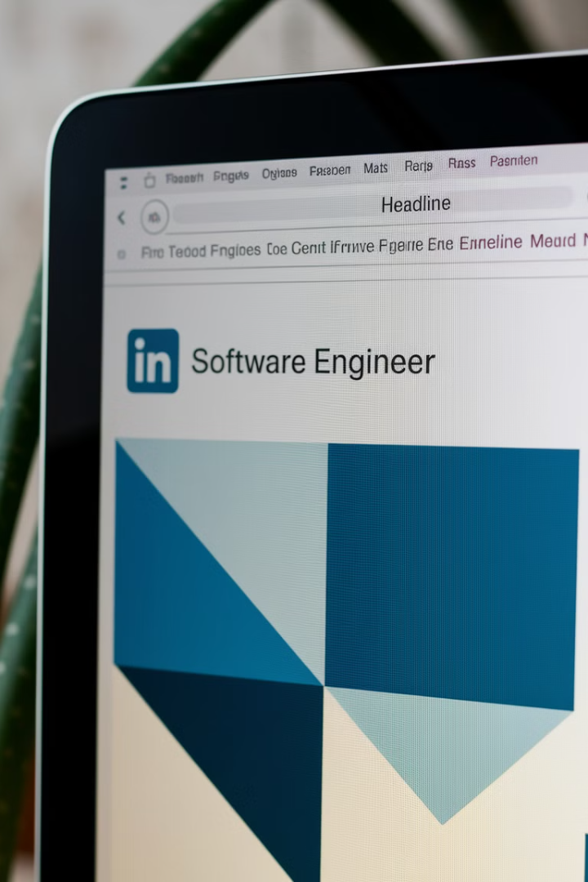
Craft a Keyword-Rich Headline
Common Mistake
Effective Approach
Using only a job title as headline: "Senior IT Project Manager"
"Senior IT Project Manager | Agile & Cloud Transformation | Driving Enterprise IT Success"
Why It Works
Includes relevant keywords and highlights expertise beyond job title

Slide 3
Write a Compelling "About" Section
Opening Statement
Start with a clear value proposition about your expertise and passion.
Key Achievements
Demonstrate impact with quantifiable results like "$5M AWS cloud migration".
Call to Action
Encourage networking with a clear invitation to connect.

Slide 4
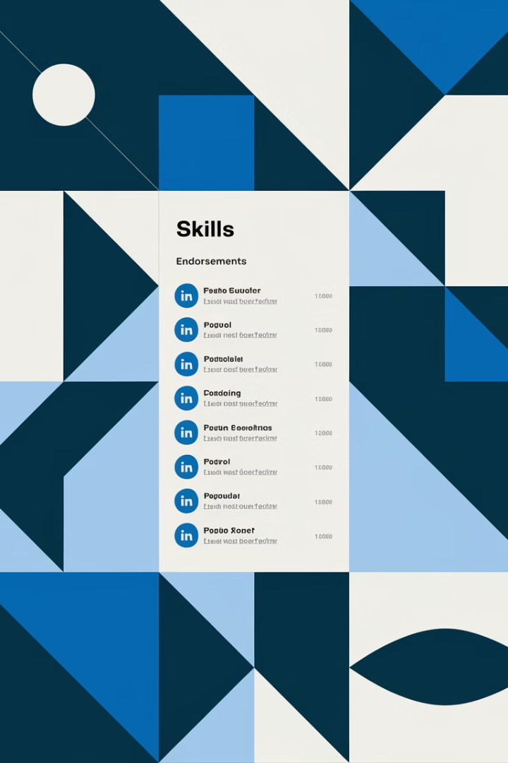
Optimize Skills & Endorsements
1
Prioritize Relevant Skills
2
Focus on Specifics
Choose industry-specific skills over generic ones.
Ensure your top three skills align with your target role.
3
Gather Endorsements
Request endorsements from colleagues to improve ranking.

Slide 5
High-Impact Skills for IT Project Managers
Agile & Scrum
Cloud Migration
Digital Transformation
Highlight expertise in modern project management methodologies.
Specify platforms like AWS, Azure, or GCP.
Showcase experience leading organizational change.

Slide 6
Use Professional Photos
14x
2
More Profile Views
Key Images
Profiles with professional headshots receive significantly more attention.
Both profile photo and background image matter for branding.
1st
Impression
Photos create the critical first impression for recruiters.

Slide 7
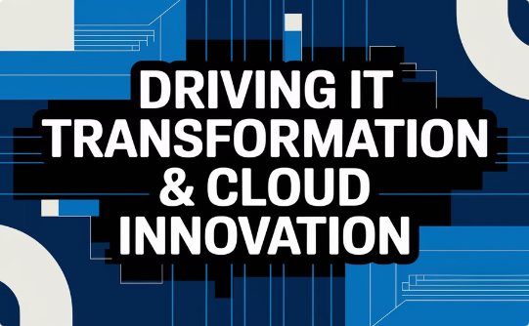
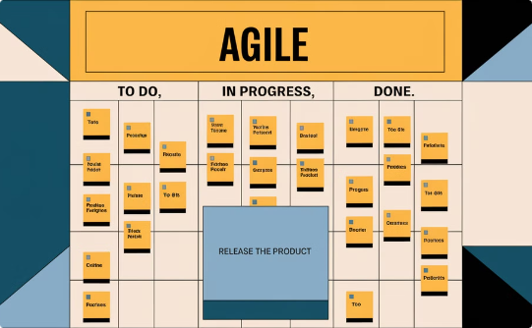
Background Image Ideas
Branded Tagline
Industry Visuals
Work Environment
Use a background with your professional motto or expertise statement.
Choose imagery that represents your field or specialization.
Show your professional context or methodology in action.

Slide 8
Increase Engagement for Visibility
Comment on Industry Posts
Share insights on relevant discussions to demonstrate expertise.
Share Project Reflections
Post short stories about successes and lessons learned.
Join LinkedIn Groups
Participate in specialized communities to expand your network.

Slide 9
Daily Engagement Strategy
1
Morning
Comment on 2-3 industry posts to share insights.
2
Midweek
Share one career insight or project success story.
3
Weekly
Connect with new industry professionals and recruiters.
4
Monthly
Review profile metrics and adjust strategy as needed.

Slide 10
Small Changes, Big Results
Achievement-Focused "About"
Keyword-Rich Headline
2
1
Showcase impact
Improve search ranking
Targeted Skills
3
Align with desired roles
5
Regular Engagement
Boost visibility
4
Professional Photos
Create strong impression

