Slide 1
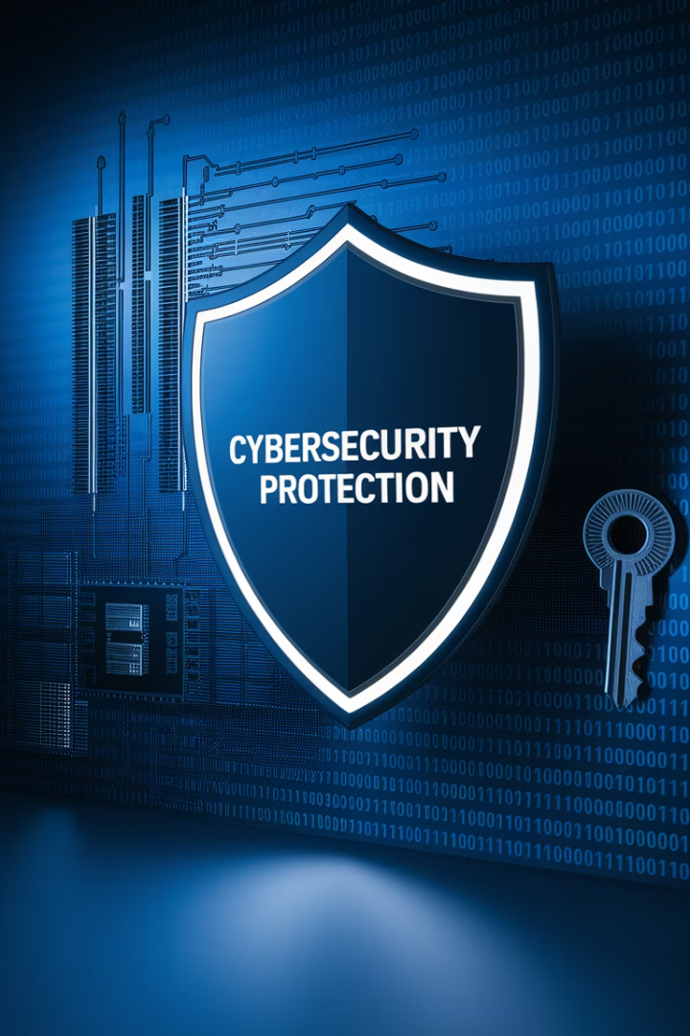
Security for Infrastructure vs. Application Projects
In an age of relentless cyber threats, data privacy regulations, and increasing reliance on cloud technologies, security isn’t optional—it’s fundamental. Whether you’re leading an infrastructure upgrade or launching a new app, understanding the distinct security considerations of each project type is critical for project success and organizational safety.
While both infrastructure and software development projects require strong security controls, they differ in scope, risk surfaces, stakeholders, and timelines. Here's what project managers need to know to keep both types of projects secure and compliant.
kW
by Kimberly Wiethoff

Slide 2
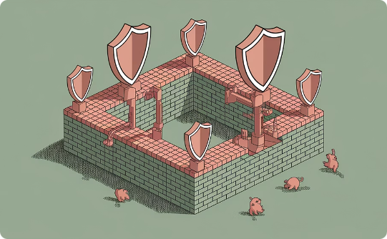
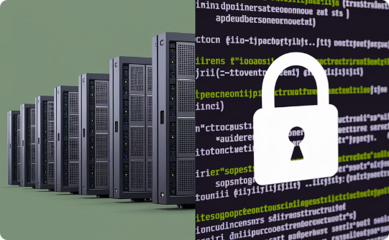

Project Security: A Shared Responsibility
Why Security Matters
Different Project Types
PM's Critical Role
Cyber threats are relentless. Data privacy regulations are strict. Cloud technologies create new vulnerabilities.
Infrastructure and application projects have distinct security considerations. They differ in scope, risk surfaces, and controls.
You must orchestrate communication between teams. Enforce security checkpoints. Escalate concerns promptly.

Slide 3
Infrastructure Security: Guarding the Foundation
Infrastructure projects focus on the systems and environments that support all applications and business operations. Security in this context is primarily about protecting the core technology stack from threats and vulnerabilities.
Key Areas to Manage:
Identity and Access Management (IAM): Ensure least privilege access to servers, network devices, and cloud consoles.
Firewall and Network Security: Coordinate rule reviews and approvals (e.g., via Entra or Cisco Firepower) early in the project.
Endpoint Hardening: Enforce baseline OS configurations, encryption policies, and antivirus protocols.
Data Center & Cloud Security: Confirm physical security for on-prem hardware and review shared responsibility models for AWS/Azure.
Audit Trails and Logging: Plan for security monitoring and log retention from Day 1.

Slide 4










Infrastructure Security Fundamentals
Audit & Monitoring
Continuous security logging
Data Center & Cloud
Physical and shared security models
Endpoint Hardening
OS configurations and encryption
Firewall & Network
Rule reviews and approvals
Identity & Access
Least privilege principles

Slide 5










Application Security Essentials
In software projects, security revolves around code quality, data protection, and secure development practices. Breaches often stem from logic flaws, insecure APIs, or poor handling of sensitive information.
Key Areas to Manage:
Data Privacy
Secure SDLC
Encryption in transit and at rest
Security gates in CI/CD pipelines
API Security
Authentication and rate limiting
Third-Party Components
Software Bill of Materials (SBOM)
User Authentication
MFA and session controls

Slide 6
Key Differences: Infrastructure vs. Application
Security Area
Infrastructure Projects
Application Projects
Access Control
Admin access to systems and cloud
User authentication, role-based access
Threat Surface
Networks, servers, cloud services
Web UIs, APIs, code vulnerabilities
Compliance
SOC 2, ISO 27001, NIST
HIPAA, GDPR, OWASP Top 10
Tools Used
Firewalls, endpoint protection, SIEM
SAST, DAST, API security scanners
Security Timing
Early, during provisioning
Continuous, throughout SDLC

Slide 7





Infrastructure Security in Action
Assessment Phase
Implementation Phase
Validation Phase
Monitoring Phase
Conduct security architecture review. Document current state vulnerabilities. Define security requirements.
Apply hardening standards. Configure firewalls. Set up IAM with least privilege access.
Perform vulnerability scans. Run penetration tests. Complete security sign-off checkpoint.
Implement continuous logging. Configure alerts. Establish incident response protocols.

Slide 8





Application Security Workflow
Design
Threat modeling and security requirements.
Develop
Secure coding and peer reviews.
Test
SAST/DAST scanning and remediation.
Deploy
Final security validation and monitoring.

Slide 9

Security Tools Landscape
Infrastructure Security Tools
Application Security Tools
Cisco Firepower for network protection
SonarQube for static code analysis
OWASP ZAP for dynamic testing
Microsoft Entra ID for identity management
Snyk for dependency scanning
Auth0 for identity and access management
Crowdstrike for endpoint security
Splunk for security information management
Cross-Functional Tools
Jira for security issue tracking
Azure DevOps for secure CI/CD pipelines
Nessus for vulnerability scanning
Qualys for compliance checks

Slide 10





PM Security Checklist: Infrastructure Projects
Include Security SMEs from Day One
Involve InfoSec in project kickoff. Include network and system security specialists.
Document Security Requirements
Define security controls. Map requirements to compliance standards like SOC 2.
Schedule Security Checkpoints
Plan vulnerability scans. Set up security architecture reviews. Allow time for remediation.
Obtain Security Sign-Off
Require formal approval before production deployment. Document risk acceptance if needed.

Slide 11




PM Security Checklist: Application Projects
Establish Security Gates
Set up automated security checks in CI/CD pipeline. Define security acceptance criteria.
Plan for Authentication & Authorization
Choose appropriate auth mechanisms. Implement proper session management. Plan for MFA.
3
Integrate Security Testing
Schedule penetration tests. Run SAST and DAST scans regularly. Review results thoroughly.
Address Data Privacy Compliance
Document data flows. Implement encryption. Ensure GDPR and HIPAA compliance where needed.

Slide 12




Security Risk Management
Identify Risks
Detect vulnerabilities and threats
Assess Impact
Evaluate potential business consequences
Implement Controls
Apply appropriate security measures
Monitor & Review
Continuously validate effectiveness

Slide 13
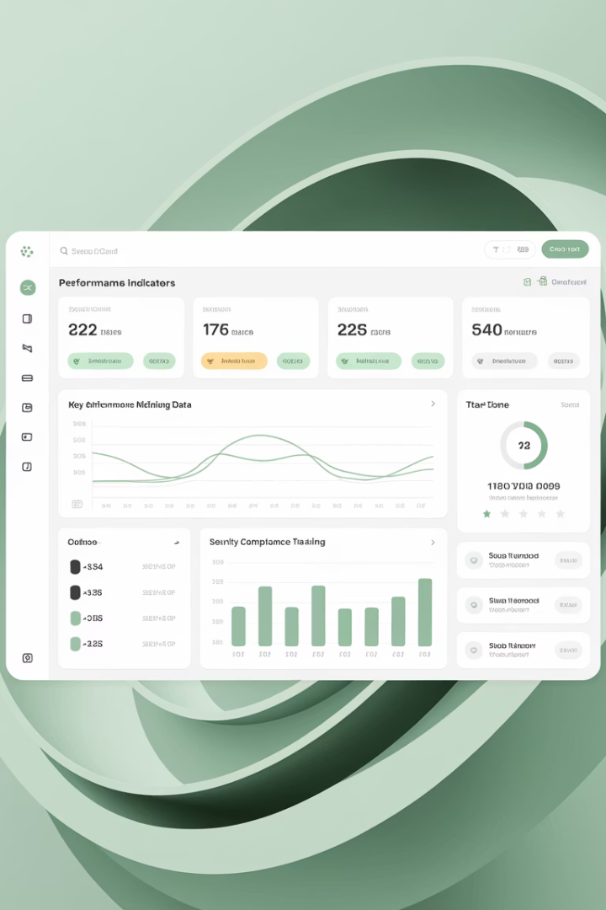
Key Performance Indicators
100%
0
Security Compliance
Critical Vulnerabilities
All security requirements implemented
At production launch
24h
95%
Remediation Time
Automated Testing
For high security findings
Coverage of security controls

Slide 14





Action Steps for Project Managers
Engage Early
Facilitate Communication
Include security from project inception. Don't wait until UAT or go-live.
Bridge gaps between security and development teams. Ensure shared understanding.
Plan Security Gates
Educate Stakeholders
Integrate security milestones into project schedule. Allow time for remediation.
Help teams understand different security risks. Explain mitigation strategies.

Slide 15

Final Thoughts
Security is not a checkbox—it's a shared responsibility across both infrastructure and application project lifecycles. As a project manager, your role in orchestrating communication, enforcing checkpoints, and escalating concerns is critical to delivery and defense.

