Slide 1
The Agile Manifesto: Transforming Software Development
In 2001, seventeen software developers met in Snowbird, Utah to create a new approach to development. Frustrated by rigid processes, they crafted the Agile Manifesto - a revolutionary document that would transform how teams build software.
kW
by Kimberly Wiethoff

Slide 2
The Birth of Agility
1
Frustration
Developers grew tired of rigid, bureaucratic development processes.
2
Gathering
Seventeen developers met in Snowbird, Utah in 2001.
3
Creation
The Agile Manifesto was born, establishing new priorities.
4
Revolution
A paradigm shift began in software development practices.

Slide 3
Four Core Values
Individuals and Interactions
Over processes and tools
Working Software
Over comprehensive documentation
Customer Collaboration
Over contract negotiation
Responding to Change
Over following a plan

Slide 4
Individuals and Interactions
People First
Communication
People are at the heart of software development, not processes or tools.
Improved communication between developers and users is paramount.
Collaboration
Without collaboration, tools and processes cannot deliver what's required.

Slide 5
Working Software
Streamlined Documentation
Just enough documentation to begin development.
Functional Software
Focus on delivering working increments.
Evaluation
Assess delivered increments and adjust documentation as needed.
Tangible Results
Prioritize software that meets customer needs over paperwork.

Slide 6
Customer Collaboration
Concept
Development
Begin with high-level product concept
Continuous iterative development
Refinement
Feedback
Adjust to meet customer expectations
Direct customer feedback loop

Slide 7
Responding to Change
Traditional Approach
Agile Approach
Static roadmap with rigid adherence to plan
Flexible roadmap with ability to pivot
Resistance to change, inefficient for evolving needs
Regular updates and adaptation to changing requirements

Slide 8
The Twelve Principles
Early Value Delivery
Self-Organizing Teams
Deliver valuable software frequently, from weeks to months.
Empower teams to organize themselves for best results.
Transparent Communication
Continuous Improvement
Foster open dialogue between all stakeholders.
Regularly reflect and adjust to become more effective.

Slide 9
Impact of Agility
Speed
Unprecedented delivery velocity
Adaptability
Embracing uncertainty and change
Efficiency
Optimized processes and resource utilization
Satisfaction
Improved customer and team experiences

Slide 10
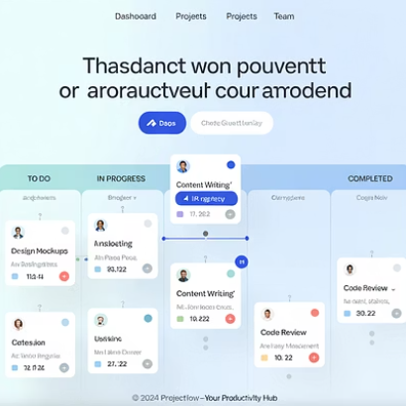
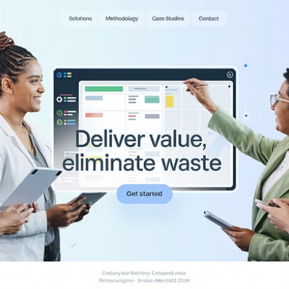
Agile Methodologies
Scrum
Kanban
Extreme Programming
Framework with sprints, daily standups, and defined roles.
Visual workflow management with continuous delivery.
Engineering practices like pair programming and TDD.

Slide 11
Organizational Transformation
Traditional Structure
Hierarchical organizations with siloed departments and rigid processes.
Agile Transition
Adopting agile values and principles across the organization.
Transformed Culture
Cross-functional teams, flattened hierarchies, and continuous improvement.

Slide 12
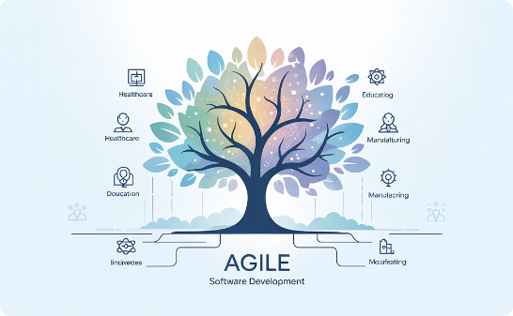
The Enduring Legacy
Innovation
Customer Satisfaction
Beyond Software
Agile has unlocked unprecedented innovation by embracing change and experimentation.
Continuous feedback loops ensure products truly meet customer needs.
Agile principles now transform industries far beyond software development.

Slide 13
Final Thoughts
As we reflect on the Agile Manifesto and its enduring legacy, we are reminded of the transformative power of agility in driving innovation, collaboration, and customer satisfaction. By embracing the values and principles outlined in the Agile Manifesto, organizations can navigate the complexities of the digital age with confidence and resilience, unlocking new opportunities for growth and success. In the words of the Agile Manifesto, let us strive to "uncover better ways of developing software by doing it and helping others do it."

