Slide 1
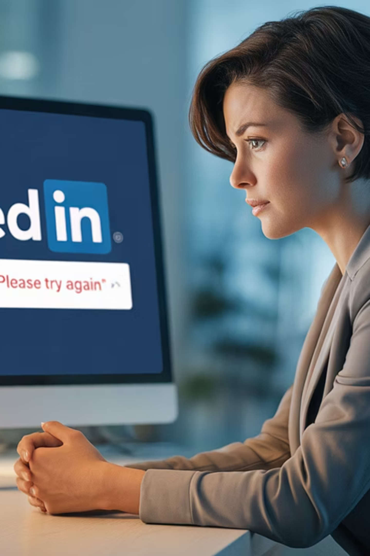
When Your LinkedIn Profile Disappears: A Recovery Guide
A comprehensive guide to help you respond effectively when your LinkedIn profile is compromised or suddenly disappears.
#CyberSecurity #LinkedInTips #OnlineSafety #DigitalIdentity #ProfessionalBrand #ManagingProjectsTheAgileWay
kW
by Kimberly Wiethoff
Managing Projects The Agile Way

Slide 2
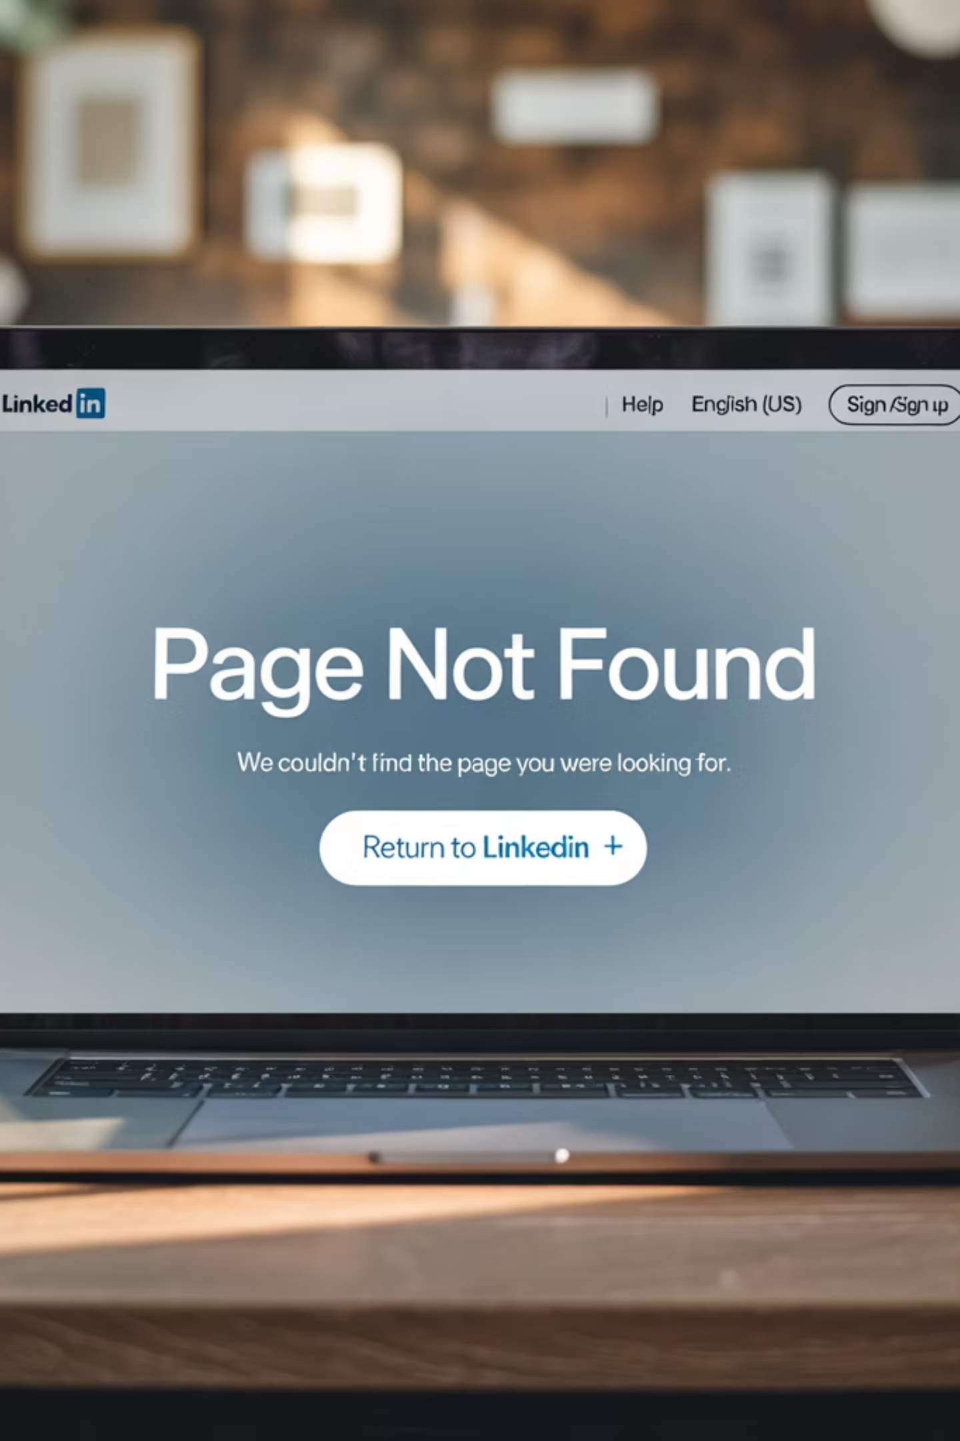
The Growing Concern of Compromised LinkedIn Accounts
One day you're actively networking, applying to jobs, and sharing thought leadership on LinkedIn—and the next, your profile is gone. You try to access it and get the dreaded message: "This page doesn't exist."
It's a disorienting experience—and unfortunately, a growing concern for many professionals. Whether due to hacking, unauthorized changes, or LinkedIn's own moderation systems, compromised accounts are becoming increasingly common.
A compromised LinkedIn account can impact your professional visibility, networking opportunities, and even job prospects.

Slide 3
Step 1: Confirm the Issue
1
2
3
Try Multiple Access Points
Use Different Browsers
Check LinkedIn Status
Log in through both desktop and mobile apps to rule out device-specific issues.
Try an alternative browser or incognito mode to eliminate browser cache or cookie problems.
Visit LinkedIn's Status Page to verify if there are platform-wide outages affecting all users.
If after these steps your profile truly can't be accessed—or if you've received suspicious emails or password reset notifications—it's likely your account has been compromised.

Slide 4
Warning Signs Your Account May Be Compromised
Unexpected password reset emails in your inbox
Login alerts from unfamiliar locations or devices
Connections mentioning messages from you that you didn't send
Posts or comments appearing on your profile that you didn't create
Profile details or settings changed without your authorization
"This page doesn't exist" error when trying to access your profile

Slide 5
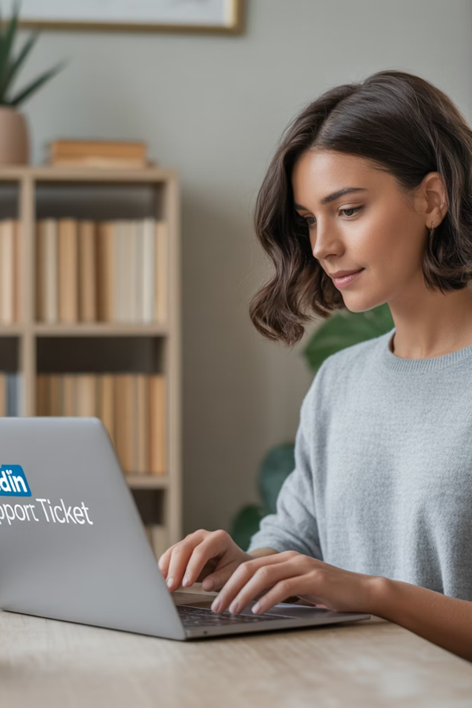
Step 2: Report It to LinkedIn Immediately
Time is of the essence when your account is compromised. The sooner you report the issue, the better your chances of recovery.
Go to LinkedIn Help: Hacked Account and:
Submit a detailed support ticket explaining your situation
Include your full name, email associated with the account, and LinkedIn URL (if known)
Mention if you're a Premium member or event host (this can expedite resolution)
Be concise but thorough in describing exactly what happened
LinkedIn's support team handles thousands of requests daily. Be patient but persistent in following up if you don't receive a response within 48 hours.

Slide 6
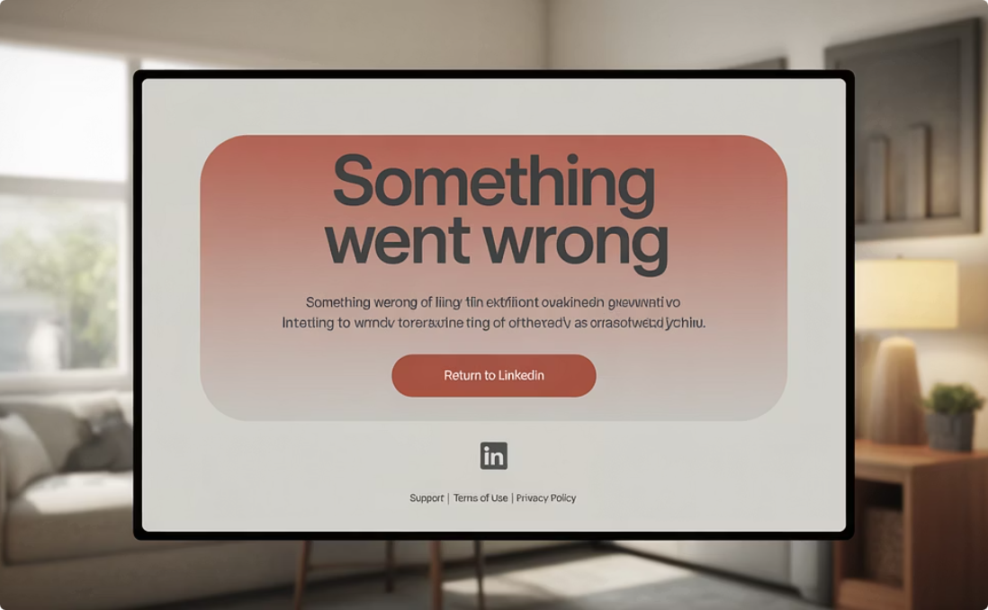
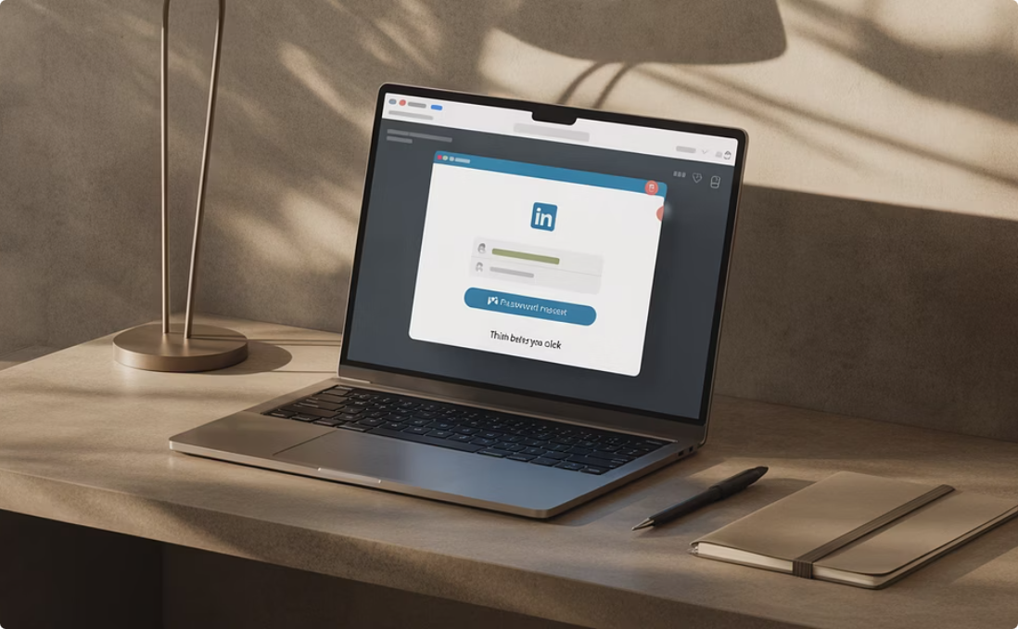
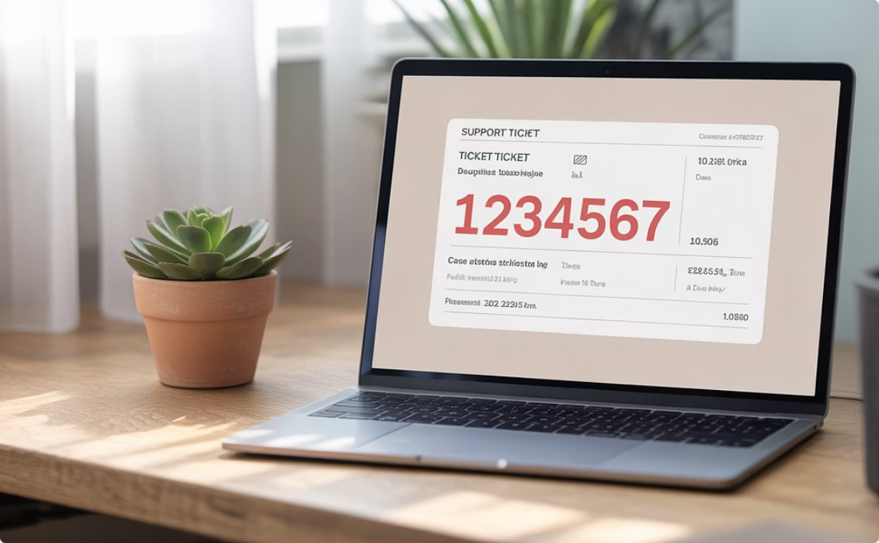
Step 3: Document Everything
Error Messages
Suspicious Communications
Support Interactions
Capture screenshots of any error pages or messages you encounter when trying to access your account.
Save any unusual emails, messages, or notifications related to your LinkedIn account.
Keep records of all communications with LinkedIn support, including ticket numbers and representative names.
This documentation creates a paper trail that may be crucial for account recovery or if further action becomes necessary.

Slide 7
Step 4: Secure Your Other Accounts
Change Critical Passwords
Enable Two-Factor Authentication
Immediately update passwords for your email provider, other social media accounts, and any platforms sharing the same login credentials as your LinkedIn account.
Activate 2FA on all major accounts to add an extra layer of security beyond just passwords. Use authenticator apps rather than SMS where possible.
Monitor for Suspicious Activity
Consider Security Tools
Keep a close eye on your email inbox, bank statements, and credit reports for any unusual activity that might indicate broader identity theft.
Tools like 1Password, Dashlane, or LifeLock can help protect your credentials and monitor for potential identity theft across multiple platforms.

Slide 8
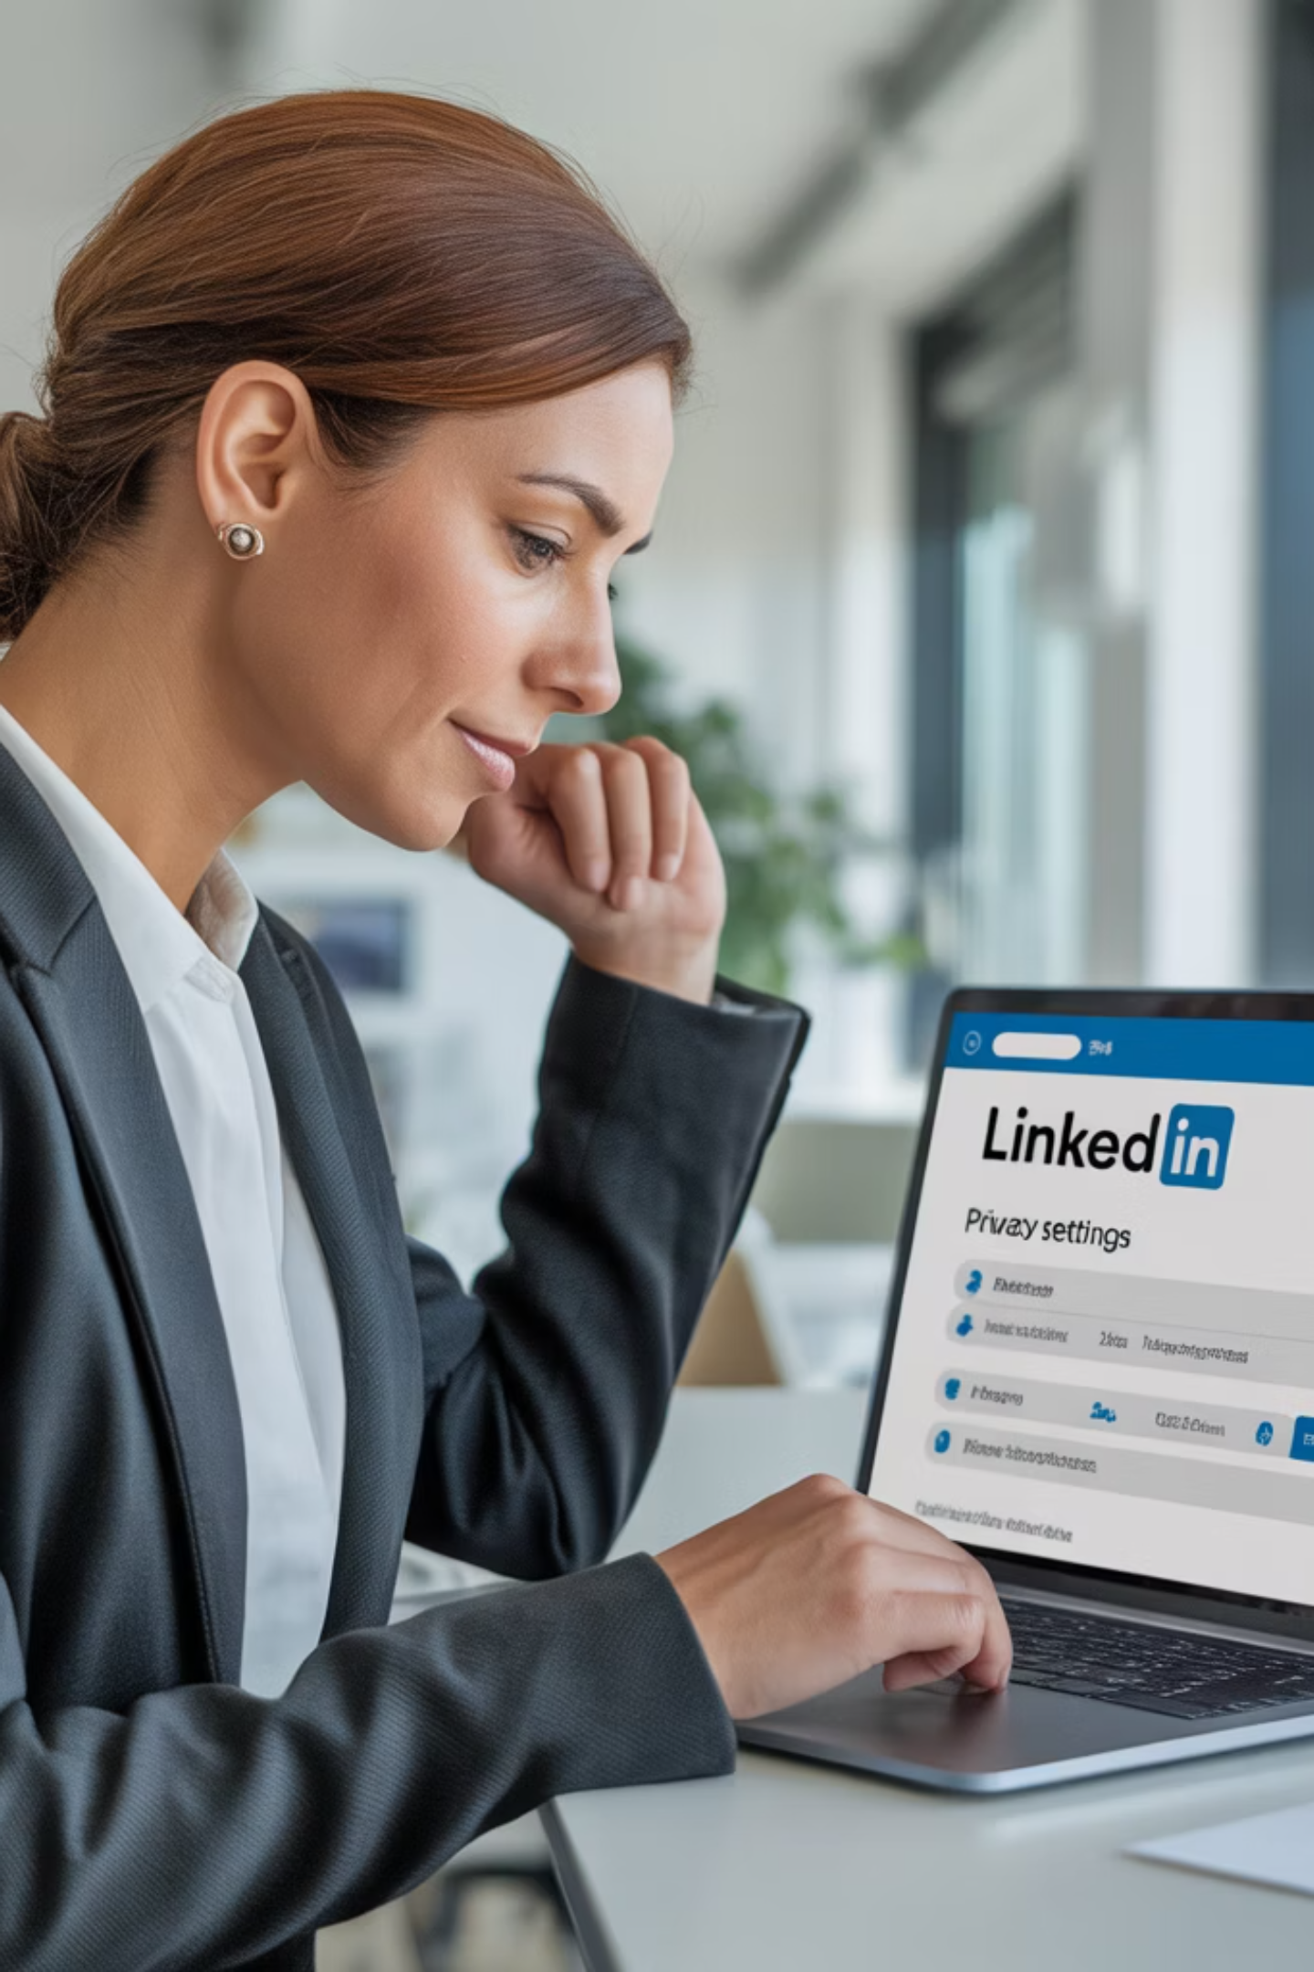
Step 5: Reflect and Rebuild
Once your account is recovered:
1
Audit your connections and remove any suspicious new contacts
2
Review recent activity including posts, comments, and messages you didn't create
3
Remove unauthorized logins from LinkedIn's "Where you're signed in" section
4
Strengthen your password and enable LinkedIn's two-factor authentication
Consider posting a brief, professional update to your network: "My account was compromised last week—thank you for your patience while I restored it."

Slide 9
If Recovery Isn't Possible
Spread the Word
Reconnect Your Network
Post notices on your personal website, blog, or other social media accounts to direct your network to your new LinkedIn profile.
Recreate Your Profile
Reach out to key connections via email or other platforms to explain what happened and invite them to connect with your new profile.
Use cached content, your resume, or screenshots of your old profile to rebuild from scratch with a new account.
While starting over is challenging, it also presents an opportunity to update your professional brand and refocus your networking strategy.

Slide 10
Preventive Measures for the Future
Use Complex Passwords
Enable 2FA Everywhere
Create unique, strong passwords for each of your professional accounts. Avoid using the same password across multiple platforms.
Two-factor authentication adds a critical second layer of security to prevent unauthorized access even if your password is compromised.
Backup Your Profile
Monitor Login Activity
Regularly download a copy of your LinkedIn data (under Privacy & Settings) to ensure you have a recent backup of your connections and content.
Periodically check the "Where you're signed in" section of LinkedIn to review and remove any suspicious session activity.

Slide 11
The Impact of a Compromised LinkedIn Profile
Professional Reputation
Job Opportunities
Hackers may post inappropriate content or send spam to your connections, potentially damaging your professional image.
Recruiters and hiring managers who can't find your profile may move on to other candidates, affecting your job prospects.
Personal Security
Network Connections
Information from your profile could be used in broader identity theft attempts or social engineering attacks.
Years of carefully cultivated professional relationships may be temporarily or permanently disrupted.
Understanding these impacts emphasizes why quick action and preventative measures are so important.

Slide 12
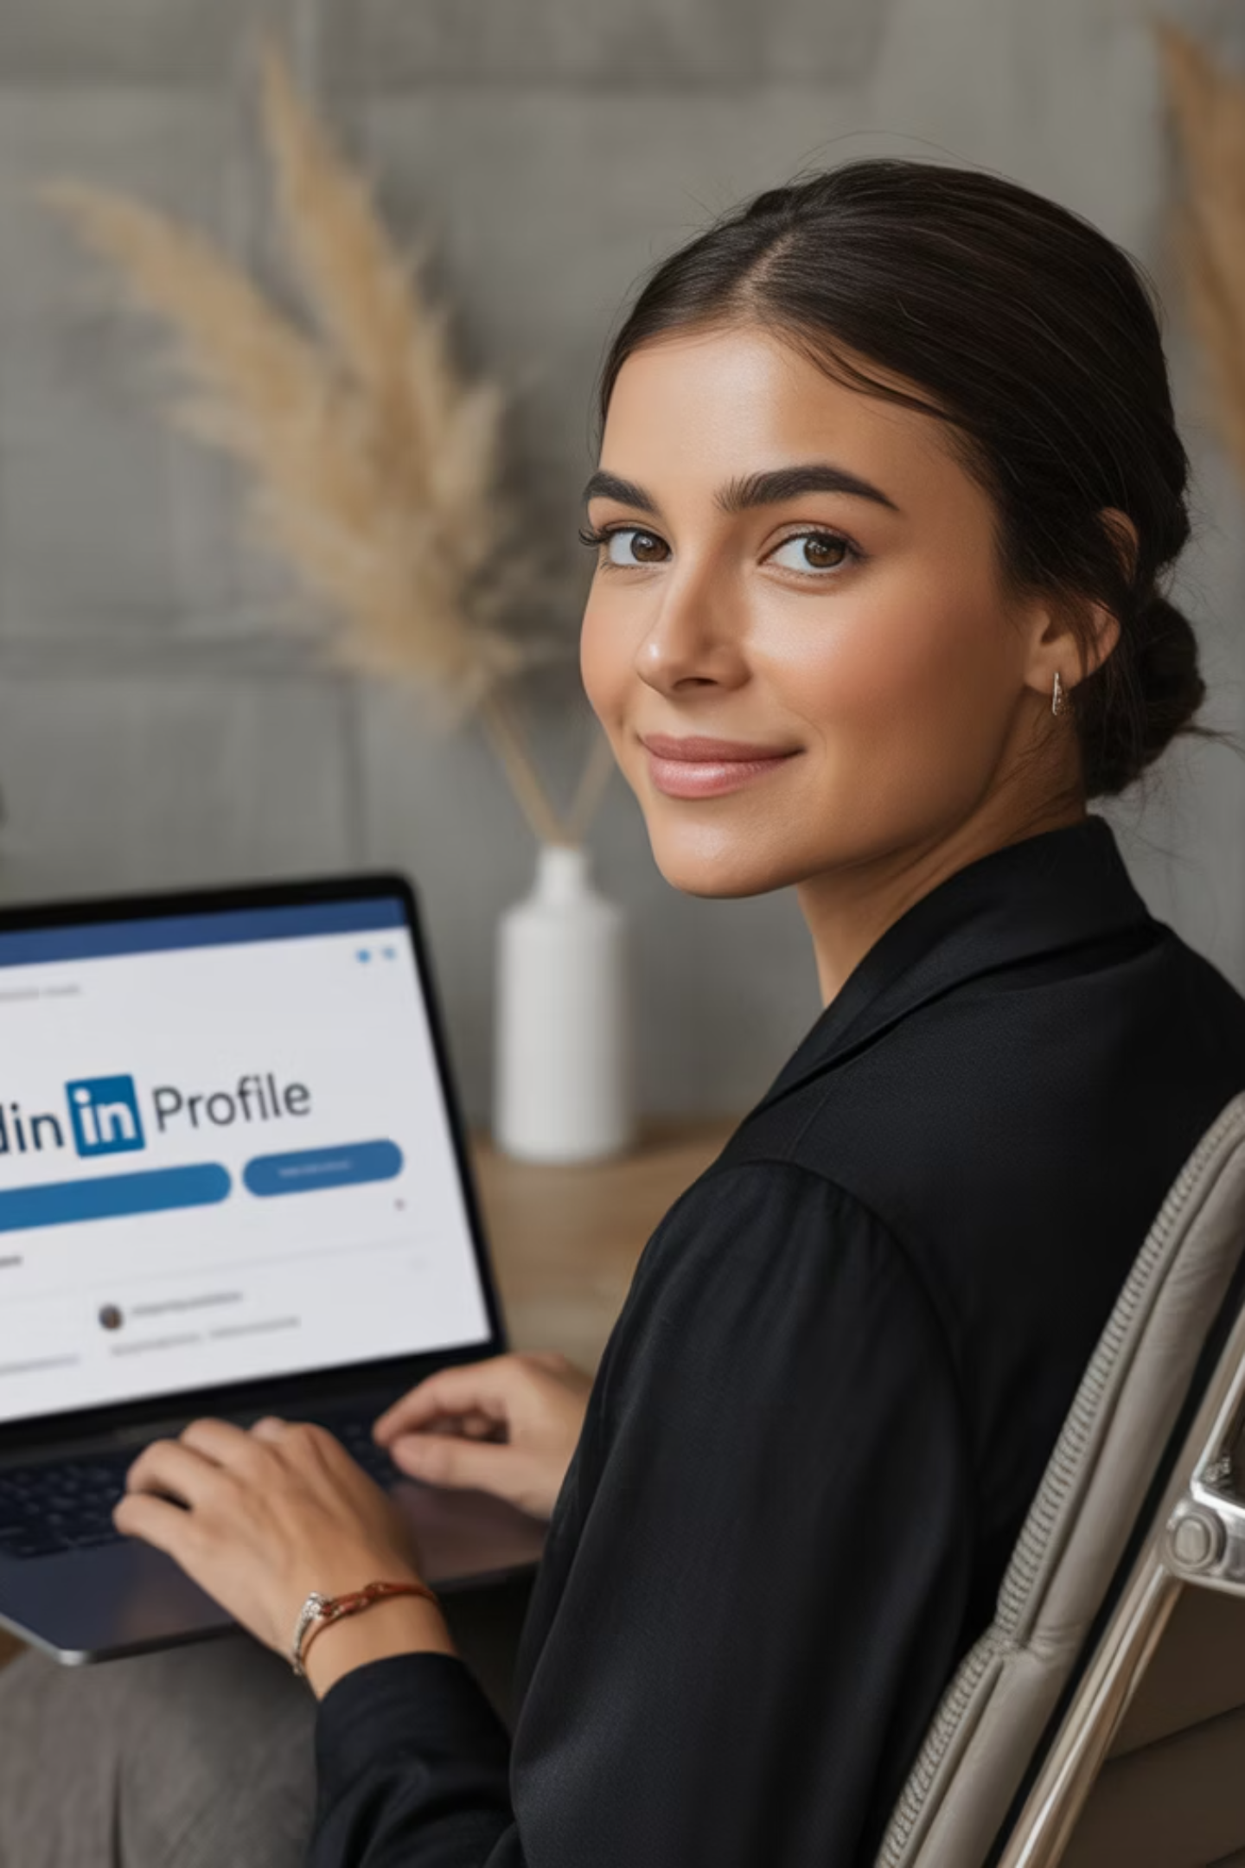
Final Thoughts: Stay Calm and Take Action
Having your LinkedIn profile disappear is more than just inconvenient—it can impact your job search, reputation, and professional visibility. But it's not the end of the world.
Act quickly. Stay calm. And take this as a moment to reinforce your digital security hygiene.
With the right steps, you can recover—stronger and smarter than before.
Remember: LinkedIn is just one aspect of your professional identity. While you work to recover your profile, continue networking through other channels and platforms.
Key Takeaways:
Verify the issue before panicking
Report compromised accounts immediately
Document everything for your records
Secure all your digital accounts
Use this as an opportunity to strengthen your online presence

