Slide 1

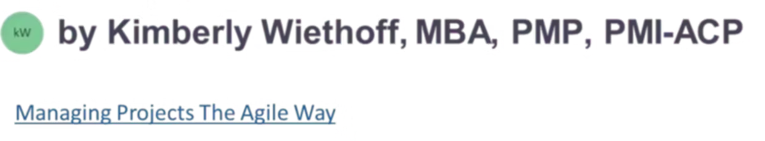
What Project Managers Need to Know About APIs
In today's digital ecosystem, APIs are the invisible threads that tie systems, platforms, and applications together. As a project manager, understanding what APIs do, why they matter, and how to manage them will help you communicate with technical teams and deliver better outcomes.
#APIs #ProjectManagement #TechnicalProjectManagement #DigitalTransformation #SystemIntegration #APIManagement #SoftwareIntegration #ITProjectManagement #ProductDevelopment #AgileDelivery #TechnologyLeadership #DataIntegration #EnterpriseArchitecture #TechForBusiness #InnovationInIT #ProjectManagerTips #ManagingProjectsTheAgileWay #TechLeadership #PMCommunity #APIEconomy

Slide 2




What Is an API?
Digital Waiter
System Connector
Data Exchanger
Acts as an intermediary between client and server.
Facilitates secure and efficient communication between systems.
Allows different software components to interact.

Slide 3
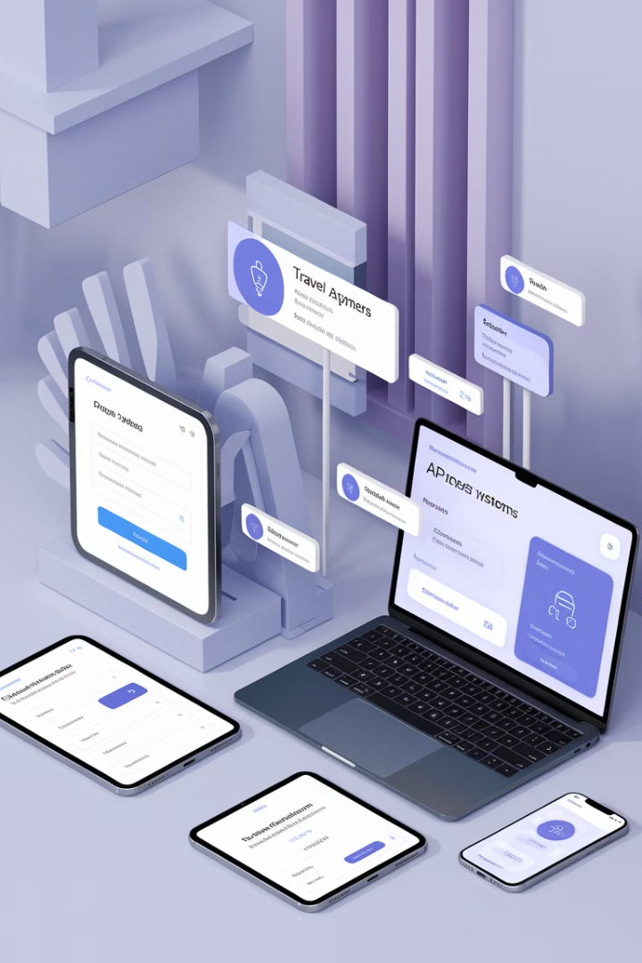
Real-World API Examples
Travel Apps
E-commerce Sites
Pull flight data from multiple airlines using APIs.
Use payment APIs to process credit card transactions.
HR Systems
Sync data with third-party payroll services via APIs.

Slide 4





Why APIs Matter in Projects
Integration
APIs connect systems like CRMs, ERPs, and payment gateways.
Scalability
Tap into other systems instead of building everything from scratch.
Time and Budget
Well-documented APIs save resources. Poor ones delay timelines.
Security & Compliance
APIs handle sensitive data requiring proper security practices.

Slide 5
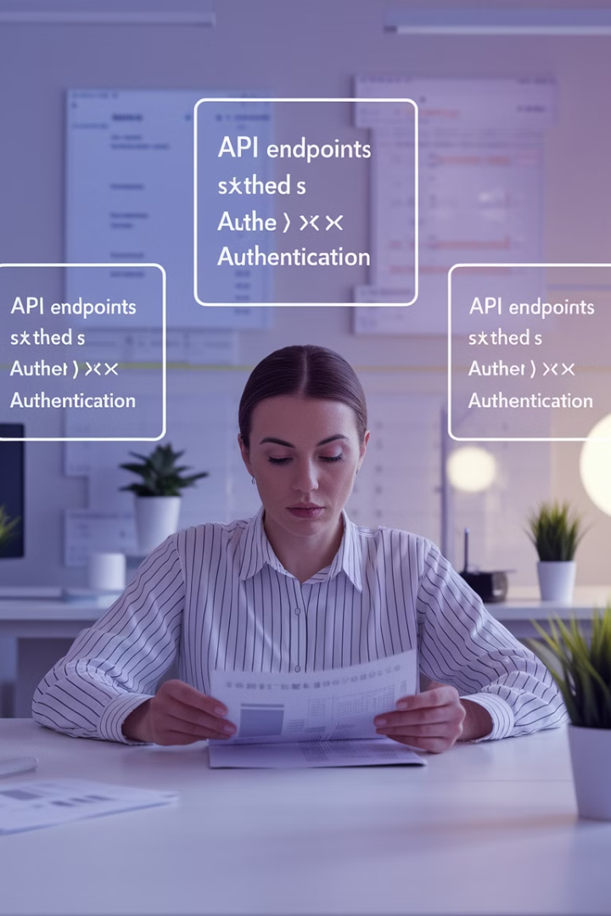




API Basics for Project Managers
Endpoints
URLs through which data is accessed or sent.
Request and Response
Client sends a request, server sends a response (JSON/XML).
Authentication
Methods like API keys, OAuth, or bearer tokens secure data.
Rate Limits
Restrictions on requests per minute/hour affect planning.

Slide 6

Understanding API Status Codes
200
OK
Request succeeded.
400
Bad Request
Client error in request.
404
Not Found
Resource doesn't exist.
500
Server Error
Something went wrong on server.

Slide 7












Key Questions for API Projects
Dependencies
Costs
What other systems does the API rely on?
Are there limitations or licensing fees?
Type
Versioning
Is it RESTful, GraphQL, or SOAP?
How are updates handled?
Testing
Availability
What's the plan for testing? (sandbox, mock services)
Is the API public or internal/proprietary?

Slide 8





PM's Role in API Projects
Coordinate
Connect developers, QA, product owners, and vendors.
Clarify Requirements
Define what the API needs to do.
Manage Expectations
Set realistic timelines and dependencies.
Track Risks
Monitor unstable APIs, documentation gaps, or poor support.
Facilitate Testing
Ensure APIs deliver as intended.

Slide 9








API Documentation Essentials
Comprehensive Guide
Complete reference for developers
Code Examples
Sample implementations in various languages
Endpoint Reference
Details of all available endpoints
Authentication Guide
Security implementation instructions
Always request comprehensive API documentation early in the project. It serves as the blueprint for your developers and saves significant time and resources.

Slide 10
API Project Lifecycle
Requirements Gathering
Define what the API needs to do and how it integrates.
Design & Planning
Create technical specifications and integration architecture.
Development
Build the API or integration with existing APIs.
Testing
Validate functionality, security, and performance.
Deployment & Monitoring
Launch and continuously track API performance.

Slide 11



Common API Challenges
Technical Debt
Security Concerns
Performance Issues
Legacy systems may have poorly documented or outdated APIs that require extra work to integrate.
APIs can create vulnerabilities if not properly secured with authentication and encryption.
Third-party APIs may have rate limits or downtime that affect your application's performance.

Slide 12



Final Thoughts
Understand the Basics
Know enough to ask the right questions
Bridge the Gap
Translate between technical and business teams
Deliver Value
Ensure APIs power successful projects
APIs are powerful tools that unlock innovation, streamline operations, and enhance user experiences. With the right mindset and curiosity, you can bridge the gap between business needs and technical execution.

