Slide 1
Project Management in Hedge Funds: Essential Knowledge for Success
Managing projects in hedge funds requires a unique skillset that blends technical expertise with financial acumen. The high-stakes environment demands precision, agility, and strategic thinking unlike any other industry. This presentation will guide project managers through the essential knowledge and skills needed to thrive in this challenging but rewarding sector.
by Kimberly Wiethoff
kW

Slide 2
Understanding Hedge Fund Business Models
Investment Strategies
Asset Classes
Strategic Alignment
Long/short equity approaches
Equities and fixed income
Project managers must understand how their fund generates returns to effectively align technical initiatives with trading objectives. This knowledge forms the foundation for all project decisions and prioritization processes.
Arbitrage opportunities
Derivatives and options
Quantitative trading models
Commodities and currencies
Multi-strategy portfolios
Alternative investments including crypto

Slide 3
Speed and Agility in Hedge Fund Projects
Time Sensitivity
Market opportunities are fleeting; delays directly impact profit potential and competitive advantage
Methodology Flexibility
Hybrid approaches combining Agile sprints with strategic roadmaps outperform traditional waterfall
Lean Teams
Coordinate small but elite groups of specialists who expect autonomy and minimal process overhead
Scalable Solutions
Balance immediate needs with architecture that can support rapidly growing AUM and strategy expansion

Slide 4
The Data Ecosystem of Hedge Funds
Integration Infrastructure
Financial Data Storage
FIX protocol implementation
Time-series databases
Market Data Sources
API management
Data lakes
Analysis Platforms
Bloomberg Terminal
Data transformation pipelines
Low-latency systems
Quantitative research tools
Refinitiv Eikon
Machine learning environments
FactSet
Alternative data vendors
Risk analytics

Slide 5
Essential Technology Infrastructure
Trading Platforms
Portfolio & Risk Systems
Infrastructure Priorities
Order Management Systems (OMS)
Portfolio accounting software
Low-latency network architecture
Execution Management Systems (EMS)
Risk management platforms
Cloud and hybrid deployments
Scenario analysis tools
Disaster recovery solutions
Integrated OMS/EMS solutions like Eze and FlexTrade
Exposure monitoring dashboards
Cybersecurity frameworks
Algorithmic trading engines

Slide 6
Regulatory Compliance Considerations
Regulatory Bodies
SEC, CFTC, FCA, and MiFID II requirements demand specific documentation, reporting, and system controls that impact project scope and delivery.
Data Protection
GDPR, CCPA, and other privacy regulations require careful handling of investor and counterparty data across all systems and processes.
Information Security
SOC 1/2 compliance and cybersecurity frameworks like NIST must be incorporated into technology decisions and implementation plans.
Audit Readiness
Project deliverables must support comprehensive audit trails, documentation, and testing evidence to satisfy both internal and regulatory reviews.

Slide 7
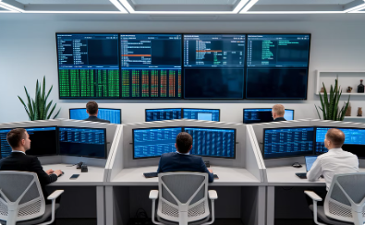
Stakeholder Management in Hedge Funds
Understanding the unique needs and communication styles of each stakeholder group is essential for project success
Front Office: Portfolio Managers & Traders
Middle Office: Risk & Operations
Back Office: Finance, Legal & Compliance
C-Suite & Investors
Present strategic impact, ROI, and competitive advantages. Focus on how projects contribute to the fund's overall growth strategy and investor confidence.
Focus on performance impact and time-to-market. They require concise updates using financial terminology and clear demonstrations of value delivered to trading capabilities.
Emphasize process improvements, control enhancements, and system reliability. Their priorities include accuracy, transparency, and operational efficiency gains.
Address regulatory alignment, reporting accuracy, and audit readiness. Communication should include compliance validation and documentation completeness.

Slide 8
Change Management for Hedge Fund Projects
Strategic Vision
Articulate how changes align with fund objectives
Secure Champions
Engage senior traders and key stakeholders early
Targeted Training
Develop role-specific education with real scenarios
Measure Adoption
Track usage metrics and performance improvements

Slide 9
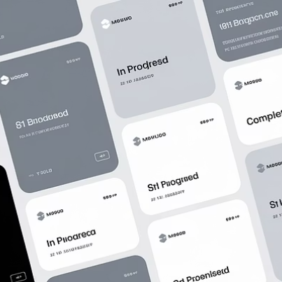
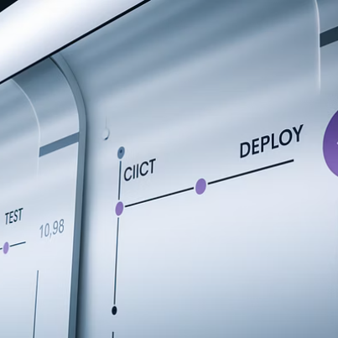
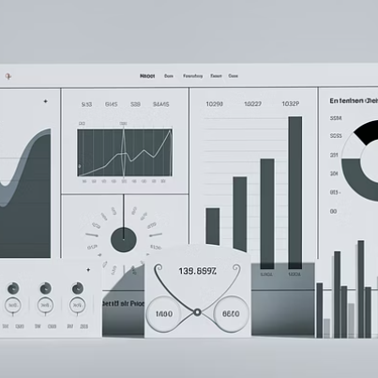
Essential Project Management Tools
Effective project management requires the right toolset. Modern hedge funds leverage specialized platforms to track projects, manage resources, and report on progress. Jira and Monday.com excel at agile delivery, while Azure DevOps supports the technical integration needs. Reporting tools like Power BI and Tableau help translate complex project data into insights that resonate with financial stakeholders.

Slide 10
Technical Skills for Hedge Fund PMs
Programming Literacy
Basic Python and SQL understanding
Data Visualization
Power BI, Tableau, and financial charting
Infrastructure Knowledge
Cloud architecture and deployment models
Financial Data Structures
Market data formats and integration patterns

Slide 11
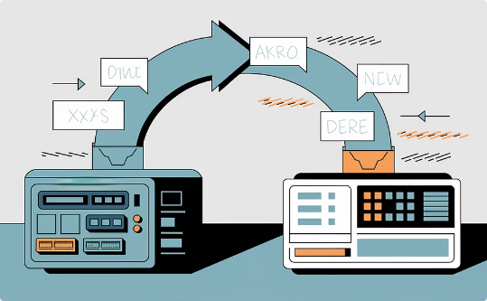
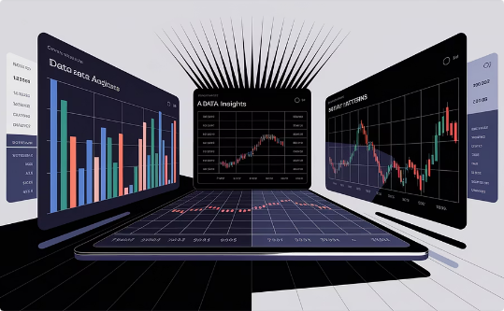
Project Types in Hedge Fund Environments
System Migrations
Process Automation
Analytics Platforms
Transitioning from legacy platforms to modern solutions while maintaining trading continuity presents unique challenges. These projects typically involve parallel runs, comprehensive data validation, and precisely orchestrated cutover weekends to minimize market exposure risks.
Automating manual workflows through RPA, API integration, and custom development delivers significant operational leverage. Successful automation projects require deep understanding of existing processes, careful exception handling, and rigorous reconciliation procedures.
Implementing advanced analytics capabilities that provide trading insights requires balancing data science innovation with production stability. These projects often combine vendor platforms with proprietary algorithms to create unique competitive advantages.

Slide 12
Key Performance Metrics
Hedge fund projects are evaluated on metrics that directly impact investment operations. Time to market consistently ranks highest, as delays can mean missed trading opportunities. System reliability and compliance coverage follow closely, reflecting the critical nature of continuous operations and regulatory adherence. Performance optimization becomes increasingly important for quantitative strategies where microseconds matter.

Slide 13
Risk Management Strategies
Identify Trading Impact
Analyze Dependencies
Assess how project risks could affect investment operations and PnL
Map critical market data and trading system interdependencies
Monitor Real-Time
Mitigate Through Testing
Deploy heightened surveillance during critical deployments
Implement market simulation and parallel processing validation

Slide 14
Succeeding as a Hedge Fund Project Manager
2-3x
$10M+
24/7
Implementation Speed
Impact Scale
Global Operations
Hedge fund projects move 2-3 times faster than traditional financial services initiatives
A single successful project can influence tens of millions in trading revenue
Many hedge funds trade across markets requiring round-the-clock support
Hedge funds reward project managers who can deliver precision, speed, and strategic thinking. Success in this environment means mastering the financial domain while maintaining technical credibility. The most effective PMs not only move tickets but enable billion-dollar decisions through their leadership and execution excellence. By understanding the unique dynamics of hedge funds, you position yourself at the intersection of finance and technology—where your impact is directly measurable in fund performance.

Slide 15
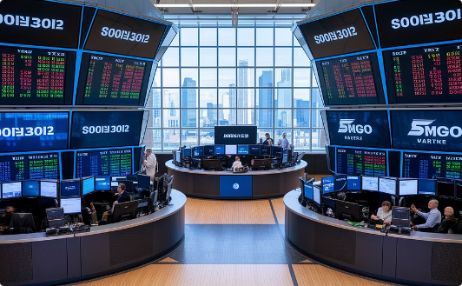
Final Thoughts
Precision
Speed
Strategic Thinking
Hedge funds reward precision in every aspect of project delivery. As a PM, your attention to detail directly impacts trading operations and investment decisions.
In the fast-paced hedge fund environment, your ability to execute quickly translates to market advantage. Projects move at the speed of capital.
You're not just moving tickets—you're enabling billion-dollar decisions. Learn the language of finance, understand your stakeholders, and lead with strategic vision.

