Slide 1

DMAIC: Breaking the Cycle of Recurring Project Problems
A structured approach for Agile project managers to permanently solve delivery challenges
#ManagingProjectsTheAgileWay #DMAIC #LeanSixSigma #ProjectManagement #ProcessImprovement #AgileDelivery
kW
by Kimberly Wiethoff
Managing Projects The Agile Way
Notes:
Here are concise talking points for Slide 1 of your presentation, titled “DMAIC: Breaking the Cycle of Recurring Project Problems”:
🎯 Slide 1: Title Slide – DMAIC: Breaking the Cycle of Recurring Project Problems
1. Welcome & Introduction
Welcome the audience and introduce yourself (Kimberly Wiethoff, Agile Program Manager and author of Managing Projects the Agile Way).
Briefly share your background in Agile, Lean, and continuous improvement.
2. Set the Stage
Ask: “Have you ever felt like your team is stuck in project Groundhog Day?”
Highlight the frustration of recurring issues in Agile projects: testing delays, approval bottlenecks, scope creep, or constant rollover of user stories.
3. Purpose of Today’s Talk
Introduce DMAIC as a structured, data-driven approach that helps Agile teams permanently resolve persistent delivery problems.
Emphasize that this method complements Agile, it doesn’t replace it.
4. What to Expect
Walk through each step of DMAIC: Define, Measure, Analyze, Improve, Control.
Share real-world examples and practical tools for immediate use.
Discuss how to embed DMAIC into existing Agile ceremonies.
5. Why It Matters
Move beyond reactive firefighting.
Empower teams to become true problem solvers.

Slide 2

The Problem: Project Groundhog Day
Every project manager has experienced it: the same issues surfacing sprint after sprint, despite your best efforts to address them.
Testing delays that push deadlines
Approval bottlenecks holding up progress
Stories consistently rolling over to next sprint
Scope creep that never truly gets contained
Notes:
Here are the talking points for Slide 2 titled "The Problem: Project Groundhog Day":
🌀 Slide 2: The Problem – Project Groundhog Day
1. Frame the Problem
“Let’s talk about a familiar scenario—one many of us have experienced.”
“You fix an issue in one sprint, only to see it resurface in the next. Sound familiar?”
2. Examples of Recurring Pain Points
Walk through each bullet briefly:
Testing delays → "Despite planning, QA always lags behind dev."
Approval bottlenecks → "Decisions pile up, waiting for one person or group."
Story rollover → "We consistently miss our sprint goals."
Scope creep → "New requests sneak in and destabilize the sprint."
3. The Real Issue
These aren’t one-time problems—they’re patterns.
Agile alone often addresses symptoms but lacks the structure to solve root causes.
4. The Impact
These recurring problems lead to:
Demoralized teams
Missed deadlines
Wasted effort
Frustrated stakeholders
5. Segue to the Solution
“If you’ve tried retrospectives, extra meetings, or more planning—and the issues keep coming back—then it’s time for a deeper, more structured approach.”
6. Transition
“That’s where DMAIC comes in. Let’s look at how this method helps us break the cycle once and for all.”

Slide 3










Introducing DMAIC: Beyond Agile Problem-Solving
While Agile gives us iterative improvement, it doesn't always provide the structure to solve persistent problems at their root.
Measure
Define
Gather data to understand the current state
Clearly state the problem and desired outcome
Analyze
Identify root causes of the issue
Control
Sustain the gains and prevent regression
Improve
Design and implement solutions
Notes:
Here are the talking points for Slide 3, titled “Introducing DMAIC: Beyond Agile Problem-Solving”:
🧩 Slide 3: Introducing DMAIC – Beyond Agile Problem-Solving
1. Bridge the Gap
“Agile is great for continuous improvement—but it doesn’t always give us the depth we need to fix persistent problems at the root.”
2. Why Agile Alone Isn’t Enough
Agile retrospectives are valuable, but often focus on immediate symptoms rather than systemic issues.
Teams may identify what went wrong, but not always why it keeps happening.
3. What Is DMAIC?
Introduce DMAIC as a Lean Six Sigma framework tailored for process improvement.
Highlight that it's structured, data-driven, and outcome-focused.
4. Walk Through the Phases
Briefly define each phase:
Define – Clearly state the problem and goal.
Measure – Gather data to understand the current performance.
Analyze – Identify root causes using structured techniques.
Improve – Design and test targeted solutions.
Control – Ensure the improvements stick.
5. How DMAIC Complements Agile
DMAIC doesn’t compete with Agile—it enhances it.
It gives Agile teams the tools to move from “fixing” to solving.
6. Transition
“So how do you know when it’s time to use DMAIC? Let’s talk about that next.”

Slide 4
When to Use DMAIC in Agile Environments
DMAIC is your go-to approach when you hear these recurring statements:
Recurring blockers
"We never finish all the stories we commit to."
Quality issues
"Testing is always the bottleneck."
"Stakeholder feedback comes too late."
Communication breakdowns
"We're constantly reworking the same feature."
Hand-off failures
These aren't one-off issues. They're patterns that need systematic resolution.
Resource constraints
Notes:
Here are the talking points for Slide 4, titled “When to Use DMAIC in Agile Environments”:
⏱ Slide 4: When to Use DMAIC in Agile Environments
1. Recognizing the Patterns
“Sometimes, teams say things that sound like normal challenges—but if you hear them repeatedly, they’re red flags for deeper issues.”
Share a few familiar quotes:
“We never finish all the stories we commit to.”
“Testing is always the bottleneck.”
“Stakeholder feedback comes too late.”
“We’re constantly reworking the same feature.”
2. These Aren’t One-Off Problems
Emphasize: “These statements point to patterns, not isolated incidents.”
Patterns signal systemic issues that require structured problem-solving—not just more retrospectives.
3. Common DMAIC Use Cases
Quickly run through scenarios where DMAIC fits:
Recurring blockers – The same impediments slow progress every sprint.
Quality issues – Bugs, rework, or high defect rates that persist.
Communication breakdowns – Handoffs and feedback loops that consistently fail.
Resource constraints – Team members overloaded or misaligned sprint after sprint.
4. The Takeaway
“If the same issue comes up more than twice—it’s time to stop firefighting and start investigating.”
DMAIC gives you the structure to resolve these challenges once and for all.
5. Transition
“Let’s dive into how each DMAIC phase works—starting with Define.”

Slide 5

Step 1: Define
Key Activities:
Clearly articulate the recurring issue
Identify all relevant stakeholders
Establish project boundaries
Define what success looks like
Example: "Our team consistently carries over 40% of stories into the next sprint, impacting delivery timelines and team morale."
Clarity is key—vague problems yield vague solutions.
Notes:
Here are the talking points for Slide 5, titled “Step 1: Define”:
🔍 Slide 5: Step 1 – Define
1. Set the Foundation
“The Define phase is where it all starts. If you skip this or stay vague, everything downstream gets fuzzy.”
Emphasize: Clear problem definition = clear solution path.
2. Key Activities in Define
Walk through each:
Articulate the recurring issue – Be specific and measurable.
Identify relevant stakeholders – Who is impacted and who needs to be involved?
Establish boundaries – What’s in scope and what’s not?
Define success – What does ‘solved’ actually look like?
3. Share the Example
Use the example from the slide: “Our team consistently carries over 40% of stories into the next sprint, impacting delivery timelines and team morale.”
Point out why this is a strong definition:
It’s quantified (40%)
It describes impact (timelines, morale)
It’s actionable
4. Common Pitfall
Warn: “Avoid vague definitions like ‘we’re not productive enough’—you can’t fix what you can’t define.”
5. Action Tip
Encourage the audience to revisit old problem statements and ask: “Is this specific enough to measure?”
6. Transition
“Once we’ve defined the problem clearly, the next step is to gather data and measure what’s really happening.”

Slide 6



Step 2: Measure
Gather Quantitative Data
Collect Qualitative Data
Establish Baseline
Sprint velocity trends
Team surveys
Document current performance
Defect counts
Retrospective themes
Identify patterns and trends
Cycle time metrics
Stakeholder interviews
Create visualization of data
Story point completion rates
Process observations
Set measurable improvement targets
Data removes assumptions and shows whether the issue is systemic or situational.
Notes:
Here are the talking points for Slide 6, titled “Step 2: Measure”:
📊 Slide 6: Step 2 – Measure
1. Why Measure?
“This is where we replace assumptions with data.”
“Measurement helps us determine whether the issue is systemic or just a one-off.”
2. Three Key Measurement Areas Walk through each:
Quantitative Data – “These are your hard metrics—your sprint reports, Jira boards, defect rates.”
Examples: sprint velocity trends, defect counts, cycle time, story point completion rates.
Qualitative Data – “This reveals what the numbers don’t—team sentiment, stakeholder friction.”
Examples: surveys, retrospectives, interviews, observations.
Baseline Establishment – “You need to know where you’re starting from to measure improvement.”
Look for patterns, trends, and visualizations.
3. Visualization Matters
“Use charts, graphs, dashboards. It makes your case clearer to leadership and the team.”
4. Example Talking Point
“Imagine you’re investigating high story rollover. You measure 3 months of sprint data and find the rollover rate averages 42%. That’s your baseline.”
5. Action Tip
“If you don’t have clean data, start capturing it now. Even a basic Excel tracker is better than flying blind.”
6. Transition
“With your problem clearly defined and your baseline measured, it’s time to investigate why the issue is happening. That’s the Analyze phase.”
Let me know if you’d like sample metrics or templates for this phase.

Slide 7

Step 3: Analyze
Use proven analytical techniques to identify true root causes, not just symptoms:
5 Whys - Ask "why" repeatedly to drill down to fundamental causes
Fishbone (Ishikawa) diagrams - Map potential causes across categories
Pareto charts - Identify the vital few causes creating the majority of issues
Value Stream Mapping - Visualize waste in the process flow
Example: "Why are stories rolling over?" → "They're too big." → "Why?" → "Unclear requirements." → "Why?" → "Insufficient backlog refinement."
Notes:
Here are the talking points for Slide 7, titled “Step 3: Analyze”:
🧠 Slide 7: Step 3 – Analyze
1. Purpose of Analyze
“Now that we know what’s happening and how often—it’s time to figure out why it’s happening.”
“This step moves us from symptom management to true root cause discovery.”
2. Use Proven Techniques Briefly explain each tool listed:
5 Whys – “Keep asking ‘why’ until you get past surface-level answers.”
Example: Why are stories rolling over? → They’re too big → Requirements unclear → Not enough backlog grooming.
Fishbone (Ishikawa) Diagram – “Visually map causes across categories like People, Process, Tools, etc.”
Pareto Chart – “Helps you focus on the 20% of causes leading to 80% of issues.”
Value Stream Mapping – “Used to identify bottlenecks and waste across your workflow.”
3. Key Message
“Don't jump to solutions too early. If you misdiagnose the problem, your fix won’t stick.”
4. Example Reinforcement
Walk through a quick analysis:
Symptom: Story rollover
Root Cause: Lack of backlog refinement and unclear acceptance criteria
5. Action Tip
“Use a combination of data and team insights. Data tells you what, the team helps you understand why.”
6. Transition
“Once you’ve identified the real root cause, it’s time to design and test improvements that address it directly—without overcomplicating things. That’s next.”

Slide 8
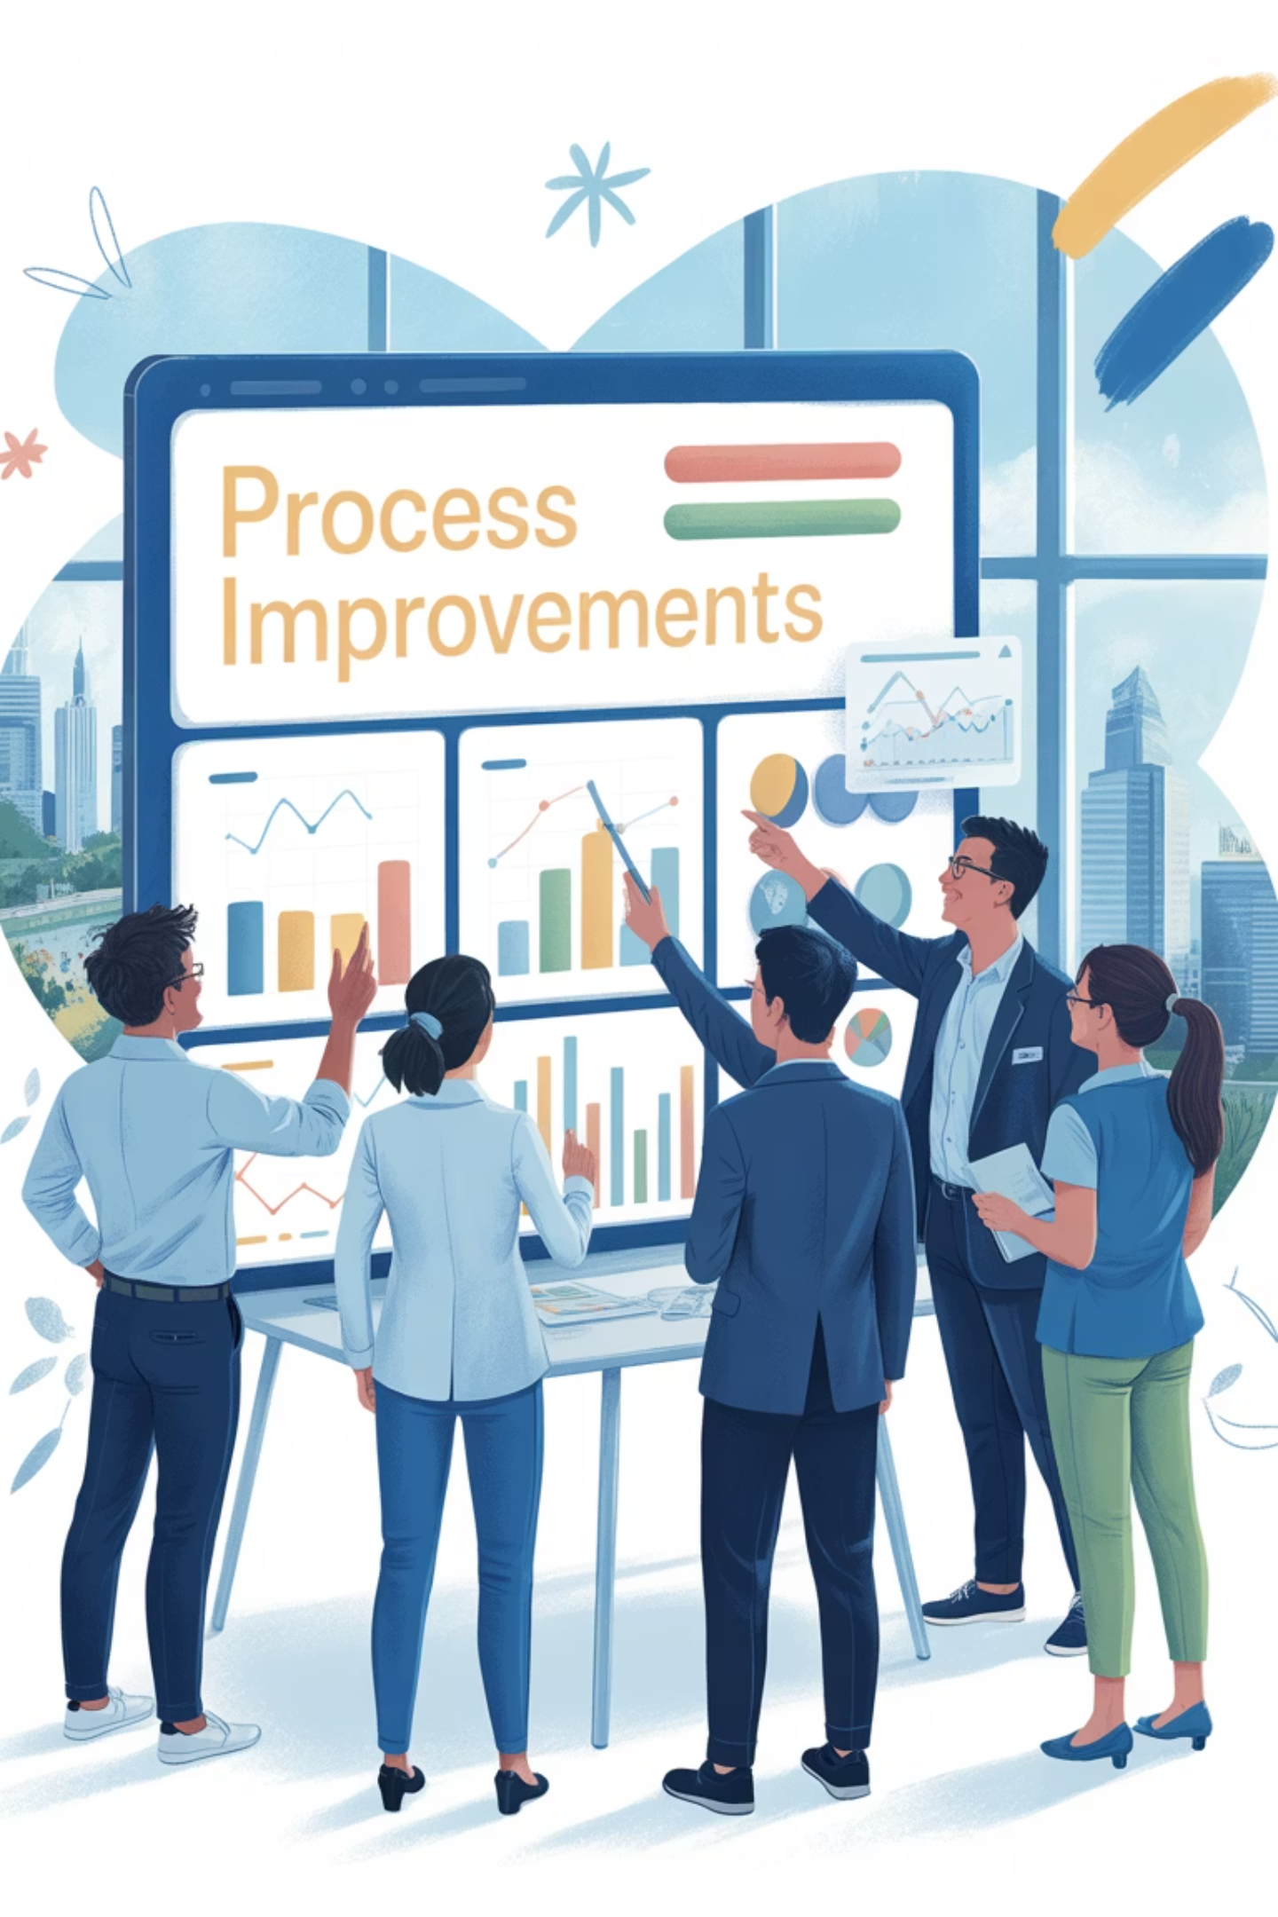
Step 4: Improve
1
Brainstorm Solutions
Generate multiple potential improvements based on root cause analysis
2
Prioritize Interventions
Select high-impact, low-effort solutions first
3
Pilot Changes
Test improvements in a controlled environment
4
Evaluate Results
Measure effectiveness against baseline data
5
Refine Approach
Adjust solutions based on feedback and results
Start small and iterate. Improvement doesn't need to be complex—it just needs to stick.
Notes:
Here are the talking points for Slide 8, titled “Step 4: Improve”:
🛠 Slide 8: Step 4 – Improve
1. Shift from Insight to Action
“Now that you’ve uncovered the root cause, it’s time to act on it.”
“But improvement doesn’t mean implementing the most complex solution—it means implementing the right one.”
2. Step-by-Step Breakdown Walk through each part of the Improve phase:
Brainstorm Solutions – “Encourage the team to generate a wide range of ideas. You might be surprised by the insight from different roles.”
Prioritize Interventions – “Use impact vs. effort matrices. Start with quick wins—solutions that are low effort but high impact.”
Pilot Changes – “Don’t overhaul everything. Test improvements on a small scale to manage risk.”
Evaluate Results – “Compare outcomes to the baseline data from the Measure phase. Did it make a difference?”
Refine Approach – “Use feedback loops to tweak and optimize before full rollout.”
3. Real-World Tip
“Don’t try to fix everything at once. Focus on one key issue, validate the result, then build momentum.”
4. Example
“In our story rollover case, the team introduced weekly refinement meetings and added a ‘Definition of Ready’ checklist—simple but powerful changes that reduced rollover from 40% to under 15%.”
5. Action Tip
“Make improvement part of the sprint—not an extra task. Integrate it into your ceremonies and workflows.”
6. Transition
“So what happens after things get better? You make sure they stay better. That’s where the Control phase comes in.”

Slide 9

Step 5: Control
Sustain your improvements by:
Creating new process documentation
Adding checklist items to ceremonies
Establishing ongoing monitoring metrics
Updating team training materials
Building verification into retrospectives
Control is about building stability so the issue doesn't resurface when pressure mounts.
Monitor key performance indicators over time to ensure improvements stick.
Notes:
Here are the talking points for Slide 9, titled “Step 5: Control”:
🔒 Slide 9: Step 5 – Control
1. Why Control Matters
“Improvement is only a win if it lasts. Without a Control plan, old habits return under pressure.”
“This phase is about sustainability—making sure your fix sticks.”
2. Key Activities in Control Walk through each one:
Create new process documentation – “Codify what’s changed so it becomes part of your operating rhythm.”
Add checklist items to ceremonies – “Make improvements visible and repeatable in daily standups, grooming, reviews.”
Establish monitoring metrics – “Continue tracking performance to catch regression early.”
Update team training – “Ensure new team members understand and follow the improved process.”
Build verification into retrospectives – “Ask: Are we holding the gains? What’s slipping?”
3. Example Reinforcement
Refer back to the story rollover example:
“The team tracked carryover rates in retrospectives. Improvements held steady under 15% for multiple sprints.”
4. Key Message
“Control is not about perfection—it’s about consistency.”
“If it’s not monitored, it will eventually unravel.”
5. Action Tip
“Keep your control actions lightweight but visible. A simple dashboard or KPI tracker can go a long way.”
6. Transition
“Now that we’ve walked through all five DMAIC phases, let’s look at how this works in real project environments—and how you can start integrating it into your Agile practices today.”

Slide 10
Real-World Example: Story Rollover Crisis
Define
Analyze
Control
40% of stories carried over every sprint, causing missed deadlines and stakeholder frustration
Root causes: poor backlog refinement and lack of clarity in acceptance criteria
Monitored carryover rates in retrospectives; improved from 40% to under 15% in two sprints
1
2
3
4
5
Measure
Improve
Analyzed 3 months of Jira data, story completion rates, and team survey responses
Introduced weekly refinement meetings and implemented a Definition of Ready checklist
Notes:
Here are the talking points for Slide 10, titled “Real-World Example: Story Rollover Crisis”:
✅ Slide 10: Real-World Example – Story Rollover Crisis
1. Set the Context
“Let’s walk through a real example of DMAIC in action—one many of you will relate to.”
“A Scrum team was consistently rolling over 40% of their stories each sprint.”
2. Step-by-Step Recap of the DMAIC Process
Define – “Clearly stated the problem: 40% of stories were carried over each sprint, frustrating stakeholders and affecting delivery timelines.”
Measure – “Collected 3 months of Jira data, tracked story completion rates, and surveyed the team. This built a solid baseline.”
Analyze – “Used 5 Whys and retrospectives to uncover the root cause: poor backlog refinement and unclear acceptance criteria.”
Improve – “Implemented two lightweight but impactful changes: weekly backlog refinement sessions and a ‘Definition of Ready’ checklist.”
Control – “Tracked carryover rates during retros. Within two sprints, rollover dropped from 40% to under 15% and stayed there.”
3. Key Takeaway
“This wasn’t a massive process overhaul. These were targeted, data-informed, and sustainable changes.”
“DMAIC gave the team a clear path forward—and the results were measurable.”
4. Invite Reflection
“Think about your own team—do you have a ‘story rollover’ problem in disguise? What patterns could DMAIC help you break?”
5. Transition
“Now let’s talk about how you can use DMAIC tools directly within your existing Agile ceremonies.”

Slide 11
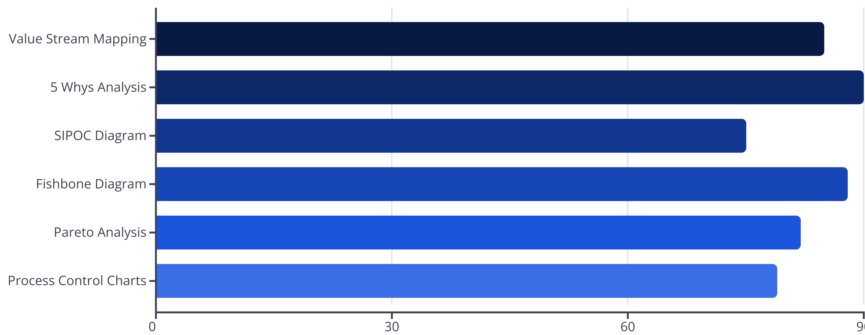
DMAIC Tools for Agile Project Managers
Based on survey of 200 Agile project managers who implemented DMAIC for process improvement
Notes:
Here are the talking points for Slide 11, titled “DMAIC Tools for Agile Project Managers”:
🧰 Slide 11: DMAIC Tools for Agile Project Managers
1. Introduce the Value
“DMAIC isn’t something separate from Agile—it’s a toolkit that integrates seamlessly into what you’re already doing.”
“These tools help Agile project managers move from reactive to proactive—solving root causes, not just patching symptoms.”
2. Highlight the Survey
“This slide is based on input from over 200 Agile project managers who successfully used DMAIC for process improvement.”
“They identified the most effective tools for each phase of the process.”
3. Match Tools to Phases You can highlight a few examples across phases:
Define: SIPOC diagrams, problem statements
Measure: Jira dashboards, burndown charts, surveys
Analyze: 5 Whys, Fishbone diagrams, Pareto analysis
Improve: Impact/effort matrix, A/B testing, pilot plans
Control: Dashboards, checklists, process audits, retrospective tracking
4. Emphasize Simplicity
“You don’t need fancy software. Most of these tools can be implemented with what you already have—Jira, Excel, Miro, or even a whiteboard.”
5. Practical Advice
“Start small. Use just one or two tools per phase to build familiarity.”
“The goal isn’t more documentation—it’s clarity and accountability.”
6. Transition
“Next, I’ll show you how to weave these tools directly into your Agile ceremonies, so DMAIC becomes part of your team’s rhythm.”

Slide 12
Integrating DMAIC with Agile Ceremonies
Sprint Planning
Daily Standups
Use Define and Measure insights to adjust capacity planning and story prioritization
Track improvement initiatives and identify new data points for the Measure phase
Sprint Review
Retrospective
Demonstrate progress on DMAIC metrics to stakeholders alongside feature demos
Use Analyze techniques to dig deeper into issues and evaluate Control effectiveness
DMAIC doesn't replace Agile—it enhances it by providing structure to solve persistent problems.
Notes:
Here are the talking points for Slide 12, titled “Integrating DMAIC with Agile Ceremonies”:
🔄 Slide 12: Integrating DMAIC with Agile Ceremonies
1. Reinforce the Message
“DMAIC doesn’t require you to change your framework—it enhances what you’re already doing in Scrum or Kanban.”
“Think of it as a continuous improvement engine that fits into your existing Agile ceremonies.”
2. Ceremony-by-Ceremony Integration Walk through how each Agile event can support a DMAIC phase:
Sprint Planning → “Use insights from Define and Measure to guide what gets prioritized.” → “For example, if story size or clarity is a recurring issue, address it during planning.”
Daily Standups → “Track progress on improvement actions identified in Improve.” → “Use this time to surface any blockers tied to root causes you’re tackling.”
Sprint Review → “Share progress on DMAIC outcomes with stakeholders—don’t just demo features.” → “It reinforces transparency and shows you’re addressing systemic delivery issues.”
Retrospective → “This is where DMAIC shines. Use Analyze tools like 5 Whys or Fishbone diagrams.” → “Evaluate Control mechanisms—what’s working, what needs reinforcing?”
3. Tip for Agile Leaders
“Make DMAIC part of the team’s language—ask: ‘Is this a Define phase conversation, or are we ready to Improve?’”
“Small mindset shifts lead to big performance gains.”
4. Call to Action
“Pick one ceremony where you’ll integrate a DMAIC technique this week.”
“Make process improvement visible and deliberate—not accidental.”
5. Transition
“Let’s wrap up by looking at common pitfalls to avoid—and best practices to keep your DMAIC effort on track.”

Slide 13
Common Pitfalls and How to Avoid Them
Pitfalls:
Best Practices:
Rushing through the Define phase
Take time to get stakeholder alignment
Collecting insufficient data
Set clear metrics before starting
Fixing symptoms instead of root causes
Use multiple analysis techniques
Implementing too many changes at once
Test one solution at a time
Neglecting the Control phase
Build monitoring into existing ceremonies
Notes:
Here are the talking points for Slide 13, titled “Common Pitfalls and How to Avoid Them”:
⚠️ Slide 13: Common Pitfalls and How to Avoid Them
1. Set the Tone
“Even with a structured approach like DMAIC, it’s easy to fall into traps that undermine your effort.”
“Let’s look at the most common mistakes Agile teams make—and how to stay clear of them.”
2. Pitfalls to Watch Out For Briefly explain each one:
Rushing through the Define phase → “Teams jump to solutions without fully understanding the problem. A vague problem leads to vague fixes.”
Collecting insufficient data → “If you don’t measure, you’re guessing. That leads to misdiagnosed problems.”
Fixing symptoms instead of root causes → “It might feel good to ‘do something,’ but if it’s not addressing the cause, the problem will return.”
Implementing too many changes at once → “Teams overwhelm themselves. Stick to one or two targeted improvements and test their impact.”
Neglecting the Control phase → “This is one of the most skipped steps. Without Control, your gains won’t last.”
3. Best Practices to Counter Pitfalls
Take time to align with stakeholders – “Buy-in from the beginning avoids resistance later.”
Set clear metrics before you start – “Know how you’ll measure success.”
Use multiple analysis tools – “Different angles help uncover the real root.”
Test one solution at a time – “That way, you know what worked.”
Integrate Control into Agile ceremonies – “Make sustainability a habit, not an afterthought.”
4. Action Tip
“If you’ve done a DMAIC effort and didn’t see results—ask yourself if one of these pitfalls was in play.”
5. Transition
“Let’s wrap up with the big takeaways from today—and how you can start applying DMAIC on your next sprint.”

Slide 14
Key Takeaways
Move from reactive to proactive problem-solving
DMAIC provides the structure to permanently resolve recurring issues, not just patch them temporarily.
Leverage data to drive decisions
Replace assumptions with measurements to identify true causes and validate improvements.
Integrate with existing Agile practices
DMAIC complements Agile frameworks by adding depth to continuous improvement efforts.
Build sustainable solutions
The Control phase ensures improvements stick, even when teams are under pressure.
In Agile environments, we move fast—but fast doesn't always mean smart. DMAIC transforms teams from problem managers to problem solvers.
Notes:
Here are the talking points for Slide 14, titled “Key Takeaways”:
🧭 Slide 14: Key Takeaways
1. Bring It All Together
“Let’s recap the core ideas you can walk away with today—whether you’re a Scrum Master, Agile Coach, or Project Manager.”
2. Recap Each Key Message
✅ Move from reactive to proactive problem-solving → “Agile helps us move fast. DMAIC helps us move smart.” → “Don’t just manage the problem—solve it.”
📊 Leverage data to drive decisions → “Let data replace assumptions. Metrics give you the power to see clearly and act with confidence.”
🔄 Integrate with existing Agile practices → “You don’t need to overhaul your framework. DMAIC fits right into your sprint planning, standups, reviews, and retros.”
🛡 Build sustainable solutions → “Lasting change requires structure. The Control phase ensures improvements hold—especially under pressure.”
3. Final Reflection
“DMAIC turns persistent problems into solvable challenges.”
“You now have a proven framework to break the cycle of Groundhog Day projects—and turn your Agile team into true problem solvers.”
4. Call to Action
“Pick one recurring issue your team faces today. Apply just the Define and Measure steps—and see where it leads.”
“Start small. Start structured. Start solving.”
5. Invite Engagement
“If you’d like templates or tools to get started—or want to share your experience applying DMAIC—connect with me on LinkedIn or visit Managing Projects the Agile Way.”

