Slide 1

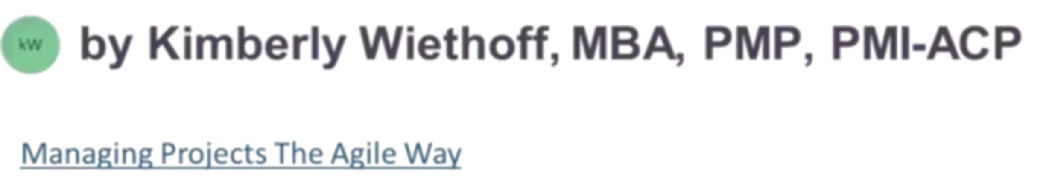
Integrating ServiceNow with Zuora, AgentForce, Sitracker, and the Enterprise SaaS Ecosystem
Building the central nervous system of enterprise service delivery through strategic platform integration
#ServiceNow #SystemsIntegration #Zuora #AgentForce #Sitracker #SaaSIntegration #EnterpriseArchitecture #WorkflowAutomation #ITSM #CSM #FSM #DigitalTransformation #PlatformEngineering #CustomerExperience #ManagingProjectsTheAgileWay

Slide 2

The Integration Imperative
ServiceNow rarely delivers outcomes in isolation. In modern enterprise environments—particularly in subscription-based, asset-heavy, or service-driven businesses—the platform's true value emerges through tight, reliable integrations with surrounding systems.
Platforms like Zuora, AgentForce, and Sitracker don't simply exchange data with ServiceNow—they complete the service lifecycle. Weak integration strategies lead to broken workflows, delayed resolutions, and customer frustration. Strong integrations create seamless, end-to-end service experiences that drive business outcomes.

Slide 3



ServiceNow's Strategic Position
Orchestration Layer
System of Record
Visibility Layer
Coordinates workflows across multiple systems, ensuring processes flow smoothly from initiation to completion
Maintains authoritative data for service execution, incidents, and customer interactions
Provides unified insights for customers, agents, and leadership across the service ecosystem
ServiceNow should not be positioned as the billing engine, CRM, or provisioning system. Attempting to force it into these roles introduces unnecessary complexity and architectural fragility. Clear role definition is the foundation of successful integration strategy.

Slide 4
Zuora Integration: Closing the Billing Loop
Zuora serves as the subscription billing, usage-based charging, and revenue recognition engine for many enterprises. Integration with ServiceNow creates powerful synergies that transform how billing-related service issues are handled.
01
02
Real-Time Billing Visibility
Automated Incident Handling
Agents access current billing status directly within customer cases, eliminating context switching
Billing disputes and payment issues trigger automated workflows, reducing manual intervention
03
04
Service State Management
Reduced Handoffs
Account status changes automatically drive service suspension or restoration workflows
Seamless coordination between support, finance, and operations teams improves resolution speed

Slide 5


Zuora Integration: Technical Considerations
Key Integration Points
Business Impact
Contract and entitlement synchronization
When ServiceNow and Zuora are properly aligned, customer service teams resolve billing issues 40-60% faster with significantly fewer escalations to finance departments. This directly impacts customer satisfaction and operational efficiency.
Event-driven updates for billing state changes
Strong data governance around financial records
Bi-directional communication patterns
Exception handling for failed transactions

Slide 6



AgentForce Integration: Empowering Assisted Service
Guided Workflows
Scripted Interactions
Rapid Onboarding
Agents follow structured paths through complex resolution scenarios
Consistent customer experiences through standardized conversation flows
New support staff become productive faster with contextual guidance
When integrated with ServiceNow, AgentForce consumes rich case context and customer data, drives consistent resolution paths, and feeds outcomes back into ServiceNow for reporting and continuous learning. The result is higher first-contact resolution rates and more predictable customer experiences across the support organization.

Slide 7

Sitracker Integration: Bridging Digital and Physical Work
Sitracker and similar operational systems support asset lifecycle management, network deployment, maintenance operations, and field service provisioning. Integration with ServiceNow creates a crucial bridge between digital workflows and physical execution.
Integration Capabilities
Automatic work order creation from incidents or service requests
Real-time status updates visible to customers and agents
Asset relationship management synchronized with the CMDB
Coordinated scheduling between digital and field operations
This integration point represents where ServiceNow, Field Service Management, and operational systems converge to deliver tangible, real-world outcomes for customers.

Slide 8

Common Integration Patterns
API-Based Integrations
Event-Driven Architecture
Real-time orchestration and synchronous communication for immediate workflow coordination. Ideal for user-initiated actions requiring instant feedback.
Proactive service management through asynchronous event propagation. Enables loose coupling and resilient, scalable system interactions.
Middleware-Mediated Flows
Batch Synchronization
Transformation, routing, and resilience through integration platforms. Provides abstraction layer for complex enterprise architectures.
Scheduled data reconciliation for reporting, analytics, and non-time-critical updates. Balances completeness with system load.
Guiding Principle: ServiceNow orchestrates workflows and maintains service context; specialized systems execute their domain-specific functions. This separation of concerns creates maintainable, scalable architectures.

Slide 9

Observability and Reliability
Integrated systems introduce architectural complexity—and complexity demands comprehensive visibility. Without proper observability, integration failures surface as customer complaints rather than actionable technical insights.
End-to-End Transaction Tracing
Track requests across system boundaries to identify bottlenecks and failures in distributed workflows
Correlated Logging
Unified logging strategies that connect events across platforms, enabling rapid root cause analysis
Clear Ownership Models
Defined escalation paths and on-call responsibilities for each integration point and system boundary
Business-Impact Alerting
Automated notifications tied to customer impact and SLA violations, not just technical metrics

Slide 10

Security, Compliance, and Trust
Non-Negotiable Requirements
Enterprise integrations must meet stringent standards that protect sensitive data and maintain regulatory compliance across jurisdictions.
Authentication & Authorization
OAuth 2.0, API keys, service accounts with principle of least privilege
Data Privacy & Protection
Encryption in transit and at rest, PII handling, GDPR compliance
Auditability & Traceability
Complete audit trails for data access, modifications, and cross-system flows
Security and compliance must be built into integration design from the start, not layered on as an afterthought. This approach prevents costly rework and reduces risk exposure.

Slide 11





Designing for Scale and Change
1
Standards
2
Patterns & Practices
3
Loose Coupling
4
Modular Architecture
5
Change-Ready Foundation
The most resilient ServiceNow integration architectures are designed for evolution, not perfection. They embrace modularity and loose coupling, enabling organizations to onboard new platforms, evolve service offerings, and scale operations without constant architectural rework.
Governed by clear standards and reusable patterns, these architectures reduce time-to-value for new integrations while maintaining consistency and quality across the enterprise ecosystem.

Slide 12
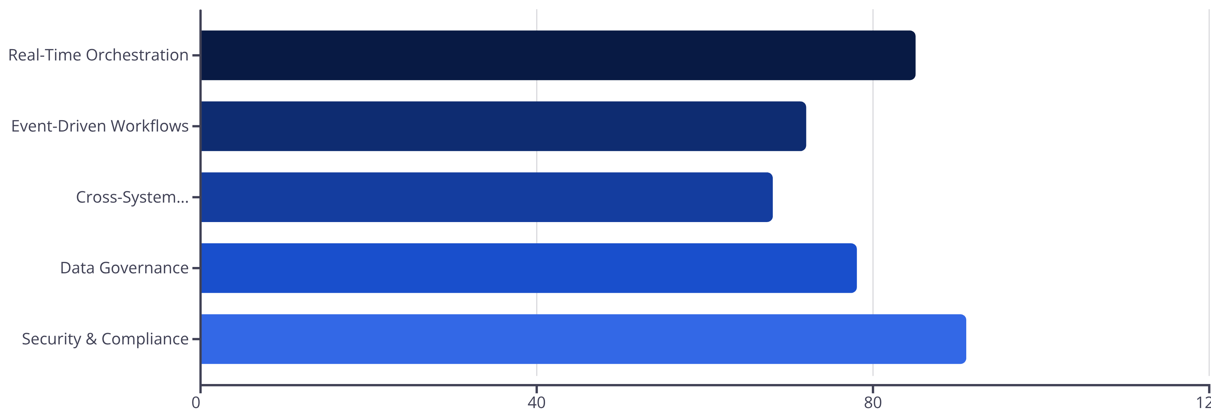
Integration Architecture in Practice
Organizations with mature integration practices demonstrate higher levels of operational excellence, faster time-to-resolution, and improved customer satisfaction across all service channels.

Slide 13

The Central Nervous System
Where Everything Converges
Integrations are not a technical afterthought—they are where customer experience, operational efficiency, and business outcomes converge.
When ServiceNow is thoughtfully integrated with platforms like Zuora, AgentForce, Sitracker, and the broader SaaS ecosystem, it transcends its role as a workflow engine.
It becomes the central nervous system of the enterprise—orchestrating intelligence, coordinating action, and enabling the organization to sense and respond to customer needs with precision and speed.

