Slide 1

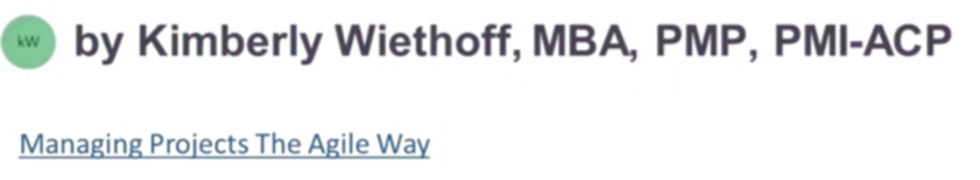
Microsoft Dynamics 365 Certification Guide: Your Path to Success
Whether you're just starting your journey with Microsoft Dynamics 365 or already working with CRM and ERP applications, understanding the certification paths can be a game-changer. This guide will help you navigate the entire Dynamics 365 certification landscape to find the path that aligns with your career goals.

Slide 2
Why Microsoft Dynamics 365 Certifications Matter
Career Advancement
Skill Validation
Higher Value
Stand out in a competitive job market and unlock new professional opportunities with validated skills.
Prove your expertise in implementing and optimizing Dynamics 365 solutions to solve real business problems.
Certified professionals typically earn more and are seen as more valuable to organizations and clients.
Dynamics 365 certifications demonstrate your ability to bridge the gap between customer experiences and core business operations, making you an invaluable asset to any organization.

Slide 3


The Two Worlds of Microsoft Dynamics 365
Customer Engagement (CRM)
Finance & Operations (ERP)
The front office: Sales, Marketing, Customer Service, and Field Service
The back office: Finance, Supply Chain, Commerce, HR, and Manufacturing
Together, these create an end-to-end platform that connects customer experiences with core business operations. Professionals who understand both ecosystems are especially valuable.

Slide 4
Your Certification Journey: Where to Begin
Step 3: Advanced Expertise
Step 2: Specialization
Combine certifications to become a valuable cross-functional expert who understands both worlds.
Step 1: Fundamentals
Choose your path based on career goals: CRM (Sales, Marketing, Service) or ERP (Finance, Supply Chain, Commerce).
Start with MB-910 (CRM) or MB-920 (Finance & Operations) to build a solid foundation.
Think of fundamentals as your launchpad—helping you speak the language of Dynamics 365 before diving into role-based specializations that align with your career goals.

Slide 5
Fundamentals Certifications: Your Starting Point
MB-910: Dynamics 365 Fundamentals (CRM)
MB-920: Dynamics 365 Fundamentals (Finance & Operations)
Focus: Customer engagement apps
Sales fundamentals
Focus: Core ERP concepts
Marketing concepts
Financial management
Customer service principles
Supply chain principles
Field service basics
Commerce operations
Human resources basics
While these fundamental exams are optional, they provide a solid foundation and common language that will help you succeed with more specialized certifications later in your journey.

Slide 6
Customer Engagement (CRM) Certification Path
Certification
Exam
Focus Areas
Sales Functional Consultant Associate
MB-210
Lead management, opportunity pipeline, forecasting, product catalog
Marketing Functional Consultant Associate
MB-220
Marketing automation, customer journeys, segmentation, analytics
Customer Service Functional Consultant Associate
MB-230
Case management, SLAs, knowledge base, omnichannel service
Field Service Functional Consultant Associate
MB-240
Work orders, resource scheduling, inventory management, mobile solutions
These certifications validate your ability to configure and optimize the customer-facing applications within Dynamics 365.

Slide 7
Finance & Operations (ERP) Certification Path
Certification
Exam
Focus Areas
Finance Functional Consultant Associate
MB-310
General ledger, accounts payable/receivable, tax, budgeting
Supply Chain Management Functional Consultant Associate
MB-330
Inventory, warehousing, manufacturing, procurement, logistics
Commerce Functional Consultant Associate
MB-340
Retail stores, e-commerce, point-of-sale, merchandising
Finance & Operations Apps Developer Associate
MB-500
Extending, integrating, customizing F&O applications
Important Update: Until February 2024, you needed MB-300 (Core F&O) plus a specialization exam. Now you only need the specialization exam to earn the certification.

Slide 8


Upcoming Changes to CRM Certifications
September 2024 Update
Microsoft is introducing the Customer Experience Analyst Associate certification, which will replace:
MB-210 (Sales)
MB-220 (Marketing)
MB-260 (Customer Insights Data)
These exams retire on November 30, 2024.
This change reflects Microsoft's strategic shift toward customer insights and analytics, emphasizing a more holistic approach to customer data across the Dynamics 365 platform.

Slide 9








How CRM and ERP Work Together
Sales (CRM)
Supply Chain (ERP)
Opportunities captured in Sales flow into demand planning.
Demand signals trigger procurement and production planning.
Service (CRM)
Fulfillment (ERP)
Post-sale support maintains customer satisfaction.
Orders are processed, picked, packed, and shipped.
Real-world projects often require both CRM and ERP expertise. For example, sales opportunities captured in CRM (MB-210) flow into demand planning in ERP (MB-330), while customer orders in CRM connect directly to invoicing in ERP (MB-310).
Professionals who understand both ecosystems can deliver true end-to-end business transformation with Dynamics 365.

Slide 10
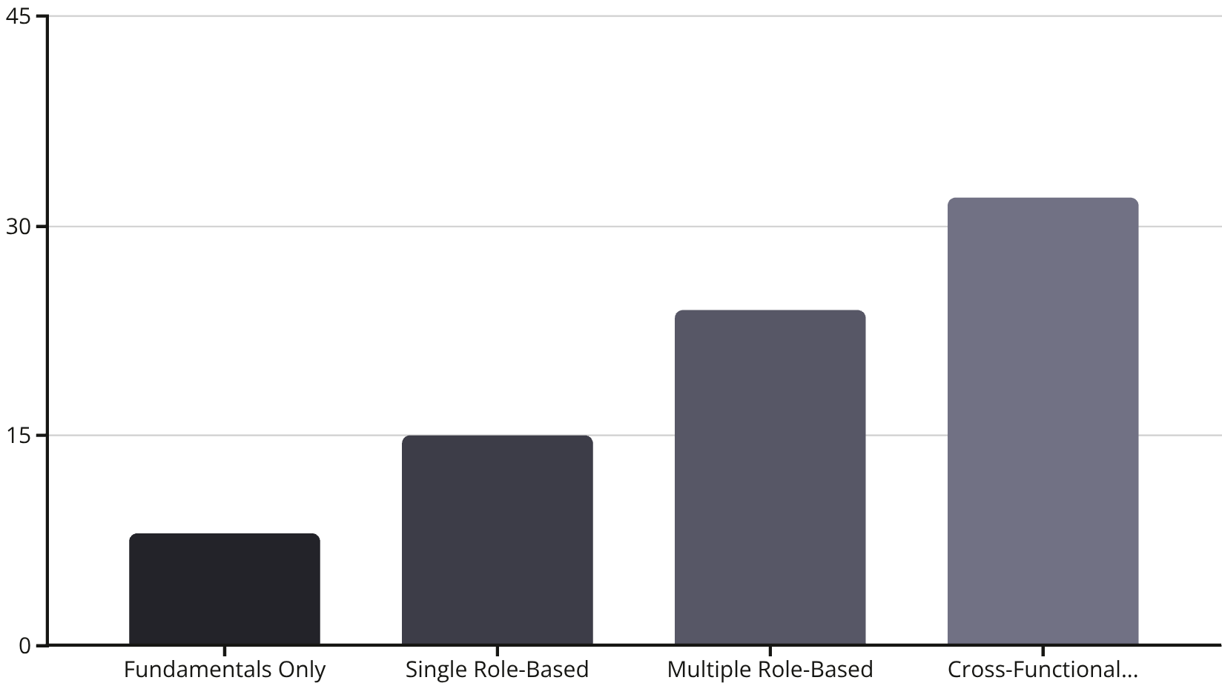
Certification Value: By the Numbers
The Cross-Functional Advantage
IT professionals who can bridge both CRM and ERP worlds command significantly higher salaries and are more valuable to employers. This is because they can:
Design integrated business solutions
Troubleshoot cross-platform issues
Provide strategic business insights
Support end-to-end processes

Slide 11


Legacy Certifications: Still Relevant?
Legacy CRM Certifications
Legacy ERP Certifications
Before role-based certifications, Dynamics CRM used exam codes like:
Dynamics AX/Finance used exam codes like:
MB6-869 (AX 2012 Development)
MB2-631 (CRM 4.0 Applications)
MB6-892 (AX Distribution and Trade)
MB2-632 (CRM 4.0 Customization)
MB6-895 (Financial Management)
MB2-876 (Extending CRM 2015)
Why This Matters
While these certifications are retired, understanding the legacy ecosystem is valuable if you're supporting on-premise installations or migrating from older versions to Dynamics 365 cloud solutions.

Slide 12




Building Your Certification Roadmap
Assess Your Starting Point
Define Your Career Goals
Evaluate your current experience with Dynamics 365 and determine if you need to start with fundamentals.
Decide whether you want to specialize in customer-facing (CRM) solutions, back-office (ERP) solutions, or both.
Create a Study Plan
Expand Your Expertise
Allow 4-8 weeks of preparation per exam, including hands-on practice with Dynamics 365.
After initial certification, continue building cross-functional skills to increase your market value.
The most successful Dynamics 365 professionals follow a strategic certification path that aligns with both their interests and market demand, regularly updating their skills as the platform evolves.

Slide 13


Study Resources for Certification Success
Official Microsoft Resources
Community Resources
Microsoft Learn paths (free, self-paced modules)
Dynamics 365 Community forums
LinkedIn Learning courses
Official exam study guides
Third-party practice tests
Microsoft certification practice assessments
YouTube channels focused on Dynamics 365
Documentation at docs.microsoft.com
Pro Tip
Set up a trial instance of Dynamics 365 for hands-on practice. Nothing prepares you better than actually configuring and using the applications you'll be tested on.

Slide 14

Your Next Steps to Dynamics 365 Certification
This Week
This Month
This Year
Create a Microsoft Learn account
Set up your Dynamics 365 trial environment
Earn your first role-based certification
Take the free Dynamics 365 fundamentals learning path
Schedule your first certification exam
Apply new skills in real-world projects
Complete 1-2 hands-on practice exercises weekly
Start working toward a complementary certification
Join the Dynamics 365 Community
With CRM and ERP certifications under your belt, you'll validate your expertise and strengthen your ability to deliver true end-to-end business transformation with Dynamics 365. The journey starts now—which certification will you pursue first?

