Slide 1
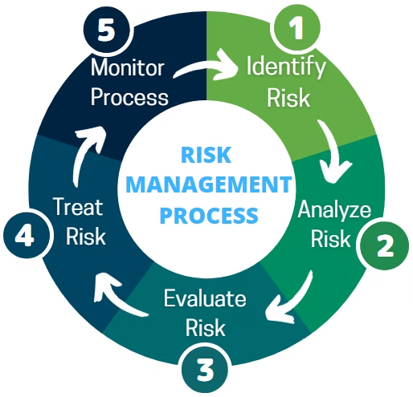
Navigating the Seas of IT Project Management: The Importance of Risk Management
Every IT project faces risks that can derail success. Effective risk management protects investments and ensures project objectives are met within constraints.
kW
by Kimberly Wiethoff

Slide 2
Today's Agenda
Why Risk Management Matters
The critical importance in IT projects
Key Principles
The foundation of effective risk management
Best Practices
Strategies for implementation
Action Steps
Taking risk management to the next level

Slide 3
The IT Project Landscape
Complex Systems
Evolving Requirements
IT projects involve interconnected technologies, creating layers of dependencies and potential failure points.
Stakeholder needs shift throughout project lifecycles. New technologies emerge constantly.
Significant Investments
Organizations commit substantial resources. Project failures damage budgets and reputations.

Slide 4
Why Risk Management Matters
Uncertainty & Complexity
Investment Protection
Project Success
IT projects face inherent uncertainty due to emerging technologies and dynamic environments.
Early risk identification safeguards time, resources, and capital investments.
Systematic risk management maximizes achieving objectives within constraints.
Risk management helps teams anticipate challenges and prepare effective contingency plans.
Minimizes costly delays, budget overruns, and potential project failures.
Teams can mitigate threats while capitalizing on emerging opportunities.

Slide 5
The Risk Management Cycle
Identify
Assess
Document potential risks through brainstorming, historical analysis, and stakeholder input.
Determine likelihood and impact using qualitative and quantitative techniques.
Monitor
Mitigate
Continuously track effectiveness and identify new risks throughout the project lifecycle.
Implement strategies to reduce likelihood or impact through avoidance, transfer, or reduction.

Slide 6
Risk Identification Techniques
Brainstorming Sessions
SWOT Analysis
Gather the project team to identify potential risks through collaborative thinking.
Assess Strengths, Weaknesses, Opportunities, and Threats related to the project.
Document all concerns, regardless of perceived probability or impact.
Helps identify internal and external risk factors systematically.
Historical Review
Expert Interviews
Examine similar past projects to identify common pitfalls and recurring issues.
Consult with subject matter experts who can highlight domain-specific risks.
Learn from previous successes and failures within your organization.
Tap into specialized knowledge for comprehensive risk identification.

Slide 7
Risk Assessment Methodologies
Quantitative Analysis
Numerical evaluation of probability and financial impact
Qualitative Assessment
Descriptive evaluation using scales and matrices
Risk Prioritization
Ranking risks by severity to focus resources effectively
Effective assessment requires both subjective judgment and objective data. Teams should use multiple approaches for a comprehensive view of the risk landscape.

Slide 8
Risk Response Strategies
Avoid
Eliminate the risk by removing its cause or changing approach.
Transfer
Shift the risk impact to a third party through insurance or contracts.
Mitigate
Reduce probability or impact through preventive actions.
Accept
Acknowledge the risk and prepare contingency plans if needed.

Slide 9
Risk Monitoring Tools
Risk Register
Key Risk Indicators
Comprehensive document tracking all identified risks, their status, and mitigation actions.
Metrics that provide early warning signs of increasing risk levels.
Status Meetings
Dashboard Reports
Regular review sessions to discuss emerging risks and mitigation progress.
Visual summaries of risk status across the project portfolio.

Slide 10
Building a Risk-Aware Culture
Open Communication
Create psychological safety for team members to report potential risks without fear.
Reward early problem identification rather than punishing the messenger.
Regular Training
Provide ongoing education about risk management principles and techniques.
Build risk thinking into every team member's skillset.
Leadership Modeling
Executives must demonstrate commitment to risk management through actions.
Include risk discussions in strategic planning sessions.

Slide 11
Common IT Project Risks
Technical Risks
Resource Risks
Integration challenges
Skill shortages
Performance issues
Team turnover
Stakeholder Risks
Scalability problems
Vendor dependencies
Timeline Risks
Changing requirements
Unrealistic schedules
Unclear expectations
Delayed dependencies
Stakeholder conflicts
Scope creep

Slide 12
Risk Management Success Metrics
25%
30%
Reduction in Issues
Faster Resolution
Fewer unexpected problems during project execution
Quicker response to problems that do arise
85%
20%
Projects On Budget
Stakeholder Satisfaction
Higher percentage of projects completed within financial constraints
Improved satisfaction scores from key project stakeholders

Slide 13
Case Study: Global ERP Implementation
Risk Identified
Data migration challenges across legacy systems
Mitigation Strategy
Pilot migration with sample data sets
Outcome
90% reduction in data loss during final migration
A multinational manufacturing firm identified data migration as a critical risk early. Through careful planning and pilot testing, they avoided the common pitfall of corrupted or lost data during the transition.

Slide 14
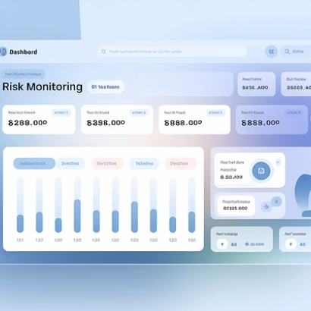
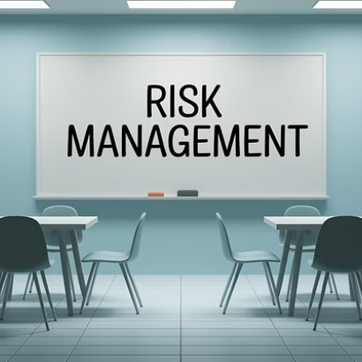
Taking Action: Next Steps
Begin implementing these risk management principles in your next IT project. Start small with a basic risk register, then expand your approach as your team builds confidence and capability.

Slide 15
Final Thoughts
In conclusion, effective risk management is a critical component of successful IT project management. By proactively identifying, assessing, and mitigating risks, organizations can minimize threats, capitalize on opportunities, and deliver value to stakeholders with confidence and resilience. Embracing risk management as an integral part of the project lifecycle empowers teams to navigate the complexities of IT projects and achieve their goals with greater certainty and success.

