Slide 1


RFID in Retail: A Project Manager's Guide
RFID technology is transforming retail operations through enhanced inventory management and improved customer experiences.
This guide provides retail project managers with practical insights for successful RFID implementation.
#RFID #RetailTech #ProjectManagement #InventoryManagement #RetailInnovation #SupplyChain #RetailIT #SmartRetail #RetailTechnology #RetailTrends #ITProjectManagement #RFIDinRetail #RetailAutomation #CustomerExperience #DigitalTransformation #SupplyChainVisibility #RetailSolutions #RetailEfficiency #TechnologyInRetail #PMO #AgileProjectManagement

Slide 2

What is RFID Technology?
Tag-Based Tracking
Bulk Reading
RFID uses electromagnetic fields to identify and track tags on merchandise. No line-of-sight required, unlike barcodes.
Multiple items can be scanned simultaneously. This speeds up inventory counts dramatically.
Real-Time Updates
RFID provides instant inventory visibility. Staff can locate items quickly throughout the store.

Slide 3





Core RFID Components
RFID Tags
RFID Readers
Antennas
Microchip and antenna attached to merchandise. Stores product data and communicates with readers.
Fixed or handheld devices that capture tag data. They transmit information to central systems.
Enable communication between tags and readers. Strategic placement improves read rates.
Software
Processes RFID data and integrates with retail systems. Connects to ERP, WMS, and POS.

Slide 4

Key Business Benefits
99%
Inventory Accuracy
RFID dramatically improves inventory precision compared to traditional methods.
65%
Labor Reduction
Staff spend less time on inventory counts, allowing focus on customer service.
30%
Shrinkage Decrease
Better visibility helps prevent theft and loss throughout the supply chain.
10X
Speed Improvement
Inventory counts happen up to ten times faster than manual scanning.

Slide 5

Customer Experience Enhancements
1
Improved Product Availability
2
Faster Checkout
Accurate inventory ensures items are in stock when customers want them. This reduces disappointment and lost sales.
RFID-enabled checkouts eliminate manual scanning. Customers spend less time waiting in line.
3
Interactive Experiences
4
Omnichannel Fulfillment
Smart fitting rooms can identify items and suggest complementary products. This creates personalized shopping moments.
Precise inventory visibility enables buy-online-pickup-in-store options. Customers enjoy flexible shopping methods.

Slide 6





Implementation Challenges
Data Management
1
Processing large volumes of RFID data
System Integration
2
Connecting with existing retail platforms
RF Interference
3
Metal fixtures and liquids affect performance
Staff Adoption
4
Training employees on new processes
Cost Considerations
5
High initial investment in infrastructure
Each challenge requires careful planning and mitigation strategies. Project managers must anticipate these hurdles and develop solutions before implementation begins.

Slide 7





Project Planning Essentials
Engage Stakeholders
Define Objectives
Involve IT, operations, and store managers early
2
Set clear, measurable goals for your RFID project
1
Select Vendors
Choose experienced partners with retail expertise
3
Test & Validate
5
Run pilots before full-scale deployment
Design Infrastructure
4
Plan tag types, reader placement, and network needs

Slide 8





Pilot Testing Approach
Select Test Location
Choose a representative store or department. Look for average size and typical product mix.
Define Success Metrics
Establish clear KPIs. Measure read rates, inventory accuracy, and process efficiency.
Limited Deployment
Implement RFID in the test area. Start with high-value or high-turnover merchandise.
Gather Data
Collect performance metrics. Compare results against traditional methods.
Refine Approach
Adjust implementation plan based on findings. Address any technical or process issues.

Slide 9
Change Management Strategy
Leadership Alignment
Secure executive sponsorship. Ensure management understands and supports RFID benefits.
Communication Plan
Develop clear messaging about changes. Explain how RFID improves daily operations.
Training Program
Create role-specific training materials. Include hands-on practice with RFID equipment.
Support System
Establish help resources for employees. Provide floor support during initial implementation.
Feedback Loop
Collect employee input regularly. Make adjustments based on frontline experiences.

Slide 10
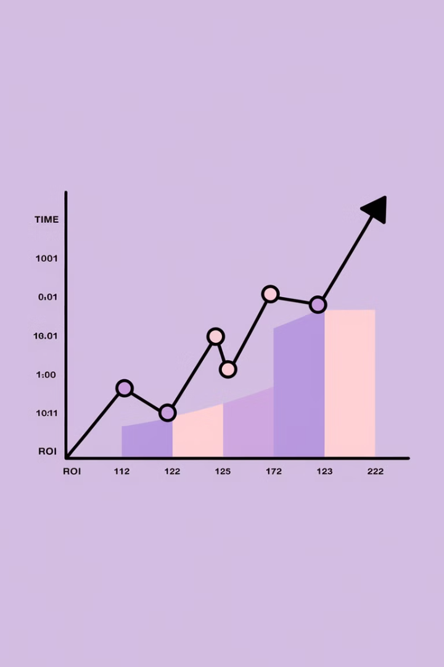
ROI Timeline Expectations
1
Months 1-3
Initial implementation costs and learning curve. Expect minimal financial return during setup and training.
2
Months 4-6
Early efficiency gains emerge. Inventory counts become faster and more accurate.
3
Months 7-12
Operational benefits materialize. Reduced labor costs and improved in-stock positions.
4
Year 2
Full ROI typically achieved. Enhanced customer experience drives additional sales growth.

Slide 11

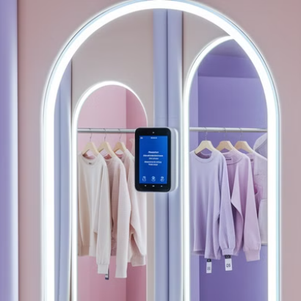

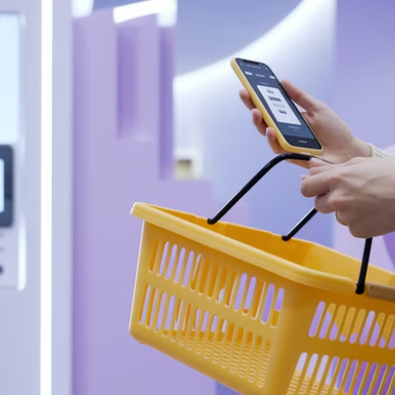
Future-Proofing Your RFID Investment
Plan for emerging retail technologies that will integrate with your RFID system. Consider how AI, computer vision, and IoT will enhance capabilities.
Build scalable infrastructure that can grow with your business. Choose vendors committed to ongoing innovation.

Slide 12



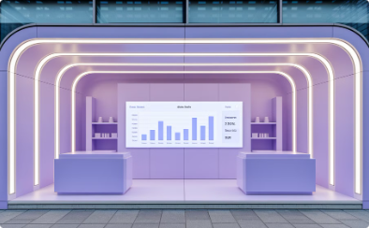
Final Thoughts
For project managers in retail, RFID presents a significant opportunity to drive efficiency and enhance operations:
Operational Efficiency
Customer Satisfaction
Project Leadership
Business Value
Effective project managers can navigate implementation challenges through careful planning and change management.
Well-executed RFID projects deliver tangible returns through reduced costs and increased sales opportunities.
Successfully implemented RFID systems dramatically improve inventory accuracy and streamline daily retail operations.
RFID enables better product availability and personalized shopping experiences that directly enhance customer satisfaction.

