Slide 1

A Phased Approach to Migrating Applications to the Cloud
Migrating applications to the cloud is a strategic initiative that offers organizations the opportunity to enhance scalability, agility, and cost efficiency. This presentation outlines a comprehensive, phased approach to guide you through a successful cloud migration journey, minimizing risks and maximizing benefits along the way.
kW
by Kimberly Wiethoff

Slide 2
Phase 1: Assessment & Planning
Business Objectives
Application Inventory
Before embarking on a cloud migration, clearly define your business goals. What are you aiming to achieve? Are you looking to reduce costs, improve performance, enhance scalability, or achieve greater agility? These objectives will serve as your guiding principles throughout the migration process.
Conduct a thorough assessment of your existing IT infrastructure and applications. This includes identifying all applications, dependencies, data flows, and potential integration points. This step provides valuable insights into your current IT landscape and helps prioritize applications for migration.

Slide 3
Phase 1: Assessment & Planning (cont.)
Cloud Model Selection
Total Cost of Ownership (TCO) Analysis
Choose the cloud model that best aligns with your organization's requirements, including compliance, security, and performance needs. Explore public, private, hybrid, or multi-cloud options and consider factors such as data sovereignty, cost optimization, and flexibility.
Perform a comprehensive TCO analysis to compare the cost of running applications on-premises versus in the cloud. Consider operational costs, infrastructure expenses, licensing fees, and potential savings from cloud-based services. This analysis helps justify the investment in cloud migration and ensures a strong business case.

Slide 4
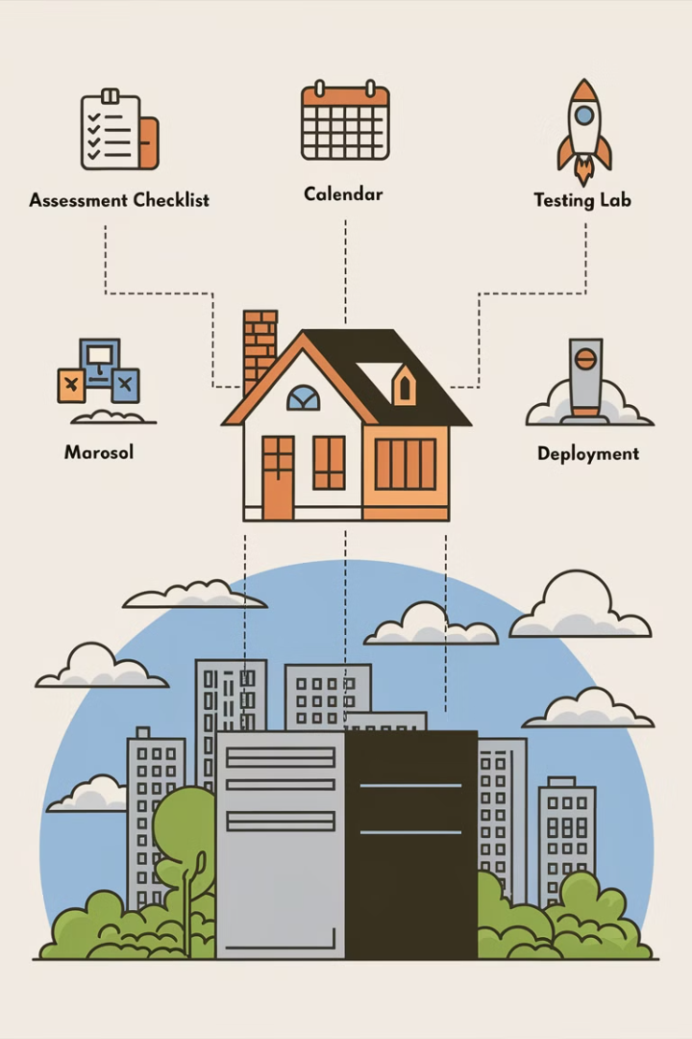
Phase 2: Proof of Concept (PoC) & Pilot Migration
1
Instead of a risky "big bang" migration, start with a gradual approach. Select a non-critical, low-risk application and conduct a pilot migration to test its performance, security, and compatibility in the cloud environment.
2
Use this opportunity to identify any gaps in automation, security, or networking. Evaluate the effectiveness of your cloud infrastructure and optimize configurations for cost-efficiency and performance.
3
Document all lessons learned throughout the PoC phase, including challenges encountered and successful strategies implemented. This valuable information will help inform future migration decisions and ensure smoother transitions for subsequent applications.

Slide 5
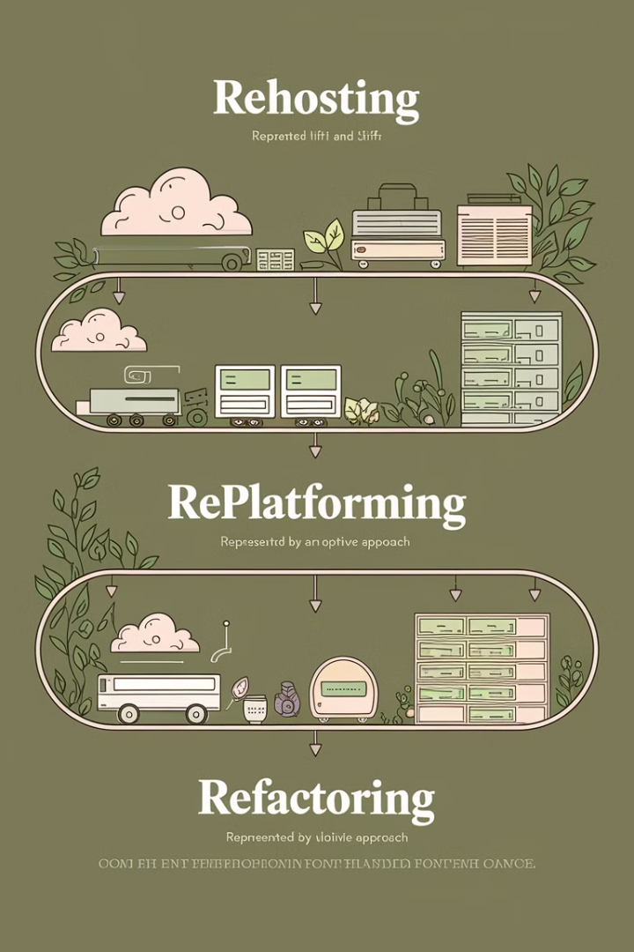
Phase 3: Incremental Migration & Optimization
Rehosting (Lift-and-Shift)
Replatforming (Lift-Tinker-and-Shift)
The simplest approach involves migrating applications to the cloud without making any significant changes. This method is quick and easy but may not fully leverage the benefits of cloud computing, such as scalability or cost optimization.
This strategy involves introducing minor optimizations to applications during migration. Examples include modernizing databases or upgrading operating systems. Replatforming allows for improved performance and efficiency while minimizing disruption.
Refactoring (Rearchitecting)
The most complex approach involves completely redesigning applications to take full advantage of cloud-native benefits. This could involve migrating to serverless computing, adopting microservices architecture, or leveraging cloud-specific features.

Slide 6




Phase 4: Performance Tuning & Security Hardening
Continuously monitor and optimize cloud costs to avoid overspending. Leverage cloud-native tools like AWS Cost Explorer or Azure Advisor to analyze resource usage, identify cost-saving opportunities, and proactively manage expenses.
Enhance security measures in the cloud environment. Implement robust Identity and Access Management (IAM) policies, enable encryption at rest and in transit, and establish comprehensive threat monitoring systems to mitigate potential risks.
Implement auto-scaling and load balancing features to automatically adjust resources based on demand. Utilize managed services to reduce operational overhead and ensure efficient, scalable infrastructure.

Slide 7



Phase 5: Full Cloud Operations & Continuous Improvement
Embrace Cloud-Native Services
Adopt cloud-native services like Kubernetes for container orchestration, serverless computing for event-driven applications, and managed databases for scalability and reliability. These services empower businesses with agility and innovation.
2
Optimize Workloads
Leverage AI-driven insights and analytics to continually optimize workloads and ensure efficient resource utilization. This includes identifying bottlenecks, eliminating redundancies, and proactively addressing performance issues.
1
Review Security & Compliance
Regularly review security and compliance measures to ensure ongoing adherence to industry best practices and evolving cloud standards. Proactively address vulnerabilities, update security configurations, and stay ahead of emerging threats.
3

Slide 8




Key Takeaways
Phased Approach
Continuous Optimization
Cloud-First Mindset
A structured, phased approach to cloud migration minimizes risk and maximizes benefits by allowing organizations to gradually transition applications and gain valuable experience along the way.
Cloud migration isn't a one-time event; it's an ongoing journey. Continuously monitor, optimize, and adapt to maximize performance, cost efficiency, and security in the dynamic cloud environment.
Embrace a cloud-first mindset by upskilling teams in cloud technologies, DevOps practices, and cloud security best practices. This fosters innovation and enables organizations to fully leverage the potential of cloud computing.

Slide 9
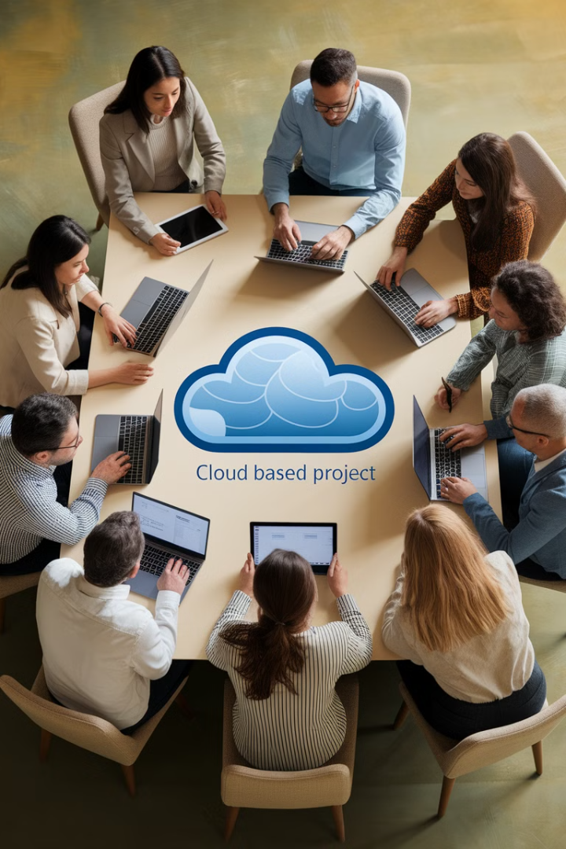
A Cloud-First Culture
Upskilling
Invest in training and development programs to equip your IT professionals with the skills and knowledge necessary to operate effectively in a cloud environment. This includes cloud-native technologies, DevOps practices, and cloud security best practices.
Embracing Automation
Automate cloud deployments, infrastructure management, and other repetitive tasks using Infrastructure as Code (IaC) and CI/CD pipelines. This reduces manual errors, streamlines operations, and increases efficiency.
Cloud-Native Adoption
Adopt cloud-native services like Kubernetes, serverless computing, and managed databases to leverage the full potential of the cloud. These services provide enhanced agility, scalability, and cost optimization.

Slide 10



Cloud Migration Success Factors
Leadership Support
1
Secure buy-in from leadership, including a clear vision for cloud adoption and a commitment to invest in the necessary resources and expertise.
Strong Business Case
2
Develop a compelling business case that outlines the potential benefits of cloud migration, such as cost savings, improved performance, and increased agility. This helps justify the investment and gain stakeholder support.
Experienced Cloud Partner
3
Partner with a reputable cloud service provider that offers comprehensive expertise, industry-specific solutions, and ongoing support. This helps ensure a smooth migration and ongoing success.

Slide 11
Cloud Migration Best Practices
Security First
1
Prioritize security throughout the migration process. Implement robust IAM policies, data encryption, and comprehensive threat monitoring to safeguard your data and applications in the cloud.
Compliance Adherence
2
Ensure compliance with industry regulations and data privacy laws. Select cloud providers and services that meet your compliance requirements and implement appropriate security controls.
Continuous Monitoring
Implement continuous monitoring of cloud resources and applications. This includes performance metrics, security logs, and compliance audits to ensure optimal performance, security, and compliance.
3

Slide 12

Moving Beyond the Cloud
Cloud migration isn't just about moving applications to the cloud—it's about embracing a new way of thinking and operating. By adopting a cloud-first culture, organizations can leverage the power of the cloud to unlock new possibilities, drive innovation, and achieve transformative results.

