Slide 1

From Legacy to Modern: A Project Manager's Guide to Navigating a D365 F&O Transformation
This guide helps project managers successfully lead the journey from legacy systems to Microsoft Dynamics 365 Finance & Operations, balancing system capabilities with business needs and stakeholder expectations.
kW
by Kimberly Wiethoff
Managing Projects The Agile Way

Slide 2

Why Transform? Setting Your North Star
The Business Case Imperative
Common Transformation Drivers
Before diving into technical requirements, establish a clear vision of why this transformation matters. Your business case becomes your anchor when project challenges arise.
Streamlining business processes
Reducing growing technical debt
Enabling global scalability
A well-defined business case helps you maintain focus and make consistent decisions throughout the project lifecycle.
Improving reporting capabilities
Enhancing security and compliance

Slide 3

Business Process Mapping: The Foundation
Implementing D365 F&O "as-is" without understanding your current processes can lead to critical gaps or unnecessary customization.
Document As-Is Processes
Identify Inefficiencies
Capture current workflows, pain points, and tribal knowledge. Interview key users across departments to understand both formal processes and informal workarounds.
Map existing bottlenecks, redundancies, and manual steps that could be automated. Quantify the business impact of these inefficiencies where possible.
Define To-Be Processes
Design future state processes with D365 capabilities in mind. Focus on standard functionality first, considering customizations only when business-critical needs aren't met.

Slide 4


The Overlooked Critical Path: Data Strategy
Data migration is consistently one of the most underestimated aspects of ERP transformations. Problems here can derail testing, training, and go-live schedules.
1
2
Data Cleansing
Data Mapping
Begin cleaning data in legacy systems before migration. Remove duplicates, standardize formats, and archive obsolete records to prevent carrying bad data forward.
Map legacy data structures to D365 F&O data entities. Document transformation rules, validation criteria, and handling of edge cases that don't fit standard structures.
3
Master Data Governance
Define ongoing governance processes for creating and maintaining master data. Establish data ownership, approval workflows, and quality standards for the new system.

Slide 5



Change Management: Beyond Communications
The shift from legacy to D365 F&O means major changes in workflows, user roles, and reporting. Effective change management requires engagement at all levels of the organization.
Identify Change Champions
Recruit influential users from each department who can advocate for the system and provide peer-to-peer support.
"People don't resist change. They resist being changed."— Peter Senge
Regular Demos & Feedback
Conduct regular system demonstrations to familiarize users with new interfaces and gather actionable feedback.
Business-Focused Training
Build training plans that cover not just "button clicks" but the business impact and value of new processes.

Slide 6

Measuring Implementation Success
Define success metrics early to track progress and demonstrate value throughout the transformation journey.
95%
30%
User Adoption
Process Efficiency
Target percentage of users consistently using the system correctly without workarounds
Reduction in processing time for key business workflows compared to legacy systems
99.5%
25%
Data Accuracy
Reporting Time
Percentage of data transactions processed without errors or manual corrections
Decrease in time required to generate critical business reports and insights
These metrics should be established at project kickoff and regularly measured throughout implementation and post-go-live phases.

Slide 7

The Standardization Balancing Act

Slide 8

Finding the Right Balance: Standardization vs. Flexibility
A key benefit of D365 F&O is standardization across business units—but over-engineering processes can create inflexibility and resistance.
When to Consider Customization
When standard functionality creates significant business disruption
The Standard-First Approach
For processes that provide competitive differentiation
Begin with standard D365 functionality as your baseline. This approach leverages built-in best practices, reduces maintenance complexity, and simplifies future upgrades.
When regulatory requirements demand specific handling
When the user experience would severely impact productivity
Each customization creates long-term technical debt and may complicate future upgrades. Document the business justification for each exception to standard functionality.

Slide 9

Testing Strategy: Beyond Checkbox Validation
Unit Testing
1
Validate individual functionalities against expected results. Focus on both positive paths and exception handling.
Owner: Technical team
Integration Testing
2
Verify end-to-end processes across modules and with external systems. Map test scenarios to actual business workflows.
Owner: Business analysts with key users
User Acceptance Testing
3
Business users validate that the system meets requirements in real-world scenarios using production-like data.
Owner: Department representatives
Performance Testing
4
Measure system response times and stability under expected load conditions and peak usage periods.
Owner: Technical team with business input

Slide 10

Technology Ecosystem: D365 F&O Doesn't Stand Alone
Understanding the broader technology ecosystem ensures proper integration planning and avoids unexpected gaps in functionality.
Core D365 F&O
Integration Layer
Reporting Solutions
Legacy Systems
Third-Party Add-ins
While core D365 F&O implementation consumes the majority of project resources, integration requirements often present the most complex technical challenges and potential schedule risks.

Slide 11

Preparing for Hypercare: Success Beyond Go-Live
Success isn't achieved at go-live—it's proven in the weeks that follow. A well-planned hypercare period ensures business continuity and user confidence during the critical transition.
On-Demand Support Resources
Establish dedicated support teams with clear escalation paths. Include both technical and business process experts who can quickly resolve issues.
Issue Triage Process
Create a structured process for categorizing and prioritizing defects and issues. Define resolution SLAs based on business impact severity.
Post-Implementation Reviews
Schedule regular reviews to capture lessons learned and identify process improvements. Document findings for future phases or projects.

Slide 12

Common Pitfalls and How to Avoid Them
Scope Creep
Insufficient Executive Sponsorship
Expecting Perfect Day One
"We just need one more feature before go-live..."
"The new system should do everything our old system did, plus more."
"IT will handle it. Just tell us when it's ready."
Prevention: Implement a formal change control process with business case requirements for all scope additions. Create a "Phase 2" list for non-critical enhancements.
Prevention: Secure active executive involvement through steering committees, regular demonstrations, and clear articulation of business outcomes tied to transformation milestones.
Prevention: Set realistic expectations about the transition period. Identify critical vs. nice-to-have capabilities and ensure critical functions are fully ready before go-live.

Slide 13
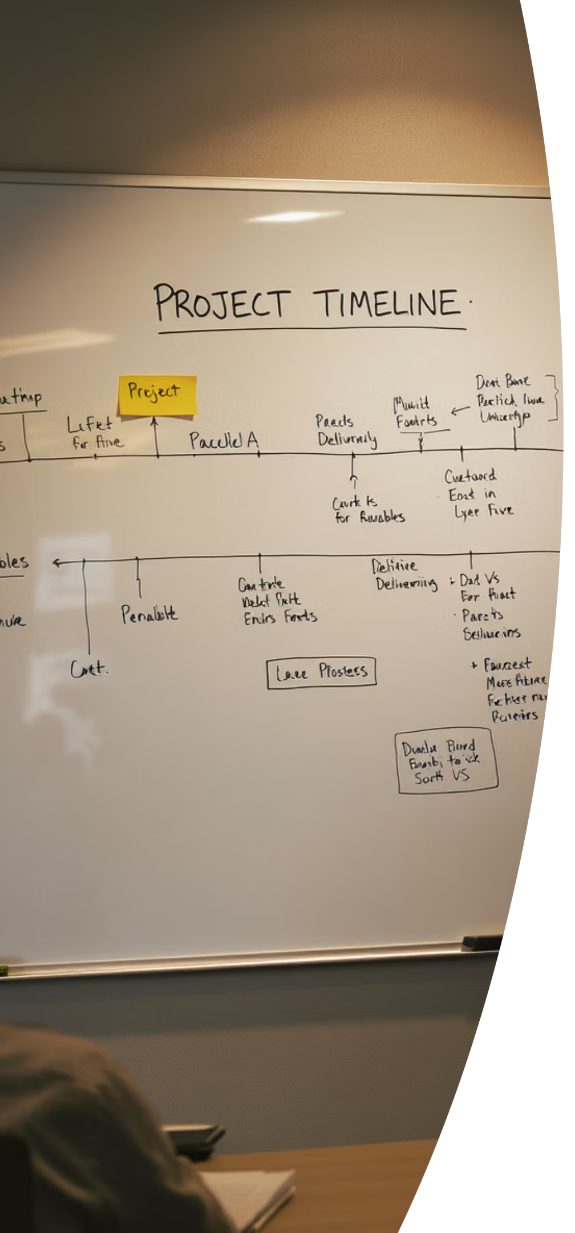
Your 90-Day Implementation Roadmap
Days 1-30: Foundation
Days 31-60: Design & Build
Establish project governance structure
Complete to-be process designs
Document business case and success metrics
Configure system environments
Develop data migration strategy
Complete as-is process mapping
Begin integration development
Begin data cleansing in legacy systems
Conduct initial user demos
Identify change champions
Days 61-90: Validation
Execute integration testing
Begin user acceptance testing
Finalize training materials
Develop cutover plan
Establish hypercare support model

Slide 14

A Marathon, Not a Sprint
As a project manager, your role is to orchestrate not just the tasks and timelines, but the people, processes, and expectations that will ultimately define success.
Focus on building sustainable momentum rather than short-term wins. The true value of your D365 F&O transformation will be measured in years, not months, as your organization leverages new capabilities and continuously improves processes.

