Slide 1

Leading in the Age of AI: Adaptive Project Management for a Disrupted Workforce
Artificial intelligence is no longer a future concept—it's here, reshaping industries, transforming workflows, and redefining how organizations create value. This presentation explores how leaders can navigate workforce disruption through adaptive project management approaches.
kW
by Kimberly Wiethoff, MBA, PMP, PMI-ACP
#AI #Leadership #ProjectManagement #FutureOfWork #AgileLeadership #AdaptiveLeadership #WorkforceTransformation #DigitalTransformation #ResponsibleAI #Innovation

Slide 2
Today's Agenda
01
02
The AI Revolution
Workforce Transformation
Understanding the current landscape and impact
How AI is reshaping roles and team dynamics
03
04
Adaptive Leadership Principles
Agile Governance Frameworks
Core competencies for leading through disruption
Balancing speed with responsibility
05
06
Building Resilient Teams
Action Planning
Strategies for developing future-ready capabilities
Practical next steps for implementation
Our journey today explores how project managers and executives can not only survive but thrive amid AI-driven workplace transformation.

Slide 3

The AI Revolution is Here
Artificial intelligence has moved beyond theoretical discussions to become a driving force reshaping:
Day-to-day operations and workflow automation
Decision-making processes and data analysis
Customer experiences and service delivery
Product development and innovation cycles
Talent management and workforce planning
Organizations that view AI as merely a technology upgrade rather than a fundamental business transformation are already falling behind. The question is no longer if AI will disrupt your projects, but how you'll lead through that disruption.
AI is no longer coming—it's here and changing everything.

Slide 4
Workforce Transformation: The Human Reality
Role Evolution
Emerging Opportunities
85% of jobs that will exist in 2030 haven't been invented yet. Current roles are being redefined as routine tasks become automated and human-specific skills gain premium value.
New positions are appearing in data ethics, AI governance, algorithm auditing, and human-AI collaboration facilitation—areas requiring both technical understanding and human judgment.
Emotional Impact
Skill Transition
Team members are experiencing uncertainty, anxiety, and concerns about relevance. 73% of workers report feeling anxious about how AI might affect their job security.
The half-life of professional skills has dropped from 10-15 years to 5 years or less, requiring continuous learning and adaptation from all workforce members.
Leaders must manage not just projects, but people's uncertainty, anxiety, and evolving skillsets. This requires empathy, transparent communication, and a commitment to reskilling teams for the future.

Slide 5

The Human Cost of Technological Change
"The biggest challenge we faced wasn't implementing the AI system—it was addressing the fear and uncertainty it created among our project teams. People weren't resistant to the technology; they were afraid of becoming obsolete."
— Sarah Chen, Director of Digital Transformation, Fortune 500 Financial Services Firm
When implementing AI solutions, remember that your most valuable asset—your people—are watching closely to understand what these changes mean for their future. Their engagement will determine your success.

Slide 6
Adaptive Leadership
A New Approach for a New Era

Slide 7










Core Principles of Adaptive Leadership
Curiosity
Flexibility
Maintaining a learning mindset that continuously explores AI applications, experiments with new approaches, and questions assumptions.
Moving from rigid planning to dynamic prioritization that can adjust as AI capabilities evolve and new opportunities emerge.
Balance
Harmonizing technological possibilities with human realities, efficiency with empathy, and short-term gains with long-term sustainability.
Transparency
Creating visibility into how AI tools are used, decisions are made, and how workforce transitions will be managed.
Collaboration
Fostering cross-functional partnerships that bring together technical and human expertise to co-create solutions.
Adaptive leaders view projects not as linear deliverables but as living systems requiring constant feedback, adjustment, and collaborative problem-solving.

Slide 8
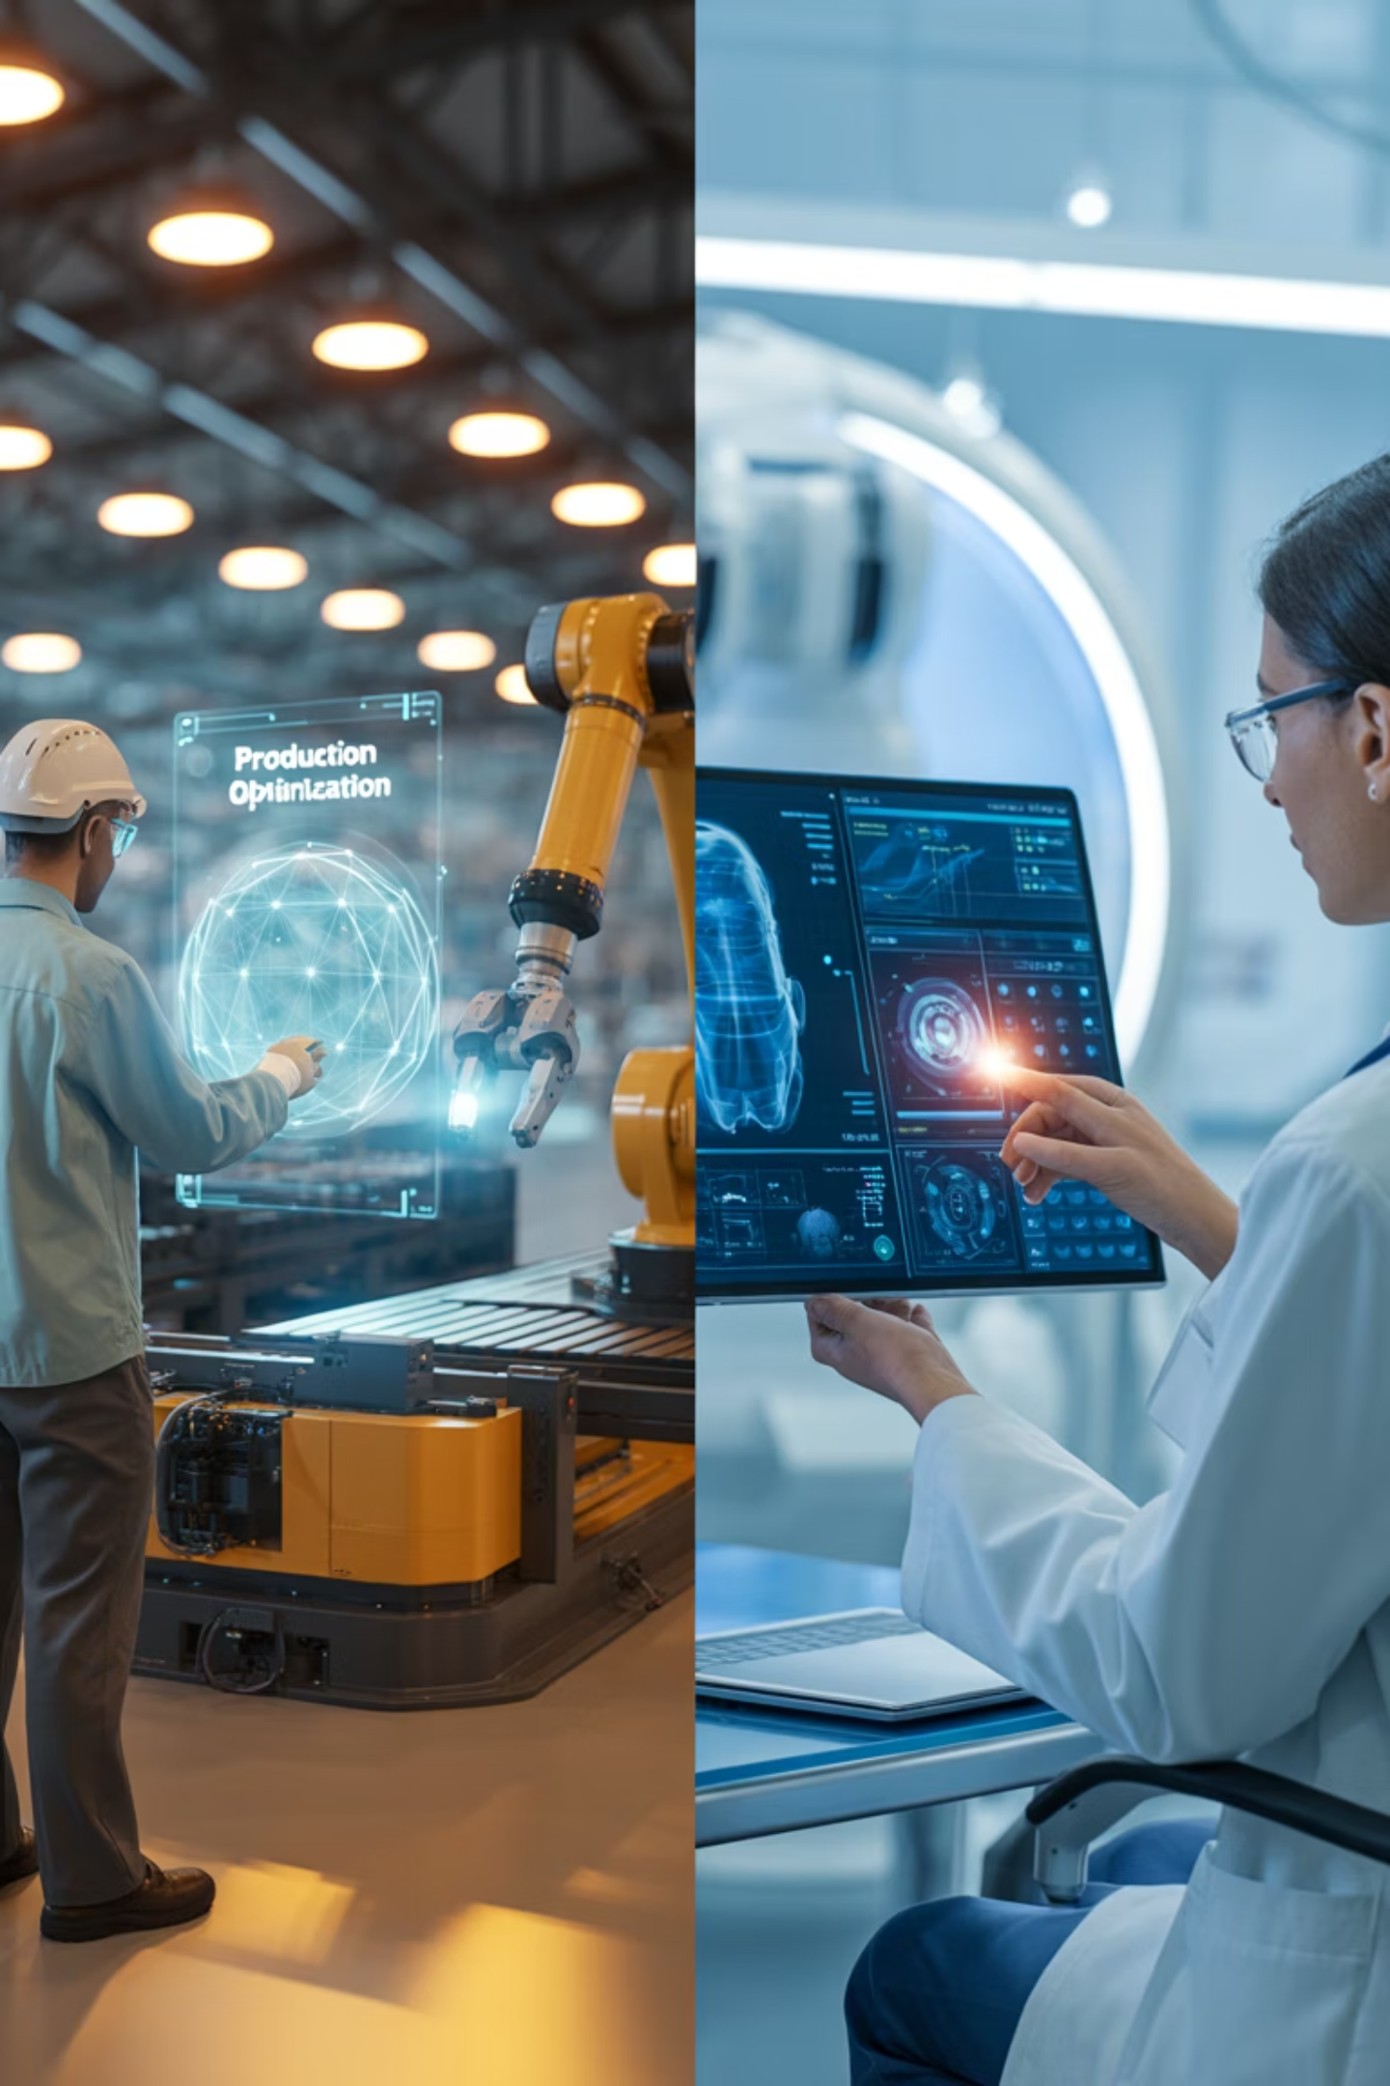
Adaptive Leadership in Action: Case Studies
Manufacturing Transformation
Healthcare Innovation
A global manufacturing firm implemented AI-powered predictive maintenance while:
A regional hospital network deployed AI for diagnostic assistance by:
Framing AI as "intelligence augmentation" rather than replacement
Involving maintenance technicians in AI training and validation
Creating new "AI Reliability Specialist" roles for experienced staff
Creating physician-led governance committees for AI implementation
Establishing clear boundaries between AI recommendations and human decisions
Developing transparent override protocols for AI recommendations
Result: 27% reduction in downtime with 92% employee satisfaction during transition.
Result: 18% improvement in diagnostic accuracy with increased physician adoption rates.

Slide 9
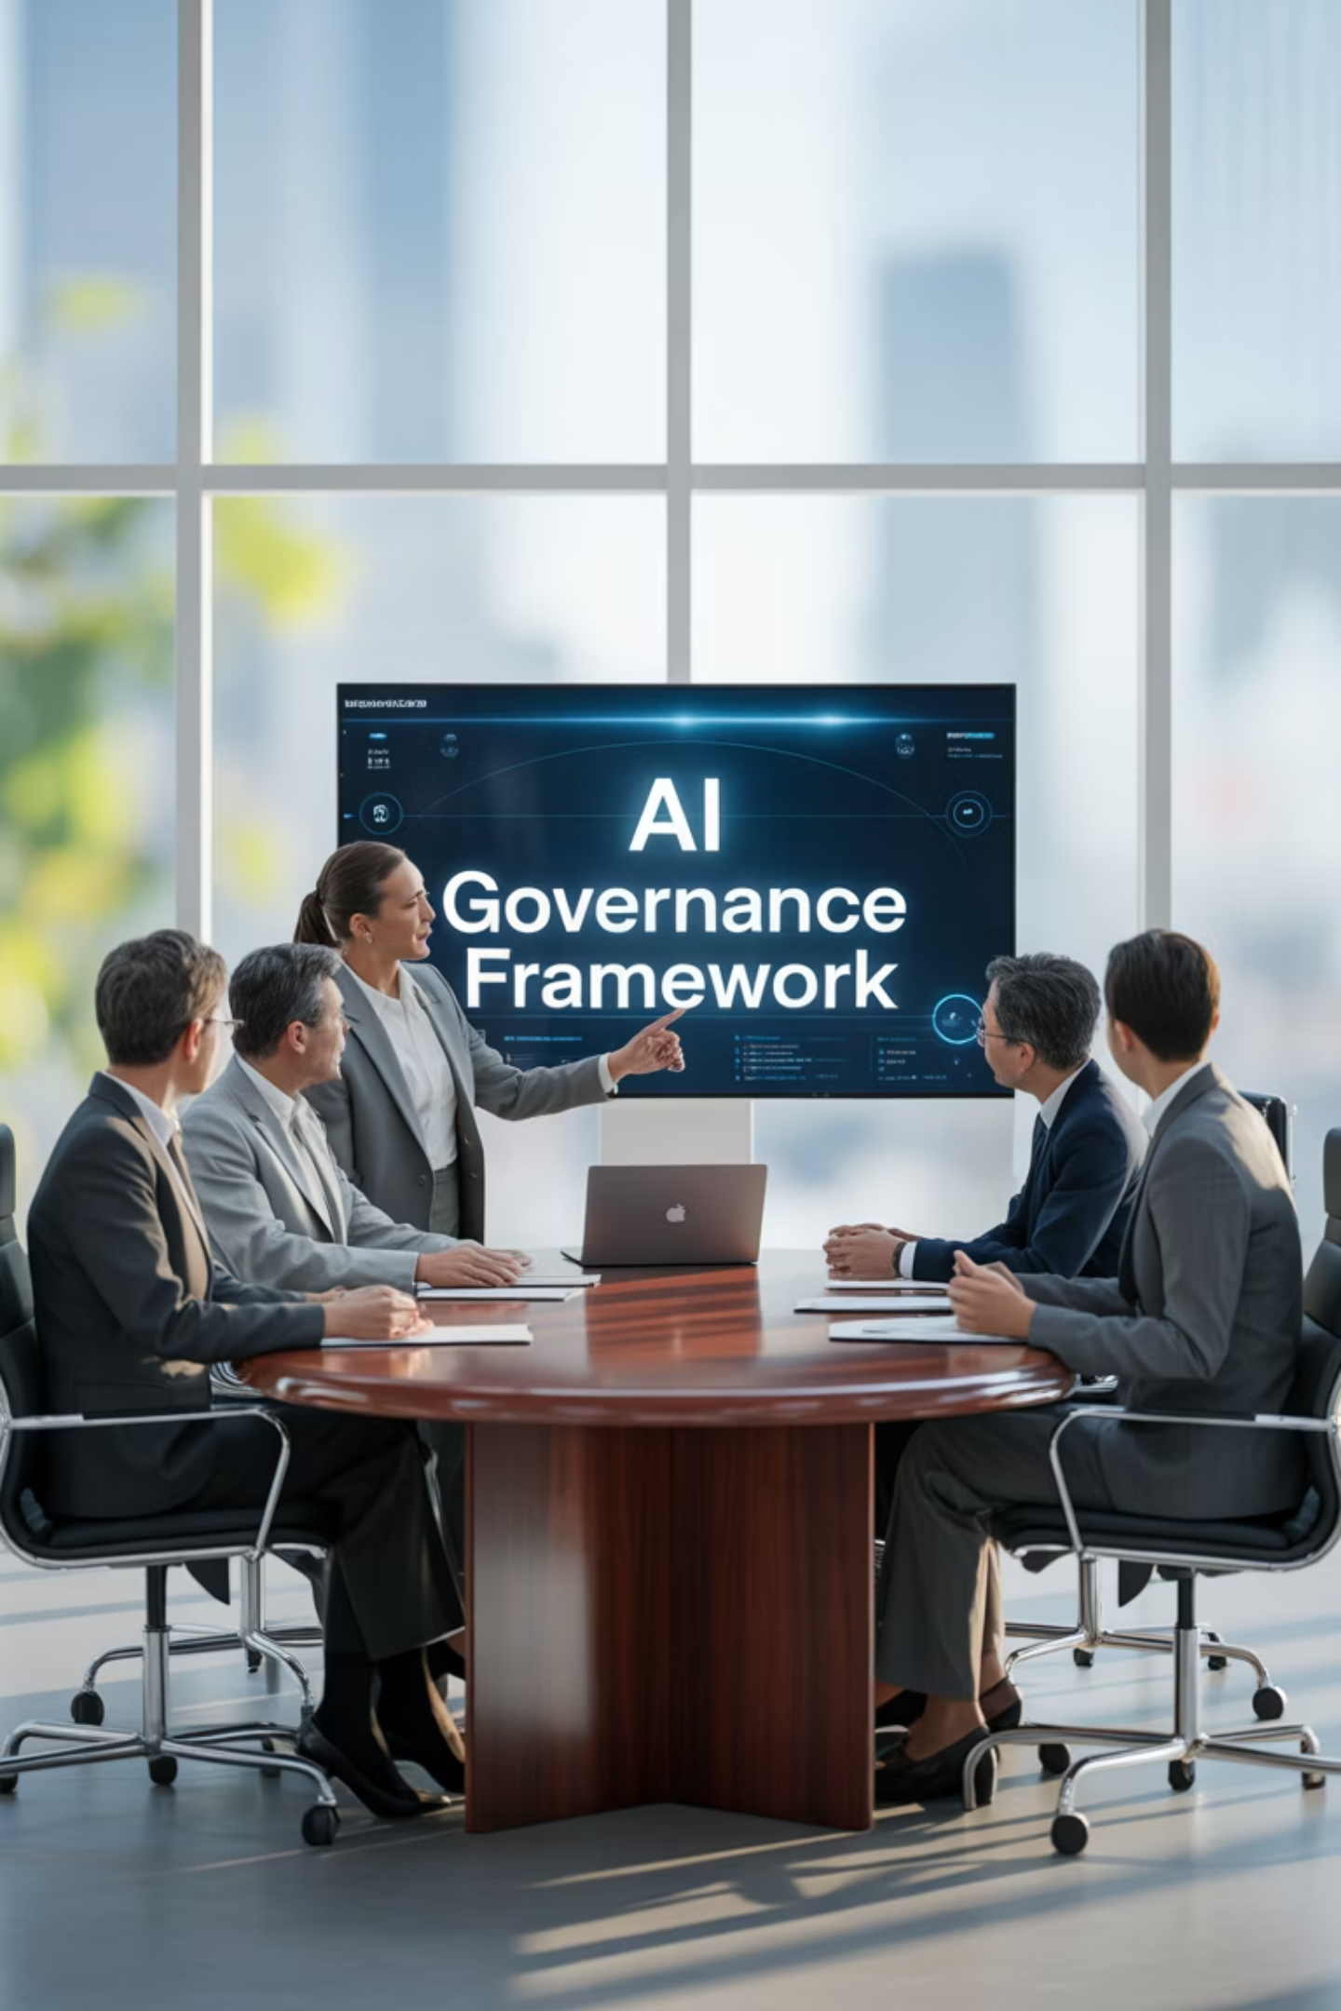



Navigating Complexity with Agile Governance
Speed
AI accelerates decision-making and implementation timelines, requiring faster response cycles from project teams.
Governance
Increased speed introduces new risks—from biased algorithms to data privacy concerns—that demand thoughtful oversight.
Balance
Adaptive leaders create frameworks that enable rapid innovation while ensuring responsible implementation and ethical considerations.
The challenge isn't choosing between agility and governance—it's designing systems that deliver both. This requires new approaches to project management that emphasize continuous monitoring, transparent decision-making, and clear accountability.

Slide 10
The Agile Governance Framework
Principles-Based Approach
Distributed Responsibility
Continuous Assessment
Replace rigid rules with clear ethical principles and decision frameworks that teams can apply in real-time as AI implementation evolves.
Empower cross-functional teams with authority while maintaining centralized visibility through digital dashboards and regular governance reviews.
Move beyond point-in-time approvals to ongoing monitoring of AI systems' impacts on both business performance and workforce wellbeing.
Focus on outcomes, not procedures
Assign dedicated ethics champions
Monitor for algorithmic drift and bias
Establish clear red lines and boundaries
Create rapid response protocols for issues
Track employee experience metrics
Conduct regular ethical impact assessments
Document decision rationales, not just decisions
Implement "see something, say something" culture
Your governance model must evolve as quickly as the technology it oversees. Static approaches create either excessive risk or paralyzing bureaucracy.

Slide 11

Building Resilient Teams for an AI-Driven Future
Resilient teams in the AI era share common characteristics that adaptive leaders deliberately cultivate:
Psychological safety to voice concerns about AI changes without fear
Growth mindset that views AI as an opportunity to develop new capabilities
Collaborative problem-solving that brings together technical and domain expertise
Learning agility to rapidly acquire new skills as technology evolves
Comfort with ambiguity in roles and responsibilities during transition periods
Research shows that teams with these characteristics are 320% more likely to successfully implement AI initiatives compared to those focused solely on technical aspects.

Slide 12
Strategic Approaches to Team Development
Assessment
1
Map current capabilities against future needs to identify skill gaps and potential transition paths for team members. Use data to personalize development plans.
2
Transparent Communication
Share the vision for how AI will transform work, being honest about challenges while emphasizing new opportunities. Address fears directly rather than dismissing them.
Experiential Learning
3
Create low-risk opportunities to experiment with AI tools through sandboxes, pilot projects, and innovation challenges that build familiarity and confidence.
4
Skills Development
Invest in both technical AI literacy and human-centric skills like critical thinking, creativity, and ethical reasoning that will remain valuable as AI advances.
Recognition & Reinforcement
5
Celebrate early adopters, learning efforts, and successful human-AI collaborations to reinforce the behaviors that drive successful transformation.
The most effective leaders recognize that technology adoption is fundamentally a human change process, not just a technical implementation.

Slide 13

The Call to Lead Differently
"The greatest danger in times of turbulence is not the turbulence itself, but acting with yesterday's logic."
— Peter Drucker
Leading in the age of AI requires project managers and executives to develop new mindsets and capabilities. Those who can balance technological possibilities with human realities will not only deliver successful projects but cultivate workforces prepared to thrive in the rapidly evolving future of work.

Slide 14
Your Next Steps: Adaptive Leadership in Action
1
Assess Your AI Readiness
2
Develop Your Adaptive Toolkit
Conduct an honest evaluation of your team's current AI literacy, emotional readiness for change, and the potential impact of AI on your project portfolio.
Create a personalized learning plan to strengthen your capabilities in both technical AI understanding and human-centered leadership approaches.
3
Prototype a Governance Framework
4
Build Community
Design and test a minimum viable governance model that enables innovation while addressing ethical considerations for your specific context.
Connect with other leaders navigating similar challenges to share learnings, resources, and support through professional networks and communities of practice.
The future belongs to those who prepare for it today. Start your adaptive leadership journey with one concrete action this week.
Contact us: leadership@adaptiveai.org | www.adaptiveleadership.com

