Slide 1
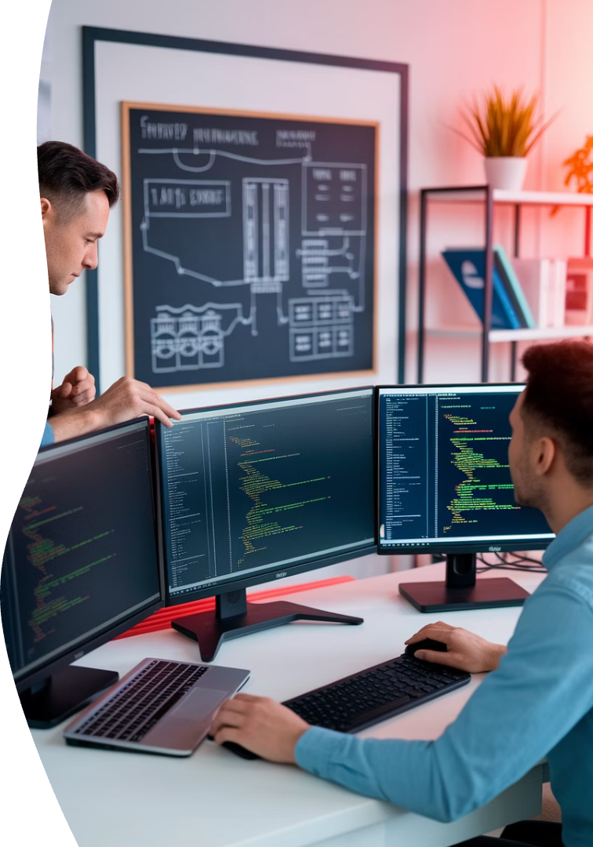
Infrastructure vs. Software Development Project Management
In the world of IT, not all project management approaches are created equal. Let's explore the key differences between infrastructure and software development projects.
kW
by Kimberly Wiethoff

Slide 2

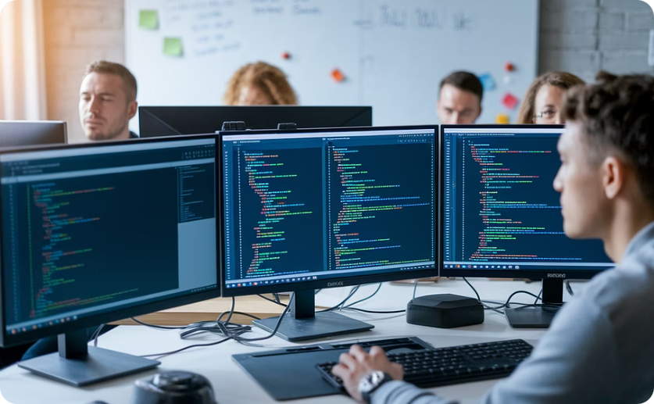
Understanding IT Project Types
Infrastructure Projects
Software Development Projects
Focus on hardware, networks, and systems integration.
Center on building or enhancing applications.
Build the foundation that supports business operations.
Create solutions for users and businesses.
Emphasize stability and security.
Prioritize functionality and user experience.

Slide 3





Infrastructure Project Scope
Server Setup & Configuration
Network Security Implementation
Physical and virtual server deployment with precise specifications.
Firewalls, VPNs, and security measures to protect organizational assets.
Cloud Resource Provisioning
System Integration
AWS, Azure, or GCP environments configured for optimal performance.
Connecting disparate systems to work seamlessly together.

Slide 4

Software Development Project Scope
Requirement Gathering
Collecting user stories and defining functional specifications.
Iterative Development
Building features in sprints with regular feedback loops.
Testing & Quality Assurance
Ensuring code works correctly through unit and integration tests.
Deployment & User Feedback
Releasing code and gathering real-world usage insights.

Slide 5
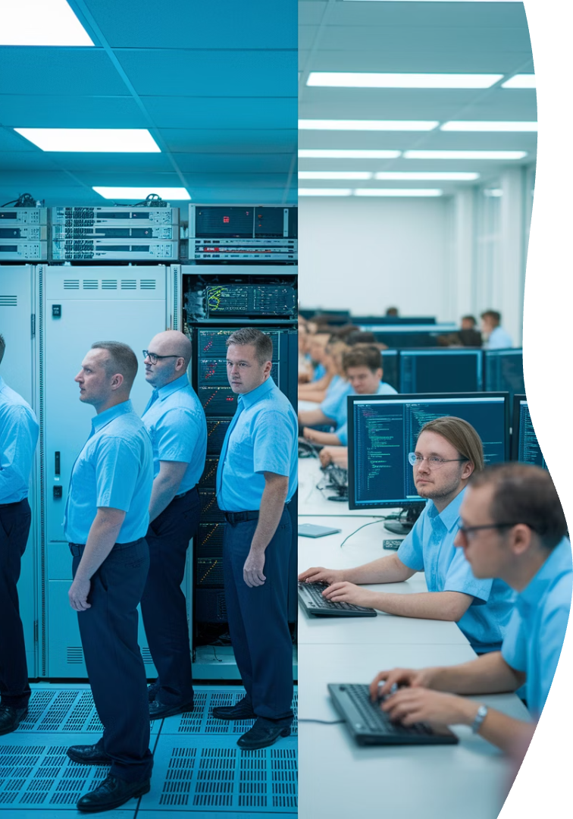
Team Composition Differences
Infrastructure Teams
Software Development Teams
System administrators
Network engineers
Frontend/backend developers
Cybersecurity experts
UX/UI designers
Cloud architects
QA testers
Database administrators
Product managers
Scrum masters
Shared Roles
Project managers
Business analysts
Technical writers
Executive sponsors
End-user representatives

Slide 6








Methodological Approaches
Traditional/Waterfall
Agile/Scrum
Often used in infrastructure for linear, sequential progress.
Preferred in software for iterative development and adaptation.
DevOps
ITIL Framework
Bridges both worlds, emphasizing automation and collaboration.
Common in infrastructure for standardized service management.

Slide 7




Risk Profile Comparison
Infrastructure Risk
High operational impact, affects entire organization
Mitigation Strategy
Careful change control, redundancy, and testing
Software Risk
Feature-specific impact, easier rollbacks
Mitigation Strategy
Version control, feature flags, and CI/CD pipelines

Slide 8

Success Metrics
Infrastructure Projects
Software Development Projects
System uptime (99.9%+)
Feature completion rate
Performance benchmarks
Code quality metrics
Security compliance
User adoption rates
Service continuity
Sprint velocity
Capacity utilization
Bug resolution time

Slide 9
Key Differences at a Glance:
Aspect
Infrastructure PM
Software Development PM
Focus
Physical/virtual systems, environments
Application features, code functionality
Methodologies
Waterfall, ITIL, hybrid
Agile, Scrum, Kanban
Team Roles
Network/Cloud Engineers, Security Analysts
Developers, QA, Designers, Product Owners
Change Management
Formal CRs, scheduled maintenance windows
Agile sprints, version control, hotfixes
Tools
ServiceNow, CMDB, monitoring dashboards
Jira, GitHub, CI/CD tools
Risk Profile
High operational risk
Lower, with faster iteration cycles

Slide 10




Project Dependencies
Infrastructure Dependencies
Hardware delivery timelines
Vendor support schedules
Change control board approvals
Software Dependencies
Developer resource availability
API integration readiness
Design approval workflows
Shared Dependencies
Budget approval cycles
Stakeholder sign-offs
Compliance requirements

Slide 11
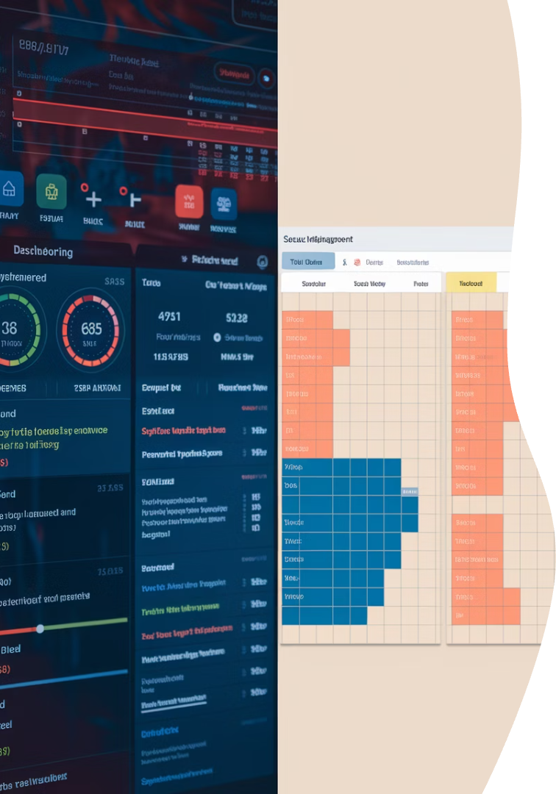



Tools of the Trade
Infrastructure Tools
Development Tools
Shared Tools
Microsoft Project
ServiceNow
Jira
Confluence
CMDB systems
GitHub/GitLab
Slack/Teams
Monitoring dashboards
CI/CD pipelines
Reporting dashboards
Testing frameworks
Network mapping tools

Slide 12







Change Management Approaches
Infrastructure Changes
Stakeholder Communication
Formal change requests with detailed documentation.
Advanced notifications of system downtime.
Scheduled maintenance windows, often during off-hours.
Detailed impact assessments for business units.
Software Changes
User Notification
Sprint-based releases with regular cadence.
In-app announcements for new features.
3
Training materials for significant changes.
Feature toggles to control deployment impact.

Slide 13

Budget Considerations
Hardware
Software Licenses
Staff Resources
Cloud Services
Training
Infrastructure projects often have higher upfront capital expenses. Software development typically involves more ongoing operational costs for maintenance and enhancements.

Slide 14










PM Skills Comparison
Strategic Vision
Understanding how projects align with business goals
Team Leadership
Managing diverse technical specialists effectively
Stakeholder Communication
Translating technical concepts to business value
Risk Management
Identifying and mitigating potential issues
Domain Knowledge
Understanding technical specifics of the project area

Slide 15

Key Takeaways
2
4+
Project Types
Methodologies
Infrastructure focuses on operational stability while software emphasizes user value.
From traditional waterfall to agile approaches, each has its place.
5
1
Critical Skills
Adaptability
Project managers need both technical understanding and business acumen.
The most valuable PMs can bridge both infrastructure and software worlds.

Slide 16



Final Thoughts
Project managers in both domains require similar core skills but with different emphasis based on their area of focus:
Infrastructure Project Managers
Software Project Managers
Cross-Trained Project Managers
Prioritize product value, feature delivery, and user experience, driving innovation while meeting business requirements.
Focus on operational stability and system integrity, ensuring reliable technical foundations and minimal disruptions.
Professionals who understand both domains become invaluable assets in today's hybrid tech environments.

