Slide 1

Mastering Workday Finance: A Guide for Project Managers
Workday Finance is a powerful cloud-based solution that transforms how businesses manage their financial operations. This presentation explores the essential knowledge, skills, and strategies needed for project managers overseeing Workday Finance implementations. It's a journey through the technical, financial, and organizational complexities of a successful deployment, highlighting best practices and navigating common challenges.
kW
by Kimberly Wiethoff

Slide 2
Understanding the Workday Finance Ecosystem
General Ledger (GL)
Accounts Payable (AP) & Accounts Receivable (AR)
Procurement
Financial Planning & Analytics (FP&A)
Real-time financial reporting, multi-ledger capabilities, and seamless integration with other Workday modules.
Supplier management, purchase orders, and expense tracking, enhancing efficiency and control over procurement processes.
Budgeting, forecasting, and analytics using Workday Adaptive Planning, providing insights for informed decision-making.
Automated invoicing, payments, and collections, streamlining the entire procure-to-pay and order-to-cash processes.

Slide 3




The Project Manager's Role in Workday Finance
Planning & Governance
Stakeholder Management
Change Management
Define scope, budget, timeline, and risk mitigation strategies for a smooth and successful implementation.
Work with finance leaders, IT, and Workday consultants to align business requirements and ensure everyone is on the same page.
Drive process optimization and train end-users on new workflows to maximize adoption and minimize resistance.

Slide 4
The Workday Finance Implementation Journey
Plan
1
Define objectives, governance structure, and project roadmap to lay the foundation for a successful implementation.
2
Architect & Configure
Workday consultants configure the system based on business needs, ensuring it aligns with organizational goals and processes.
Test
3
Perform unit testing, integration testing, and User Acceptance Testing (UAT) with finance users to validate the system's functionality and accuracy.
4
Deploy
Go live with a structured rollout strategy and contingency plans to ensure a smooth transition to Workday Finance.
Optimize
5
Provide post-go-live support and continuous process improvements to maximize the value of the Workday Finance investment.

Slide 5
Skills Every Workday Finance PM Needs
Experience with Agile and Waterfall methodologies, ensuring flexibility and rigor throughout the project lifecycle.
Understanding of accounting principles, financial reporting, and ERP systems, enabling effective communication with finance stakeholders.
Experience managing ERP implementations, specifically with Workday or similar systems, providing valuable insights into best practices and potential challenges.
Ability to collaborate with finance teams, IT, and Workday consultants, fostering strong relationships and efficient communication.
Ensuring data integrity and seamless integration with third-party applications to maintain data accuracy and system efficiency.
Addressing potential disruptions and ensuring smooth adoption, mitigating risks and facilitating change management.

Slide 6
Navigating Data Migration Complexities
Data Cleansing
Data Transformation
Data Validation
Identify and correct errors in legacy data to ensure a clean and reliable foundation for Workday Finance.
Transform data into Workday-compatible formats, mapping fields and ensuring consistency across different systems.
Validate the migrated data to ensure accuracy and completeness, minimizing errors and potential disruptions.

Slide 7

Addressing Stakeholder Resistance
Communication
Training
Clearly communicate the benefits of Workday Finance, highlighting its value for improved efficiency, reporting, and decision-making.
Provide comprehensive training on Workday Finance functionalities, addressing user concerns and building confidence in the new system.
Demonstrations
Showcase real-world examples of how Workday Finance can solve specific business challenges, demonstrating its tangible value.

Slide 8
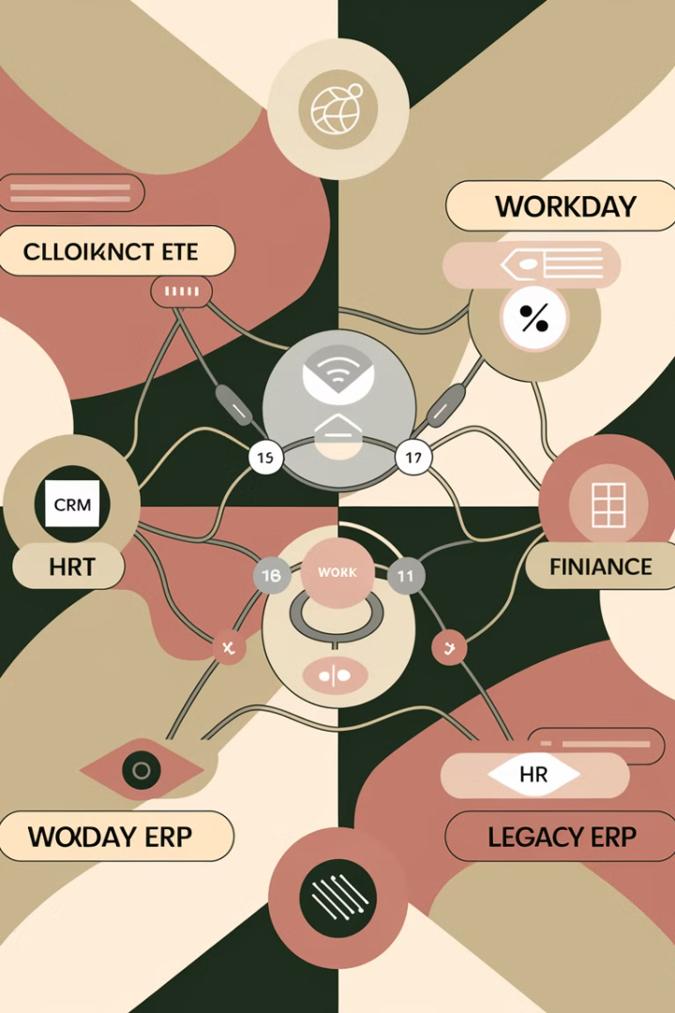



Overcoming Integration Challenges
Collaboration
Work closely with IT and Workday consultants to troubleshoot connectivity problems, ensuring seamless data flow between systems.
Testing
Perform integration testing to validate data transfer and system interactions, ensuring a smooth and error-free transition.
Documentation
Document integration details, including data mapping, transformation rules, and error handling procedures, ensuring clarity and consistency.

Slide 9

Balancing Customization & Out-of-the-Box Functionality
Understand Core Functionality
Leverage Workday's out-of-the-box functionalities as much as possible, minimizing customizations and ensuring compatibility with future updates.
Identify Essential Needs
Identify the specific business requirements that cannot be met by standard functionality, focusing on customization where necessary.
Minimize Scope Creep
Establish clear boundaries for customizations, preventing scope creep and ensuring the project remains on track.
Workday Expertise
Consult with Workday experts to identify the most effective ways to achieve customizations while minimizing impact on the core system.

Slide 10




Ensuring Regulatory Compliance
Industry Standards
1
Ensure financial reporting aligns with relevant industry standards such as IFRS or GAAP, demonstrating accuracy and consistency.
Local Regulations
2
Comply with local regulations and tax laws, avoiding legal complications and ensuring data privacy and security.
Internal Controls
3
Implement strong internal controls to ensure data accuracy and prevent fraud, promoting financial integrity and transparency.
Auditing
4
Prepare for audits by ensuring clear documentation, auditable processes, and a system that meets regulatory requirements.

Slide 11
Workday Finance Implementation: A Successful Approach
Clear Objectives
Strong Leadership
Effective Communication
Proactive Risk Management
Define specific, measurable, achievable, relevant, and time-bound project objectives to guide the implementation process.
Establish strong leadership for the project, ensuring clear communication, decision-making, and accountability across teams.
Foster open and transparent communication between stakeholders, ensuring everyone is informed and involved in the process.
Identify and mitigate potential risks throughout the project lifecycle, proactively addressing challenges and ensuring a smooth transition.

Slide 12

Leveraging Workday Finance for Business Success
20%
15%
Improved Efficiency
Enhanced Reporting
Streamline financial processes and eliminate manual tasks, freeing up time and resources for strategic initiatives.
Generate real-time financial reports and dashboards, providing timely and accurate insights for informed decision-making.
10%
Increased Visibility
Gain comprehensive visibility into financial data, enabling better forecasting, budgeting, and performance monitoring.

Slide 13
Building a Solid Foundation for Future Growth
Continuous Improvement
1
Embrace continuous process improvement, leveraging Workday Finance's capabilities to optimize financial processes and enhance efficiency.
Data Analytics
2
Leverage data analytics to uncover insights, identify trends, and make data-driven decisions for improved financial performance.
Strategic Partnerships
3
Build strong partnerships with Workday and other technology vendors to access the latest innovations and ensure future growth.

Slide 14



Embrace the Workday Finance Transformation

Slide 15

Next Steps: Elevate Your Workday Finance Expertise
To maximize your success as a Workday Finance project manager, consider pursuing additional training, certifications, and networking opportunities. Build a strong network of colleagues and professionals, share experiences, and learn from each other's expertise.

