Slide 1
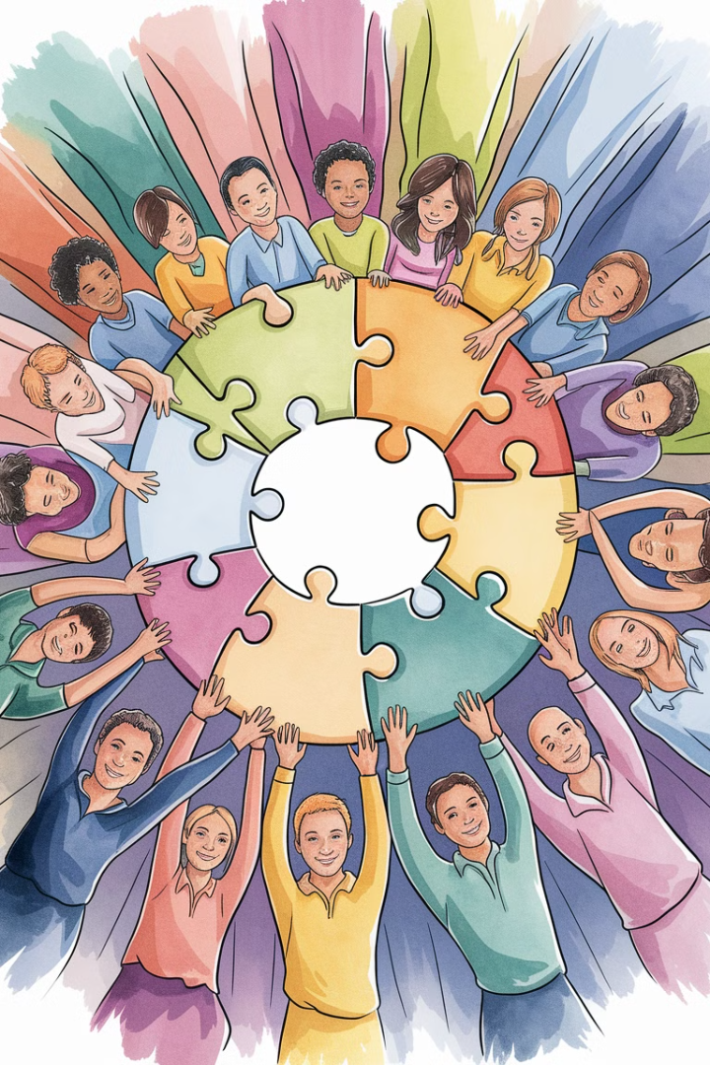
Team Building, Collaboration, and Managing Stress in Project Teams
This presentation explores a structured approach to building cohesive, collaborative, and resilient project teams. We'll delve into practical strategies for team-building, fostering a culture of open communication, and managing stress effectively to unlock your team's full potential.
kW
by Kimberly Wiethoff

Slide 2
Team-Building: Fostering Connection and Alignment
Define Shared Goals and Values
Strengths-Based Collaboration
Start by clarifying the team's purpose and aligning on shared goals, ensuring everyone understands the "why" behind the project. A dedicated kick-off meeting provides an opportunity for each team member to share their role and how they contribute to overall goals, fostering a sense of collective purpose.
Identify and leverage individual team strengths through personality assessments or informal skill-sharing sessions. This promotes appreciation for each team member's unique contributions and encourages cross-functional support, leading to more efficient and effective teamwork.

Slide 3

Strengthening Bonds: Engaging in Regular Team-Building Activities
Integrate activities that foster connections, whether virtual or in-person, like brainstorming sessions, problem-solving exercises, or even casual social activities (e.g., coffee chats, lunch-and-learns).
These activities help establish rapport, trust, and a supportive atmosphere, laying the foundation for effective collaboration and a positive team dynamic.

Slide 4
Promoting a Collaborative Culture: Open Communication and Cross-Functional Collaboration
Encourage Open Communication
Cross-Functional Collaboration
Create a safe environment where team members feel comfortable sharing ideas, asking questions, and voicing concerns. Regular check-ins and an "open-door policy" foster transparency and encourage communication, building trust and a sense of psychological safety within the team.
Break down silos by encouraging collaboration between departments or functions on shared tasks. Regular cross-functional meetings or rotating team members to work on different project areas can enhance understanding and build stronger bonds, leading to more effective and holistic solutions.

Slide 5

Empowerment and Recognition: Key Drivers of Collaboration
Empower Team Decision-Making
Recognition and Appreciation
Allow team members to make decisions within their areas, fostering a sense of ownership and responsibility. When they feel empowered, team members are more likely to actively engage, contribute ideas, and work collaboratively to solve challenges.
Recognize collaborative efforts and individual achievements regularly. This could be as simple as acknowledging a team member's contribution during meetings or through a shout-out in team communication channels. Recognition cultivates motivation and reinforces a collaborative spirit, fostering a positive and appreciative team environment.

Slide 6
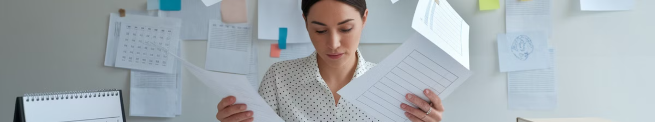


Managing Stress: Setting Clear Expectations and Prioritizing Workflows
Reduce ambiguity by setting clear roles, timelines, and priorities. Using tools like JIRA, Asana, or Microsoft Teams to organize tasks helps prevent overload and allows everyone to understand their responsibilities and deadlines.
Respect work hours and encourage team members to set boundaries. Set an example by managing your time well and respecting breaks and personal time. Offering flexible scheduling when possible can significantly reduce stress and promote a healthy work-life balance.

Slide 7

Supporting Team Well-being: Regular Check-Ins and Resources
1
Conduct one-on-one meetings to provide support and check in on each team member's workload and well-being.
2
Use these sessions to understand any challenges they're facing and offer resources or adjust workloads as needed. This proactive approach demonstrates care and fosters trust.

Slide 8



Building Resilience and Self-Care: Empowering Team Members
Offer resources or workshops on stress management and resilience. Encourage practices such as mindfulness and regular breaks to help team members recharge and maintain a healthy work-life balance.
Consider providing mental health support through Employee Assistance Programs or relevant wellness resources. These initiatives demonstrate commitment to team well-being.

Slide 9


Creating a Culture of Feedback and Adaptability
Refine Processes
Seek Feedback
This feedback helps refine processes and gives the team a sense of control over their work environment, reducing stress and fostering adaptability.
1
Actively seek feedback from the team on what's working well and where adjustments are needed.
2

Slide 10





Key Takeaways: Building High-Performing Project Teams
1
Open Communication
2
Shared Goals
3
Strengths-Based Collaboration
4
Team-Building Activities
5
Empowerment

Slide 11
Final Thoughts: Cultivating a Thriving Team Culture
1
Prioritize Well-being
2
Foster Open Dialogue
3
Embrace Adaptability

Slide 12

Next Steps: Embracing Continuous Improvement
Building strong, collaborative teams and managing stress effectively are ongoing processes. Remember, a team that feels supported and valued is not only more productive but also more resilient in the face of adversity. As you refine your approach to team-building and stress management, consider how small changes in your leadership style can create a ripple effect, transforming your team dynamics and driving long-term success. Stay agile, stay empathetic, and continue to prioritize your team's well-being as the cornerstone of every project.

