Slide 1
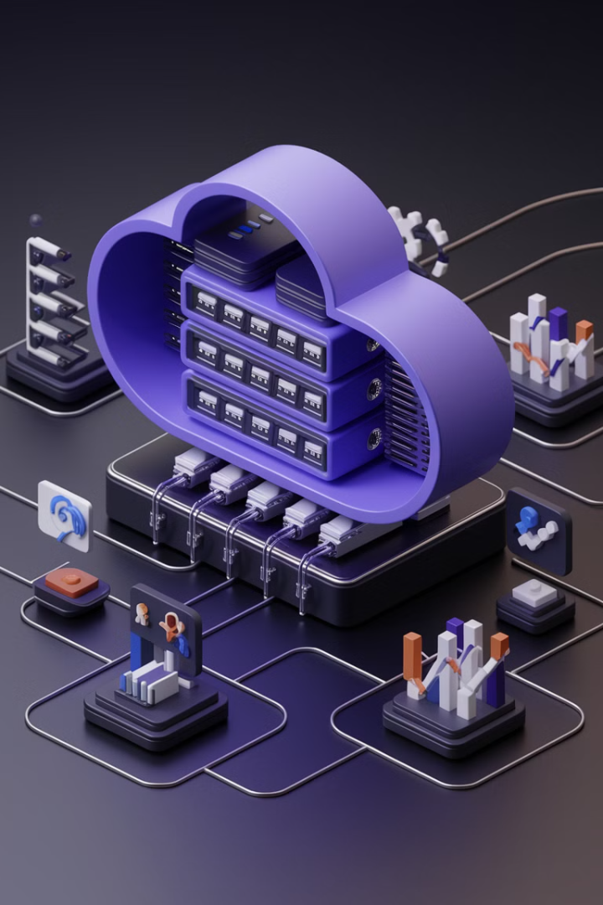
Understanding NetSuite Modules: A Comprehensive Guide
NetSuite is a cloud-based Enterprise Resource Planning (ERP) solution that helps businesses integrate and automate their operations. Its modular architecture allows companies to select and configure features that best suit their business needs. Whether you're in finance, retail, manufacturing, professional services, or supply chain management, NetSuite offers specialized modules to streamline operations.
In this guide, we'll explore the core NetSuite modules, their functionalities, and how they help businesses achieve operational efficiency.
kW
by Kimberly Wiethoff

Slide 2
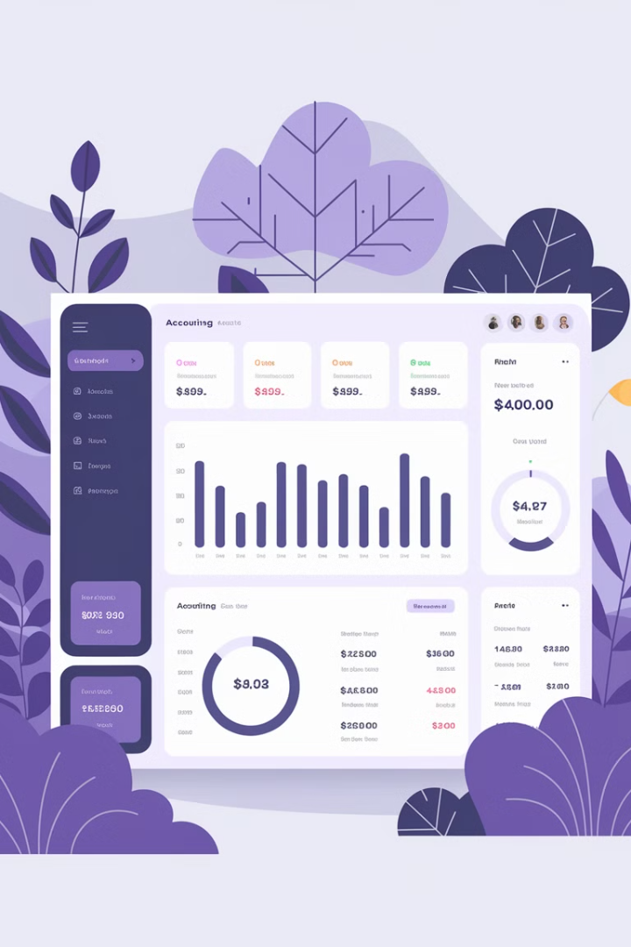
NetSuite Financial Management Modules
NetSuite Accounting
Financial Planning & Budgeting
Automates general ledger, accounts payable (AP), and accounts receivable (AR). Supports multi-currency, multi-entity, and multi-subsidiary accounting. Ensures compliance with tax regulations (GAAP, IFRS, ASC 606).
Enables real-time forecasting, financial modeling, and variance analysis. Automates budget creation and approval workflows. Seamlessly integrates with Excel and business intelligence tools.
Revenue Recognition
Manages complex revenue streams for subscription-based businesses. Ensures compliance with ASC 606 and IFRS 15 revenue standards. Automates deferred revenue schedules and reporting.

Slide 3
NetSuite Billing & Subscription Management
SaaS Businesses
Finance Sector
Subscription-Based
Ideal for software-as-a-service companies, supporting recurring billing models and usage-based pricing.
Tailored for financial services, ensuring accurate invoicing and revenue tracking for complex financial products.
Supports contract renewals, flexible pricing models, and seamless invoicing for subscription businesses.
NetSuite's Billing & Subscription Management module is designed to handle the complexities of modern business models, ensuring efficient revenue management and customer satisfaction.

Slide 4
NetSuite Supply Chain & Inventory Management Modules
Inventory Management
1
Tracks real-time inventory levels, demand planning, and stock movements. Automates replenishment strategies to reduce overstock or stockouts. Supports multi-location inventory tracking and serial/lot tracking.
2
Warehouse Management System (WMS)
Optimizes warehouse workflows for picking, packing, and shipping. Uses barcode scanning & mobile access for inventory accuracy. Integrates with fulfillment centers and third-party logistics (3PLs).
Procurement
3
Automates purchase orders (POs) and vendor management. Provides real-time cost and supplier performance tracking. Streamlines approval workflows for faster procurement cycles.
4
Demand Planning
Uses historical data and AI-driven insights to forecast demand. Ensures optimized inventory levels based on sales trends. Helps supply chain teams reduce waste and improve cash flow.

Slide 5
NetSuite Customer Relationship Management (CRM) Modules
Marketing Automation
2
Manages email campaigns, lead scoring, and customer segmentation.
NetSuite CRM
1
Provides a 360-degree view of customer interactions across marketing, sales, and support.
Customer Service Management
3
Helps support teams track customer issues and case resolution.
NetSuite's CRM modules work together to create a seamless customer experience, from initial contact through ongoing support. This integrated approach ensures that all customer-facing teams have access to the same up-to-date information, enabling more personalized and effective interactions.

Slide 6
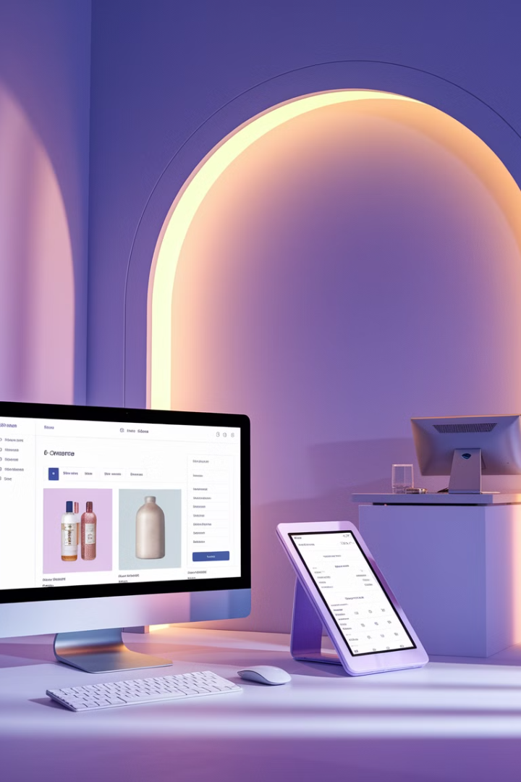
NetSuite E-Commerce & Retail Modules
SuiteCommerce
Allows businesses to run online stores fully integrated with NetSuite ERP. Provides multi-channel sales capabilities (web, mobile, in-store).
Point of Sale (POS)
Unifies in-store and online transactions for omnichannel retail. Supports real-time inventory tracking and loyalty programs.
Order Management System (OMS)
Manages order processing, fulfillment, and returns efficiently. Automates carrier selection and shipment tracking.

Slide 7
NetSuite Human Capital Management (HCM) Modules
NetSuite SuitePeople (HR Management)
NetSuite Payroll
Manages employee records, payroll, and benefits administration. Automates performance management and talent acquisition. Enhances workforce planning with real-time analytics.
Automates payroll processing and tax compliance. Supports direct deposit and payroll reporting. Integrates with accounting for accurate labor cost tracking.

Slide 8
NetSuite Professional Services Automation (PSA) Modules
Project Management
Helps teams plan, track, and execute projects efficiently. Provides Gantt charts, milestone tracking, and task dependencies.
Time & Expense Management
Employees can log billable/non-billable hours and expenses. Integrates with payroll, invoicing, and financial reports.
Project Profitability
Improves project profitability with cost and revenue tracking. Provides real-time visibility into project costs.

Slide 9
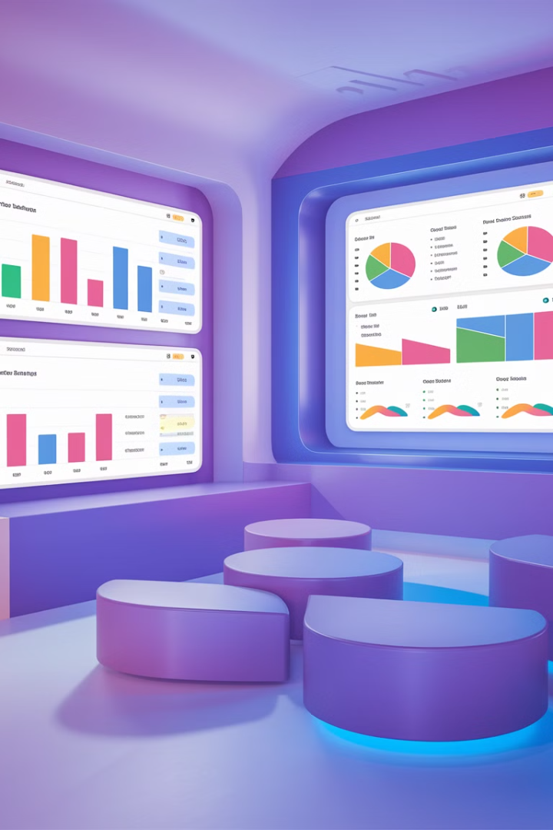
NetSuite Analytics & Business Intelligence Modules
1
NetSuite SuiteAnalytics
Provides custom dashboards, real-time KPIs, and interactive reports. Uses AI-driven insights for trend detection. Enables cross-functional business intelligence reporting.
2
NetSuite Advanced Reporting
Offers custom financial and operational reports. Integrates with Excel, Power BI, and other BI tools. Supports real-time drill-down analytics.

Slide 10
NetSuite Customization & Integration Modules
SuiteCloud Platform
1
Enables custom applications and integrations
Low-Code/No-Code Automation
2
Simplifies business process automation
Third-Party Application Integration
3
Supports integration with popular business tools
API Support
4
Enables secure data exchange
NetSuite's customization and integration capabilities allow businesses to tailor the platform to their specific needs, ensuring seamless operations across all systems and processes.

Slide 11
Benefits of NetSuite's Modular Structure
Flexibility
Integration
Efficiency
Cost Reduction
Select and scale functionalities based on operational needs.
Fully integrated, cloud-based solution across all business functions.
Improve operations through automation and real-time insights.
Eliminate manual processes and data silos.
NetSuite's modular approach allows businesses to create a tailored ERP solution that grows with their needs, ensuring long-term scalability and efficiency.

Slide 12
Industry-Specific NetSuite Solutions
NetSuite offers tailored solutions for various industries, including manufacturing, retail, professional services, wholesale distribution, and software companies. Each industry-specific solution combines relevant modules to address unique business challenges and processes.

Slide 13
Implementation and Support
1
Consultation
Assess business needs and goals
2
Configuration
Set up and customize modules
3
Data Migration
Transfer data from legacy systems
4
Training
Educate staff on new systems
5
Ongoing Support
Provide continuous assistance and updates
Implementing NetSuite involves a structured process to ensure smooth adoption and maximize the benefits of the platform. Ongoing support helps businesses stay up-to-date with new features and best practices.

Slide 14
Future of NetSuite: Emerging Technologies
Artificial Intelligence
Internet of Things (IoT)
Enhanced predictive analytics and automated decision-making
Real-time data collection from connected devices
1
2
Machine Learning
4
3
Blockchain
Advanced pattern recognition and process optimization
Improved security and transparency in transactions
NetSuite continues to evolve, incorporating cutting-edge technologies to provide businesses with even more powerful tools for growth and efficiency. These advancements promise to further streamline operations and provide deeper insights across all business functions.

Slide 15
Conclusion: Choosing the Right NetSuite Modules for Your Business
1
Assess Your Business Needs
Identify key pain points and growth objectives
2
Evaluate Module Functionalities
Match business requirements with module capabilities
3
Consider Scalability
Choose modules that support future growth
4
Seek Expert Guidance
Consult with NetSuite professionals for optimal configuration
By selecting the right modules, companies can improve efficiency through automation and real-time insights, reduce costs by eliminating manual processes and data silos, and scale operations seamlessly as the business grows. NetSuite's comprehensive suite of modules offers a powerful solution for businesses looking to streamline their operations and drive growth in today's competitive landscape.

