Slide 1

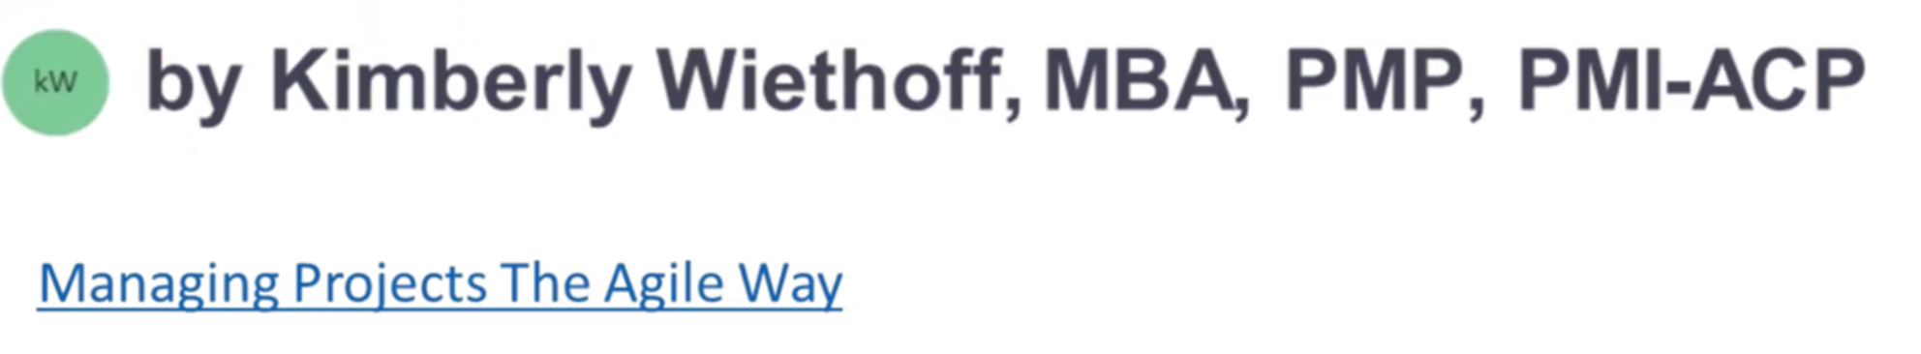
Magic ToDo: Transforming Task Overwhelm into Action
A simple AI-powered tool to break down overwhelming tasks into manageable steps
#Productivity #AIForWork #ProjectManagement #TaskManagement #AgileLeadership #FutureOfWork #AIinBusiness #DigitalTransformation #WorkSmarter #CognitiveLoad #InclusiveWorkplace #AgileTools #PMTools #ContinuousImprovement #ManagingProjectsTheAgileWay

Slide 2

The Problem We All Face
Ever stared at a massive task thinking:
"Where do I even start?"
Whether you're managing projects, organizing sprints, or just planning your day, breaking down complex tasks can be paralyzing.

Slide 3




Introducing Goblin.Tools Magic ToDo
A clever web app designed specifically to turn overwhelming tasks into bite-sized, manageable steps.
AI-Powered
Leverages artificial intelligence to intelligently break down any task into logical steps
Accessibility-Focused
Originally built for neurodivergent users (ADHD, autism) but helpful for everyone
No Installation
Works entirely in your browser - no downloads, signups, or logins required

Slide 4
How Magic ToDo Works
Visit Goblin.Tools
1
Go to https://goblin.tools in any web browser
2
Select Magic ToDo
Click on "Magic ToDo" from the available tools
Enter Your Task
3
Type your overwhelming task into the input box
4
Adjust Difficulty
Slide left for high-level or right for detailed breakdown
Click the Magic Wand
5
Watch as AI transforms your task into actionable subtasks

Slide 5
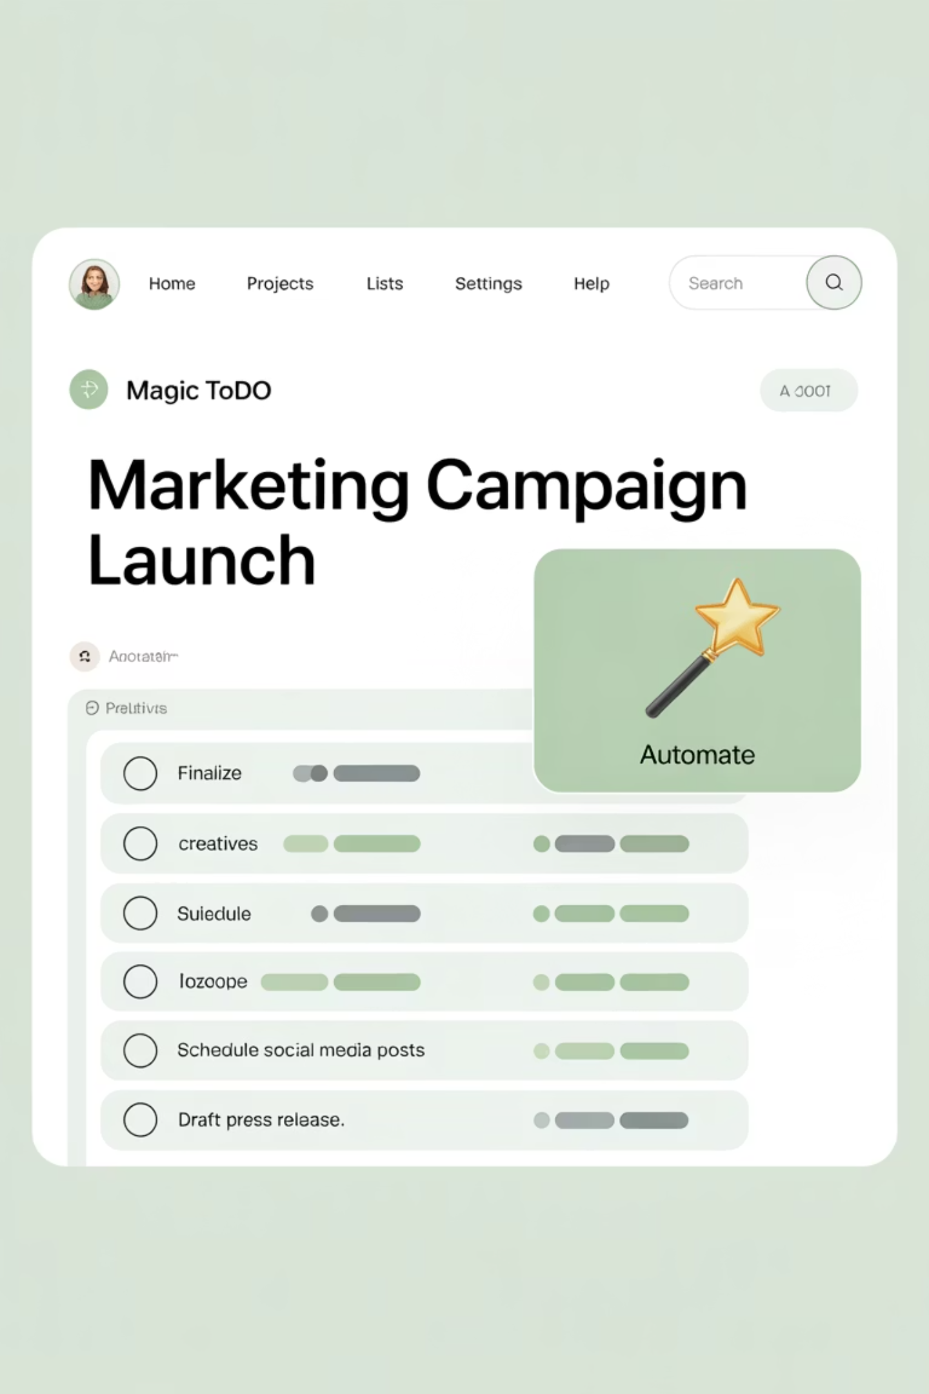
Magic ToDo in Action
Type in your task, adjust the detail level, click the wand (✨) and watch as your overwhelming task transforms into manageable steps you can check off one by one.

Slide 6
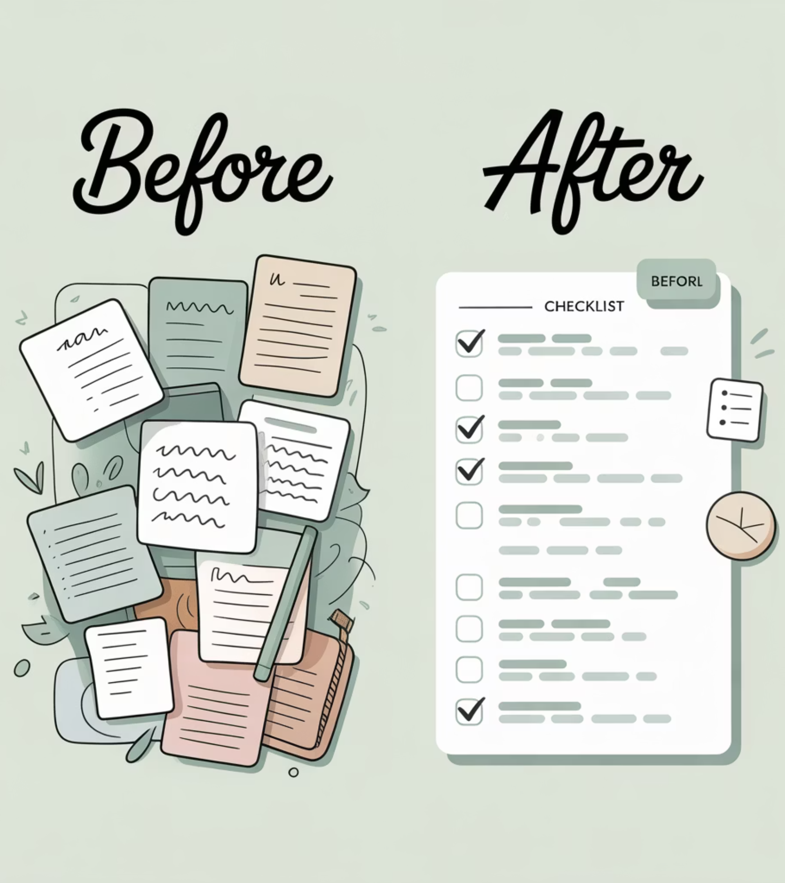
Example: From Chaos to Clarity
Original Task:
"Prepare for sprint planning meeting"
Magic ToDo Breakdown:
Review previous sprint results
Identify team capacity for next sprint
Prioritize backlog items
Create meeting agenda
Prepare visual aids for discussion
Book meeting room and send invites

Slide 7








Why Project Managers Love It
Personal Productivity
Sprint Preparation
Stay focused when managing multiple priorities or administrative work
Break down backlog grooming and planning tasks into actionable steps
Mini-WBS Generator
Team Coaching
Works like a quick Work Breakdown Structure tool when you need a jumpstart
Help team members who struggle with executive function or task overwhelm

Slide 8

Practical Applications
Complex Project Planning
Break down new initiatives into phases and deliverables before formal planning begins
Stakeholder Communication
Quickly generate structured outlines for reports, presentations, and updates
Onboarding Processes
Create detailed checklists for bringing new team members up to speed
Retrospective Planning
Generate discussion points and action items for team improvement sessions

Slide 9

Pro Tips for Maximum Benefit
Export your breakdown to your favorite task manager (Notion, Trello, Jira)
Use it for repetitive tasks to ensure consistency
Try it live during team meetings for collaborative planning
Adjust the difficulty slider based on task complexity and team experience
Customize the generated tasks to match your specific workflow

Slide 10
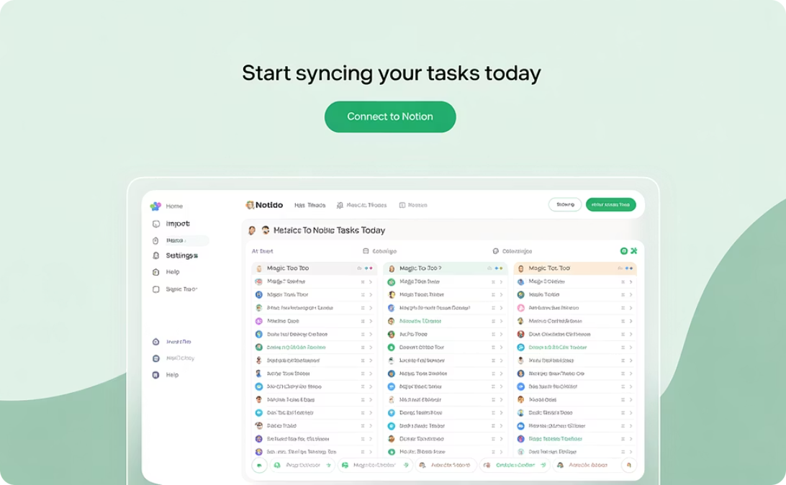
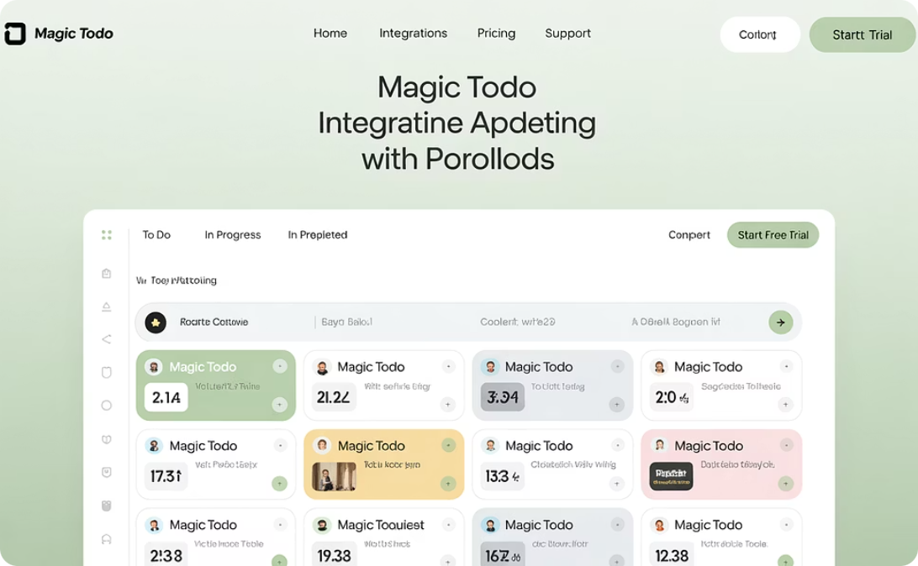
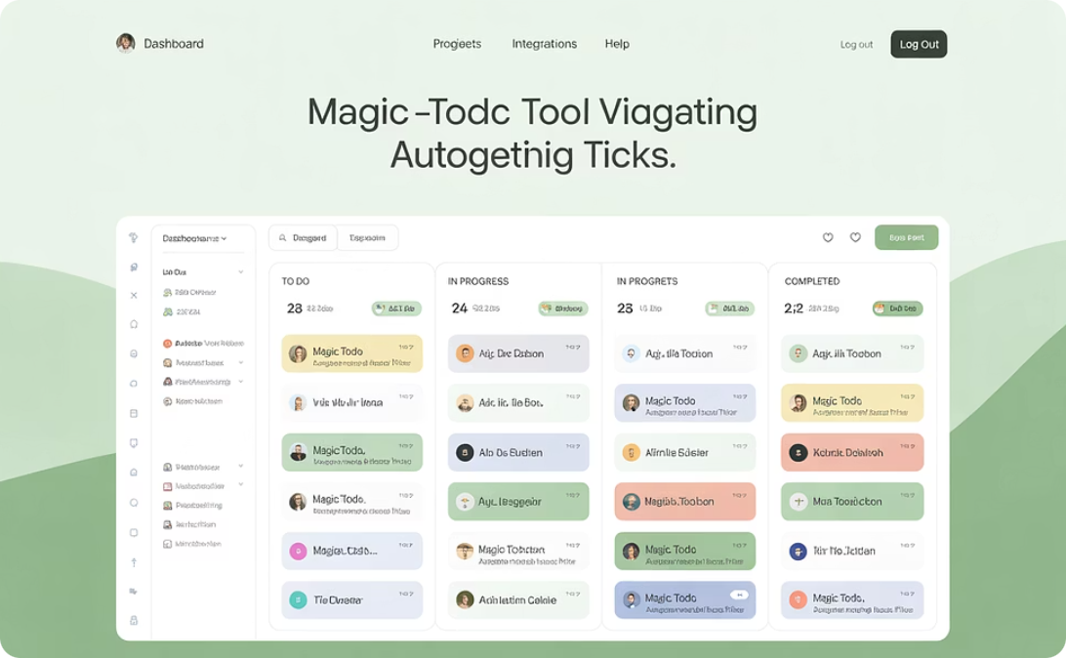
Integration With Your PM Toolkit
Notion
Trello
Jira
Copy tasks directly into your Notion workspace for team collaboration
Transfer breakdowns into Trello cards for visual project management
Convert generated tasks into Jira tickets for agile workflow tracking

Slide 11

Beyond Task Management
The Bigger Picture
Magic ToDo represents a new approach to productivity that works with your brain instead of against it.
For project managers, it's not just about the tool—it's about:
Reducing cognitive load for you and your team
Creating a more inclusive work environment
Supporting different thinking and planning styles
Helping everyone take that crucial first step

Slide 12


Get Started Today
Turn Overwhelm into Action
Visit https://goblin.tools and try Magic ToDo now
No signup required. Completely free.

