Slide 1

Agile Contracts: Enabling Flexibility Between Teams and Clients
In the world of Agile methodologies, traditional contract models often clash with the principles of flexibility, adaptation, and collaboration. When rigid agreements meet dynamic projects, both teams and clients can find themselves trapped in arrangements that hinder rather than help.
This presentation explores how to create contracts that align with Agile values, protecting business interests while enabling the adaptability that makes Agile truly powerful.
kW
by kimberly Wiethoff

Slide 2

The Problem with Traditional Contracts
Overplanning
Scope Defense
Rigid contracts force teams to predict every detail upfront, creating exhaustive specifications that are outdated before development begins.
Teams spend more energy defending against "scope creep" than focusing on delivering actual value to users and stakeholders.
Penalized Adaptation
When change is treated as an exception requiring formal amendments, the agility that drives innovation becomes procedurally burdensome.
Traditional fixed-price, fixed-scope contracts create an adversarial environment where change is the enemy. This fundamentally contradicts Agile's core principle that responding to change creates more value than following a plan.

Slide 3

Time and Materials with Capped Budget
1
Client Pays Only for Work Done
Billing reflects actual effort, creating transparency and trust in the process.
2
Budget Ceiling Provides Security
Maximum expenditure is established upfront, protecting clients from unlimited spending.
3
Regular Delivery Validates Value
Frequent deliverables allow clients to see return on investment throughout the engagement.
This model works best in trust-based relationships where the client values flexibility but needs financial predictability. The capped budget creates a safety net while the T&M approach accommodates the reality that requirements will evolve.

Slide 4

Incremental and Rolling-Wave Contracts
Initial Discovery Phase
A paid exploration period where teams and clients align on vision and establish initial priorities.
Contracted Iterations
Agreements cover specific sprints or releases, allowing for adjustment between phases.
Evaluation and Adaptation
Stakeholders review progress and decide whether to continue, modify approach, or end the engagement.
Rolling-wave contracts acknowledge the inherent uncertainty in complex projects. Rather than pretending to know everything upfront, they create structured points for reflection and redirection, building in the opportunity to learn from actual results.

Slide 5




Fixed Price per Sprint or Feature
Feature-Based Pricing
Sprint-Based Pricing
Definition of Done
Establishes cost for specific deliverables rather than the entire project, making value tangible.
Creates predictable cost per time-boxed iteration, allowing for scope flexibility within the timeframe.
Clear acceptance criteria establishes when payment is due, preventing ambiguity about completion.
This approach gives clients the cost certainty of fixed pricing while preserving Agile's iterative nature. By breaking the project into smaller, independently valuable components, teams create natural checkpoints for evaluation and course correction.

Slide 6
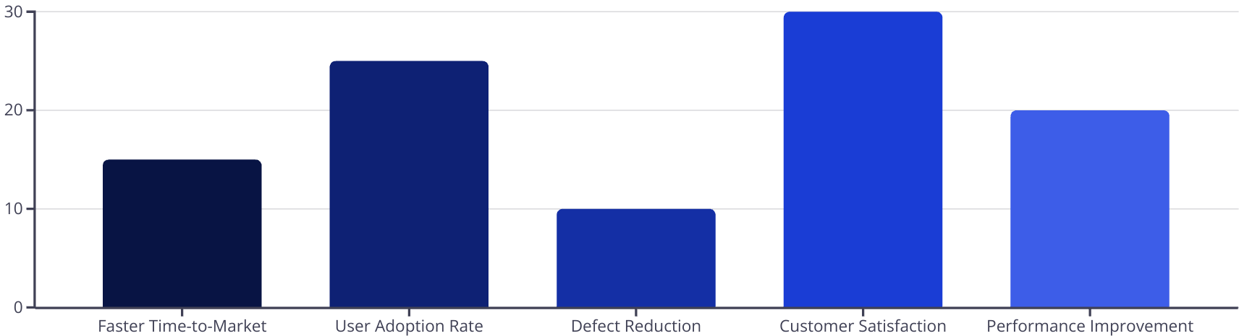
Incentive-Based Contracts
Incentive-based contracts align vendor performance with client business outcomes. By rewarding metrics like faster delivery, higher user satisfaction, or improved system performance, these agreements focus both parties on what truly matters: creating solutions that deliver measurable value.
The contract becomes a framework for shared success rather than a mechanism for scope enforcement.

Slide 7





Making Agile Contracts Work: Key Elements
Outcome-Focused Definition of Success
Frame goals in terms of business results and user experiences rather than features and functions. This maintains focus on value creation.
Flexibility Clauses
Include explicit provisions for reprioritization, backlog refinement, and scope adaptation without triggering formal change processes.
Embedded Collaboration Rituals
Codify sprint reviews, retrospectives, and other Agile ceremonies within the contract to ensure sustained engagement.
Trust-Building Mechanisms
Start with smaller commitments or discovery phases before expanding to larger engagements, allowing relationships to develop.

Slide 8








The Role of the Agile Project Manager
Educator
Risk Manager
Helps clients and legal teams understand the value proposition of flexible contracting models.
Identifies and mitigates contract-related risks that could impede Agile delivery.
Translator
Bridges the gap between business expectations and Agile delivery realities, ensuring mutual understanding.
Transparency Facilitator
Creates visibility through dashboards, demos, and regular stakeholder engagement.
The Agile PM serves as the connective tissue between contractual requirements and Agile execution. By helping both sides understand each other's perspectives, they create an environment where contracts enable rather than constrain the work.

Slide 9
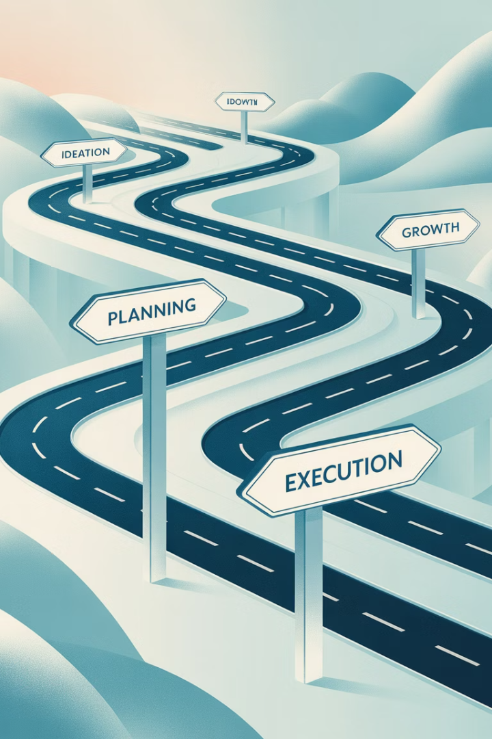




Implementing Agile Contracts: A Roadmap
Assess Current State
Evaluate existing contract processes and identify pain points in the current approach. Document specific examples where traditional contracts have hindered agility.
Engage Stakeholders
Bring together delivery teams, legal counsel, procurement, and client representatives to understand concerns and requirements from all perspectives.
Pilot a New Approach
Start with a lower-risk project to test an Agile contract model. Document both the process and outcomes to build an evidence base.
Develop Templates
Create standardized Agile contract templates that have been pre-approved by legal and procurement to streamline future implementations.

Slide 10
Case Study: Transforming Contracts at Acme Corp
Challenge
Acme's fixed-price contracts led to scope disputes, change order battles, and delayed value delivery.
Approach
Implemented incremental contracts with 3-sprint commitments and explicit reprioritization processes.
Stakeholder Concerns
Legal worried about open-ended commitments; Finance needed predictable budgeting.
Solutions
Created budget ranges with confidence levels; established value-based exit criteria.
Results
50% reduction in contract negotiation time; 35% improvement in client satisfaction; 40% increase in feature adoption.
This transformation didn't happen overnight. The Agile PM worked closely with the legal department for six months to develop new templates and processes. The investment paid off with dramatically improved outcomes for both Acme and its clients.

Slide 11
Common Objections and Responses
Legal Department
Finance Team
Clients
"These contracts don't protect us enough."
"We need fixed costs for budgeting."
"We need to know exactly what we're getting."
Response: Capped T&M or phased approaches still provide maximum expenditure limits. They also reduce the risk of paying for features that deliver no value, making them more financially responsible.
Response: Agile contracts often provide better protection by creating multiple exit points rather than one high-stakes delivery. Regular demos and reviews also catch issues earlier when they're less expensive to fix.
Response: Traditional contracts provide an illusion of certainty. Agile contracts trade detailed upfront specifications for the ability to incorporate learning and changing requirements, ultimately delivering higher-value solutions.

Slide 12








Key Takeaways: Contracts as Enablers, Not Barriers
Contracts Should Enable Value
Agreements must prioritize business outcomes over rigid scope enforcement
Build in Flexibility
Structure contracts to accommodate learning and changing requirements
Foster Collaboration
Create agreements that align incentives between teams and clients
Start Small, Learn, and Adapt
Begin with pilot projects and refine your approach based on results

Slide 13

Final Thoughts
The best contracts are living documents designed to grow with the project—not chain it down. With the right model, you don't have to choose between structure and flexibility. You can create agreements that protect business interests while embracing the adaptability that makes Agile truly powerful.
What's your next step toward more Agile-friendly contracts?

