Slide 1
SAFe vs Traditional Project Management
A guide for project managers transitioning from traditional methodologies to the Scaled Agile Framework.
kW
by Kimberly Wiethoff

Slide 2
Agenda
Mindset Shift
From command-and-control to servant leadership
Planning Cadence
Waterfall milestones vs Agile PI Planning
Team Structure
Centralized vs decentralized decision-making
Role Redefinition
Finding your place in the SAFe framework
Success Measures
Deliverables vs business value

Slide 3
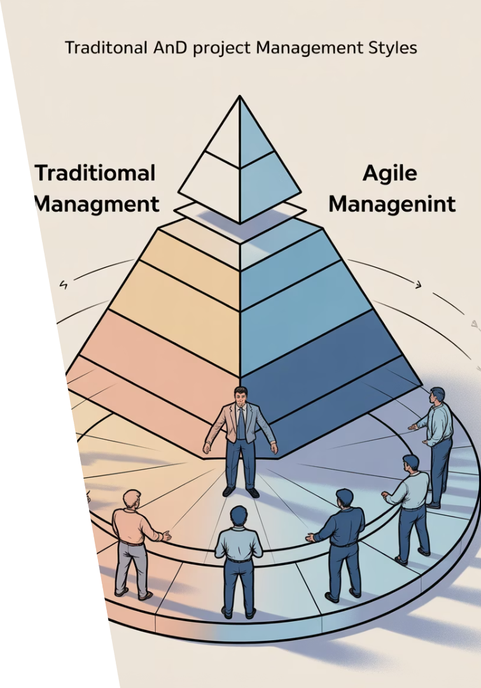
The Mindset Shift
Traditional Approach
SAFe Approach
Project manager owns the plan and timeline.
Teams self-organize and collaborate.
Tasks are assigned to team members.
Servant leadership empowers the team.
PM drives progress toward deadlines.
RTEs and Scrum Masters facilitate.
Detailed task management is expected.
Focus is on removing obstacles.

Slide 4
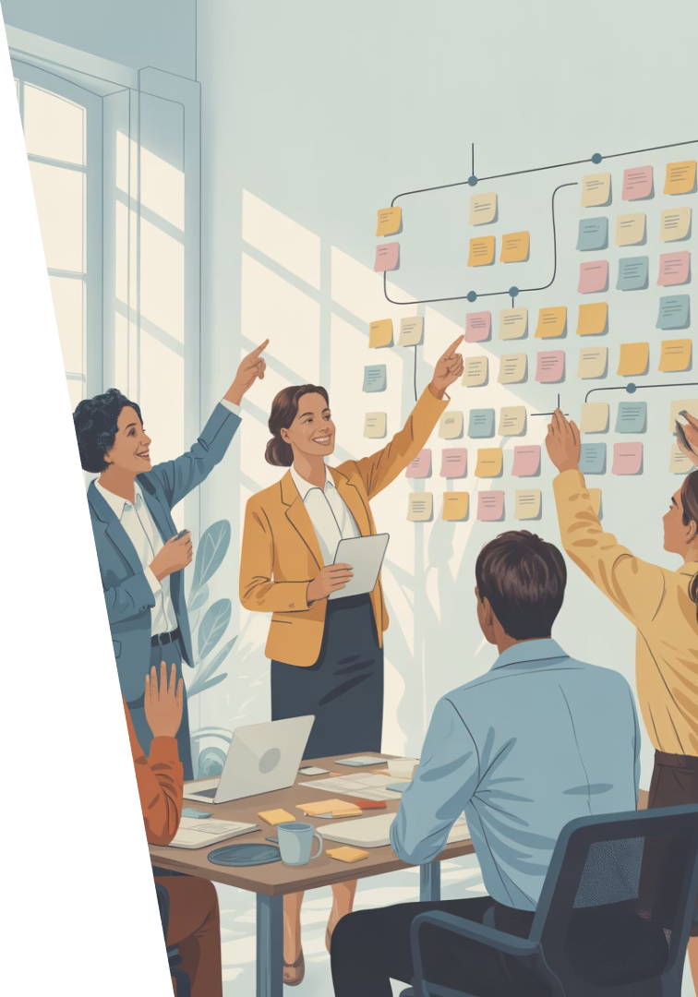
From Manager to Facilitator
Support Teams
Help teams become self-sufficient rather than directing their work.
Coach Lean Thinking
Guide others in applying lean principles to their work.
Remove Obstacles
Focus on eliminating blockers that prevent team progress.
Build Connections
Create relationships across the organization to solve problems.

Slide 5
Planning Cadence
Traditional Waterfall
Long-range Gantt charts with fixed milestones
Hybrid Approaches
Mixed methodologies with some flexibility
SAFe Program Increment
8-12 week cycles with collaborative planning
The shift from detailed task planning to objective-based increments requires embracing shorter planning horizons and more collaborative approaches.

Slide 6
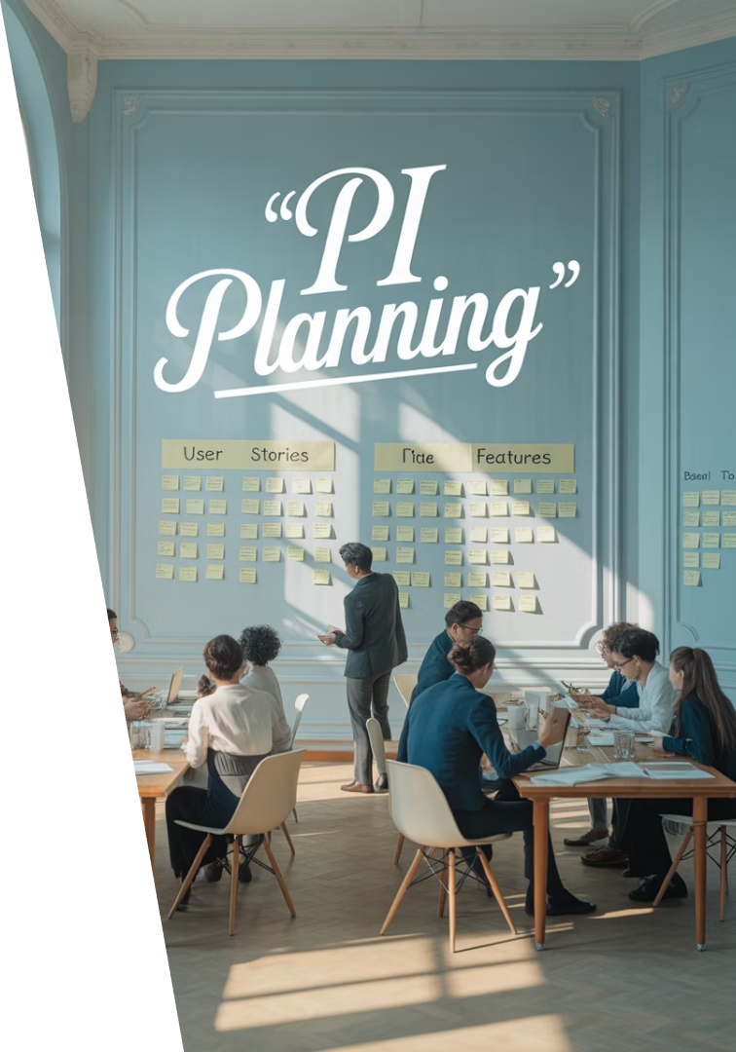
PI Planning in Action
Business Context
Leadership shares vision and business priorities for the upcoming PI.
Team Planning
Agile teams break down features into stories and estimate capacity.
Inter-team Alignment
Teams identify dependencies and resolve conflicts.
Commitment
Teams present objectives they commit to deliver in the PI.

Slide 7
Team Structure Evolution
Traditional Structure
SAFe Structure
Hierarchical reporting
Agile Release Trains
Centralized decision-making
Decentralized decisions
Cross-functional teams
Functional silos
Shared responsibility
PM as central coordinator
PM's New Focus
Enabling alignment
Supporting decisions
Removing impediments
Managing dependencies

Slide 8
Role Redefinition
Release Train Engineer
Scrum Master
Facilitates the ART and removes impediments. Similar to a "super Scrum Master."
Coaches teams on Agile practices and helps maintain process.
Lean Portfolio Management
Value Stream Engineer
Aligns strategy with execution and manages the flow of initiatives.
Coordinates multiple ARTs and optimizes value delivery across the stream.

Slide 9
Transferable Skills
Risk Management
Stakeholder Communication
Dependency Coordination
Progress Tracking
Identifying, mitigating, and tracking risks remains crucial in SAFe environments.
Engaging with leaders and stakeholders effectively translates directly to SAFe.
Managing cross-team dependencies becomes even more important in SAFe.
Monitoring and reporting on delivery status remains essential.

Slide 10
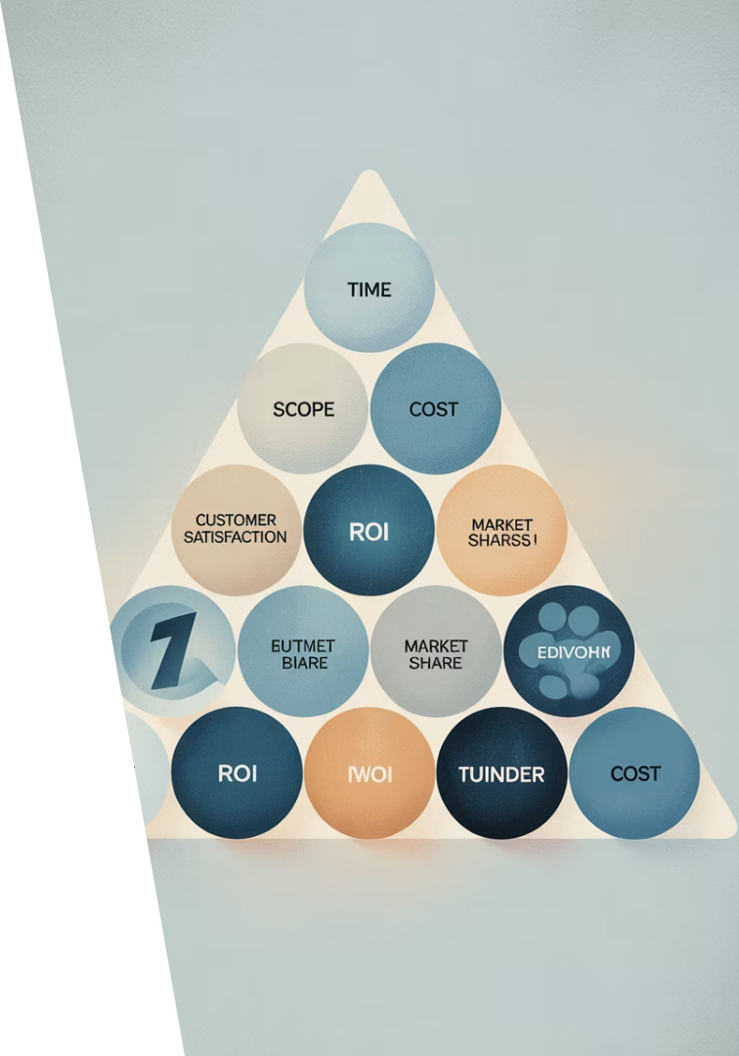
Success Measures Transformation
1
Traditional Metrics
Focus on delivering on time, on budget, and according to scope.
2
Transitional Metrics
Blend of delivery metrics with early value measurements.
3
SAFe Metrics
Emphasis on business outcomes, customer value, and flow metrics.

Slide 11
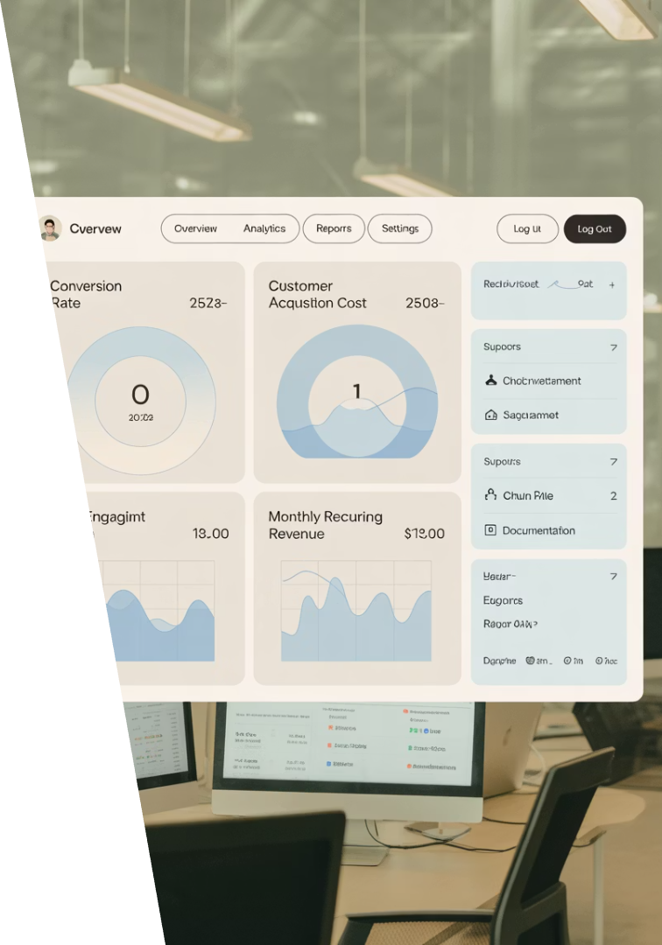
Value-Based Success Metrics
85%
3.5d
Feature Usage
Cycle Time
Track actual customer adoption of delivered features.
Measure days from start to completion of work items.
92%
46%
Reliability
Revenue Growth
Monitor system stability and performance.
Connect features to business impact.

Slide 12
Common Challenges
Project managers often struggle most with the perceived loss of control and uncertainty about their new role in the SAFe environment.

Slide 13
Your Path Forward
Learn SAFe Principles
Study the framework and earn certification
Participate in PI Planning
Experience the event firsthand
Adopt Servant Leadership
Shift your management style
Embrace New Metrics
Focus on value and outcomes
Your project management skills remain valuable. The framework may change, but your ability to deliver value, manage complexity, and drive results is more important than ever.

Slide 14
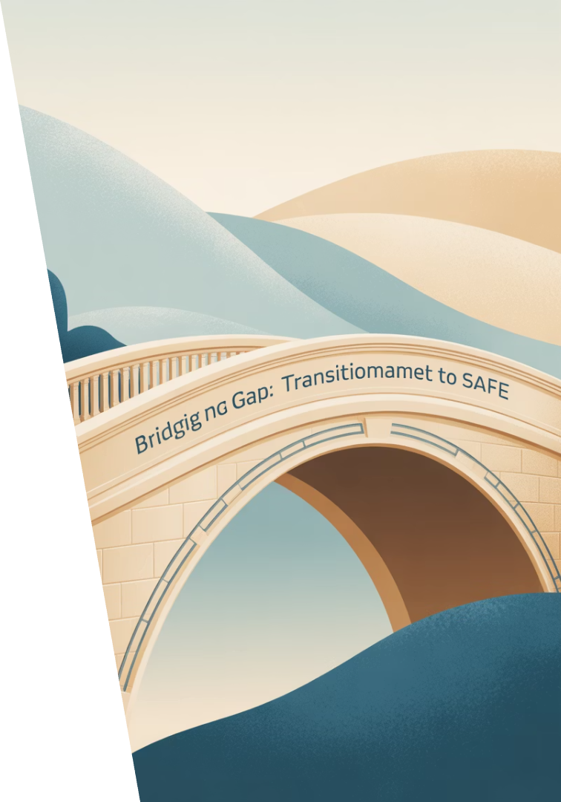
Final Thoughts
The move from traditional project management to SAFe isn't just about changing tools or terminology—it's about embracing a new way of thinking. While the role of the project manager may shift in a SAFe environment, your ability to coordinate, communicate, and lead cross-functional efforts remains essential.
If you're a project manager looking to stay relevant in an Agile world, learning SAFe principles, participating in PI Planning, and adapting to a servant leadership style are great first steps. The framework may be different, but your ability to deliver value, manage complexity, and drive results is more important than ever.

