Slide 1
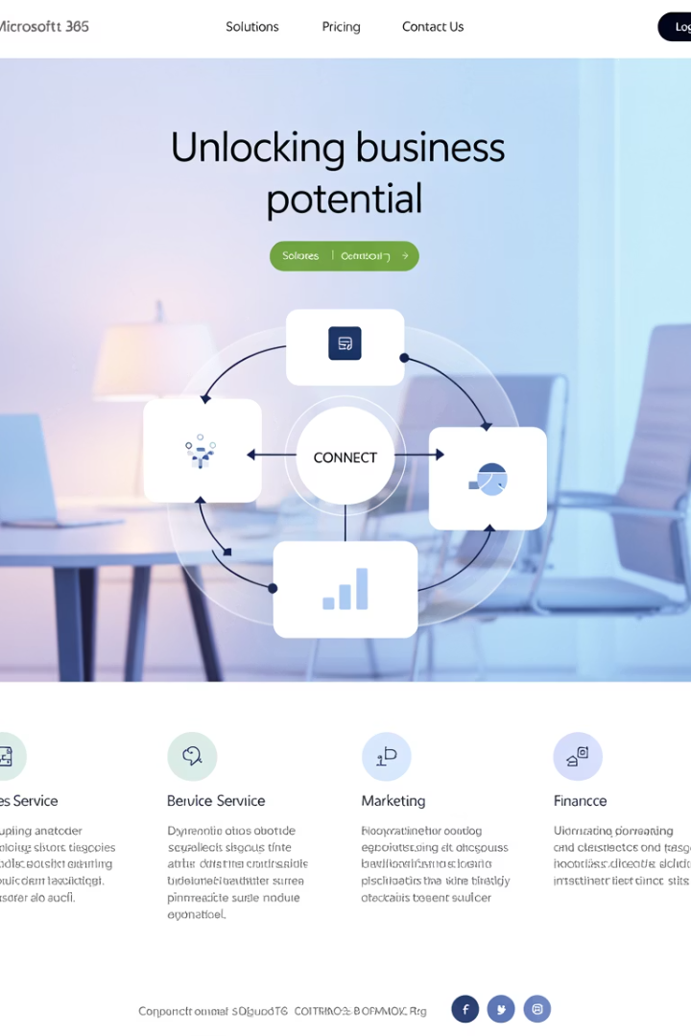
Microsoft Dynamics 365 Modules: A Project Manager's Guide
As businesses grow digitally mature, integrated platforms become critical. Microsoft Dynamics 365 offers a modular ecosystem that helps organizations unify operations across departments.
For project managers, understanding these modules is key to managing enterprise-level technology projects efficiently.
kW
by Kimberly Wiethoff

Slide 2




Customer Engagement (CRM) Modules
Dynamics 365 Sales
Dynamics 365 Customer Service
Dynamics 365 Field Service
Manages customer pipelines and deal forecasting. Automates sales processes with AI-driven insights.
Improves satisfaction through case management, SLAs, and omnichannel support.
Optimizes scheduling and service delivery for mobile technicians.

Slide 3
More Customer Engagement Modules
Dynamics 365 Marketing
Dynamics 365 Customer Insights
Dynamics 365 Customer Voice
Automates campaign management and lead nurturing. Integrates with Sales module.
Unifies data across systems for a 360-degree customer view.
Collects real-time feedback through surveys and sentiment analysis.
PMs can track campaign milestones and team capacity for marketing transformation projects.
Enables segmentation strategies for customer experience initiatives.
Useful for service improvement or post-launch evaluations.

Slide 4
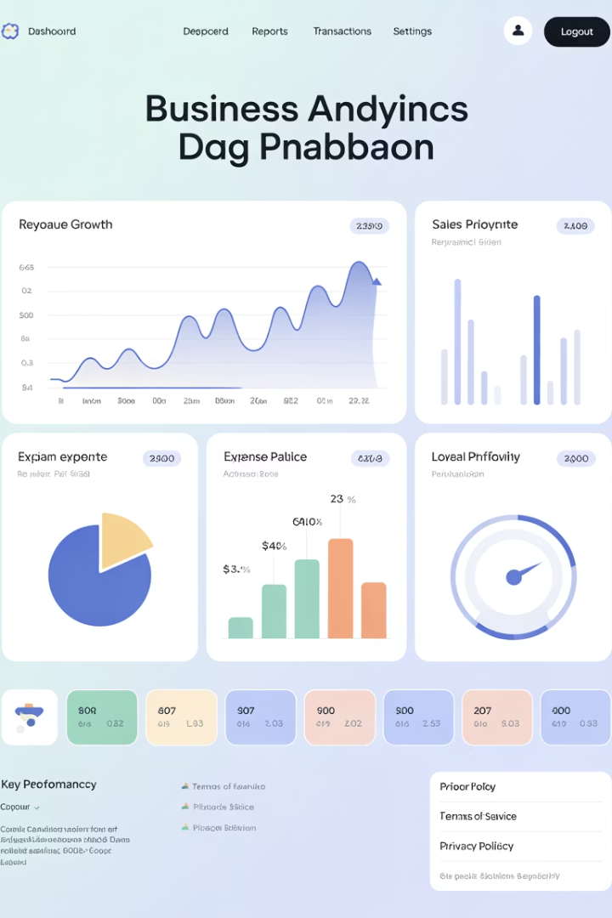
Finance & Operations (ERP) Modules
Dynamics 365 Finance
Dynamics 365 Supply Chain Management
Handles general ledger, budgeting, accounts payable/receivable, and financial forecasting.
Manages inventory, production, warehouse operations, and demand forecasting.
Critical for financial visibility in cost-sensitive projects.
Ideal for logistics or manufacturing projects.
Dynamics 365 Commerce
Unifies online, in-store, and back-office retail operations.
Streamlines omnichannel initiatives for retail tech PMs.

Slide 5



Human Resources & Project Operations
Dynamics 365 Human Resources
Manages employee records, benefits, leave, and performance. Now transitioning to Microsoft Viva/Workday integrations.
Dynamics 365 Project Operations
Covers planning, resource allocation, time tracking, billing, and profitability for project-based businesses.
Dynamics 365 Business Central
All-in-one ERP for small to midsize businesses. Covers finance, sales, inventory, and project management.

Slide 6








Specialized & Industry Modules
Dynamics 365 Guides
Dynamics 365 Remote Assist
Mixed reality instructions and training tools for manufacturing and field operations.
Dynamics 365 Intelligent Order Management
Dynamics 365 Fraud Protection
Enables field workers to collaborate in real time using augmented reality.
AI-powered module to detect and prevent fraudulent transactions and identity theft.
Orchestrates fulfillment across multiple order sources using AI and real-time insights.

Slide 7





Integration and Customization Tools
Power BI
Business analytics and dashboarding for visualizing KPIs and metrics.
Power Automate
Workflow automation to streamline processes across the organization.
Power Apps
Low-code custom applications to extend Dynamics 365 functionality.
Dataverse
Shared data layer that connects all modules in the ecosystem.

Slide 8




Project Manager Benefits: Sales Module
Monitor Sales Cycles
Track sales pipeline timelines to better plan project resources.
Align Teams
Ensure delivery teams understand customer expectations from sales process.
Forecast Resources
Use sales data to predict upcoming project demands.
Set Realistic Timelines
Base project schedules on actual sales cycle data.

Slide 9






Project Manager Benefits: Customer Service Module
Improved Customer Satisfaction
Measure project success through customer feedback.
Consistent Support Workflows
Standardize post-implementation support processes.
Measurable Service Levels
Track SLAs to ensure project deliverables meet expectations.

Slide 10



Project Manager Benefits: Field Service Module
Mobile Workforce Transformation
Manage projects involving field technicians and remote work.
IoT Integration
Connect smart devices to service workflows.
Asset Tracking
Monitor equipment and resources across locations.

Slide 11
Project Manager Benefits: Finance Module
100%
24/7
360°
Financial Visibility
Real-time Tracking
Comprehensive View
Complete transparency into project costs and budgets.
Continuous monitoring of financial metrics.
See financial impact across all departments.

Slide 12








Project Manager Benefits: Supply Chain Module
Inventory Management
Logistics Coordination
Track materials and resources needed for project completion.
Ensure timely delivery of project components.
Demand Forecasting
Production Planning
Predict resource needs based on project pipeline.
Align manufacturing schedules with project timelines.

Slide 13
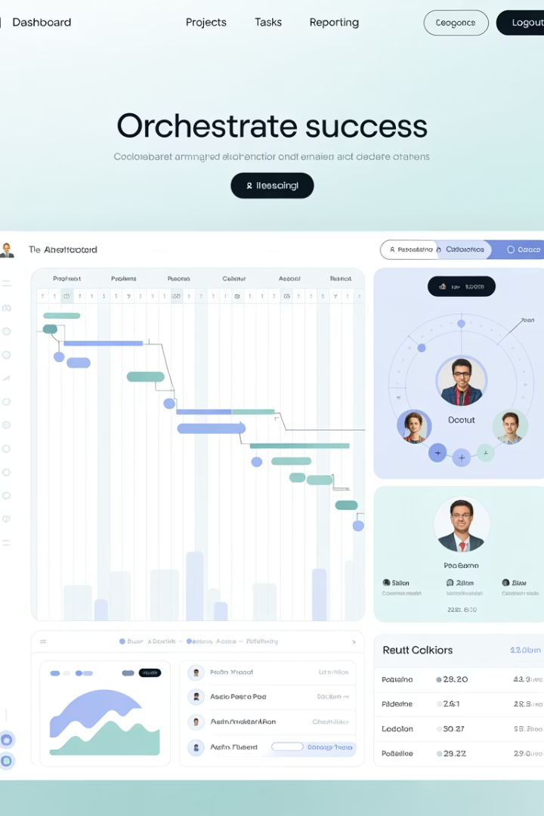
Project Manager Benefits: Project Operations
Planning & Scheduling
Create comprehensive project plans with resource allocation and timelines.
Resource Management
Assign team members based on skills, availability, and project needs.
Time & Expense Tracking
Monitor actual hours and costs against project budgets.
Billing & Profitability
Generate invoices and track project financial performance.

Slide 14
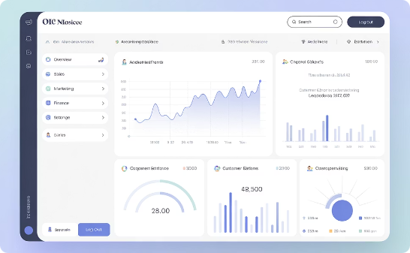
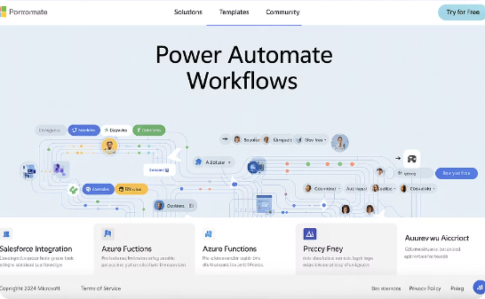
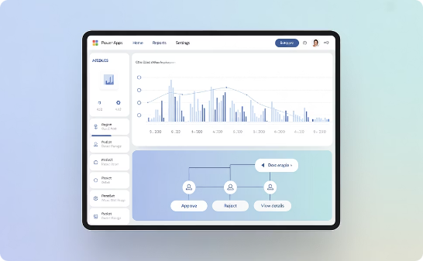
Project Manager Benefits: Power Platform
Power BI
Power Automate
Power Apps
Create custom project dashboards to visualize progress and KPIs.
Automate routine project tasks and approval processes.
Build custom tools for specific project management needs.

Slide 15

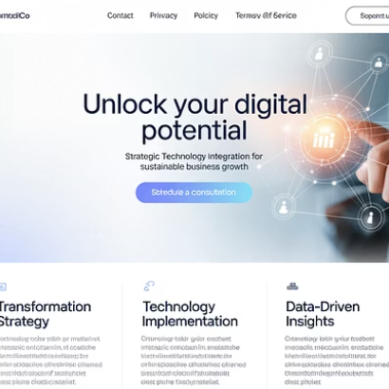

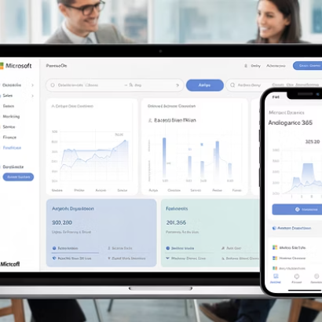
Final Thoughts: Driving Project Outcomes
Understanding Dynamics 365 modules helps project managers better plan, implement, and oversee enterprise software projects.
With the right modules, project outcomes become easier to measure, manage, and deliver.

