Slide 1
How Agile and DevOps Fuel Continuous Digital Transformation
Digital transformation isn't a one-time initiative—it's a continuous evolution. Organizations must become responsive and adaptable.
Agile and DevOps form the engine of this transformation. They turn strategy into speed and vision into value.
kW
by Kimberly Wiethoff

Slide 2
From Project Thinking to Product Thinking
Traditional Projects
One-off initiatives with fixed scope and timeline
Agile Transition
Cross-functional teams form around products
Product Thinking
Continuous value delivery aligned to business needs

Slide 3
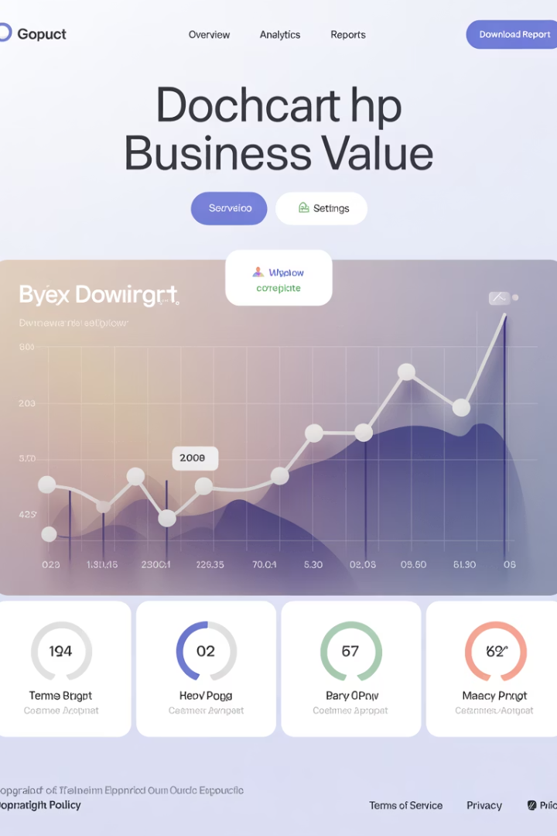
Benefits of Product Thinking
Business Value Focus
Faster Value Delivery
Teams prioritize outcomes over task completion.
Stakeholders receive incremental benefits earlier.
Customer Alignment
Product ownership ensures focus on real customer needs.

Slide 4
Continuous Delivery Pipeline
Code
Build
Developers submit code to version control
CI tools compile and package code
Test
Deploy
Automated testing validates code quality
CD systems push to production automatically

Slide 5
Transformation Impact of DevOps
Reduced Time-to-Market
Faster Feedback
Lower Deployment Risk
Delivery cycles shrink from months to weeks or even days.
Automated testing and CI/CD pipelines accelerate learning cycles.
Small, frequent releases minimize impact of changes.

Slide 6
Culture Is the Real Differentiator
Experimentation
Collaboration
Teams try new approaches without fear of failure.
Silos disappear as departments work together.
Continuous Improvement
Ownership
Regular retrospectives drive ongoing refinement.
Teams take responsibility for outcomes.

Slide 7
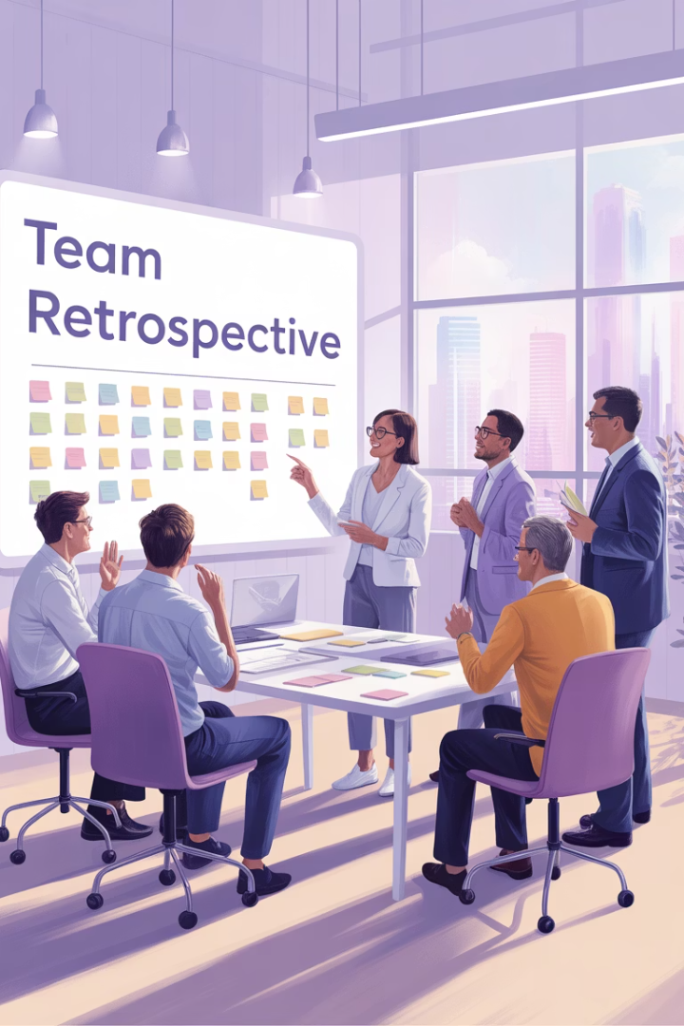
Real-World Culture Tips
Team-Level Retrospectives
Hold regular meetings to reflect on processes and outcomes.
Program-Level Reviews
Scale learnings across multiple teams for broader impact.
Leadership Modeling
Executives demonstrate vulnerability and continuous learning.

Slide 8
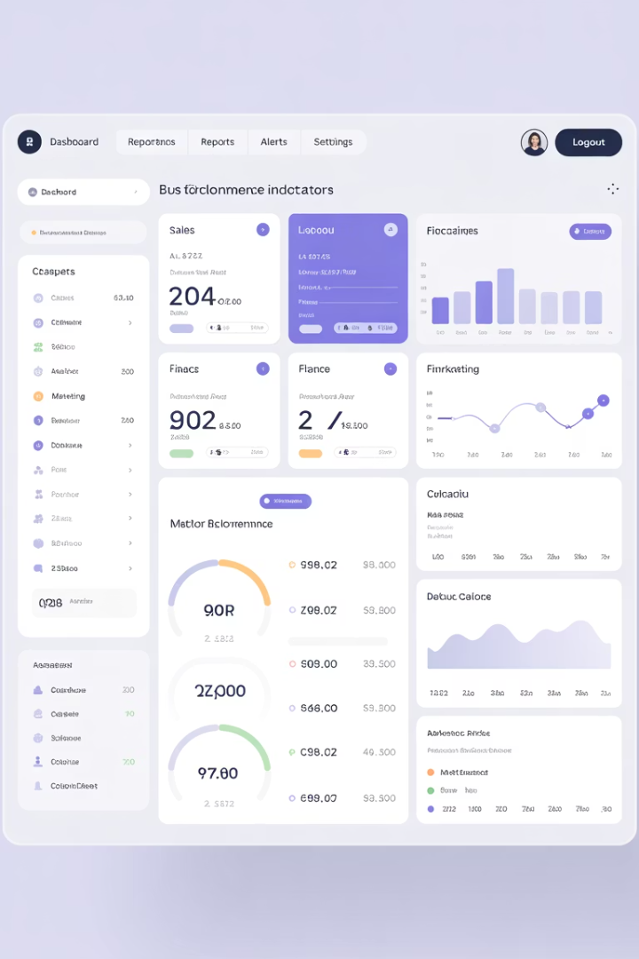
Measurable Outcomes
80%
65%
Faster Delivery
Fewer Defects
Average reduction in lead time
Reduction in production bugs
3x
42%
More Deployments
Cost Savings
Increase in deployment frequency
Reduction in overall IT costs

Slide 9
Bridging IT and Business
IT Metrics
Business KPIs
Deployment frequency
Customer satisfaction
Lead time for changes
Revenue growth
Change failure rate
Cost reduction
Mean time to recovery
Market share gains

Slide 10
Resilience Through Automation
Build & Test
Deploy
Automated quality checks prevent issues
Controlled rollouts minimize risk
Improve
Monitor
Data-driven enhancements
Real-time visibility into performance

Slide 11
Balancing Innovation and Stability
Innovation
Scrum for new features
Adaptation
Mixed approaches for evolving products
Stability
Kanban for operations and maintenance

Slide 12
Agile and DevOps as Core Enablers
Structure
Automation
Culture
Frameworks for fast, customer-centered delivery
Tools for safe, frequent deployments
Mindsets for empowered, high-performing teams

Slide 13
Taking Action: Next Steps
Assess Current State
Evaluate your Agile and DevOps maturity
Set Clear Objectives
Define measurable transformation goals
Build Capabilities
Invest in people, processes, and tools
Measure and Adapt
Track progress and refine your approach

