Slide 1

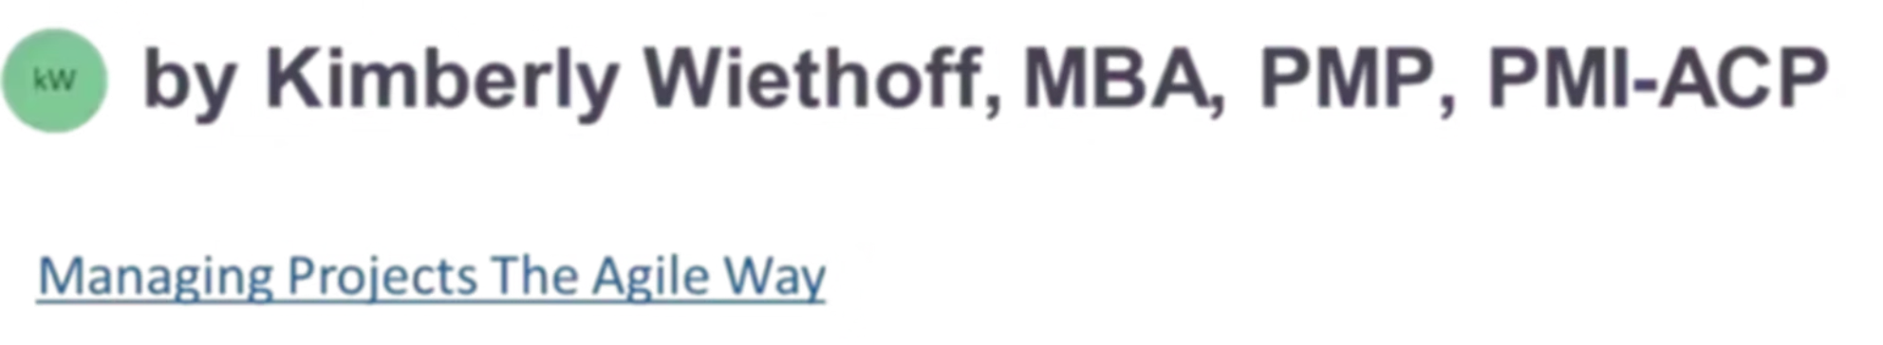
AI in Project Management: 5 Revolutionary Shifts
AI isn't just changing project management—it's revolutionizing it. Discover how cutting-edge AI tools are transforming planning, execution, and delivery across industries.
#AIinProjectManagement #DigitalTransformation #FutureOfWork #AgileLeadership #PMO #ProgramManagement #ProjectLeadership #AIForPMs #PredictiveAnalytics #DeliveryExcellence #ManagingProjectsTheAgileWay #LeadershipInTech

Slide 2





The AI Revolution in Project Management
Learn AI Tools
Understand AI-enhanced platforms for project management.
Interpret Data
Develop skills to analyze AI-generated insights.
Automate Tasks
Delegate routine work to AI assistants.
Focus on Strategy
Elevate your role to strategic leadership.

Slide 3
Predictive Risk Management
Traditional Approach
AI-Powered Approach
Relies on historical data and intuition.
Analyzes real-time project data continuously.
Reactive to problems after they appear.
Forecasts bottlenecks before they happen.
Limited by human perception of patterns.
Identifies subtle risk patterns humans might miss.

Slide 4
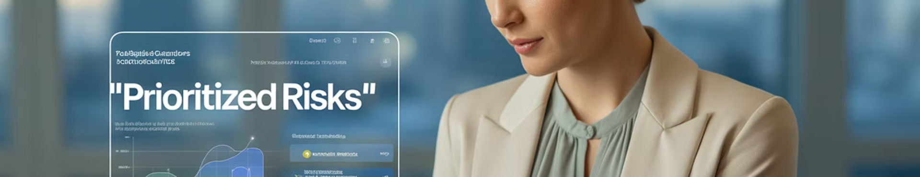
Tools for Predictive Risk Analysis
Smartsheet
Wrike
Microsoft Project
Uses AI to flag potential schedule conflicts and resource bottlenecks.
Offers predictive risk assessment based on task completion patterns.
Features AI-powered schedule analysis and resource optimization.
Provides automated risk scoring across projects.
Generates automated recommendations for risk mitigation.
Identifies critical path issues before they impact delivery.

Slide 5








Automating Routine Project Tasks
Schedule Management
Report Generation
Automatic updates to timelines based on progress.
Automated status reports and executive summaries.
Task Prioritization
Resource Allocation
AI-driven backlog management and sprint planning.
Smart assignment of team members to tasks.

Slide 6
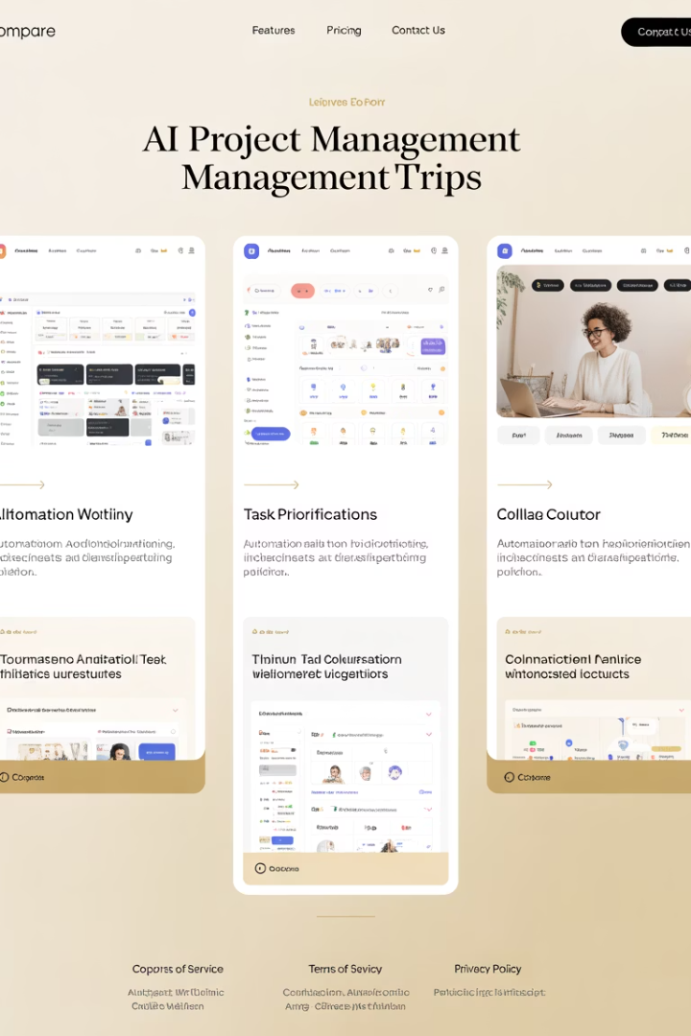



AI-Enhanced Project Platforms
ClickUp
Asana Intelligence
Features AI writing assistant for project documentation and smart time estimates.
Offers workflow automation and smart task prioritization.
Jira Smart Fields
Provides intelligent field suggestions and automated workflows.

Slide 7






Real-Time Data Insights
Strategic Insights
Actionable recommendations for project optimization
Visual Analytics
Interactive dashboards and predictive models
Integrated Data
Unified sources from across the project ecosystem

Slide 8
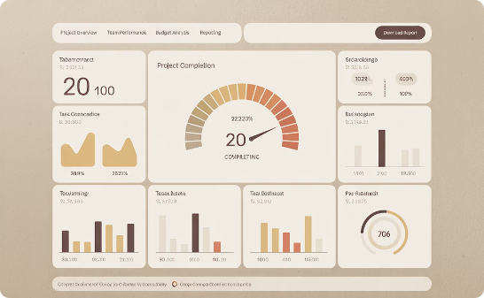
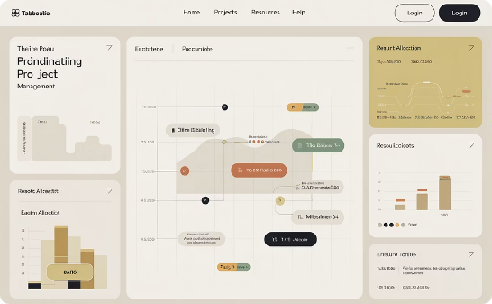
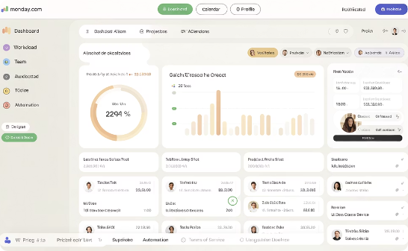
Business Intelligence for Project Managers
Power BI
Tableau
Monday.com
Connects to multiple data sources for comprehensive project analytics.
Creates advanced visualizations for complex project data.
Offers intuitive dashboards with AI-driven recommendations.

Slide 9





AI Assistants for Team Productivity
Meeting Transcription
AI captures and summarizes key discussion points and decisions.
Smart Reminders
Contextual alerts based on project needs and team availability.
Knowledge Assistance
AI answers project questions using organizational knowledge base.
Time Tracking
Automated logging of activities and task completion.

Slide 10
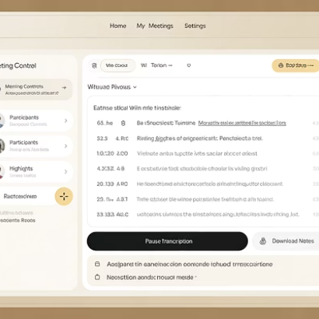
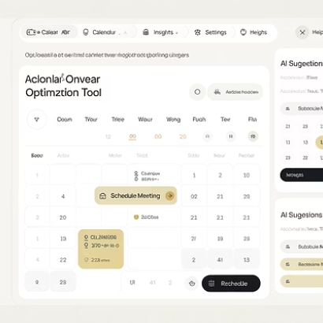
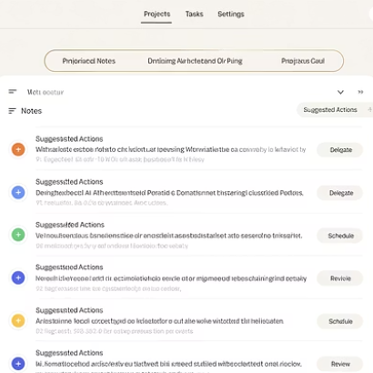
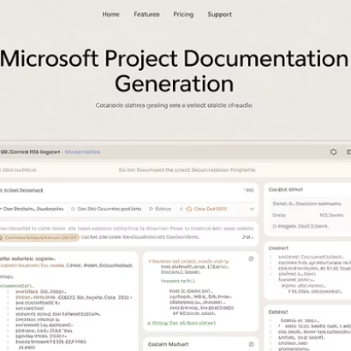
Productivity Tool Integration
Today's project managers integrate specialized AI tools to create a seamless productivity ecosystem.

Slide 11



Accelerating Documentation & Communication
Content Creation
Generate project charters, plans, and reports
Audience Adaptation
Tailor messaging for different stakeholders
Time Savings
Reduce documentation time by up to 80%

Slide 12

AI Writing Tools for Project Managers
10x
65%
Faster Documentation
More Consistency
Speed increase for creating project artifacts
Improvement in documentation standardization
45%
Time Savings
Reduction in time spent on administrative tasks

Slide 13





The Future Project Manager
Strategic Leader
AI Orchestrator
Continuous Learner
Human Connection
Focus on vision and outcomes rather than tasks.
Direct AI tools to optimize project delivery.
Stay adaptable through ongoing skill development.
Excel at leadership that AI cannot replicate.

Slide 14

Final Thoughts
AI is not replacing project managers—it's amplifying them. Those who embrace these technologies will unlock new levels of productivity, foresight, and influence. The key is to stay curious, experiment with AI-enhanced tools, and lean into a mindset of continuous learning.
Because in the age of AI, the best project managers won't just deliver outcomes—they'll architect the future.

