Slide 1
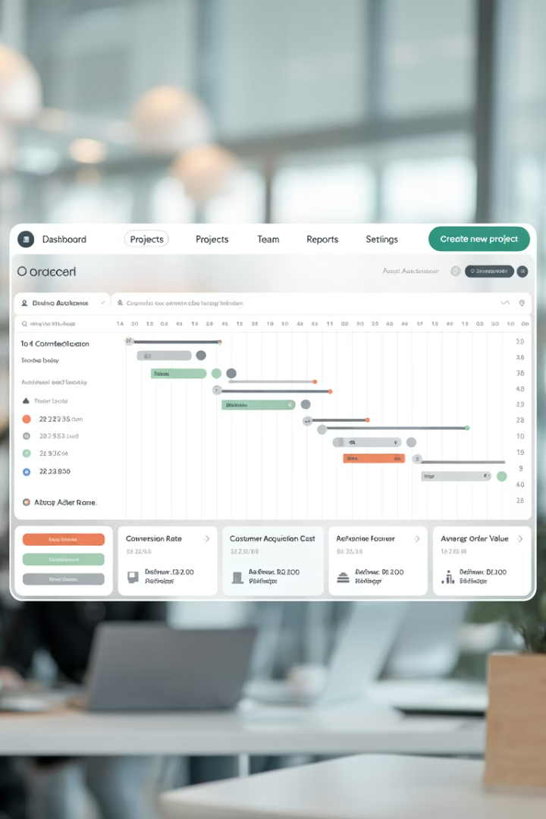

Mitigating Risk in E-Commerce Launches: A Project Manager's Guide
Launching or relaunching an e-commerce platform is exciting—but it's also one of the riskiest initiatives a business can undertake. From broken payment flows to data migration mishaps and SEO drops, a single overlooked detail can cost you revenue, customer trust, and brand reputation.
That's why risk mitigation is a top priority for e-commerce project managers. Whether you're overseeing a replatforming effort, new feature rollout, or complete redesign, having a proactive risk management strategy is the difference between a seamless launch and a six-figure mistake.
#EcommerceProjectManagement #DigitalRiskManagement #EcommerceLaunch #ProjectManagementTips #RiskMitigation #TechProjectManagement #DigitalPM #GoLiveChecklist #EcommerceUX #SiteMigration #SEORisks #EcommerceDevelopment #OmnichannelCommerce #WebsiteLaunch #ProjectManagerLife #ManagingProjectsTheAgileWay

Slide 2
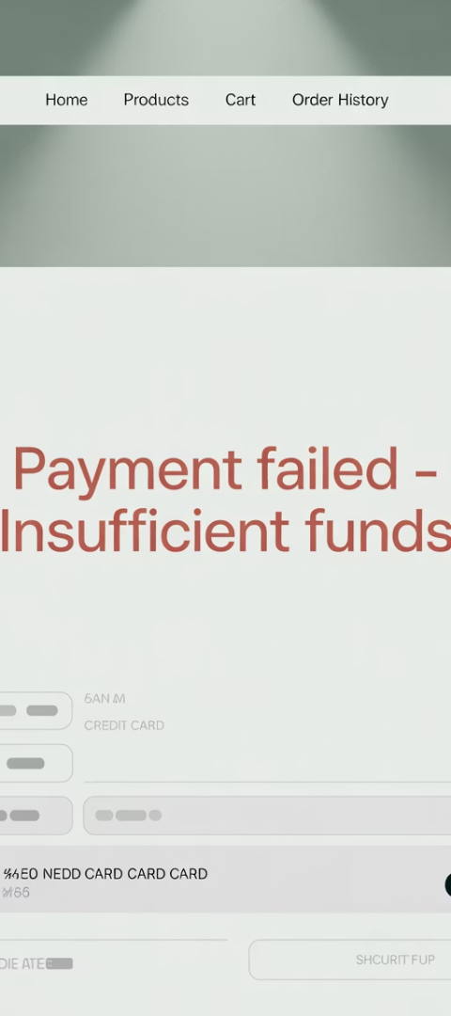



Understanding E-Commerce Launch Risks
Understanding what can go wrong is the first step to avoiding it. E-commerce launches involve multiple critical systems that must work together flawlessly to deliver a smooth customer experience.
Payment Processing Failures
Data Loss or Corruption
Poorly executed data migrations can result in missing products, broken SKUs, or incorrect customer records.
Incomplete or incorrect gateway configurations can block transactions or cause errors at checkout.
Performance Issues or Downtime
Traffic spikes, especially during launches or promotions, can overwhelm servers if load testing isn't done.

Slide 3
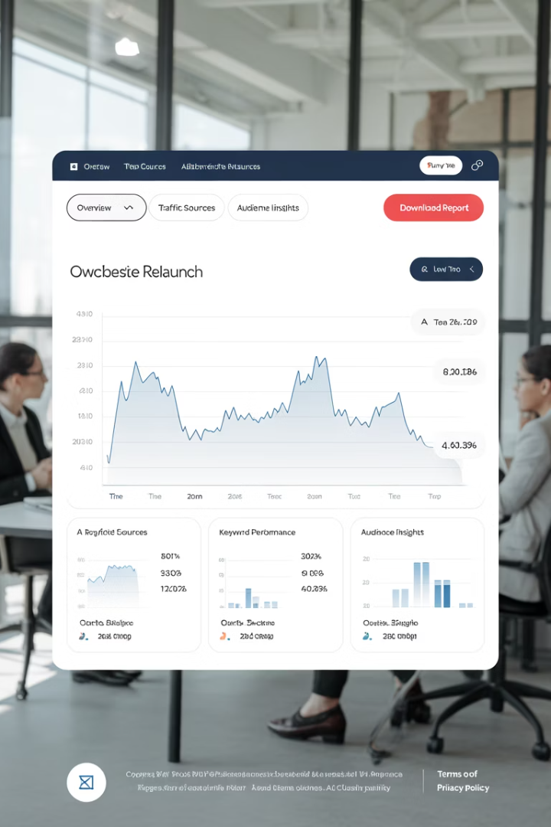
More Critical Launch Risks
Beyond technical failures, e-commerce launches face additional risks that can significantly impact business performance and customer satisfaction.
SEO Drops
Third-Party Integration Failures
Improper handling of redirects, metadata, or URL structure changes can severely damage organic traffic, leading to lost visibility and revenue.
Malfunctions with ERP, CRM, shipping, or tax tools can create order and fulfillment chaos that affects the entire supply chain.
Cart Abandonment Due to UX Changes
A new checkout or navigation flow may confuse users if not properly tested or optimized, resulting in lost sales opportunities.

Slide 4








Risk Assessment: The First Step
At project kickoff, lead a session with stakeholders and technical teams to brainstorm risks and assign severity/probability ratings. This collaborative approach ensures all perspectives are considered.
Stakeholder Input
Risk Prioritization
Gather insights from business owners, technical teams, and customer-facing staff to identify potential risks.
Rank risks based on likelihood and potential business impact to focus mitigation efforts.
RAID Log Creation
Mitigation Planning
Document Risks, Assumptions, Issues, and Dependencies in a centralized tracking system.
Develop specific action plans for each high-priority risk identified.

Slide 5





Performance & Load Testing
Include performance and load testing in your project timeline to ensure your platform can handle expected traffic volumes and peak conditions. This proactive approach prevents launch-day disasters.
Baseline Performance Testing
Establish current performance metrics as a comparison benchmark.
Simulated User Testing
Use tools like LoadNinja or k6 to simulate realistic user behaviors and traffic patterns.
Critical Path Testing
Focus on payment flows, search functionality, and checkout processes under load.
Device Compatibility Testing
Verify performance across different devices, browsers, and connection speeds.

Slide 6
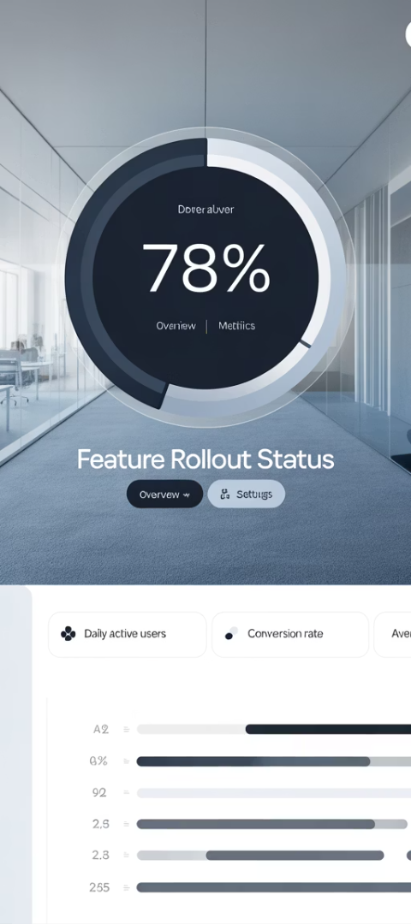
Controlled Rollout Strategies
Use a phased approach instead of a big-bang launch to minimize risk exposure and catch critical issues before they affect your entire customer base.
Internal Testing
Begin with employees and stakeholders testing in a production-like environment to catch obvious issues.
Beta Access
Invite loyal customers or a select group to preview the new platform and provide feedback.
Percentage Rollout
Gradually increase the percentage of users directed to the new platform, monitoring KPIs at each stage.
Full Launch
Complete the transition after confirming performance and functionality meet expectations.

Slide 7





Rollback & Contingency Planning
Always prepare for the worst-case scenario. Having a clear rollback strategy ensures you can quickly restore service if critical issues arise during launch.
Create Complete Backups
Ensure all databases, configurations, and content are backed up before any major change.
Document Rollback Procedures
Create step-by-step instructions for reverting to the previous system state.
Assign Rollback Responsibilities
Clearly define who makes the rollback decision and who executes each step.
Establish Trigger Criteria
Define specific metrics or issues that would trigger a rollback decision.

Slide 8




Third-Party Integration Validation
E-commerce platforms rely on numerous external systems to function properly. Thorough testing of all integrations is essential to prevent order processing and fulfillment issues.
Shipping Systems
Tax Calculators
Analytics Tools
Email Systems
Ensure accurate tax determination based on location, product type, and customer status.
Confirm proper data collection for conversion tracking and customer behavior analysis.
Test all transactional emails including order confirmations and shipping notifications.
Verify rate calculations, label generation, and tracking information flow correctly.

Slide 9
SEO Risk Management
Organic search traffic is a valuable asset that can be severely damaged during a platform migration if SEO considerations aren't properly addressed.
Pre-Launch SEO Audit
URL Mapping & Redirects
Comprehensive analysis of current performance
Detailed plan for preserving link equity
Metadata Preservation
Post-Launch Monitoring
Ensuring titles, descriptions, and structured data transfer correctly
Daily tracking of rankings, traffic, and crawl errors
Use tools like Screaming Frog, Ahrefs, or Google Search Console to catch broken links, missing tags, or misconfigured redirects. Bring in your SEO team before launch day to ensure all technical SEO elements are properly implemented.

Slide 10


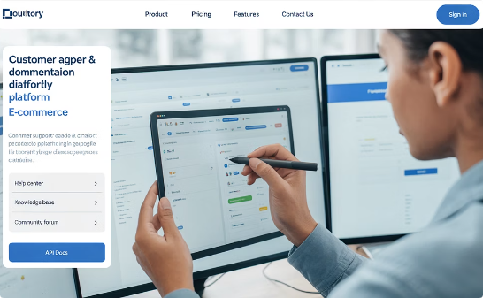
Involving Customer Support in UAT
Support teams interact with customers daily and understand their pain points. Including them in User Acceptance Testing helps identify potential issues from the customer perspective.
Edge Case Identification
Knowledge Building
Documentation Improvement
Support teams can test unusual scenarios they've encountered in customer interactions that developers might not anticipate.
Participation in testing helps support staff learn the new system thoroughly before having to assist customers with it.
Support teams can help create better help resources based on their testing experience and anticipated customer questions.

Slide 11




Feature Flags & Toggle Systems
Feature flags provide a safety net during launches by allowing teams to enable or disable specific functionality without deploying new code. This approach significantly reduces risk during complex rollouts.
Implement Feature Flag System
Integrate tools like LaunchDarkly or Split.io into your codebase
Configure User Targeting
Set up rules for which users see which features
Deploy With Features Off
Release code safely with new functionality disabled
Gradually Enable Features
Turn on features incrementally while monitoring performance

Slide 12
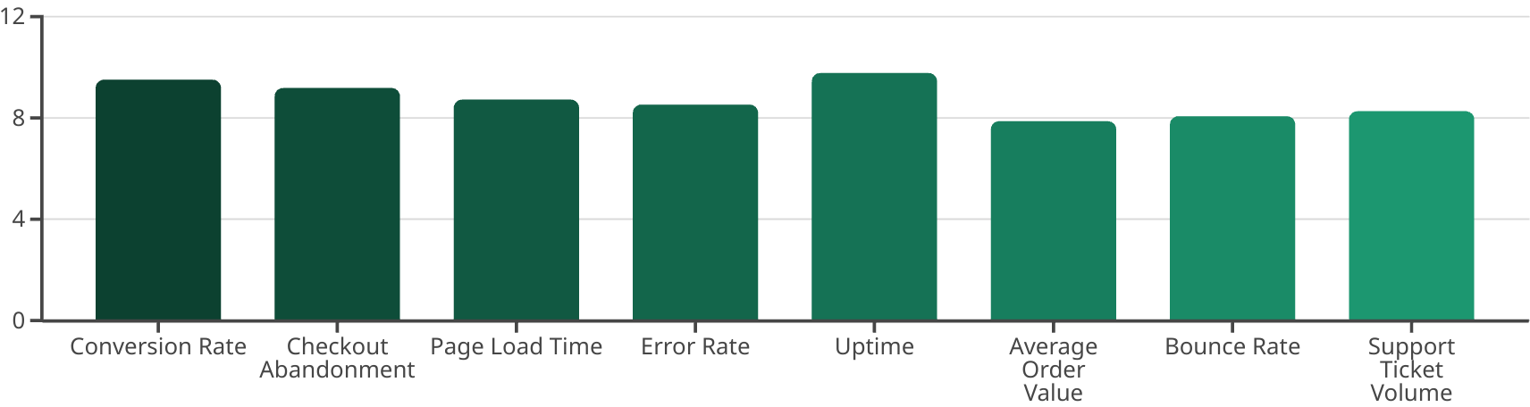
Critical KPIs to Monitor After Launch
Monitoring key performance indicators is crucial in the hours and days after a go-live. Real-time dashboards help teams quickly identify and address issues before they significantly impact the business.
Use real-time dashboards in GA4, Datadog, or Looker Studio to stay on top of these metrics and respond fast to any concerning trends. The first 24-48 hours after launch are especially critical for monitoring system performance and user behavior.

Slide 13







Phased Monitoring Approach
Different metrics require attention at different stages after launch. A structured monitoring plan ensures nothing falls through the cracks during the critical post-launch period.
First Day
Immediate (First Hours)
Monitor conversion metrics, cart abandonment, and user behavior patterns compared to pre-launch baselines
Focus on technical metrics: server uptime, error rates, payment processing, and critical user flows
First Month
First Week
4
Evaluate overall business KPIs, customer retention, and long-term performance indicators
Analyze SEO impact, organic traffic trends, and customer feedback through support channels

Slide 14

Final Thoughts: Proactive Risk Management
E-commerce launches are complex, high-stakes, and filled with moving parts. But with thoughtful planning, technical foresight, and stakeholder alignment, project managers can mitigate risks—not just react to them.
80%
3x
24h
Launch Issues
Recovery Cost
Critical Window
Of e-commerce launch problems can be prevented with proper risk planning
More expensive to fix issues after launch than prevent them beforehand
First day is most important for identifying and addressing launch problems
The best PMs anticipate problems before they occur, build cushions into timelines, and always have a contingency plan ready. Launching a digital storefront may be unpredictable, but your risk strategy doesn't have to be.

Slide 15
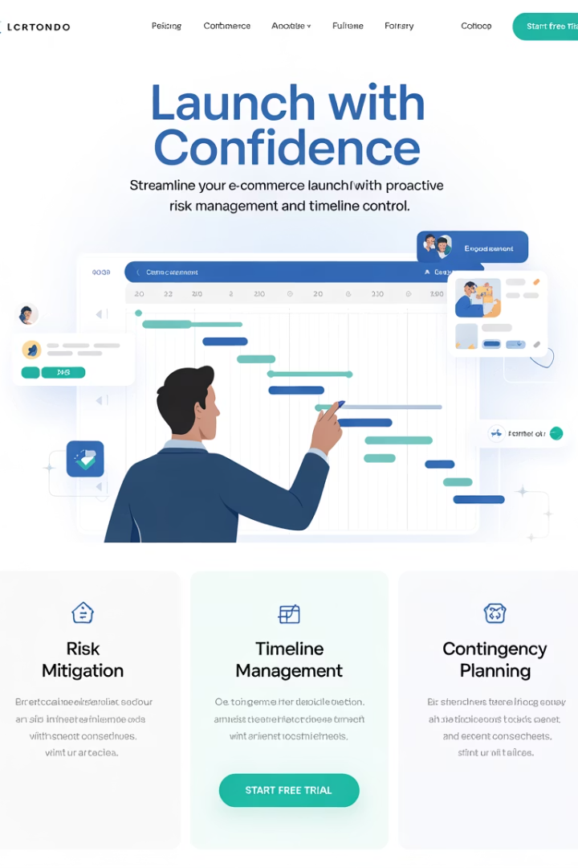
Final Thoughts
E-commerce launches are complex, high-stakes, and filled with moving parts. But with thoughtful planning, technical foresight, and stakeholder alignment, project managers can mitigate risks—not just react to them.
The best PMs anticipate problems before they occur, build cushions into timelines, and always have a contingency plan ready. Launching a digital storefront may be unpredictable, but your risk strategy doesn't have to be.
Planning a site launch or replatforming initiative? Don't let preventable issues derail your go-live. This blog covers key risks and how to manage them—before they impact revenue.

