Slide 1

New Frontiers in Agile Project Management
Discover cutting-edge approaches revolutionizing how organizations implement Agile methodologies. This presentation explores emerging trends that drive project success in today's rapidly evolving business landscape.
kW
by Kimberly Wiethoff

Slide 2
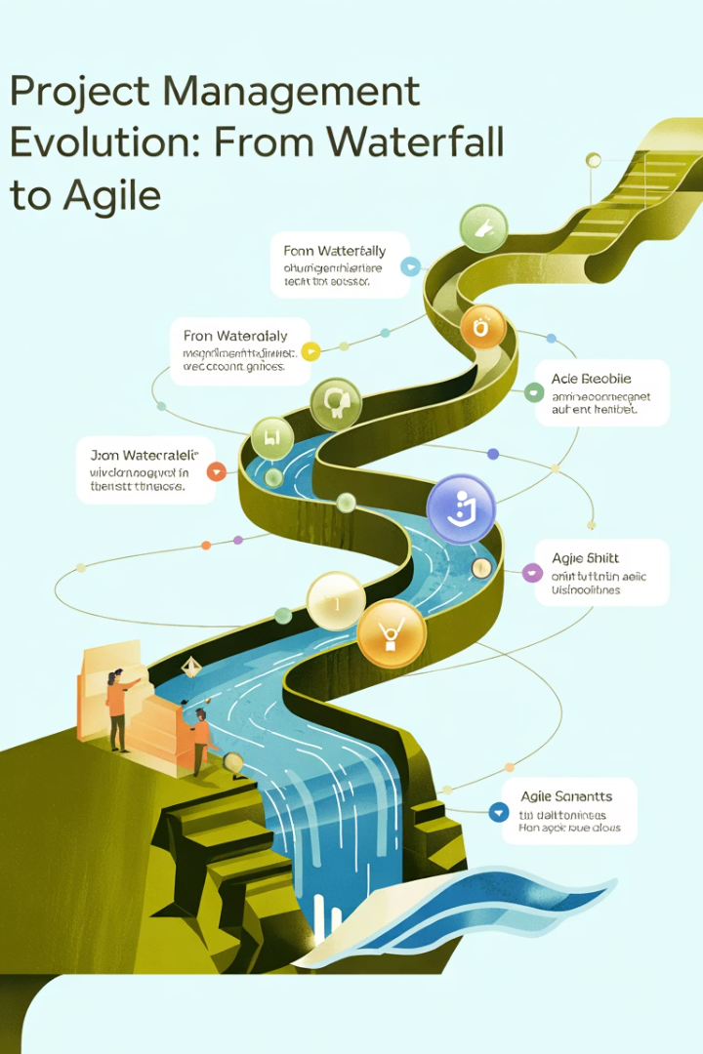




The Evolution of Agile
Traditional PM
Linear, documentation-heavy approach with rigid phases
Early Agile
Iterative development with customer collaboration and adaptability
Modern Agile
Scaling frameworks, hybrid models, and cross-industry applications
Future Agile
AI integration, predictive analytics, and distributed collaboration

Slide 3








Agile at Scale: Managing Complexity
Enterprise Vision
Unified strategic direction
Program Coordination
Aligning multiple teams
Team Autonomy
Self-organization within boundaries
Continuous Delivery
Consistent value creation

Slide 4
Scaling Frameworks Comparison
SAFe
LeSS
Disciplined Agile
Comprehensive framework with multiple layers. Best for large enterprises with complex dependencies.
Minimalist scaling approach. Maintains Scrum principles at scale without adding overhead.
Flexible toolkit approach. Allows organizations to tailor methodologies to context.
One product backlog
Situational choices
Portfolio, program, team levels
Focus on customer value
Process decision framework
Structured roles and ceremonies

Slide 5








Agile Leadership Mindset
Inspiring Vision
Servant Leadership
Create compelling direction that motivates teams
Remove obstacles and enable team success
Continuous Learning
Empowerment
Embrace feedback and model adaptability
Delegate authority and foster ownership

Slide 6

Building an Agile Culture
Psychological Safety
Create environments where team members feel safe to take risks. Encourage honest communication without fear of negative consequences.
Continuous Improvement
Establish regular retrospectives that lead to meaningful change. Celebrate learning from both successes and failures.
Cross-Functional Collaboration
Break down silos between departments. Foster mutual respect across disciplines and organizational boundaries.
Customer Centricity
Keep user needs at the center of all decisions. Regularly gather and incorporate customer feedback throughout development.

Slide 7




Evolving Agile Metrics
Output Metrics
Traditional focus on velocity and story points
Flow Metrics
Measuring cycle time and lead time
Value Metrics
Tracking business outcomes and customer satisfaction
Strategic Metrics
Aligning team performance with organizational goals

Slide 8




Beyond Velocity: Value-Based Metrics
Cycle Time
Customer Satisfaction
Measures efficiency from work start to completion. Shorter cycle times indicate smoother flow and fewer bottlenecks.
Directly measures the ultimate goal: happy users. NPS scores and user feedback provide insights into product quality.
Business Value Delivered
Quality Metrics
Tracks actual impact of features on business goals. Links technical efforts to revenue, cost savings, or user growth.
Measures defect rates and technical debt. Balances speed with sustainable development practices.

Slide 9

Remote Agile: Distributed Teams
53%
24%
Remote Workers
Productivity Gain
Percentage of development teams now primarily remote
Average increase when using proper remote Agile practices
3.5x
86%
Collaboration Tools
Satisfaction
Growth in digital workspace adoption since 2020
Teams reporting effective remote Agile implementation

Slide 10
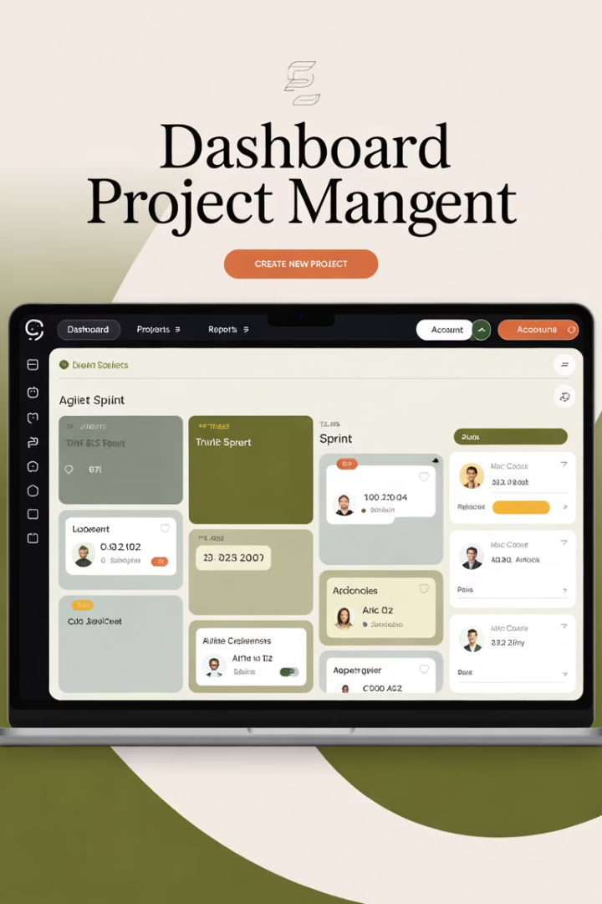
Effective Remote Agile Practices
Digital Workspace Optimization
Create persistent virtual environments with digital boards and team spaces. Ensure all team members have equal access to information and tools.
Structured Communication Protocols
Establish clear guidelines for synchronous vs. asynchronous communication. Use video for high-bandwidth discussions and text for documentation.
Virtual Ceremony Adaptation
Redesign standard meetings for remote engagement. Use facilitation techniques that encourage participation from all team members.
Intentional Social Connection
Build team cohesion through virtual team-building activities. Create opportunities for casual interaction that would happen naturally in an office.

Slide 11
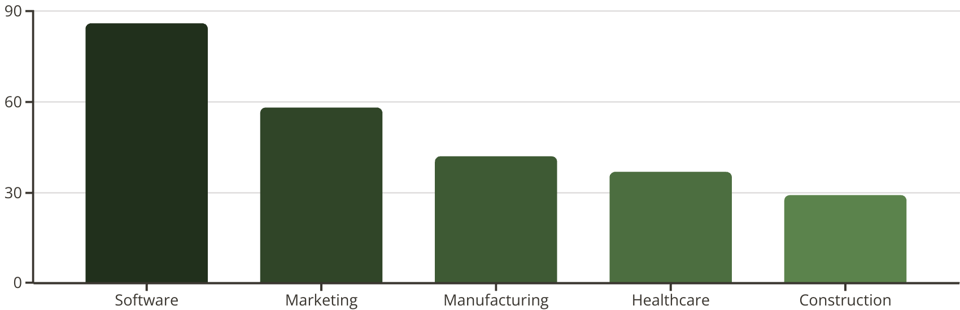
Agile Beyond Software

Slide 12

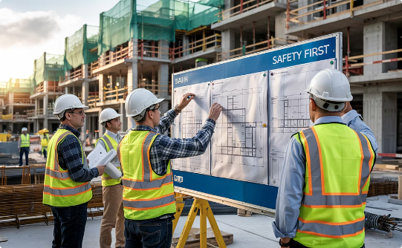

Industry-Specific Agile Adaptations
Marketing Agile
Construction Agile
Healthcare Agile
Campaign sprints focus on rapid testing of messaging. Teams measure customer engagement metrics and iterate quickly based on market response.
Visual management boards track progress on-site. Daily standups address safety concerns and coordinate trade sequencing to minimize delays.
Patient-centered planning boards improve care coordination. Cross-functional teams collaborate on treatment plans with regular reflection periods.

Slide 13
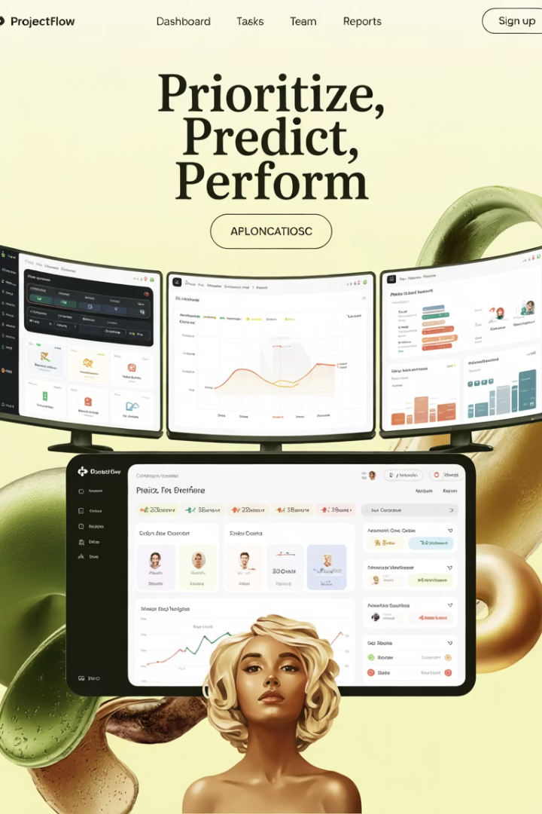




Emerging Agile Technologies
AI-Powered Analytics
Virtual Collaboration Spaces
Predicts project risks and recommends mitigations based on historical patterns. Optimizes team assignments and sprint planning automatically.
Immersive 3D environments for remote teams. Enhances presence and interaction during ceremonies and planning sessions.
Automated Documentation
Predictive Planning Tools
Smart systems capture meeting notes and decisions. Creates living documentation that updates as projects evolve.
Suggests optimal sprint loads based on team velocity. Identifies dependencies before they become blockers.

Slide 14




Key Takeaways & Next Steps
Explore modern frameworks
Evaluate scaling approaches for your context
Cultivate agile leadership
Develop servant leadership skills and mindsets
Adopt value-based metrics
Move beyond velocity to measure outcomes
Implement industry adaptations
Tailor agile practices to your specific domain

