Slide 1

From Agility to Integrity: Why Tomorrow's Leaders Must Balance AI, Ethics, and Sustainability
In an era where artificial intelligence is reshaping leadership and project management, the convergence of agility, sustainability, and ethics has become non-negotiable for those seeking lasting impact in the digital age.
kW
by Kimberly Wiethoff
Managing Projects The Agile Way

Slide 2

Today's Leadership Challenge
Leadership today exists at a critical intersection—where technology's rapid advancement meets growing demands for ethical governance and sustainable practices.
The traditional focus on agility alone is insufficient as organizations navigate:
Unprecedented technological disruption
Shifting workforce dynamics
Accelerated decision-making timelines
Increasing stakeholder scrutiny

Slide 3






The Three Pillars of Modern Leadership
Sustainability
The compass that provides direction and ensures long-term resilience
Agility
The foundation that enables quick adaptation to uncertainty and change
Ethics
The guardrail that protects against harm and maintains trust
Tomorrow's successful organizations will be led by those who masterfully integrate all three elements, refusing to sacrifice one for another.

Slide 4
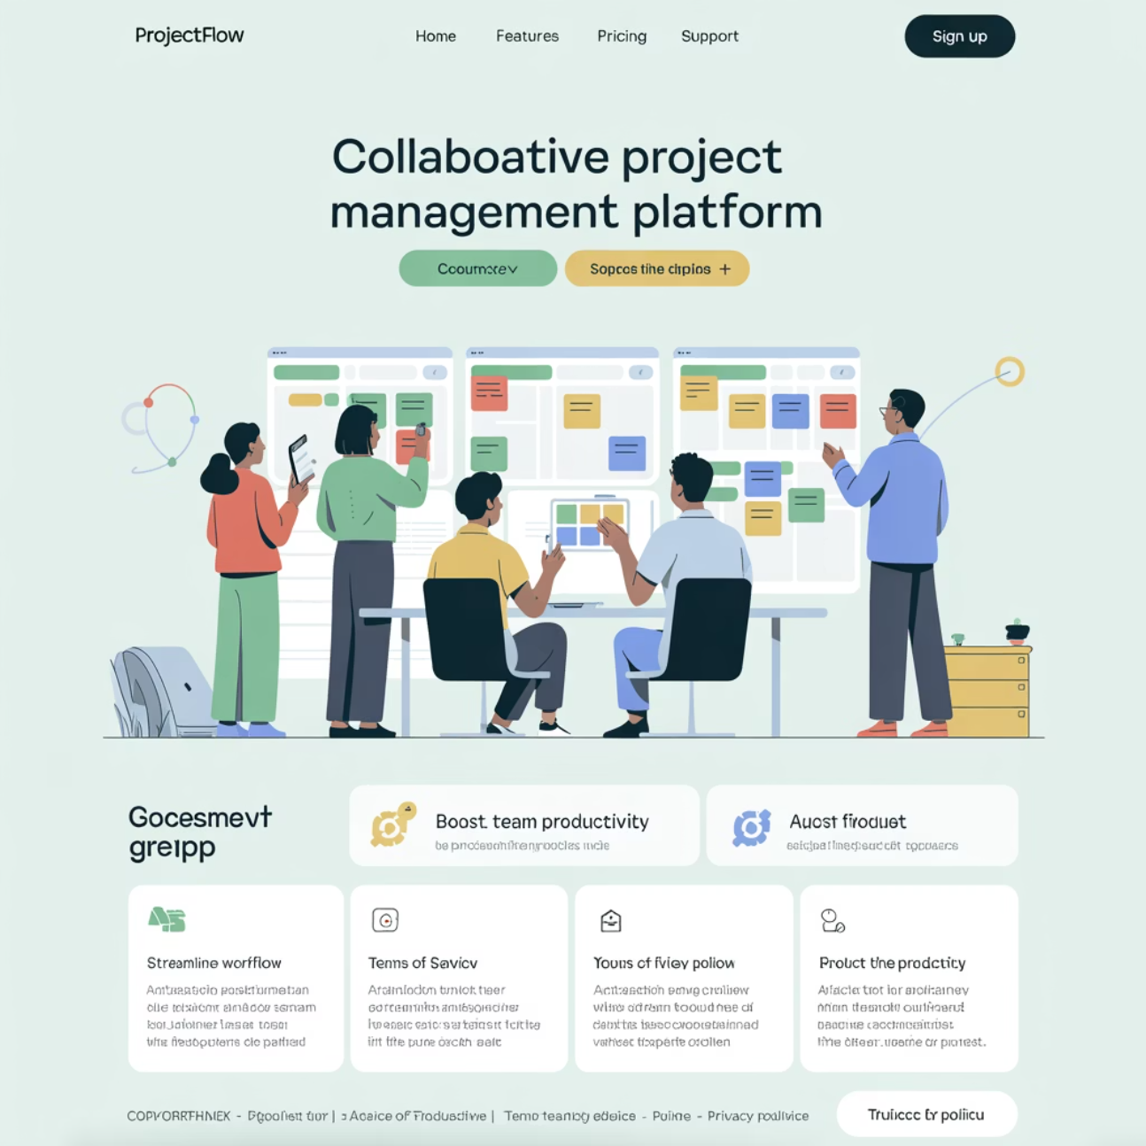
Agility: The Essential Foundation
In today's volatile environment, agility provides the critical capacity to respond to rapid change. Agile leaders:
Foster collaboration across traditional boundaries
Encourage experimentation and calculated risk-taking
Breaking down silos to enable faster information flow and decision-making
Creating psychological safety for teams to innovate without fear of failure
Empower teams to pivot when circumstances change
Distributing authority to enable faster response to emerging challenges

Slide 5


Case Study: Agility in Action
When COVID-19 struck, Memorial Healthcare System needed to rapidly shift operations. Their established agile practices allowed them to:
Before Crisis
After Agile Response
Quarterly planning cycles
Daily adaptive planning
Limited telehealth capacity
5,000% increase in telehealth visits
Traditional staffing models
AI-powered resource allocation
Key Insight: Agility enabled rapid response, but ethical questions about AI-driven care and long-term sustainability of new models required additional leadership focus.

Slide 6

Sustainability: The Strategic Compass
Environmental Impact
Social Responsibility
Leaders must address the carbon footprint of operations, especially energy-intensive AI systems that drive modern business processes.
Creating equitable opportunities, fostering diversity, and ensuring technology augments rather than replaces meaningful human work.
Economic Durability
Building business models that generate value over the long term, avoiding shortcuts that mortgage future success.
Sustainable leadership means optimizing for resilience across all three dimensions—not just quarterly profits or technological advancement for its own sake.

Slide 7

The Sustainability Imperative
Beyond environmental concerns, sustainability in leadership encompasses building lasting organizational capacity. Sustainable project management requires:
Resource optimization that considers long-term impacts
Knowledge management systems that preserve institutional learning
Talent development that prepares teams for future challenges
Stakeholder engagement that builds enduring relationships
When sustainability becomes a core leadership value, organizations make decisions that stand the test of time.

Slide 8

Ethics: The Essential Guardrail
The algorithmic revolution has raised the stakes of ethical leadership. AI systems now influence crucial decisions across industries—from hiring to healthcare, lending to legal judgments.
Algorithmic Bias
Privacy Concerns
AI systems can perpetuate or amplify existing biases if not carefully designed and monitored. Leaders must implement rigorous testing and diverse development teams.
The data that powers AI creates privacy risks. Ethical leaders establish clear boundaries for data collection, storage, and usage beyond mere compliance.
Transparency
Complex AI systems often function as "black boxes." Leaders must champion explainable AI and ensure humans remain accountable for algorithmic decisions.

Slide 9

The Project Manager's Ethical Imperative
Project managers stand at the critical intersection of technology implementation and organizational values. They must serve as ethical stewards by:
Questioning the intended and unintended consequences of AI deployments
Ensuring diverse perspectives inform technology development
Building checkpoints for ethical review throughout project lifecycles
Advocating for responsible AI governance frameworks
Project managers are often the last line of defense against ethically questionable technology implementations.

Slide 10
Ethics in Action: The Practical Challenge
73%
94%
3.7x
Leadership Gap
Business Impact
Performance Boost
Of executives believe ethical AI is important, but only 25% have comprehensive policies in place
Of companies report that ethical failures have damaged their reputation, customer trust, or financial performance
Higher financial performance for organizations with robust ethical frameworks compared to industry peers
The data is clear: ethical leadership is not just morally right—it's a business imperative that directly impacts organizational success and resilience.

Slide 11

The New Leadership Mandate
Adapt Quickly Without Losing Purpose
Prioritize Sustainability in Every Decision
Embed Ethics into Organizational DNA
Balance rapid response to emerging opportunities with unwavering commitment to organizational mission and values
Evaluate all project choices through the lens of long-term environmental, social, and organizational health
Move beyond compliance to make ethical considerations central to strategy, operations, and technology adoption

Slide 12

Practical Integration Framework
Leaders can integrate agility, sustainability, and ethics through intentional practices:
Conduct Triple-Impact Assessments
Establish Ethics Governance
Create cross-functional ethics committees with real authority to review AI implementations
For major initiatives, evaluate business, environmental, and social impacts with equal rigor
Update Success Metrics
Invest in Training
Expand beyond financial KPIs to include sustainability and ethical performance indicators
Develop leader and team capabilities across all three dimensions—not just technical skills

Slide 13

The Path Forward: Balancing Agility with Integrity
Organizations that successfully balance agility, sustainability, and ethics will build:
Resilient Business Models
Magnetic Cultures
Capable of weathering disruption while maintaining stakeholder trust
That attract and retain top talent seeking purpose-driven work
Innovation Advantage
Sustainable Growth
Through diverse perspectives and enhanced risk management
By creating value that extends beyond quarterly earnings
The future belongs not to the fastest or the most powerful, but to those who balance speed with responsibility.

Slide 14

From Projects to Purpose: Your Leadership Legacy
"The true measure of leadership is not what you accomplish today, but what you leave behind for tomorrow."
As AI continues to transform our world, your leadership choices will echo far beyond your tenure. By embracing agility while anchoring to sustainability and ethics, you won't just deliver successful projects—you'll create meaningful legacies that stand the test of time.
The question is not whether you can afford to balance these imperatives, but whether you can afford not to.

