Slide 1
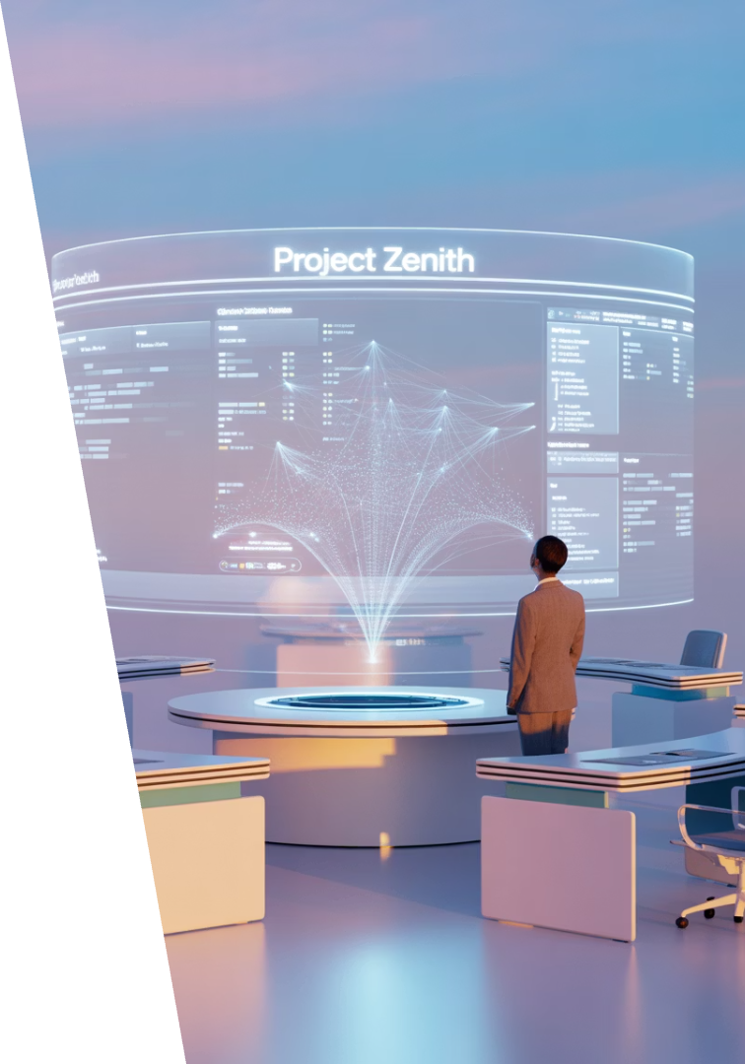
The Future of Remote Project Management
Remote work is no longer temporary—it's a strategic approach embraced worldwide. As we move beyond 2025, project managers must prepare for significant shifts in how distributed teams operate.
kW
by Kimberly Wiethoff

Slide 2
Asynchronous Work Becomes the Norm
Time-Zone Flexibility
Documentation Focus
Structured Updates
Team members collaborate across global time zones without disrupting focus time.
Clear documentation replaces constant meetings and real-time availability requirements.
Regular but non-intrusive progress tracking keeps everyone aligned.

Slide 3
AI-Powered Project Management
Strategic Leadership
PMs focus on high-value work
AI Assistants
Automated forecasting and risk flagging
Task Automation
Routine updates and reporting handled by AI
AI will transform how projects are managed, removing administrative burden and enhancing decision-making capabilities.

Slide 4
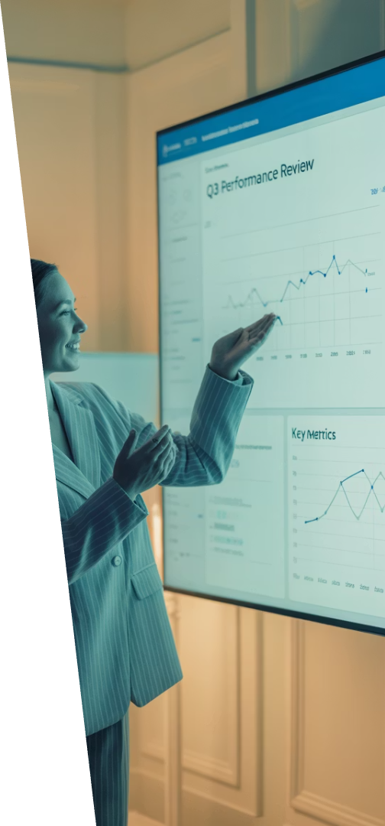
Cultivating Digital Presence
Project Dashboards
Visual representations of progress keep work visible to all stakeholders.
Strategic Communication
Frequent, intentional updates maintain influence without physical presence.
Public Recognition
Celebrating achievements virtually builds team culture and motivation.
Video Updates
Personalized stakeholder communications maintain engagement and trust.

Slide 5
Beyond Video Calls
Interactive Whiteboards
VR Planning Sessions
AI-Facilitated Meetings
Digital canvases facilitate visual thinking and complex problem-solving across distributed teams.
Immersive environments create presence and engagement beyond traditional video meetings.
Smart tools capture action items, generate summaries, and drive accountability.
Real-time collaboration
Spatial collaboration
Automated notes
Persistent workspaces
3D modeling
Task assignment
Template-driven planning
Enhanced team presence
Follow-up tracking

Slide 6
Digital HQ Platforms
Team Connection
Casual Interaction
Centralized hubs where teams gather virtually
Spaces that mimic office spontaneity
Integrated Toolsets
Ideation Spaces
All project tools accessible in one place
Dedicated environments for creativity
Platforms like Mural, Gather, and WorkHub will create more human-centered digital workplaces.

Slide 7
The Evolving PM Skill Set
Digital Fluency
Emotional Intelligence
Project management software
Remote team motivation
Cultural sensitivity
Data visualization tools
Virtual conflict resolution
Automation capabilities
Non-verbal communication
AI prompt engineering
Data Storytelling
Translating metrics into insights
Visual communication
Executive reporting
Decision support

Slide 8
PM-Led Cybersecurity
Security Awareness
Building team knowledge about threats
Risk Planning
Integrating security into project lifecycle
Compliance Verification
Ensuring regulatory requirements are met
Vendor Management
Vetting third-party security practices

Slide 9
Measuring Team Wellbeing
Current
Target
Future organizations will track team health as closely as they track project outcomes, making wellbeing a key performance indicator.

Slide 10
Wellbeing Tools for PMs
Pulse Surveys
Focus Time Blocks
Quick, anonymous check-ins that track team morale and engagement over time.
Scheduled periods where meetings are prohibited to enable deep work.
Workload Balancing
Recognition Platforms
AI-powered tools that identify overallocation and suggest redistribution.
Systems that facilitate peer appreciation and celebrate contributions.

Slide 11
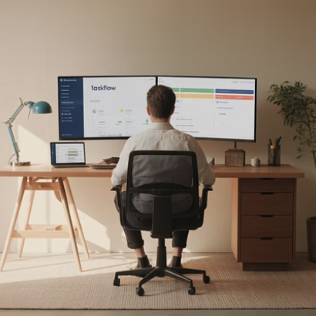
Global Talent Optimization
Remote work eliminates geographical boundaries, allowing organizations to build teams based on skills rather than location. PMs will need to master cross-cultural management.

Slide 12
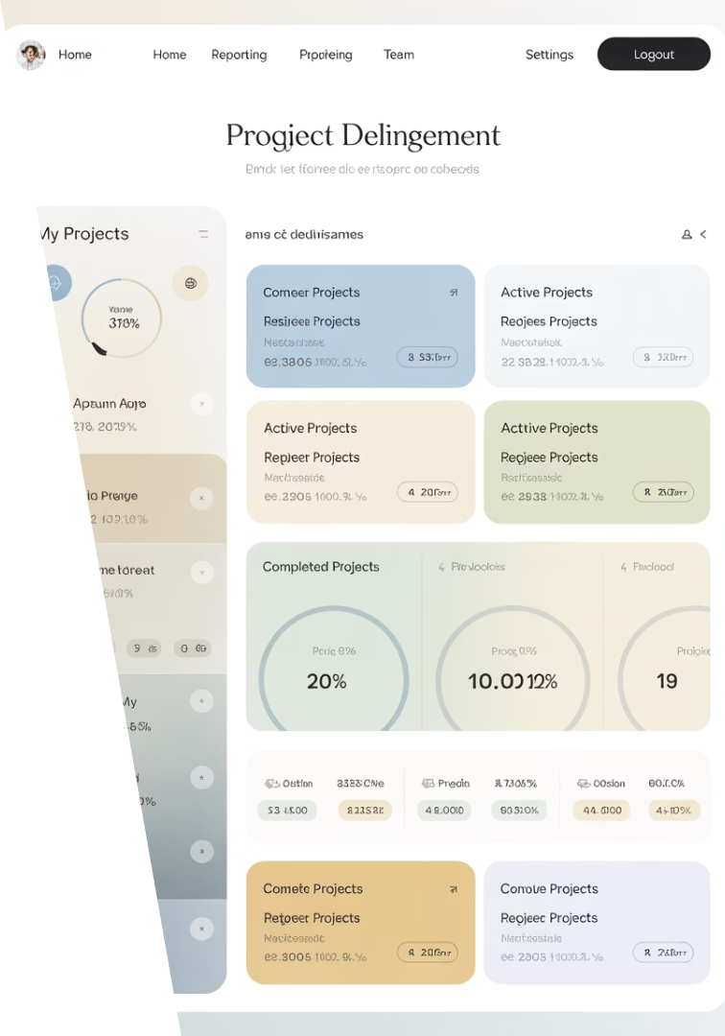
Results-Based Performance
Clear Deliverables
Focus shifts from hours worked to outcomes achieved.
Objective Metrics
Performance measured through completed tasks and quality.
Autonomous Execution
Team members choose when and how to complete work.
Value Recognition
Rewards based on impact rather than visibility.

Slide 13
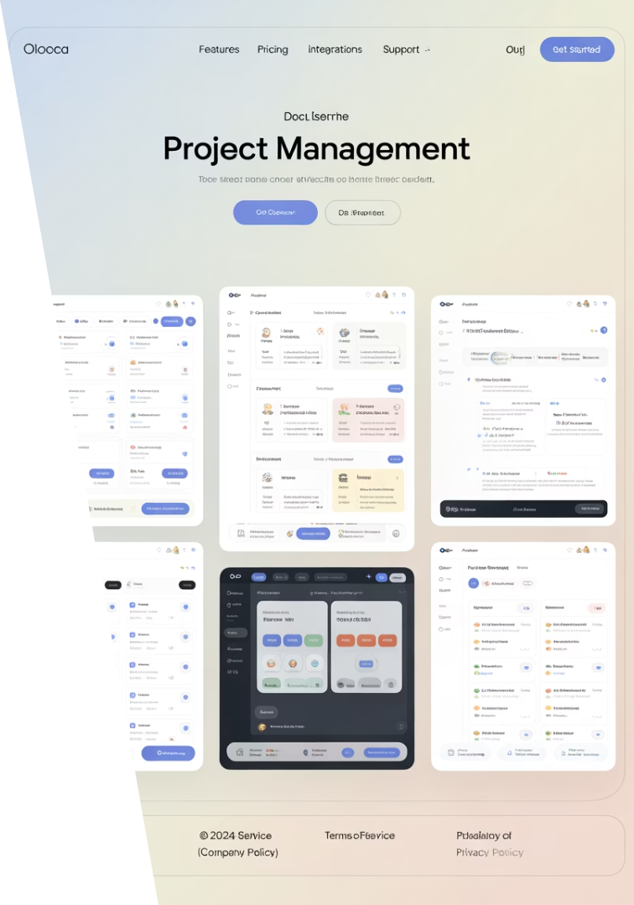
Essential PM Platforms
65%
3x
AI Integration
Productivity Gain
PM tools with embedded artificial intelligence capabilities by 2026
Reported efficiency increase from integrated digital HQ platforms
82%
40%
Remote Adoption
Time Savings
Organizations planning permanent remote or hybrid arrangements
Administrative work reduction through automation

Slide 14
Leading From Anywhere
Balance Technology & Trust
Use tools to enable connection, not monitoring. Build relationships based on outcomes and transparency.
Combine Automation & Empathy
Let AI handle routine tasks while you focus on the human elements of leadership.
Blend Flexibility & Focus
Create structure that supports autonomy while maintaining clarity on priorities and goals.
The future of remote project management is agile, digital, and deeply human. Success depends not on where you lead from, but how effectively you deliver.

