Slide 1

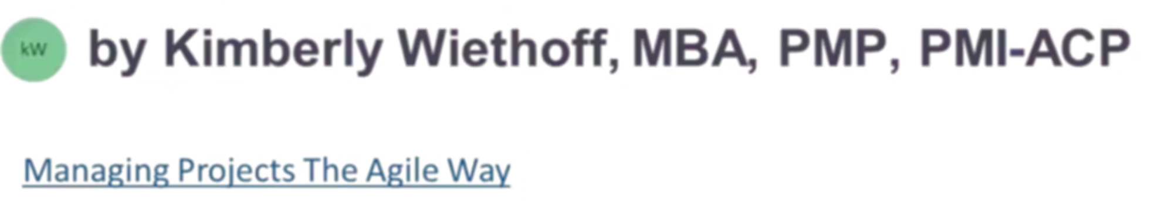
The AI-Powered PMO: Transforming Project Management
Traditional PMO tools become bottlenecks as organizations scale. AI offers a strategic transformation. Let's explore how machine learning is reshaping modern PMOs and keeping organizations competitive.
#PMO #AIInProjectManagement #MachineLearning #ProjectPortfolioManagement #DigitalPMO #SmartPMO #StrategicExecution #BusinessTransformation #DataDrivenPMO #FutureOfWork

Slide 2






Data Overload to Predictive Insights
Actionable Insights
Proactive decision-making based on AI predictions
Pattern Recognition
Identifying trends across multiple projects
Data Processing
Sifting through budgets, timelines, and resources
PMOs struggle with overwhelming data volumes. AI detects patterns and predicts risks before they become issues.

Slide 3





AI-Driven Project Forecasting
Historical Data
Past project performance metrics
AI Analysis
Pattern detection and risk modeling
Predictions
Forecasted delays and overruns
Intervention
Proactive management decisions
AI analyzes cross-project data to forecast which initiatives may deliver late based on historical patterns.

Slide 4

Automating PMO Operations
1
Automated Status Reporting
2
Resource Planning Optimization
Real-time reports generated without manual consolidation
AI-powered allocation of team members across projects
3
Compliance Verification
4
KPI Tracking & Anomaly Detection
Automatic checks against governance requirements
Instant flagging of metrics that deviate from targets
AI streamlines routine processes. PMO leaders can focus on portfolio value instead of paperwork.

Slide 5
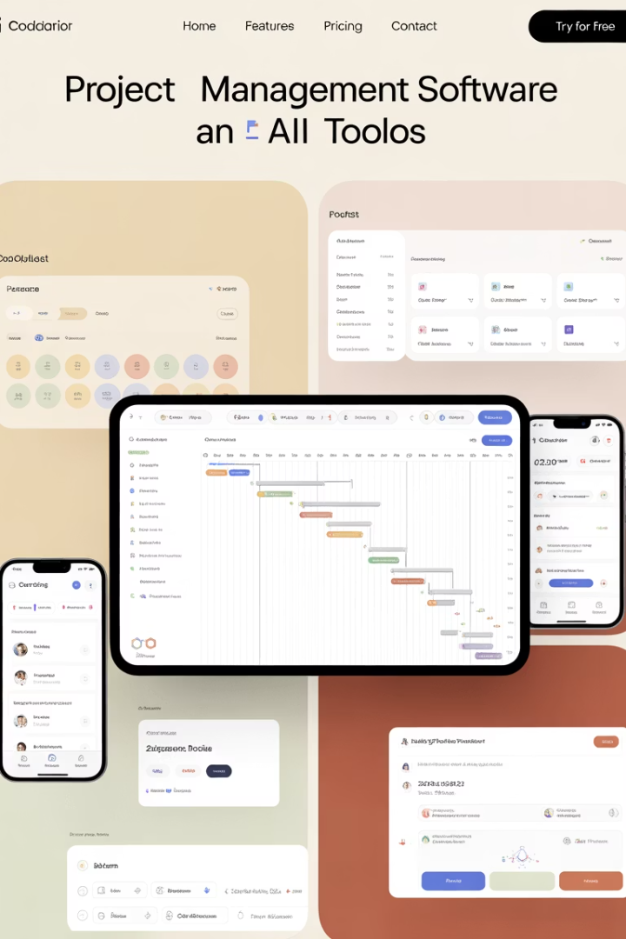




Essential AI-Powered PMO Tools
Jira Align
Azure DevOps
Enterprise agility platform with AI plugins for portfolio management
Project tracking with machine learning capabilities
Smartsheet Control Center
Power BI
Automated portfolio governance and reporting
Predictive analytics dashboards for portfolio insights
These tools reduce overhead and provide real-time visibility into project health across the portfolio.

Slide 6








Smarter Portfolio Prioritization
ROI Projections
Strategic Alignment
Financial return forecasts enhanced by AI
Scoring based on business OKRs
Risk Assessment
Resource Constraints
Predictive risk models from historical data
Capacity modeling across portfolio
Machine learning shifts prioritization from gut-feel to data-backed investment planning.

Slide 7

Data-Driven Decision Making
Faster Decisions
More Defensible Choices
AI-processed data enables quicker go/no-go calls on projects. Teams can respond to market changes with greater agility.
Data-backed recommendations provide clear rationale for project selections. Stakeholders understand why certain initiatives are prioritized.
Reduced Bias
Machine learning models help overcome human cognitive biases. Political influence has less impact on portfolio decisions.
Organizations can make more objective investment choices with AI support.

Slide 8
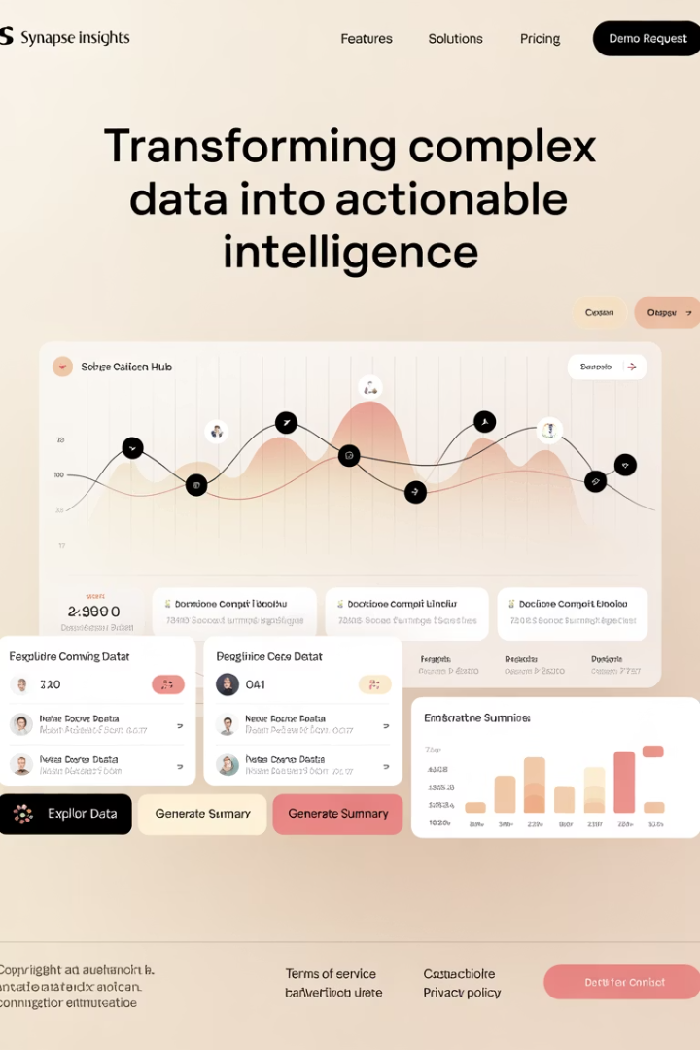




AI-Driven Stakeholder Communication
Auto-Generated Portfolio Summaries
AI creates concise executive overviews from detailed project data
Sentiment Analysis
Algorithms detect stakeholder concerns from feedback
AI Chatbots
24/7 response to project inquiries from stakeholders
Personalized Dashboards
Tailored views based on stakeholder role and interests
AI helps translate technical updates into digestible, decision-ready insights for executives.

Slide 9








Continuous Improvement Through AI
Project Execution
AI Analysis
Teams deliver work and capture performance data
Algorithms process metrics and identify patterns
Improvement Recommendations
Implementation
PMO adapts frameworks based on insights
System suggests process and methodology changes
A learning PMO evolves its methodologies based on measurable outcomes, not just retrospectives.

Slide 10



PMO Evolution Journey
Traditional PMO
Process-focused with manual reporting
Data-Driven PMO
Analytics-enhanced with basic automation
AI-Powered PMO
Predictive capabilities with strategic focus
The PMO has evolved from a compliance-focused reporting hub to a forward-looking, insight-driven strategic partner.

Slide 11




Implementing AI in Your PMO
Assess Current Capabilities
Start With Targeted Use Cases
Build Your Data Foundation
Develop AI Competencies
Train PMO staff on AI capabilities. Partner with data science teams or vendors for specialized expertise.
Evaluate your PMO's data maturity and process standardization. Identify pain points that AI could address.
Begin with specific applications like automated reporting or risk prediction. Build confidence through quick wins.
Ensure consistent data collection across projects. Clean historical data for machine learning models.
A phased approach helps PMOs integrate AI successfully without disrupting ongoing operations.

Slide 12

Measuring AI-Powered PMO Success
30%
25%
Time Savings
Risk Reduction
Reduction in administrative work through automation
Decrease in unexpected project issues
40%
20%
Improved Forecasting
Portfolio Performance
Increase in schedule and budget prediction accuracy
Growth in successful project completions
Track these metrics to demonstrate the value of AI investments in your PMO.

Slide 13
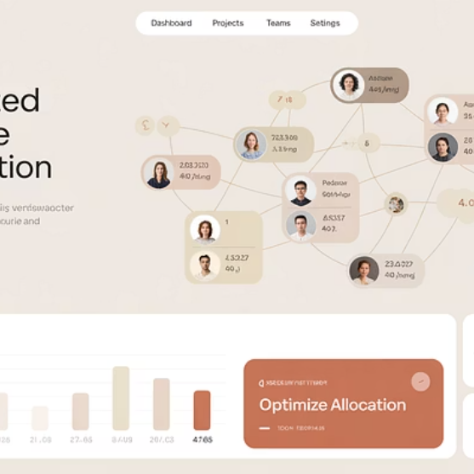
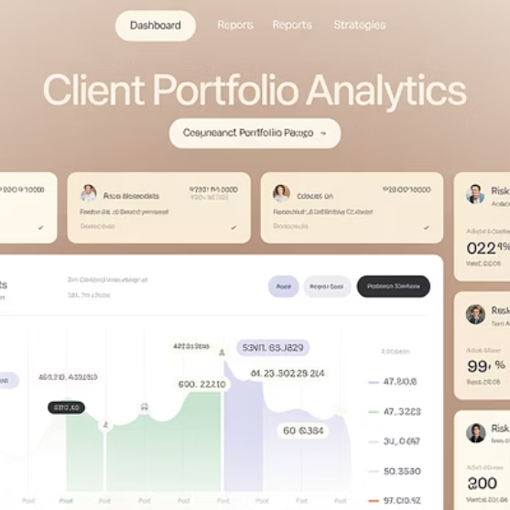

The Future Belongs to AI-Powered PMOs
The AI-powered PMO is happening now. Organizations integrating these capabilities gain competitive advantage through faster, smarter strategic execution.
The future of project success belongs to those who can see around corners—and act before others do.

Slide 14
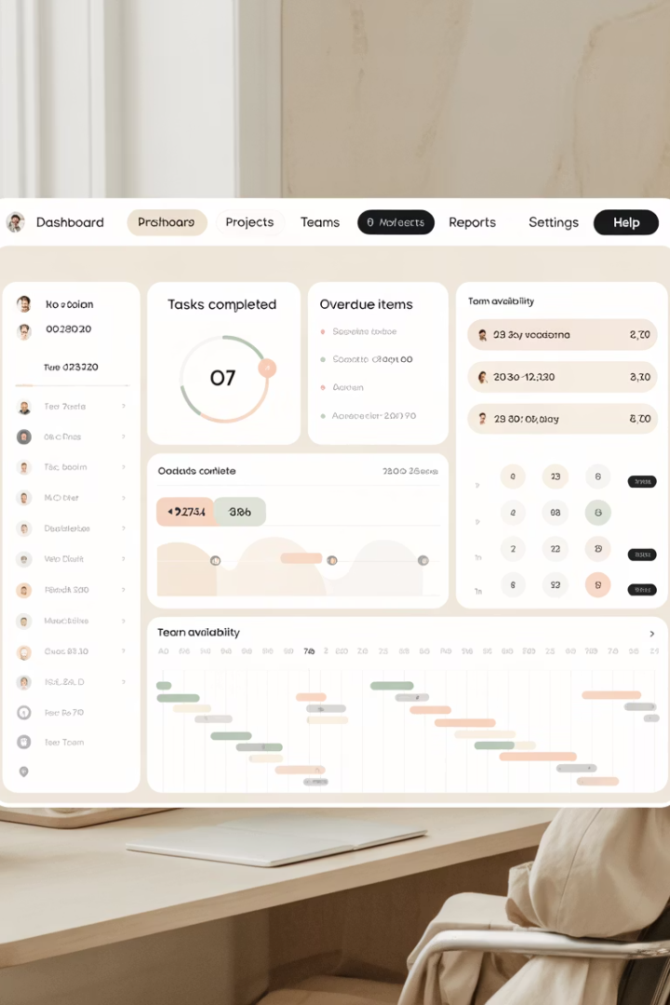
Final Thoughts
The AI-powered PMO is not a futuristic concept—it's happening now. By integrating AI and machine learning, today's PMOs can become faster, smarter, and more strategic. The shift is clear: from a compliance-focused reporting hub to a forward-looking, insight-driven partner in business transformation.
If your PMO isn't already exploring AI, now is the time to start. Because the future of project success belongs to those who can see around corners—and act before others do.

