Slide 1

Microsoft Dynamics CRM vs. Salesforce: The Project Manager's Guide
Choosing between Microsoft Dynamics CRM and Salesforce represents one of the most consequential technology decisions for organizations today. For project managers tasked with implementing or migrating these systems, understanding the nuanced differences between these platforms is essential for project success.
This presentation explores the key differences, advantages, and considerations for project managers evaluating these CRM giants. We'll examine integration capabilities, customization options, cost considerations, user experience, and other critical factors to help you make informed recommendations tailored to your organization's unique needs.
kW
by Kimberly Wiethoff

Slide 2
Ecosystem & Integration Landscape
Salesforce Ecosystem
Microsoft Dynamics Ecosystem
Built on its proprietary Force.com platform, Salesforce offers an extensive AppExchange marketplace with thousands of pre-built integrations and solutions.
Designed to work seamlessly within the Microsoft universe, Dynamics CRM integrates natively with Office 365, Teams, SharePoint, Power BI, and Azure services.
While comprehensive, integrating with non-Salesforce systems often requires third-party tools, custom API development, or additional middleware solutions that can increase project complexity.
This native compatibility significantly reduces integration effort and cost for organizations already invested in the Microsoft stack, creating a unified experience across business applications.

Slide 3





Customization & Development Approaches
Salesforce Tools
Lightning App Builder, Apex code, and declarative workflows enable powerful customizations but rely on Salesforce-specific knowledge.
Dynamics Tools
Power Apps, Power Automate, and Dataverse leverage familiar Microsoft development patterns (C#, .NET) that existing IT teams often already understand.
Skill Requirements
Salesforce customization typically requires more specialized certification, while Dynamics leverages widely available Microsoft development skills.
Time-to-Value
Implementation timelines vary based on complexity, but Microsoft-centric organizations often see faster deployment with Dynamics.

Slide 4
Licensing & Cost Considerations
Salesforce Pricing Model
Dynamics Pricing Model
Project Manager Considerations
Premium pricing structure with modular licensing (Sales Cloud, Service Cloud, Marketing Cloud, etc.). Each module is priced separately, and costs can multiply quickly when adding capabilities.
More competitive pricing, especially when bundled within Microsoft enterprise agreements that may include multiple Dynamics 365 applications.
Look beyond initial implementation costs to evaluate 3-5 year TCO. Consider growth projections, additional module needs, and long-term support requirements when building financial models.
Power Platform tools (Power BI, Power Apps) are often included or heavily discounted with existing Microsoft licenses, reducing peripheral costs.
Advanced features, storage, and API calls often incur additional charges, making total cost of ownership calculations complex.
Factor in training, customization, and integration costs that may vary significantly between platforms.

Slide 5
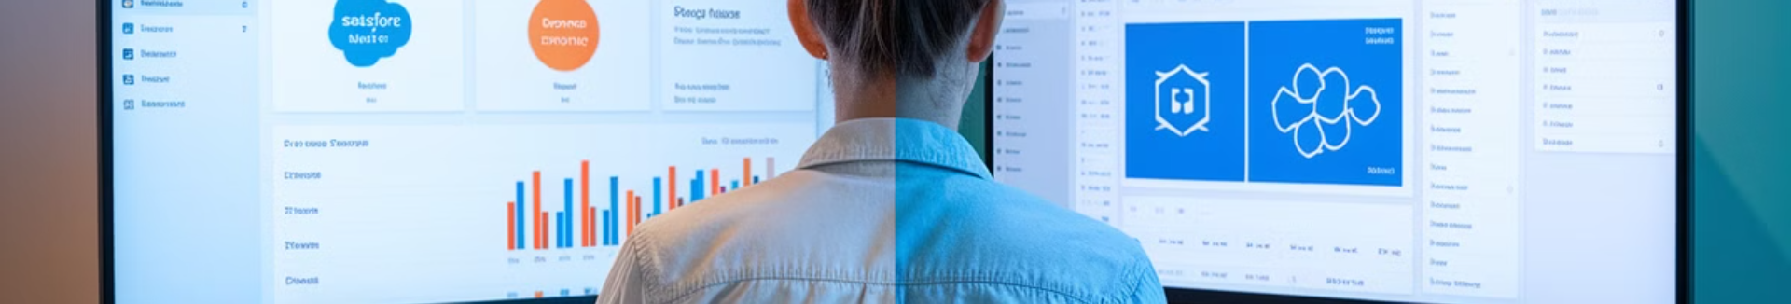




User Interface & Experience
Salesforce Lightning Interface
Dynamics 365 Interface
Modern, intuitive design with strong mobile app support and extensive customization options. The experience is consistent across devices with robust offline capabilities.
Clean, familiar Microsoft-styled UI that integrates visually with Office applications. Users already comfortable with Microsoft products typically experience a smoother transition.
Mobile Experience
User Adoption Factors
Both platforms offer comprehensive mobile applications, but Salesforce has historically led in mobile innovation. Dynamics continues to close this gap with each release.
Interface familiarity significantly impacts adoption rates. Consider your organization's existing technology preferences when evaluating potential training needs.

Slide 6








Reporting & Analytics Capabilities
Salesforce Analytics
Built-in dashboards with standard reports
Dynamics Analytics
Native Power BI integration
Tableau integration (additional licensing)
Excel integration for ad-hoc analysis
Einstein Analytics for AI-powered insights
AI Builder for predictive analytics
Real-time dashboard capabilities
Strong visualization capabilities
Visibility Factors
Data Management
Executive dashboard considerations
Accessibility and governance
Ease of creating custom KPIs
Data export flexibility
Cross-functional reporting
Custom report development
Data sharing capabilities
Data warehouse integration

Slide 7



Community & Support Ecosystem
Community Size & Resources
Salesforce boasts a larger dedicated CRM community with Trailhead learning resources, while Microsoft leverages its broader technology ecosystem community.
Partner Network Access
Both platforms offer extensive certified implementation partners, though Salesforce partners typically specialize more narrowly in CRM while Microsoft partners often cover broader technology stacks.
Support Quality & Availability
Microsoft offers enterprise-grade support with extensive documentation, while Salesforce provides tiered support packages with premium options for mission-critical implementations.

Slide 8





Implementation Timeline Considerations
Planning & Requirements
Data Migration
Both platforms require thorough discovery, but Microsoft implementations often leverage existing system knowledge. Timeline: 4-8 weeks depending on complexity.
Migration complexity depends on source systems. Microsoft environments may see smoother transitions from existing Microsoft data sources. Timeline: 4-8 weeks.
Development & Customization
Training & Adoption
Salesforce customization typically requires more specialized resources, while Dynamics can leverage existing Microsoft developers. Timeline: 8-16 weeks.
User familiarity with Microsoft products can accelerate Dynamics adoption, while Salesforce may require more extensive training. Timeline: 2-6 weeks.

Slide 9








Key Decision Factors for Project Managers
Strategic Alignment
Match CRM choice to long-term organizational technology strategy and vision
Total Cost of Ownership
Consider 3-5 year costs including licenses, customization, integration, and support
Technical Requirements
Evaluate feature needs, integration points, and customization requirements
Organizational Readiness
Assess internal skills, existing technology, and change management capabilities

Slide 10


Implementation Success Factors
Success Rate
User Adoption
CRM implementations meeting all success criteria when following best practices
Average adoption rate with proper training and change management
Efficiency Gain
ROI Timeline
Average productivity improvement after successful implementation
Average time to realize full return on CRM investment
Successful CRM implementations depend more on execution than platform choice. Focus on clear requirements, stakeholder engagement, effective change management, and thoughtful data migration. Develop a comprehensive training program and establish meaningful KPIs to track success.
Remember that CRM implementation is a journey, not a destination. Plan for continuous improvement cycles after the initial launch to maximize long-term value and user adoption.

Slide 11
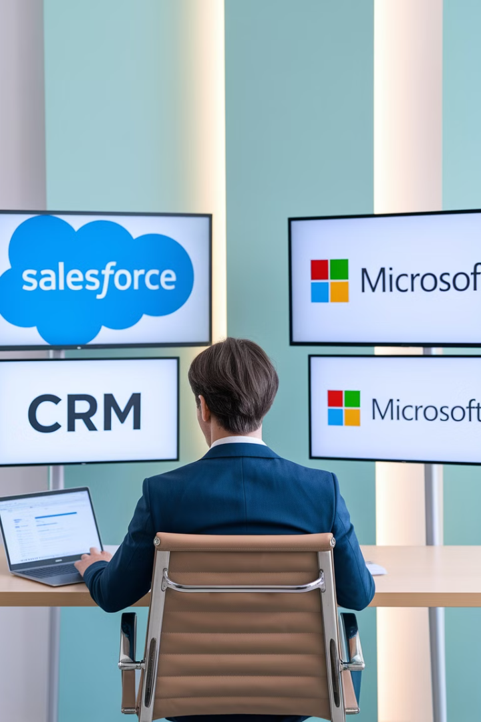
Final Thoughts
There's no one-size-fits-all answer in the Salesforce vs. Microsoft Dynamics CRM debate. Both platforms offer powerful capabilities—but your decision should align with your organization's tech stack, user base, customization needs, and long-term strategy.
As a project manager, your role is to:
Guide stakeholder discussions with unbiased insights.
Identify project constraints (timeline, budget, internal skillsets).
Focus on user adoption, scalability, and total cost of ownership—not just feature comparisons.
Whatever platform you choose, success comes down to how well you manage expectations, lead change, and deliver value.

