Slide 1
Maximizing Project Visibility with Microsoft Dynamics 365 Project Operations
In today's fast-paced business environment, project managers need comprehensive visibility to stay ahead of risks, scope creep, resource constraints, and budget issues. Microsoft Dynamics 365 Project Operations provides a unified solution that combines project management, resource planning, time tracking, billing, and financial insights into a single powerful platform.
Whether you're overseeing software development, professional services, or enterprise-wide transformation initiatives, this integrated system equips you with the tools to plan smartly, execute efficiently, and deliver with confidence.
kW
by Kimberly Wiethoff

Slide 2
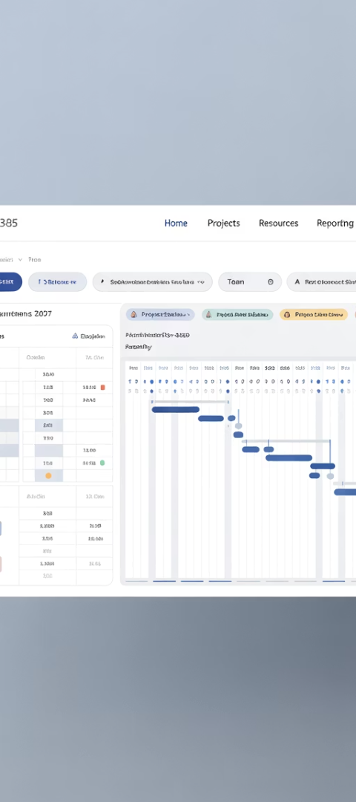
Understanding Microsoft Dynamics 365 Project Operations
Purpose-Built Design
Unified Platform
Microsoft Integration
Specifically created for project-based organizations to manage the entire project lifecycle from initial quote to final invoice
Combines project planning, finance, sales, and resource management functions into a centralized system
Seamlessly works with Teams, Power BI, Outlook, and Excel to create an intelligent workspace
Unlike traditional project management tools that operate in isolation, Project Operations creates a cohesive ecosystem where data flows freely between functions. This integration eliminates silos and provides real-time insights that enable faster, more informed decision-making across your organization.

Slide 3
Unified Project Planning
Create Visual Timelines
Build comprehensive project schedules using visual task boards and Gantt charts
Define Dependencies
Establish task relationships, critical paths, and key milestones
Adjust in Real-Time
Modify timelines based on actual resource availability and changing priorities
With Dynamics 365 Project Operations, you can finally say goodbye to disconnected spreadsheets and fragmented planning tools. The built-in scheduling capabilities, powered by Microsoft Project for the web, provide a single source of truth that all team members and stakeholders can access and understand.
This unified approach ensures everyone works from the same plan, reducing miscommunications and keeping projects on track even as conditions change.

Slide 4
Real-Time Budget & Cost Tracking
Monitor Cost-to-Completion
Track project expenses as they occur with automatic updates to financial forecasts
Analyze Budget vs. Actuals
Compare planned spending against real expenditures with intuitive dashboards
Predict Profitability
Forecast financial outcomes using integrated revenue and expense data
Financial visibility is critical for project success, yet many management tools treat budgeting as an afterthought. Dynamics 365 Project Operations puts financial control at the center of project management, tracking cost accruals, actuals, forecasts, and billing in real-time.
This integrated approach eliminates financial surprises during reviews or audits, enabling proactive management of project economics and more predictable delivery outcomes.

Slide 5
Resource Utilization and Capacity Planning
Skill-Based Assignment
Availability Management
Future Capacity Forecasting
Utilization Monitoring
Match team members to tasks based on expertise, certification, and experience levels
View real-time resource calendars to prevent overbooking and identify capacity gaps
Project staffing needs weeks or months ahead to ensure adequate resources
Track billable hours against capacity to maximize productivity and profitability
Finding the right people with the right skills at the right time often determines project success. Dynamics 365 Project Operations transforms resource management with powerful filters and heat maps that visualize capacity across your organization.
This comprehensive view allows project managers to optimize team assignments, avoid resource conflicts, and ensure team members aren't overworked—ultimately improving morale while minimizing delivery risks.

Slide 6
Time and Expense Management
Streamlined Submission
Automated Workflows
Task-Level Tracking
Team members can log hours and expenses from any device, with intuitive interfaces that minimize administrative burden.
Customizable approval routes ensure proper oversight while accelerating the review process through automated notifications and reminders.
Hours logged against specific tasks provide granular visibility into effort distribution and enable accurate velocity metrics.
The system supports various input methods, including mobile apps for capturing receipts on the go and automated time tracking integrations.
Rules-based validation helps prevent common errors, ensuring that submissions align with organizational policies and client billing requirements.
This detailed tracking creates a historical database of effort estimates versus actuals, continuously improving the accuracy of future project plans.
Accurate time and expense data forms the foundation of project tracking, billing, and future estimating. With Dynamics 365 Project Operations, these critical processes become seamless parts of the daily workflow rather than burdensome administrative tasks.

Slide 7
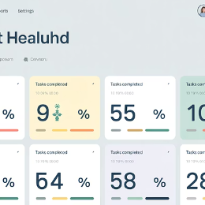
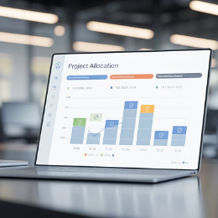
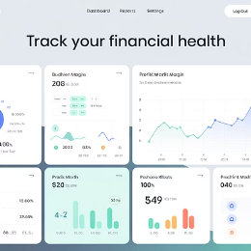
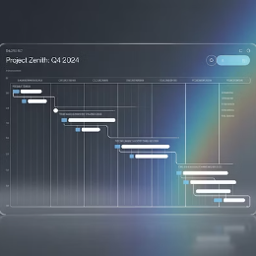
Data-Driven Dashboards
Through native integration with Power BI, Dynamics 365 Project Operations transforms raw project data into actionable visual insights. Project managers can monitor health indicators, budget burn rates, team velocity, milestone progress, and risk trends—all through customizable dashboards that highlight what matters most.
These real-time visualizations enable stakeholders at all levels to quickly understand project status without wading through detailed reports, facilitating faster decision-making and more effective governance.

Slide 8
Seamless Team Collaboration
Microsoft Teams Integration
Access project documents, conversations, and updates directly within Teams workspaces linked to specific projects
Outlook Synchronization
Schedule project meetings and manage task assignments without leaving your email environment
Document Management
Store and version-control project deliverables with SharePoint integration for comprehensive document governance
Dynamics 365 Project Operations leverages the Microsoft ecosystem to create a collaborative workspace where communication flows naturally. Team members can share updates, documents, and insights without switching between applications, reducing friction and information silos.
This integrated approach to collaboration ensures that critical project information doesn't get lost in email threads or chat messages, creating a comprehensive audit trail that connects conversations directly to project artifacts.

Slide 9
Advanced Project Intelligence
AI-Powered Insights
Predictive analytics that identify potential issues before they impact the project
Pattern Recognition
System learns from historical project data to suggest optimizations
Comprehensive Data Foundation
Unified platform that connects all project information for holistic analysis
Beyond simply tracking project metrics, Dynamics 365 Project Operations leverages Microsoft's AI capabilities to deliver predictive insights. The system analyzes patterns across historical project data to forecast potential risks, suggest resource optimizations, and highlight areas where intervention might be needed.
These intelligent capabilities transform project management from a reactive discipline into a proactive practice, allowing teams to address issues before they become problems and continuously improve delivery approaches.

Slide 10
Client and Contract Management
Opportunity Management
Track potential projects from initial inquiry through proposal and contract signing
Contract Administration
Maintain detailed records of agreements, terms, and deliverables
Billing Automation
Generate accurate invoices based on project actuals and contract terms
Client Reporting
Create customized status reports and performance dashboards for clients
Dynamics 365 Project Operations extends visibility beyond internal teams to include client relationships and contractual obligations. The system maintains comprehensive records of agreements, deliverables, and billing terms, ensuring that project execution aligns with client expectations and contract requirements.
This integrated approach to client management reduces administrative overhead while improving transparency, ultimately leading to stronger client relationships and higher satisfaction rates.

Slide 11
Project Risk Management
Risk Identification
Mitigation Planning
Capture potential threats to project success with structured risk registers that categorize and prioritize concerns across the portfolio
Document response strategies and contingency plans for each identified risk, assigning clear ownership and tracking implementation status
Impact Analysis
Continuous Monitoring
Evaluate potential consequences using probability and impact scoring that helps teams focus on the most significant threats first
Track risk indicators through automated alerts that notify stakeholders when conditions change or thresholds are exceeded
Effective project management requires not just tracking what's happening now, but anticipating what might happen next. Dynamics 365 Project Operations includes robust risk management capabilities that help teams identify, assess, and mitigate potential threats to project success.
By bringing risk management into the same platform as other project functions, the system ensures that risk considerations remain visible throughout the project lifecycle rather than being isolated in separate documents or systems.

Slide 12
Multi-Project Portfolio Management
Portfolio Dashboards
Cross-Project Resourcing
Financial Roll-ups
Get a bird's-eye view of all active projects with customizable visualizations that highlight exceptions and trends across the portfolio.
Optimize staffing across all initiatives with unified resource pools that prevent conflicts and ensure fair distribution of talent.
Analyze aggregate financial performance with automated consolidation of budgets, actuals, and forecasts across all projects.
For organizations managing multiple simultaneous projects, Dynamics 365 Project Operations provides portfolio-level visibility that helps leadership allocate resources effectively and make strategic decisions about project investments. The system automatically aggregates data across projects while maintaining the ability to drill down into specific details when needed.

Slide 13
Compliance and Governance
In regulated industries and enterprise environments, project governance is non-negotiable. Dynamics 365 Project Operations includes comprehensive compliance features including detailed audit trails that track all system changes, configurable approval workflows that enforce organizational policies, and role-based security that ensures appropriate access control.
These governance capabilities not only reduce compliance risk but also improve project quality by ensuring that established processes are followed consistently across all initiatives.

Slide 14
Integration with Business Systems
Financial Systems
Human Resources
Bidirectional sync with ERP systems for seamless accounting integration
Connect with HR platforms to maintain accurate resource profiles
Development Tools
CRM Systems
Link to engineering systems for complete delivery visibility
Share client data with sales and service applications
Dynamics 365 Project Operations doesn't exist in isolation—it's designed to connect with your organization's broader technology ecosystem. Through pre-built connectors and the Power Platform, the system exchanges data with financial, HR, CRM, and specialized operational systems, creating a unified information environment.
This seamless integration eliminates double-entry, ensures data consistency across systems, and provides the comprehensive visibility that modern businesses need to operate efficiently.

Slide 15
Getting Started with Dynamics 365 Project Operations
Adoption
Implementation
Train your teams and establish new workflows that leverage the system's capabilities. Monitor usage patterns and gather feedback to continuously refine the configuration.
Assessment
Work with a Microsoft partner to configure the system according to your requirements. Start with core functionality and phase in advanced features as your team becomes proficient.
Evaluate your current project management processes and identify key improvement opportunities. Define your unique requirements and success criteria to guide implementation planning.
Successful adoption requires executive sponsorship, clear communication of benefits, and accessible support resources for end users.
Implementation typically takes 2-4 months depending on complexity and the extent of customization needed to match your business processes.
This discovery phase typically involves workshops with stakeholders from project management, finance, and delivery teams to ensure all perspectives are considered.
Implementing Microsoft Dynamics 365 Project Operations represents a strategic investment in your organization's project delivery capabilities. While the system offers immediate benefits in terms of visibility and control, realizing its full potential requires thoughtful implementation and change management.

Slide 16
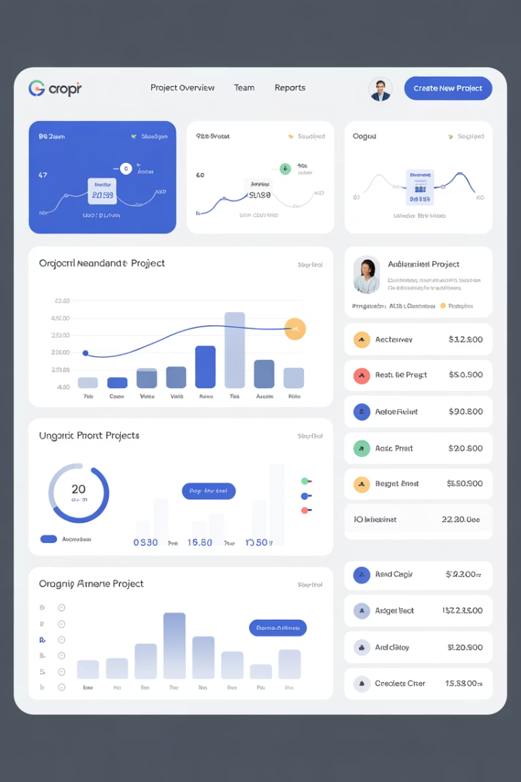
Final Thoughts
If you're managing complex, fast-moving projects and struggling to gain a 360-degree view of timelines, budgets, and resources, Microsoft Dynamics 365 Project Operations may be your competitive edge. It transforms project management from reactive to strategic—aligning delivery with business goals and driving value across the entire project lifecycle.

