Slide 1

Meet Your AI Project Team
10 AI Agents Every Program Manager Will Soon Be Managing
A few years ago, every project team consisted entirely of people. That model is beginning to change — and the program manager of the future won't just lead people. They'll orchestrate an entire digital workforce.
KIMBERLY WIETHOFF, MBA, PMP, PMI-ACP
MANAGING PROJECTS THE AGILE WAY
#AgenticAI hashtag#AIAgents hashtag#ProgramManagement hashtag#ProjectManagement hashtag#ArtificialIntelligence hashtag#AILeadership hashtag#FutureOfWork hashtag#PMO hashtag#DigitalTransformation hashtag#EnterpriseAI hashtag#Innovation hashtag#Leadership hashtag#ManagingProjectsTheAgileWay

Slide 2

The Shift to Hybrid Project Teams
As Agentic AI matures, forward-looking organizations won't simply adopt AI tools — they'll build teams that include both people and specialized AI agents. These agents won't replace project professionals. Instead, they'll take ownership of repetitive, data-intensive, and coordination-heavy activities.
This creates space for human leaders to focus on what matters most: strategy, relationships, innovation, and high-stakes decision-making. So what might an AI-enabled project team actually look like?
Then
Now
100% human teams coordinating across every function and workflow
Hybrid teams pairing human judgment with AI-powered execution
Next
Program managers orchestrating a full digital + human workforce

Slide 3
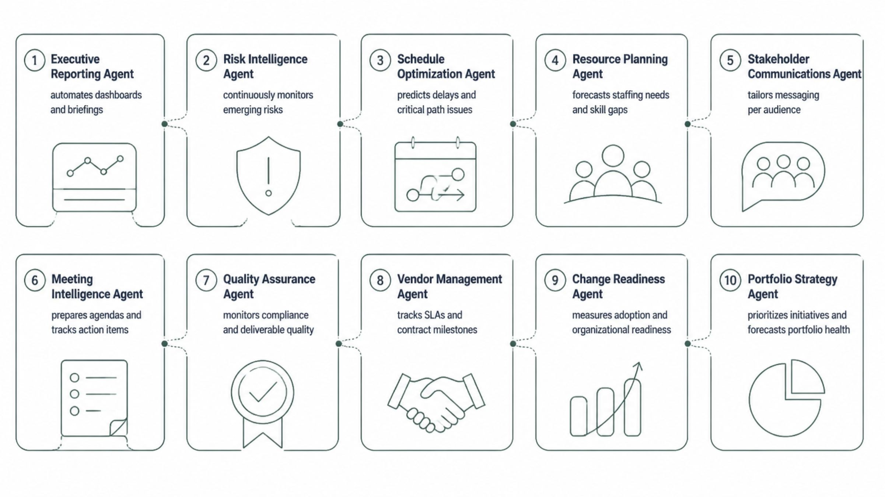
Your AI Project Team at a Glance
Ten specialized agents — each designed to take on a distinct, high-volume function in the delivery lifecycle. Together, they form a digital workforce that runs 24/7 alongside your human team.

Slide 4
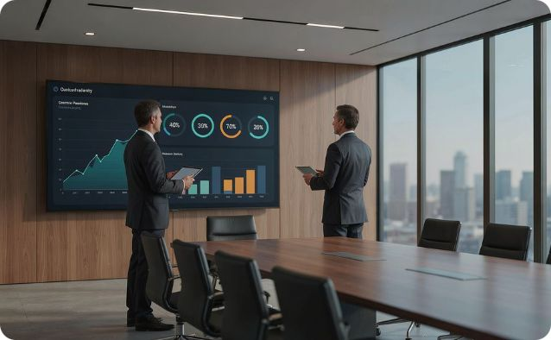
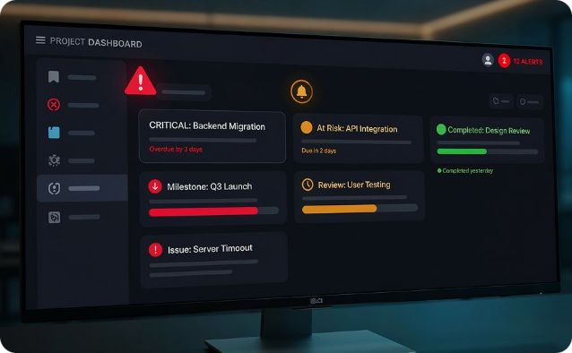
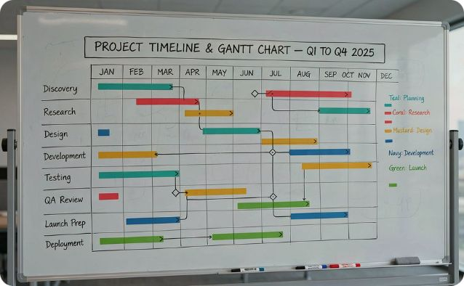
Agents 1–3: Reporting, Risk & Scheduling
Executive Reporting Agent
Risk Intelligence Agent
Schedule Optimization Agent
Automatically gathers team updates, generates portfolio dashboards, highlights risks and decisions, and drafts tailored executive briefings. Program managers review and refine — not build from scratch.
Continuously monitors schedules, budgets, vendor performance, and open dependencies. It surfaces emerging risks before they escalate and recommends mitigation strategies in real time.
Analyzes thousands of tasks and dependencies to predict milestone delays, evaluate critical path impacts, and recommend recovery scenarios. It acts like a scheduling strategist that never sleeps.

Slide 5
Agents 4–6: Resources, Communications & Meetings
Resource Planning Agent
Stakeholder Communications Agent
Meeting Intelligence Agent
Forecasts staffing shortages, identifies skill gaps, and recommends resource reallocations before vacancies become crises. Organizations shift from reactive scrambling to proactive planning — balancing workloads and anticipating future capacity constraints across the program portfolio.
Prepares agendas, gathers supporting documents, captures real-time notes, assigns action items, tracks decisions, and monitors follow-up progress. Meetings transform from note-taking exercises into focused decision-making sessions — and critical commitments never fall through the cracks.
One executive wants a one-page summary. Another wants detailed metrics. A business sponsor wants outcomes. This agent adapts messaging for each audience while maintaining consistency across the program — ensuring every stakeholder gets exactly what they need, in the format they prefer.

Slide 6
Agents 7–10: Quality, Vendors, Change & Strategy
Quality Assurance Agent
Vendor Management Agent
Continuously monitors requirements completeness, documentation quality, test coverage, and standards adherence — shifting quality from a phase-end activity to a continuous discipline.
Tracks contract milestones, monitors SLAs, flags delivery risks, and recommends escalation points — giving program managers full visibility across a complex vendor ecosystem.
Change Readiness Agent
Portfolio Strategy Agent
Measures training completion, user engagement, adoption trends, and resistance indicators so leaders can address concerns before they become barriers to program success.
Prioritizes initiatives, models investment scenarios, forecasts portfolio health, and measures value realization. Shifts the executive question from "How are projects performing?" to "Are we investing in the right work?"

Slide 7

Who Coordinates the AI Agents?
The better question isn't "Will AI replace program managers?" It's "Who leads all these AI agents?"
Someone must define objectives, set priorities, resolve conflicts, make ethical decisions, and align work with business strategy. That's the program manager. As AI becomes more capable, human leadership becomes even more valuable — not less.
01
02
03
Define Objectives
Govern & Prioritize
Lead & Decide
Set clear goals and success criteria that guide agent behavior and output quality
Establish guardrails, approve recommendations, and resolve competing priorities across agents and stakeholders
Apply judgment, empathy, and strategic thinking to decisions that AI cannot — and should not — make alone

Slide 8
Humans + AI: A Stronger Delivery Model
The most successful organizations won't choose between humans and AI. They'll design hybrid teams where each contributes what they do best — creating a delivery model stronger than either could achieve alone.
People Excel At
AI Agents Excel At
Leadership and strategic direction
Creativity and innovation
Negotiation and relationship building
Empathy and stakeholder trust
Ethical judgment and governance
Continuous monitoring across streams
Pattern recognition in complex data
Repetitive workflows and documentation
Forecasting and scenario modeling
Speed and consistency at scale

Slide 9



Where to Start: An Incremental Approach
You don't need ten AI agents on day one. The most effective path forward is deliberate, measurable, and built on trust. Begin with one or two high-value, repetitive activities and expand from there.
Step 3: Expand Thoughtfully
Step 2: Measure & Refine
Add agents incrementally as trust is established. Build the institutional knowledge and PMO governance needed to scale sustainably
Step 1: Pick a Starting Point
Track time saved, output quality, and stakeholder feedback. Use real data to refine your governance model and agent configuration
Choose a high-volume, repetitive function — executive reporting, risk monitoring, meeting documentation, or resource forecasting
Organizations that take an incremental approach build greater trust, reduce implementation risk, and realize more sustainable long-term value from AI investment.

Slide 10

The Future of Program Management
The future of program management isn't about replacing people with AI. It's about giving program managers a digital team that works alongside them — one that analyzes data, monitors progress, automates routine work, and surfaces insights so leaders can focus on strategy and outcomes.
Tomorrow's most successful program managers won't simply manage projects. They'll lead hybrid teams where people and AI agents collaborate to deliver extraordinary results.
The question is no longer whether AI agents will become part of project delivery. It's how effectively program managers will learn to lead them.
KIMBERLY WIETHOFF, MBA, PMP, PMI-ACP
MANAGING PROJECTS THE AGILE WAY

