Slide 1

Measuring What Matters: Leveraging Velocity and Burn Down Charts for True Transparency
Agile thrives on transparency. Yet too often, teams focus on metrics as checkboxes rather than tools for learning and improvement. When used intentionally, velocity charts and burn down charts become powerful lenses into team health, predictability, and delivery confidence.
kW
by Kimberly Wiethoff, MBA, PMP, PMI-ACP
#AgileLeadership #ScrumEngineer #AgileMetrics #Velocity #BurnDownCharts #Transparency #TeamSuccess #ContinuousImprovement #ManagingProjectsTheAgileWay

Slide 2


The Current State of Agile Metrics
Many organizations fall into the trap of treating metrics as mere reporting artifacts—numbers presented in slide decks for leadership consumption. This approach misses the fundamental purpose of measurement in Agile: to enable learning, adaptation, and continuous improvement.
The challenge lies not in the absence of data, but in the overwhelming abundance of it. Teams often find themselves drowning in vanity metrics that provide little actionable insight into their actual effectiveness or ability to deliver value to stakeholders.
Without proper context and intentional use, even the best metrics become meaningless numbers that can actually harm team morale and organizational trust.

Slide 3
Beyond Vanity Metrics: Focus on Value Delivery
Defect Counts
Test Coverage Percentages
Lines of Code
While important for quality, raw defect numbers without context don't indicate whether the team is improving or delivering value effectively.
High coverage doesn't guarantee quality. Teams can achieve 90% coverage with meaningless tests while missing critical functionality.
Measuring productivity by code volume incentivizes the wrong behaviors and tells us nothing about value creation or problem-solving effectiveness.
Agile is fundamentally about delivering value to stakeholders. The most effective metrics highlight whether teams are working efficiently toward that goal. Velocity and burn down charts excel in this area because they directly connect to delivery outcomes and team capacity.

Slide 4



Why Velocity and Burn Down Charts Matter
Reflect Team Capacity
Reveal Predictability Patterns
Enable Early Risk Detection
These metrics provide a realistic view of what the team can accomplish over time, helping establish sustainable work patterns and preventing burnout through overcommitment.
Changes in velocity trends or burn down patterns serve as early warning systems, allowing teams and stakeholders to address issues before they become critical problems.
Consistent patterns in these charts indicate a team's ability to deliver reliably, while fluctuations highlight areas needing attention or process improvement.

Slide 5

Understanding Velocity: Beyond the Numbers
Velocity isn't about comparing teams or chasing higher numbers sprint after sprint. It's about understanding the team's natural rhythm and using that insight to make better decisions about capacity and commitment.
The most common misconception about velocity is treating it as a performance metric. In reality, velocity is a planning tool that helps teams and stakeholders set realistic expectations based on historical evidence rather than wishful thinking.
"Velocity becomes meaningful when used to spark the right conversations: Are we overcommitting? Do we need to refine requirements better? Are external dependencies slowing us down?"

Slide 6



Three Critical Applications of Velocity Data
Trend Tracking
A stable velocity trend demonstrates consistency in delivery capability. Look for patterns over 6-8 sprints rather than focusing on individual sprint variations. Consistent trends indicate mature processes and realistic planning.
Capacity Planning
Historical velocity data enables accurate forecasting for release planning and stakeholder communication. Teams can confidently commit to deliverables based on proven capacity rather than optimistic estimates.
Early Warning System
Significant fluctuations in velocity signal underlying issues: unclear requirements, team impediments, technical debt, or external dependencies. These variations prompt investigation and process improvement.

Slide 7
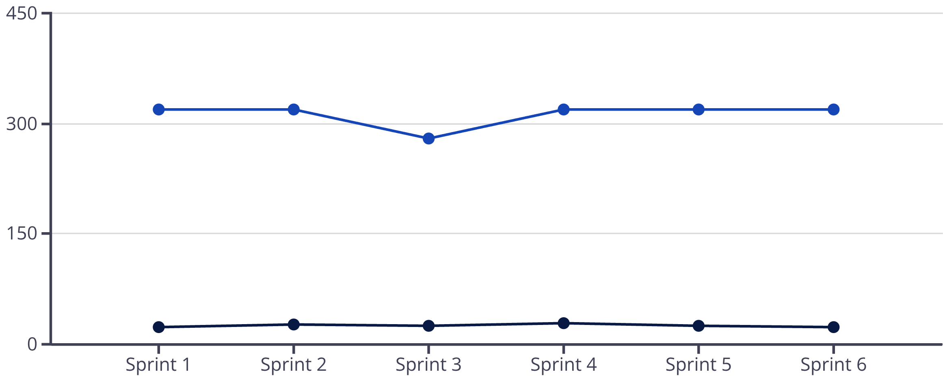
Velocity Trend Analysis in Practice
This example shows a healthy velocity pattern with minor variations around a 25-26 point average. The dip in Sprint 3 correlates with reduced team capacity, demonstrating how external factors influence delivery. This data supports planning future sprints with 24-28 point commitments.
Story Points Completed
Team Capacity (Available Ho...

Slide 8

Burn Down Charts: Visualizing Progress Flow
Burn down charts tell the story of how efficiently teams work through sprint backlogs. They provide visibility into delivery flow patterns that raw velocity numbers cannot capture.
The chart's power lies not just in whether the line reaches zero by sprint end, but in the shape and consistency of progress throughout the sprint. Different patterns reveal different insights about team dynamics and process effectiveness.
Regular review of burn down patterns in retrospectives helps teams identify execution improvements and optimize their approach to sprint work.

Slide 9




Interpreting Burn Down Chart Patterns
Flat Lines
Steep Drops
Extended periods without progress may indicate blockers, unclear requirements, or team members working on unplanned tasks. Investigation required to identify impediments.
Sudden large decreases often signal batch completion of work items. While meeting sprint goals, this pattern may indicate opportunities for more incremental delivery.
Consistent Flow
Erratic Movement
Steady, predictable progress indicates balanced work distribution, clear requirements, and effective daily standups. This pattern reflects sprint health.
Frequent ups and downs suggest scope changes, task complexity underestimation, or integration challenges. Teams should review planning and refinement practices.

Slide 10


Building Organizational Trust Through Transparency
Velocity and burn down metrics serve a dual purpose: they help teams improve their processes while building organizational confidence in delivery capabilities. When leaders see consistent, transparent data, it establishes trust in the team's ability to deliver on commitments.
This transparency works both ways. Teams feel empowered when their reality is visible and respected rather than questioned or micromanaged. Honest metrics create space for authentic conversations about capacity, challenges, and support needs.
Transparency through metrics transforms the relationship between teams and leadership from one of reporting to one of collaborative problem-solving.

Slide 11
The Scrum Master's Role in Metrics Success
01
02
Consistent Data Collection
Contextual Reporting
Establish reliable processes for capturing velocity and burn down data. Ensure accuracy and consistency across sprints to enable meaningful trend analysis.
Present metrics with appropriate context about team dynamics, external factors, and process changes. Raw numbers without context can be misinterpreted or weaponized.
03
04
Facilitated Learning
Stakeholder Education
Use metric insights to drive retrospective discussions and process improvements. Help teams identify patterns and experiment with solutions.
Teach stakeholders how to interpret and use velocity data appropriately. Prevent misuse of metrics for team comparison or performance evaluation.

Slide 12
Avoiding Common Metrics Pitfalls
Team Comparisons
Gaming Behaviors
Ignoring Context
Never use velocity to compare different teams. Each team has unique contexts, skillsets, and technical environments that make comparisons meaningless and harmful.
When velocity becomes a target rather than a measurement, teams may inflate estimates or sacrifice quality to hit numbers. Focus on sustainable delivery.
Metrics without context are dangerous. Always consider team changes, technology shifts, requirement complexity, and external dependencies when interpreting data.
The goal is to create a culture where metrics serve learning and improvement rather than judgment and control. When teams feel safe sharing honest data, everyone benefits from increased visibility and collaborative problem-solving.

Slide 13

Measuring What Matters: Key Takeaways
Metrics Enable Clarity
Velocity and burn down charts provide shared language for teams and stakeholders to assess progress, identify risks, and celebrate achievements with objective data.
Transparency Builds Trust
Consistent, honest reporting creates organizational confidence while empowering teams to focus on value delivery rather than defensive reporting.
Learning Drives Improvement
When used intentionally, these metrics become catalysts for process improvements, capacity planning, and team development rather than mere status reporting.
When we measure what matters, we don't just track work—we build trust, predictability, and momentum.

