Slide 1

Top Tips for Project Management
In the fast-paced world of project management, staying ahead of the curve is essential for delivering successful projects on time, within scope, and on budget. This presentation covers top tips for project management, from planning and risk management to communication and team leadership.
These actionable insights are designed to help you sharpen your skills, boost productivity, and achieve your project goals with confidence. Let's dive in to discover practical advice that will elevate your project management game!
kW
by Kimberly Wiethoff

Slide 2
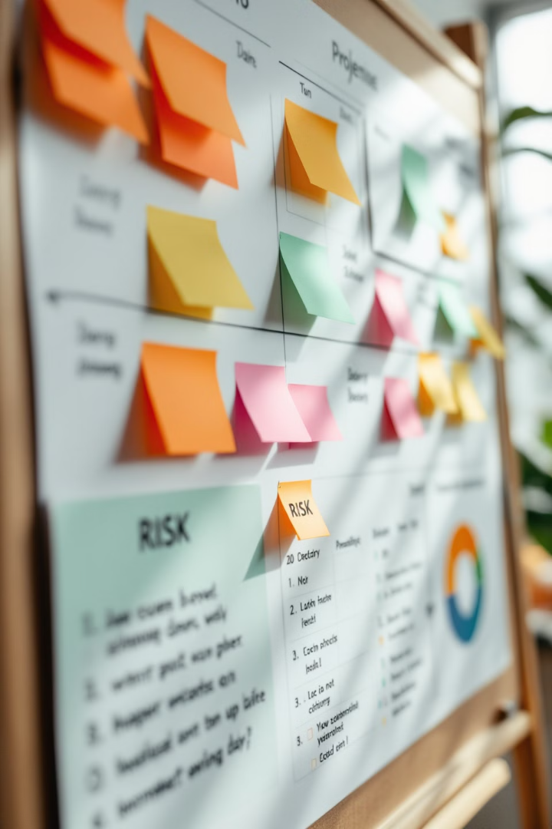
Planning & Initiation
1
Define Project Goals
2
Create Detailed Plan
Clearly define project goals before starting to ensure alignment with strategic objectives.
Develop a comprehensive project plan outlining scope, timeline, and resources.
3
Identify Stakeholders
4
Assess Risks
Identify and engage project stakeholders early in the process.
Conduct a thorough risk assessment during project initiation to anticipate potential challenges.

Slide 3





Team Management
Build Skilled Team
Foster Communication
Assemble a diverse and skilled project team to tackle various aspects of the project.
Encourage open communication within the team to ensure smooth collaboration.
Delegate Effectively
Motivate Team
Assign tasks based on team members' expertise and current workload.
Recognize achievements and promote a collaborative work environment to keep the team motivated.

Slide 4
Communication Strategies
Clear Objectives
Regular Channels
Tailored Approach
Communicate project objectives clearly to all stakeholders to ensure everyone is on the same page.
Establish regular communication channels such as meetings and emails to keep information flowing.
Adapt your communication style to different audiences for effective message delivery.

Slide 5




Risk Management
Identify Risks
1
Spot potential risks early in the project lifecycle.
Develop Plan
2
Create a comprehensive risk management strategy.
Assign Owners
3
Delegate responsibility for specific risks to team members.
Monitor & Adapt
4
Regularly assess risks and adjust strategies as needed.

Slide 6

Budget & Resource Management
Detailed Budgeting
Resource Allocation
Create a comprehensive project budget upfront and track expenses regularly to avoid overruns.
Allocate resources effectively and negotiate when competing with other projects.
Regular Reviews
Conduct periodic budget reviews to spot discrepancies and identify savings opportunities.

Slide 7

Time Management & Monitoring
1
Create Timeline
Develop a project timeline with clear milestones using project management tools.
2
Track Progress
Regularly monitor task progress and hold team members accountable for deadlines.
3
Adjust as Needed
Review timelines periodically and make necessary adjustments to ensure project success.

Slide 8





Project Closure & Review
Review Deliverables
Ensure all project deliverables meet requirements and contractual obligations.
Conduct Closure Meeting
Hold a formal project closure meeting to wrap up and collect feedback.
Document Lessons
Record lessons learned and create a final project report for future reference.
Celebrate Success
Recognize team efforts and celebrate project completion to boost morale.

Slide 9
Final Thoughts
Mastering project management requires a blend of strategic planning, effective communication, and the ability to adapt to challenges. The tips outlined are designed to serve as a practical guide for both new and experienced project managers, empowering you to navigate complexities with confidence.
Remember, successful project management is about continuous learning and improvement—leveraging lessons from past projects to refine your approach. By incorporating these tips into your daily practice, you’ll not only drive your projects to successful completion but also enhance your leadership skills and foster stronger team collaboration. Here's to managing projects the agile way and achieving success one milestone at a time!

