Slide 1
Mastering Applied Epic: What Every Insurance Project Manager Should Know
Applied Epic forms the backbone of operations for many insurance agencies, providing a unified platform for customer relationships, policy administration, accounting, and reporting. For project managers leading system implementations, migrations, or enhancements, understanding Epic's capabilities is essential for success.
This presentation will guide you through the critical knowledge areas and strategies needed to effectively manage Applied Epic projects, from initial planning to successful implementation and adoption.
kW
by Kimberly Wiethoff

Slide 2
The Applied Epic Ecosystem
Policy Management
Accounting Module
Handles new business, renewals, endorsements, and cancellations through a unified interface
Manages trust and operating account transactions, commissions tracking, and financial reporting
Reporting & Dashboards
Activities & Tasks
Provides insights on book of business, producer performance, and upcoming renewals
Facilitates workflow-driven communication and follow-up processes across teams
Applied Epic isn't just a policy management system—it's an enterprise platform connecting your entire agency. Understanding how each department relies on Epic ensures you align project goals with business needs and prepare for cross-functional impacts.

Slide 3
Defining Project Scope and Stakeholders
Success Metrics
Measurable outcomes like reduced quote time
Stakeholder Identification
Producers, CSRs, accounting, IT teams
Scope Definition
Clear boundaries and deliverables
Epic projects often impact multiple departments with varying needs and expectations. Clear scope definition prevents scope creep and ensures alignment across the organization. Many project delays stem from misaligned expectations or unaccounted use cases during discovery.
Invest time upfront to clarify customization versus out-of-the-box expectations and address compliance or regulatory reporting requirements that might impact implementation.

Slide 4
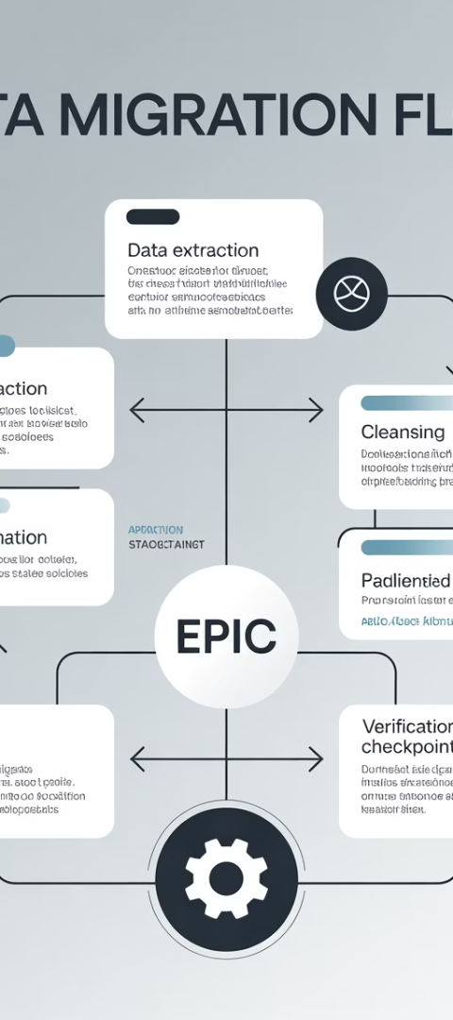
Planning for Data Migration
Data Mapping
Create comprehensive field mapping documents between legacy systems and Applied Epic schema, identifying transformation rules and data ownership.
Cleansing & Deduplication
Implement processes to identify and resolve duplicate records, standardize formats, and validate critical fields before migration.
Validation & Testing
Conduct thorough testing with business scenarios including quotes, renewals, certificates, and billing cycles to verify data integrity.
Poor data migration leads to downstream inefficiencies, client service issues, and compliance risks. Build sufficient time into your project plan for multiple test migrations and validation cycles, particularly for agencies migrating from legacy systems with years of historical data.

Slide 5
Data Quality Assurance
1
2
3
Critical Data Points
Validation Methods
Post-Migration Verification
Client contact information
Automated data quality scans
User acceptance testing
Policy effective/ expiration dates
Financial reconciliation
Exception reporting
Policy status verification
Sampling validation
Workflow validation
Premium and commission values
Cross-reference checks
Coverage limits and deductibles
Data quality directly impacts user adoption and client service. Project managers should establish quality thresholds and remediation processes for addressing data issues. Implement both automated and manual verification to ensure data integrity throughout the implementation lifecycle.

Slide 6
Change Management Strategy
Early User Involvement
Include key users in design decisions and workflow mapping to build ownership and gather practical insights
Role-Based Training
Develop tailored training programs for CSRs, producers, accounting, and management with relevant scenarios
Super-User Program
Identify and prepare champions within each department to provide first-line support and promote adoption
Communication Plan
Maintain regular updates on milestones, impacts, and wins to build momentum and manage expectations
Change resistance is a major barrier to Epic adoption. Users comfortable with legacy systems need compelling reasons to embrace new workflows and features. Your change management approach should address both the technical and emotional aspects of the transition.

Slide 7
External Resources and Support
Applied University
Implementation Guides
Leverage on-demand training courses and certification programs to build internal expertise and supplement project team knowledge
Utilize comprehensive documentation provided by Applied Systems to understand best practices and avoid common pitfalls
User Communities
Account Management
Engage with online forums and user groups to learn from peer experiences and gather innovative implementation approaches
Maintain close communication with your Applied Account Manager for escalation support and strategic guidance
Don't reinvent the wheel. Applied Systems offers extensive resources that can accelerate your implementation timeline and help you navigate complex challenges. Building relationships with these external resources early in your project lifecycle creates valuable support channels.

Slide 8
Integration Capabilities
Carrier Connectivity
Document Management
Direct integration with carrier systems for quoting, binding, and policy servicing
Seamless connection with ImageRight and other document repositories
Custom Applications
Benefits Management
API capabilities for connecting with agency-specific tools and services
Integration with BenefitPoint for comprehensive benefits administration
Applied Epic's value multiplies when properly integrated with your agency's technology ecosystem. Project managers should map all integration points early in the planning process and involve IT stakeholders to assess technical requirements and potential challenges. Consider phasing complex integrations to manage risk and ensure core functionality is stable before extending the system.

Slide 9
Testing Methodology
Unit Testing
Integration Testing
Verify individual components function correctly in isolation, focusing on specific workflows and features
Validate that connected systems exchange data correctly and maintain integrity across boundaries
User Acceptance Testing
Performance Testing
Engage business users to test real-world scenarios and validate that the system meets operational needs
Measure system responsiveness under various load conditions to ensure acceptable user experience
A structured testing approach identifies issues before they impact production. Develop comprehensive test plans covering critical insurance workflows like new business processing, renewals, endorsements, and accounting functions. Document test cases with clear pass/fail criteria to maintain accountability.

Slide 10
Epic Workflow Optimization
Common Pain Points
Epic Solutions
Implementation Approach
Redundant data entry
Automated activity creation
Map current workflows first, then design optimized processes in Epic that eliminate redundancies while maintaining necessary controls. Involve process owners in design sessions and develop clear transition plans from old to new workflows.
Manual handoffs between teams
Role-based task assignment
Inconsistent process adherence
Standardized service workflows
Limited visibility into bottlenecks
Real-time workload dashboards
Compliance documentation gaps
Built-in compliance tracking
Simply replicating existing processes in Epic misses opportunities for transformation. Project managers should challenge stakeholders to reimagine workflows that leverage Epic's capabilities rather than forcing the system to conform to legacy processes.

Slide 11
Risk Management in Epic Projects
Identify potential risks
Assess impact and probability
Document technical, resource, and business risks
Evaluate severity and likelihood of occurrence
Develop mitigation strategies
Monitor continuously
Create action plans to reduce or eliminate risks
Track risk indicators throughout project lifecycle
Epic implementations involve significant organizational change and technical complexity. Common risks include data migration issues, resource constraints, scope creep, and user adoption challenges. Establish a risk register early and review it regularly with stakeholders.
Develop contingency plans for critical risks, particularly around go-live scenarios where business continuity is essential.

Slide 12
Post-Implementation Success Metrics
42%
87%
23%
3.2x
Time Savings
User Adoption
Error Reduction
ROI
Average reduction in policy processing time after optimization
Percentage of users actively using new Epic workflows
Decrease in policy errors and omissions exposure
Average return on implementation investment within 24 months
Measuring success goes beyond on-time, on-budget delivery. Establish baseline metrics before implementation and track improvements in operational efficiency, customer satisfaction, and business outcomes after go-live.
Regular post-implementation reviews help identify opportunities for continuous improvement and build support for future enhancement projects.

Slide 13
Key Takeaways for Project Success
Comprehensive Planning
Data Quality Focus
Change Management
Workflow Optimization
Invest time in thorough scoping, stakeholder identification, and clear success metrics before technical implementation begins
Prioritize data mapping, cleansing, and validation to prevent downstream issues that impact user adoption and client service
Address both technical and human aspects of the transition with comprehensive training, communication, and support mechanisms
Leverage Epic capabilities to transform operations rather than simply digitizing existing processes
Project managers who understand Applied Epic's architecture, user workflows, and integration points are better equipped to lead impactful, cost-effective implementations. By taking a strategic approach—grounded in business goals, stakeholder engagement, and data quality—you can ensure your Epic project not only meets requirements but transforms how your agency works.

