Slide 1

Medicare Now Pays for No
Prior authorization has arrived in Original Medicare — decided with AI and paid on the denial. The hospitals that survive the next two years are the ones fixing their documentation and their data pipes right now.
BY YEMI MATEOLA, MBA, CPHIMS
FOUNDER & CEO, STRATEVORA TECHNOLOGIES
#HealthcareLeadership #PriorAuthorization #RuralHealth #HealthIT #AIinHealthcare #HealthcareInnovation #HealthcareAI #HealthIT #RevenueCycleManagement #PriorAuthorization #Medicare #Interoperability #FHIR #DigitalHealth #HospitalLeadership #RuralHealth #HealthcareTechnology #RevenueIntegrity #ClinicalDocumentation #HealthcareTransformation #AIinHealthcare #ValueBasedCare #HealthcareOperations #HealthTech #Stratevora

Slide 2
The Shift
Forty Years of Pay-First Is Over
For forty years, Original Medicare paid first and asked questions later. That changed this year, quietly, in six states, with almost no fanfare. The program is called WISeR — Wasteful and Inappropriate Service Reduction — and it runs from 2026 through 2031 in New Jersey, Ohio, Oklahoma, Texas, Arizona, and Washington.
Private technology companies, using AI backed by human clinicians, now check a short list of non-emergency services against Medicare's existing coverage rules before the bill is paid. The services in scope are familiar: skin substitutes, nerve stimulators, epidural steroid injections, and knee arthroscopy for osteoarthritis.
WISeR at a Glance
Timeline: 2026 – 2031
States: NJ, OH, OK, TX, AZ, WA
Services: Skin substitutes, nerve stimulators, epidural steroid injections, knee arthroscopy
Reviewer: Private AI + human clinician
Payment model: Contractor earns a percentage of spending their denials prevent

Slide 3
The Payment Structure Is the Problem
CMS is correct that it has not changed a single coverage rule. On the surface, WISeR is housekeeping. But look closer at how the reviewers get paid — and a well-documented failure mode comes into view.
The Incentive
The Guardrail
The Agency Gap
Contractors earn a quality-adjusted percentage of the spending their denials prevent. Pay someone to find waste, and they will find it — whether or not it is actually there.
CMS tied the contractor's cut to quality scores and provider-experience ratings, so sloppy denials cost the reviewer money. Credit where it is due — but this modifier sits on top of the primary incentive, which remains: deny.
Jensen and Meckling named this in 1976: hand your decisions to an agent whose interests run a different way, and you own the gap. WISeR runs that gap three deep — patient, CMS, contractor — and better oversight tightens bolts without changing the shape.

Slide 4
Behavioral Economics Warning
When the Measure Becomes the Mission
In 2019, Harris and Tayler named this trap "surrogation" in Harvard Business Review. Give people a fuzzy goal and a sharp number meant to measure it, and they start serving the number instead of the goal. WISeR meets all three conditions they borrow from Kahneman and Frederick.
The goal is abstract: appropriate, medically necessary care. The number is concrete: dollars saved for the contractor, a clean approval rate for the hospital. Once the number is what pays, the swap happens on its own — without anyone consciously choosing it.
Wells Fargo's strategy was lasting customer relationships. The measure was accounts per customer. Staff opened 3.5 million accounts nobody asked for, hit their targets, and torched the very relationships the targets were meant to build.
Steven Kerr described the same problem in 1975 under a blunter title: "On the Folly of Rewarding A, While Hoping for B." WISeR pays for averted spending and hopes for good care. A clinician signing each denial does not change which way the money points.

Slide 5

The Evidence Already Exists
Medicare Advantage Has Run This Experiment
We do not need to speculate about how incentivized prior authorization behaves at scale. Medicare Advantage ran the experiment in 2024 — and the numbers should stop every CFO in the room cold.
53M
4.1M
Prior Auth Requests
Denials Issued
Total MA prior authorization determinations made in 2024
7.7% of all requests — turned down before payment
80.7%
11.5%
Overturned on Appeal
Actually Appealed
Of the denials that were appealed, more than 4 in 5 did not survive scrutiny
The vast majority of denials are never challenged — the friction does the work
When someone pushes back, the denial usually collapses. But most hospitals never push back — and that is exactly what the model counts on.

Slide 6
The Friction Is the Feature
Put the two MA figures together — 80.7% overturn rate, 11.5% appeal rate — and the design reveals itself. Most denials are never appealed, and the ones that are usually collapse. The friction does the work.
Fighting every denial costs hours and staff a stretched hospital does not have. In 2022 alone, hospitals spent an estimated $19.7 billion chasing denied claims (Premier, Inc.). Across the industry, roughly two-thirds of denials are never resubmitted — a figure drawn from HFMA, Change Healthcare, and AMA industry reporting.
The Payer Spread Tells the Story
In 2024, the appeal overturn rate ranged from ~51% at one large MA plan to >95% at another — both operating under identical federal rules. A denial rate is not a clinical fact. It is a dial each payer sets to fit its own math.
Rural and community hospitals feel it hardest: fewest staff free to chase appeals, least cash to absorb the wait. WISeR is now bringing that same math into Original Medicare — at taxpayer expense.

Slide 7
Early Evidence from the Field
Washington State: The First Warning Signal
The early results from Washington — the only WISeR state with published data — are already in, and they are not encouraging. A report this April from Senator Maria Cantwell, built on data from 16 Washington hospitals, found:
Approval Timelines
Patients Waiting
CMS Targets vs. Reality
Procedures once cleared in ~2 weeks are now taking 4 to 8 weeks under WISeR review — double to quadruple the original wait.
At one health system alone, ~100 patients were left waiting for epidural steroid injections — a covered procedure for documented pain — while the review clock ran.
CMS set response targets of 1 to 3 days. Hospitals are reporting actual timelines of 15 to 20 days. The gap between promise and performance is already a political liability — criticism now spans both parties in Congress.

Slide 8

The Regulatory Collision
Two Forces. One Eighteen-Month Window.
WISeR is not arriving in isolation. Set it beside a rule that rarely comes up in the same conversation, and the pressure on hospital operations becomes acute.
2025
Jan 1, 2027
Industry pledge: 80% of electronic prior authorizations answered in real time by 2027. AHIP commits on behalf of major payers.
CMS-0057-F compliance due. Major payers — MA, Medicaid, exchange plans — must run prior authorization through standardized FHIR APIs. Electronic, not just digital.
1
2
3
4
2026 (Now)
2027 +
WISeR launches in 6 states. AI-assisted prepayment review begins for select services. The clock on first-pass approval rates is already running.
Hospitals with FHIR-connected, machine-readable prior auth workflows absorb both transitions in stride. Those still on fax and portals absorb every delay both systems create.
Digital and electronic are not the same thing. A PDF in a portal is digital — it still waits in a human queue. Electronic means your system builds the request from the chart, checks it against payer rules, and sends it machine-to-machine.

Slide 9
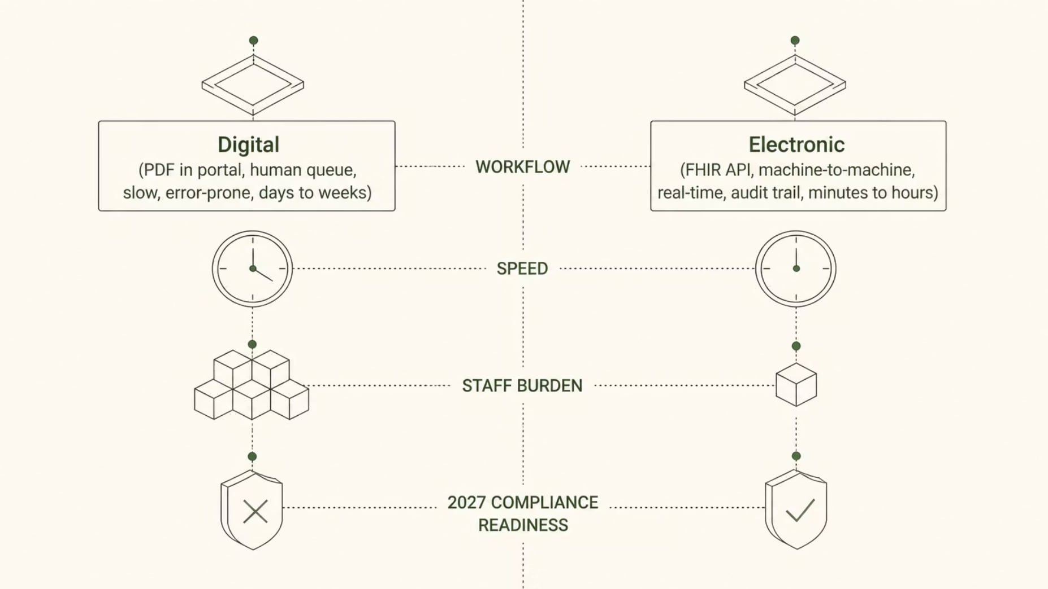
Electronic vs. Digital: The Difference That Will Define Your 2027
The HL7 Da Vinci implementation guides for coverage requirements and documentation tell your system exactly what a payer needs before you submit a claim. A hospital with that capability handles WISeR's added volume and the 2027 FHIR mandate simultaneously. A hospital still running prior authorization on fax machines and phone calls absorbs every delay both systems create — and a CIO who starts the data work in late 2026 is already behind before the first request goes out.

Slide 10
The Gold Card Pathway
There Is a Way Out — If You Earn It
Here is the part almost everyone has missed — and the part a rural operator should care about most. WISeR comes with an exit ramp. CMS has described a gold-card path: a provider with a roughly 90% affirmation rate can be exempted from prior authorization and prepayment review for those services, with final program details due in 2026.
Sit with that for a second. The model is grading paperwork. A denial here often means the record did not prove the need on the first pass — even when the patient needed the procedure all along. The medicine was right. The paperwork lagged. That distinction is the entire opportunity.
What Kills a First-Pass Rate
A conservative-treatment note missing before a knee scope
A wound measurement that never reached the chart before a skin graft
A nerve study sitting in a scanned image the reviewer's software could not open
An authorization request submitted without the payer's specific required language
Each gap is small. Each is machine-flaggable in seconds. Each is preventable before submission — if you have the workflow and the data layer to catch it.

Slide 11


The AI Arms Race
Payers Are Already Automated. Are You?
61%
20%
Physicians Alarmed
Providers Using AI
of physicians believe insurers' AI is already driving up denials (AMA, 2025)
Barely 1 in 5 providers use AI anywhere in their denials management process (Bain & KLAS, 2025)
The Asymmetry
Payers are running automated denial engines at scale. Hospitals are answering them by hand — losing on speed and volume before anyone weighs the clinical evidence.
A hospital answering an AI-generated denial with a phone call and a fax loses the exchange before it begins. The rural hospital starts on the wrong side of this arms race not because its medicine is worse, but because its tooling is a generation behind.
What is missing is not clinical judgment. It is the discipline and the infrastructure to prove that judgment at machine speed.

Slide 12
From Threat to Project
The Work Is Unglamorous — and Ownable
Treat the 90% affirmation threshold as a performance target, not a Washington abstraction, and the problem transforms from a regulatory threat into a manageable project with owners and steps.
Measure First-Pass Approval Rate by Service Line
Trace Every Denial to Its Root Gap
Establish your true baseline for each WISeR-covered service. Most CFOs do not know this number. Find it before WISeR finds it for you.
Most denials trace back to a documentation deficiency at registration or point of care — not a coverage dispute. Name the gap, own the fix.
Close Gaps at Intake and Point of Care
Build or Buy Electronic Prior Auth Capability
Clean intake, complete documentation captured the first time, and a data layer that passes it on without retyping: these are CFO and CIO deliverables, not clinical ones.
Assess whether your prior authorization workflow is truly electronic (FHIR API, Da Vinci guides) or merely digital (portal PDF). The 2027 compliance deadline rewards those who close that gap now.

Slide 13
Political Risk Assessment
WISeR May Not Survive — But the Weakness Always Would Have
The Political Reality
The Question That Outlasts WISeR
WISeR is already under bipartisan fire. Congress has moved to cut its funding. The courts could still reshape it. A Congressional Review Act resolution of disapproval was filed in May 2026, crossing party lines — a rare signal on health policy.
WISeR may be paused, modified, or repealed before it fully scales. Betting your revenue cycle strategy on that outcome is a losing wager.
Can your hospital prove medical necessity, on the first submission, at the speed a machine reads?
That capability pays off regardless of what happens to WISeR — because Medicare Advantage already works this way, commercial plans already work this way, and 2027 makes the electronic version the cost of doing business.
WISeR just started the clock on a weakness that was always going to surface.

Slide 14
Your Next Move Is Concrete
If you run or sit on the board of a community hospital in one of the six WISeR states, the window to act is now — not after the first wave of denials arrives.
Pull Your Documentation
Measure the 90% Bar
Review your selected-service documentation against published Medicare criteria. Identify gaps before the AI reviewer does.
Calculate your true first-pass approval rate by service line. Know where you stand relative to the gold-card threshold today.
Audit Your Prior Auth Channel
Ask the Board Question
Determine honestly whether your prior authorization process is electronic or merely digital. The 2027 FHIR deadline is not a long runway from here.
If you sit on the audit or technology committee, ask management this quarter: What is our first-pass approval rate for WISeR services, and who owns moving it forward?
The model is betting your answer is no. The cheapest denial is the one that never happens — and the cheapest time to lay the pipes is before the gate closes.

Slide 15
References
Centers for Medicare and Medicaid Services. WISeR Model overview, Fact Sheet, and Frequently Asked Questions (services, six states, 90 percent affirmation gold-card pathway, with details being finalized for 2026). Federal Register, "Implementation of Prior Authorization for Select Services for the WISeR Model," July 1, 2025.
U.S. Government Accountability Office. Decision B-337994, May 2026 (WISeR Notice is a rule under the Congressional Review Act; participants paid a quality-adjusted percentage of averted spending).
U.S. Senate Committee on Finance. Ranking member release on the WISeR Congressional Review Act resolution of disapproval, May 20, 2026.
U.S. House Committee on Appropriations. FY2027 Labor-HHS appropriations markup, June 9, 2026.
KFF. "Medicare Advantage Insurers Made Nearly 53 Million Prior Authorization Determinations in 2024" (4.1 million denied, 7.7 percent; 11.5 percent appealed; 80.7 percent overturned; insurer overturn range about 51 percent to 95 percent).
Premier, Inc. Trend Alert on claims denials, 2022 (hospitals spent an estimated $19.7 billion overturning denials). Resubmission estimate (roughly two-thirds of denials never resubmitted): HFMA, Change Healthcare, and AMA industry reporting.
Office of U.S. Senator Maria Cantwell and the Washington State Hospital Association. Report on WISeR prior authorization delays, April 2026 (16 hospitals; two-week approvals now four to eight weeks; about 100 patients awaiting epidural steroid injections).
Centers for Medicare and Medicaid Services. Interoperability and Prior Authorization Final Rule (CMS-0057-F), FHIR API requirements for impacted payers, compliance beginning January 1, 2027.
AHIP. "Health Plans Take Action to Simplify Prior Authorization," 2025 (industry pledge; at least 80% of electronic prior authorizations answered in real time by 2027).
American Medical Association. 2025 Prior Authorization Physician Survey (61 percent of physicians concerned that health plans' use of AI is increasing denials).
Bain and Company and KLAS Research. 2025 healthcare AI survey (about one in five providers use AI in denials management).
Harris, Michael, and Bill Tayler. "Don't Let Metrics Undermine Your Business." Harvard Business Review, 2019. Kerr, Steven. "On the Folly of Rewarding A, While Hoping for B." Academy of Management Journal, 1975. Jensen, Michael, and William Meckling. "Theory of the Firm." Journal of Financial Economics, 1976.

