Slide 1

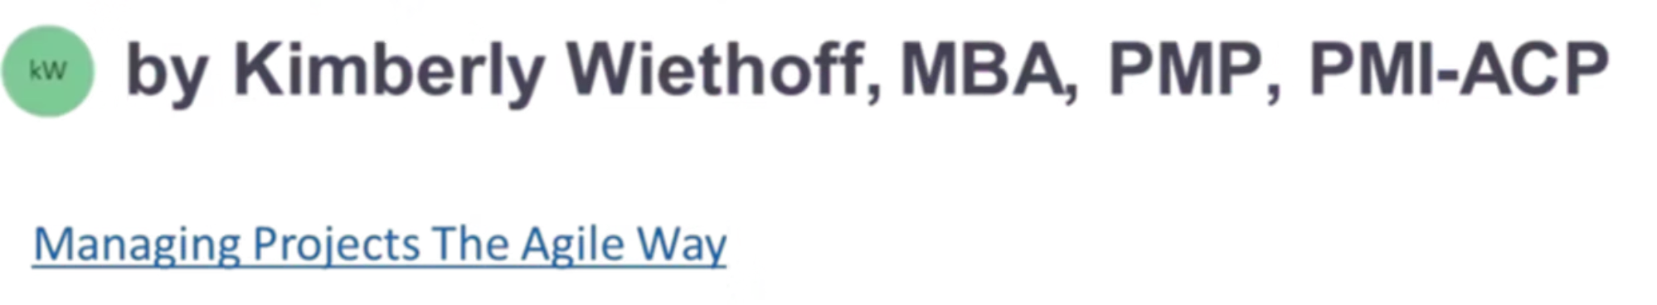
Top 10 Soft Skills That Set Great Project Managers Apart
Technical skills matter, but soft skills truly separate good project managers from great ones.
These human-side superpowers enable PMs to lead with influence, navigate complexity, and deliver results under pressure.
#SoftSkills #ProjectLeadership #EmotionalIntelligence #AgilePM #StakeholderManagement #ProjectManagerTips #LeadershipSkills #ConflictResolution #PMBestPractices #CommunicationMatters #ManagingProjectsTheAgileWay #CareerGrowth #InfluenceWithoutAuthority

Slide 2




Emotional Intelligence (EQ)
Read the Room
Recognize emotional cues and adjust your approach accordingly.
Manage Emotions
Stay calm under pressure. Guide others through stressful situations.
Foster Trust
Create psychological safety where team members feel valued.

Slide 3






Clear Communication
Tailor messaging
Adapt your style for executives, developers and business users
Simplify complexity
Turn technical concepts into understandable information
Listen actively
Pay attention to what's said and what's not said

Slide 4








Adaptability
Anticipate Changes
Pivot Gracefully
Spot potential shifts before they create problems
Change direction without losing momentum
Support Team
Maintain Vision
Help others adapt to new priorities and approaches
Keep the end goal in sight despite changing conditions

Slide 5




Stakeholder Management
Identify influencers
Map key players and their interests
Build relationships
Create trust before you need support
Align expectations
Ensure shared understanding of goals and constraints
Deliver value
Demonstrate progress that matters to each stakeholder

Slide 6





Conflict Resolution
Recognize early signs
Address tensions before they escalate into larger issues.
Facilitate open dialogue
Create space for all perspectives to be heard respectfully.
Find common ground
Identify shared interests that can lead to compromise.
Move forward constructively
Document agreements and maintain team momentum.

Slide 7
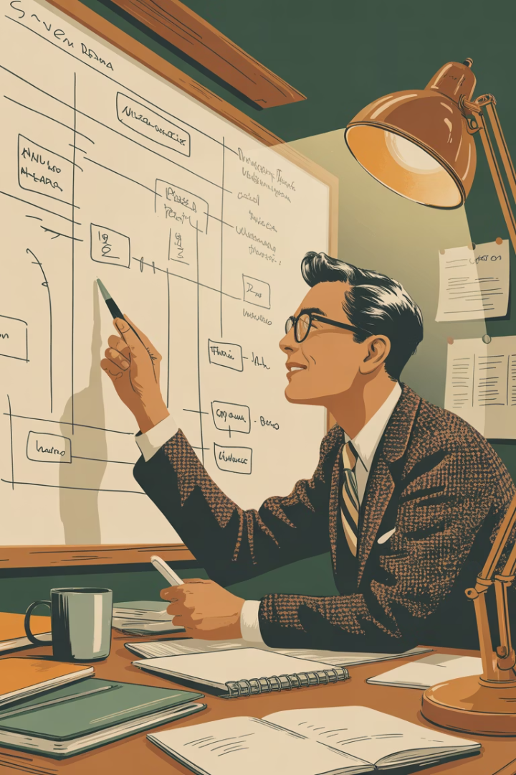
Problem Solving
Frame the problem clearly
Define what success looks like. Identify constraints and boundaries.
Remove blockers proactively
Anticipate obstacles. Create paths for the team to progress.
Assess trade-offs thoughtfully
Consider time, scope, resources, and quality implications.
Document lessons learned
Turn each problem into a future advantage through reflection.

Slide 8

Influencing Without Authority
Build credibility
Demonstrate expertise and follow through on commitments.
Be consistent in your actions and transparent in your reasoning.
Understand motivations
Learn what drives each team member and stakeholder.
Connect project goals to personal and departmental priorities.
Create coalitions
Build networks of supporters across organizational boundaries.
Use shared interests to overcome departmental silos.

Slide 9








Decision-Making Under Pressure
Stay Calm
Assess Trade-offs
Manage your stress response. Think clearly under pressure.
Quickly evaluate options against project constraints and goals.
Adjust Course
Make the Call
Be ready to pivot if new information emerges.
Decide with available information. Avoid analysis paralysis.

Slide 10
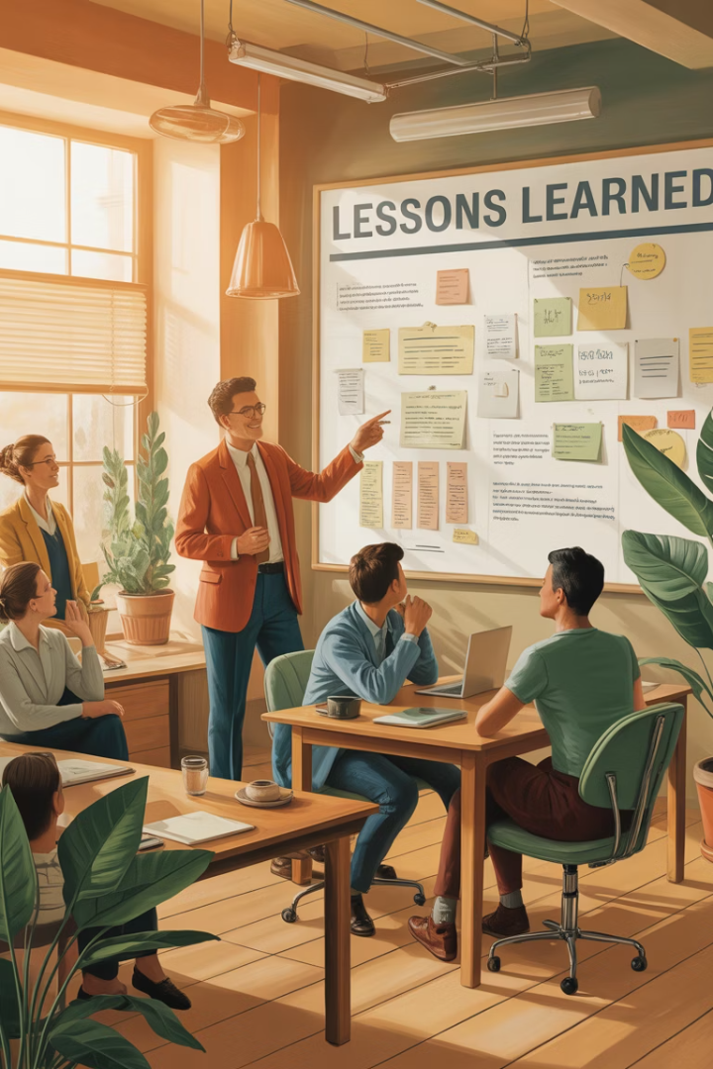




Continuous Learning
Study Best Practices
Stay current with industry trends and methodologies.
Reflect on Projects
Analyze successes and failures for improvement opportunities.
Seek Feedback
Ask team members and stakeholders for honest input.
Apply Insights
Implement lessons learned in your next project.

Slide 11





Leadership Presence
Project Confidence
Provide Direction
Stand tall. Speak clearly. Show conviction in your words and actions.
Clarify the path forward. Make complex situations manageable.
Rally the Team
Take Responsibility
Unite diverse stakeholders around a compelling shared vision.
Own outcomes, both positive and negative. Protect your team.

Slide 12

Final Thoughts
70%
2X
90%
Project Success
Career Growth
Team Satisfaction
From soft skills vs. technical skills alone
Rate for PMs with strong soft skills
Under emotionally intelligent leadership
Processes can be taught. Tools can be learned. But soft skills must be practiced and earned through experience.
As projects grow more complex, soft skills provide your competitive edge. If you’re looking to grow as a project leader, invest just as much in listening, empathizing, and influencing as you do in your Agile or PMP toolkit. Your team—and your career—will thank you.

Slide 13


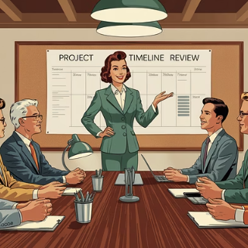
Related Resources
Related Reads from ManagingProjectsTheAgileWay.com:
Team Building, Collaboration, and Managing Stress in Project Teams
The Art of Leadership: Inspiring Change, Empowering Growth
Expectation Management: A Guide for Project Managers

