Slide 1
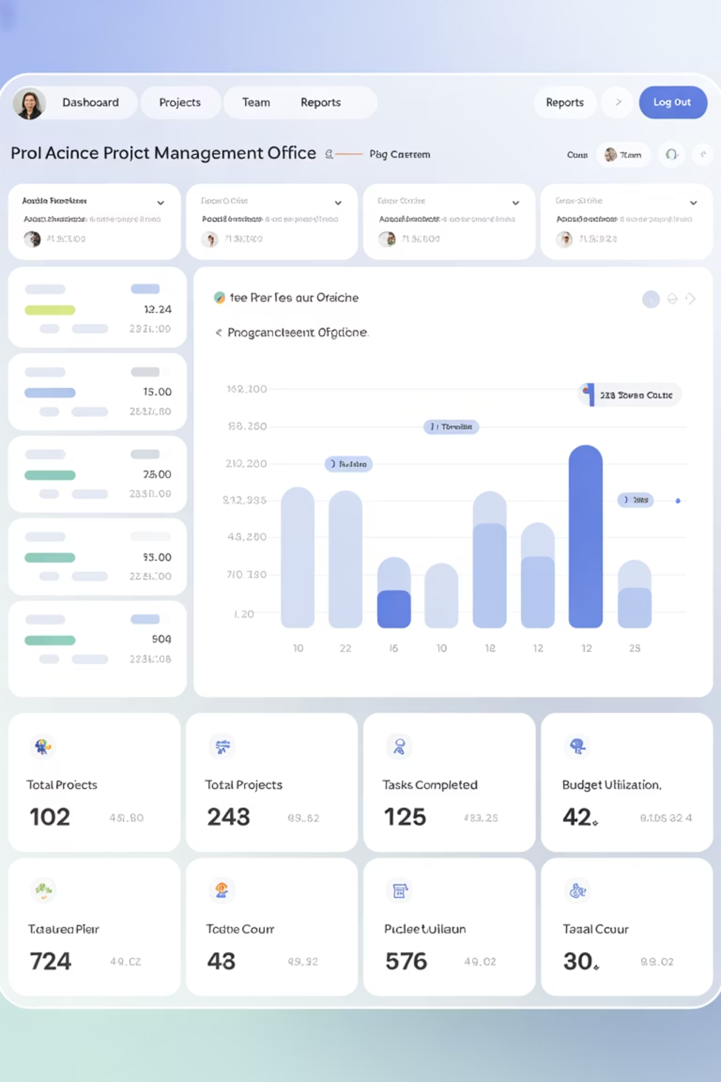
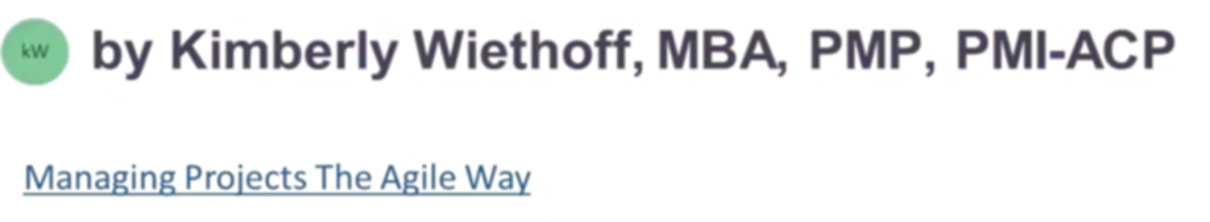
Power BI + Dynamics 365: Driving Project Insights
In project management, visibility is the secret to success. Integrating Power BI with Microsoft Dynamics 365 empowers teams with dynamic dashboards, real-time reporting, and interactive visualizations.
#PowerBI #MicrosoftDynamics365 #ProjectManagement #ProjectReporting #BusinessIntelligence #PMDashboard #ProjectKPIs #DigitalTransformation #DataDrivenPM #AgileProjectManagement #ProjectAnalytics

Slide 2

What Is Power BI?
Business Intelligence Tool
Seamless Integration
Connects directly to Dynamics 365 data across CRM, ERP, and Project Operations.
Microsoft's premier data visualization platform transforms raw data into compelling insights.
Visual Storytelling
Creates interactive dashboards that reveal performance trends and improvement areas.

Slide 3

Why Integrate Power BI with Dynamics 365?
Real-time KPIs
Access live metrics across sales, delivery, finance, and customer service.
Unified View
Track project status, risks, costs, and resources in one interactive dashboard.
Detailed Analysis
Drill down into task-level data to identify and resolve blockers quickly.
Stakeholder Reporting
Present polished visuals without manual updates or reformatting.

Slide 4
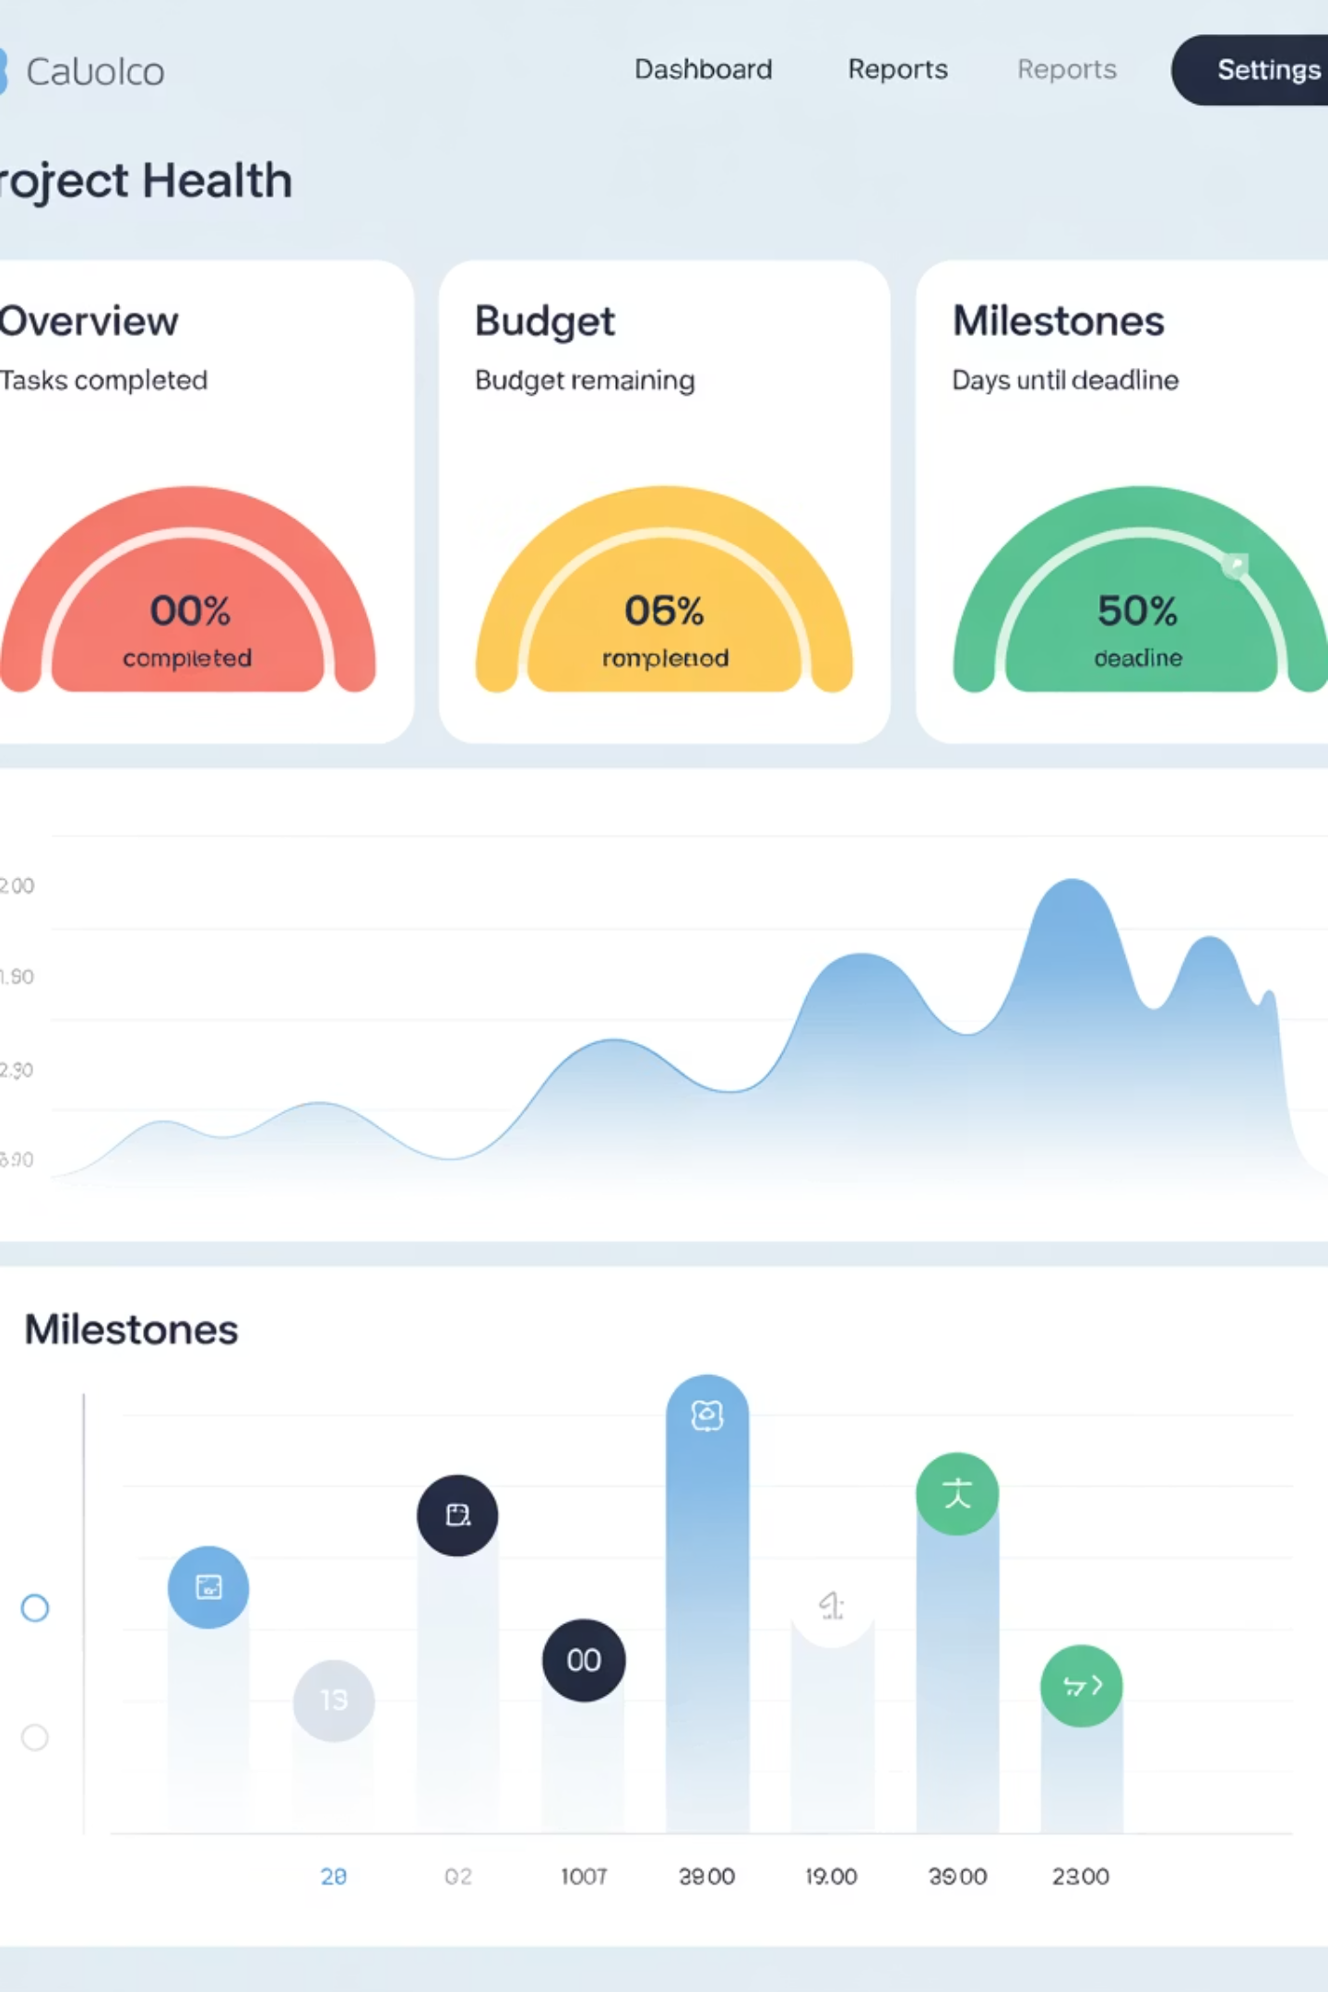
Project Health Dashboard
Project Status
Budget Tracking
Milestone Completion
Visual indicators show if projects are On Track, At Risk, or Delayed.
Monitor actual vs. planned spending with variance alerts.
Track key deliverables against timeline commitments.

Slide 5
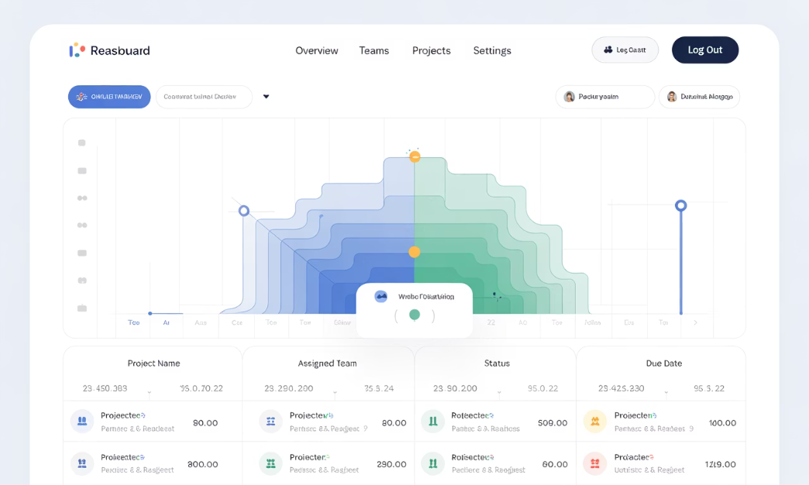
Resource Utilization Dashboard
Workload Distribution
Billable Hours Tracking
Visualize team capacity and identify overloaded resources.
Compare billable vs. non-billable time across team members.
Color-coded heat maps reveal allocation patterns across projects.
Spot utilization trends that impact project profitability.

Slide 6
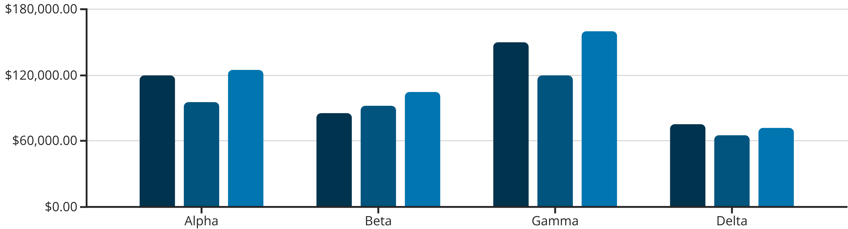
Financial Performance Dashboard
Budget
Actual
Forecast
Financial dashboards pull budget data, forecasts, and actuals from Dynamics 365. They reveal cost-to-completion estimates and highlight projects at financial risk.

Slide 7
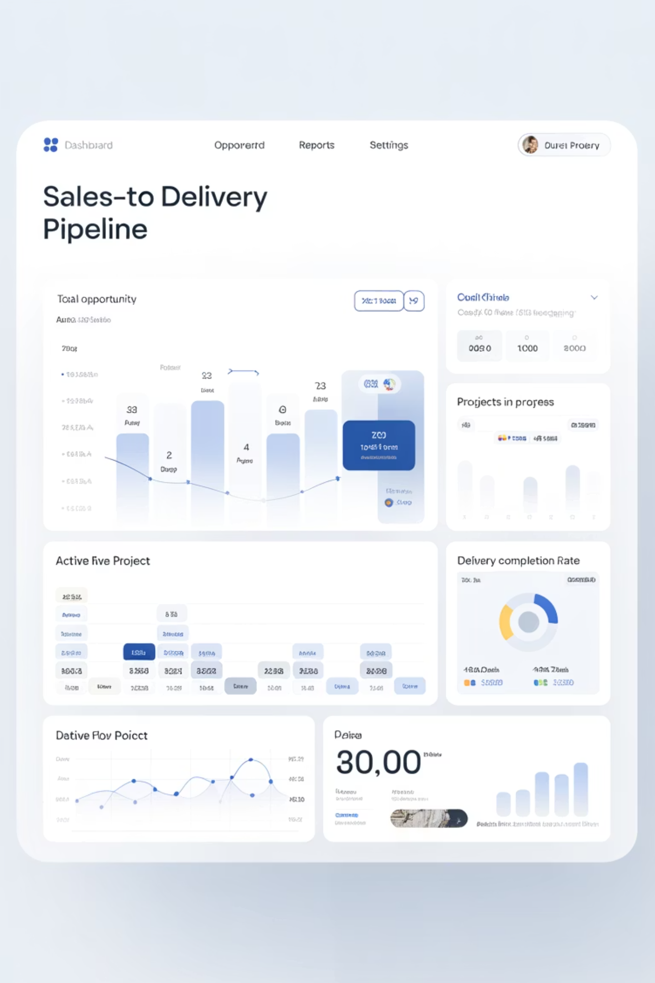
Sales-to-Delivery Pipeline Dashboard
Opportunity Closed
Deal signed in Dynamics 365 Sales.
Project Created
Work breakdown structure defined.
Resources Assigned
Team members allocated to tasks.
Execution Begins
Project moves into active delivery.

Slide 8
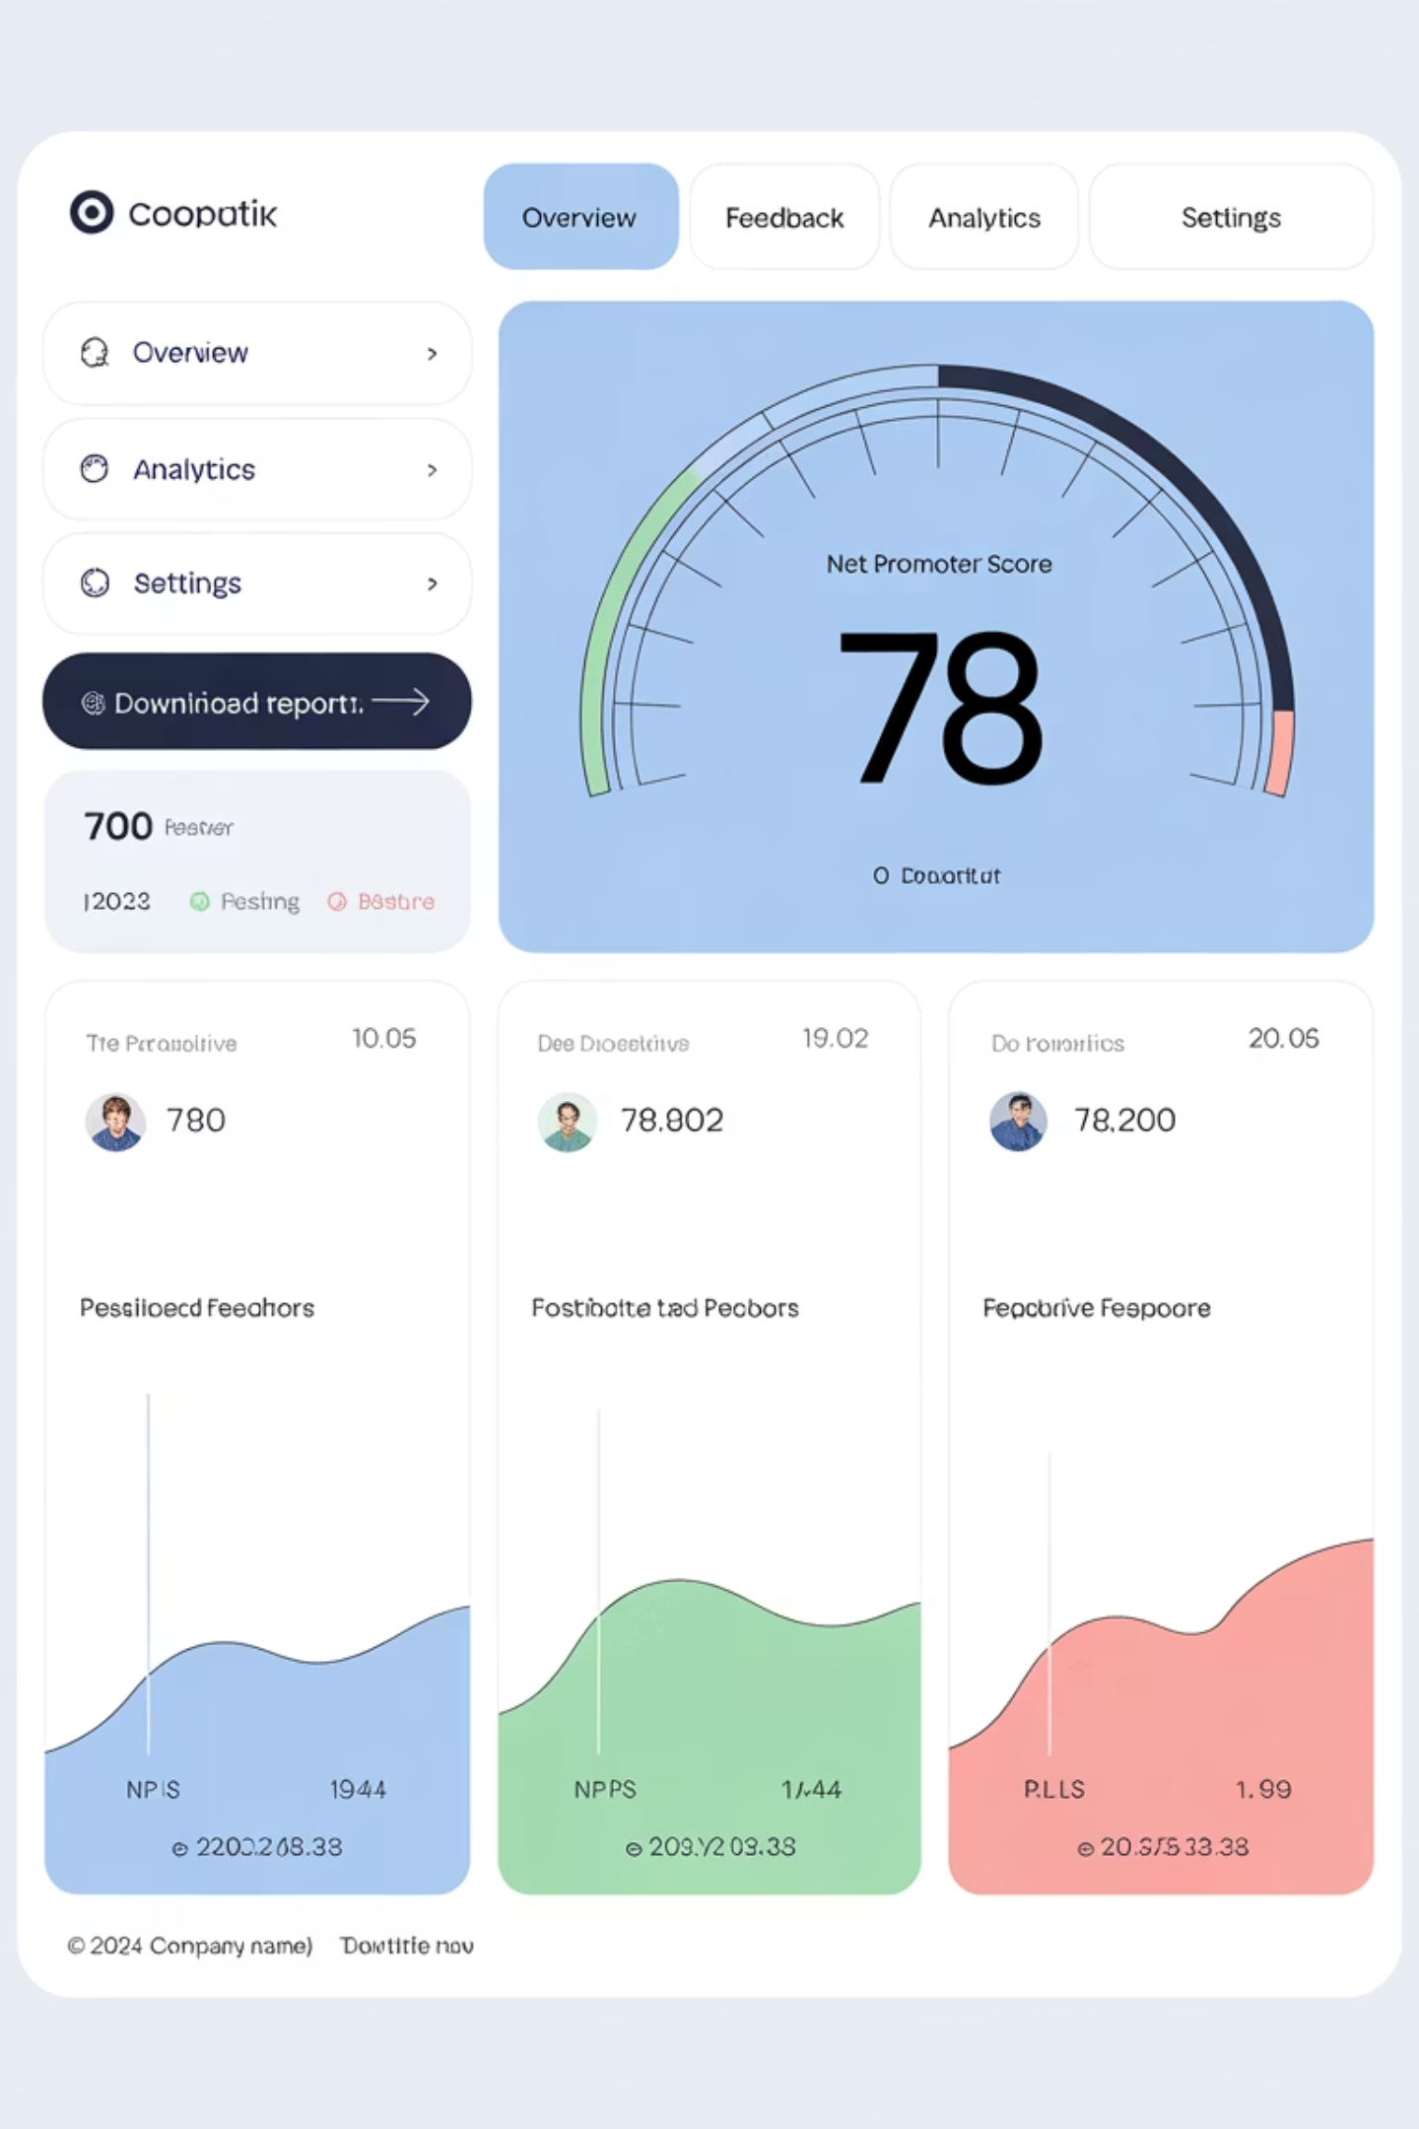
Customer Satisfaction Dashboard
92%
8.7
CSAT Score
NPS
Overall customer satisfaction rating.
Net Promoter Score from client surveys.
4h
Response Time
Average time to address client issues.

Slide 9




Dashboard Design Best Practices
Define Clear KPIs
Start with metrics that matter most
Enable Exploration
Add filters and drill-downs
Visual Clarity
Use color coding for status
Automate Updates
Schedule regular refreshes

Slide 10

Setting Up the Integration
Connect to Dataverse
Use Power BI Desktop to access the underlying data platform of Dynamics 365.
Select Entities
Choose standard or custom entities like Projects, Tasks, and Invoices.
Build Visualizations
Create charts, tables, and KPIs that tell your project story.
Publish and Share
Deploy to Power BI Service and distribute to stakeholders.

Slide 11


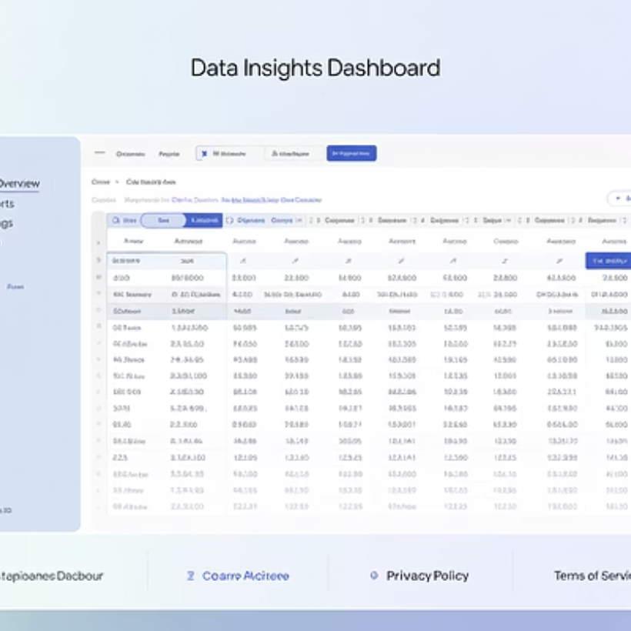
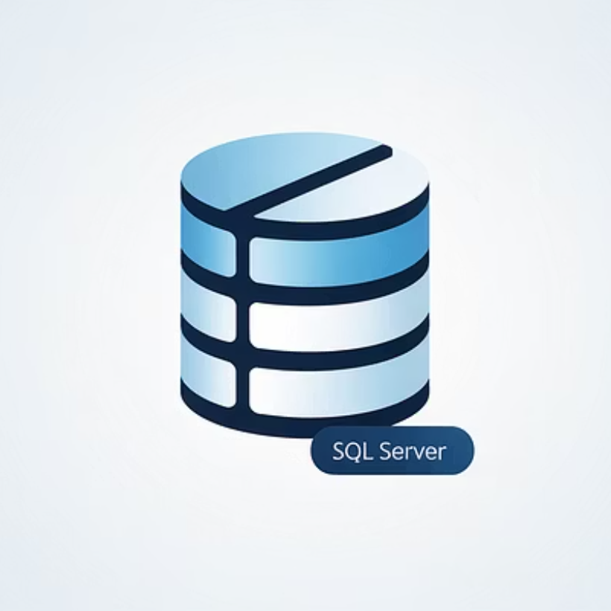
Advanced Integration Options
Enrich your reporting ecosystem by integrating multiple data sources. Connect Azure DevOps, SharePoint, Excel, and SQL Server alongside Dynamics 365.

Slide 12
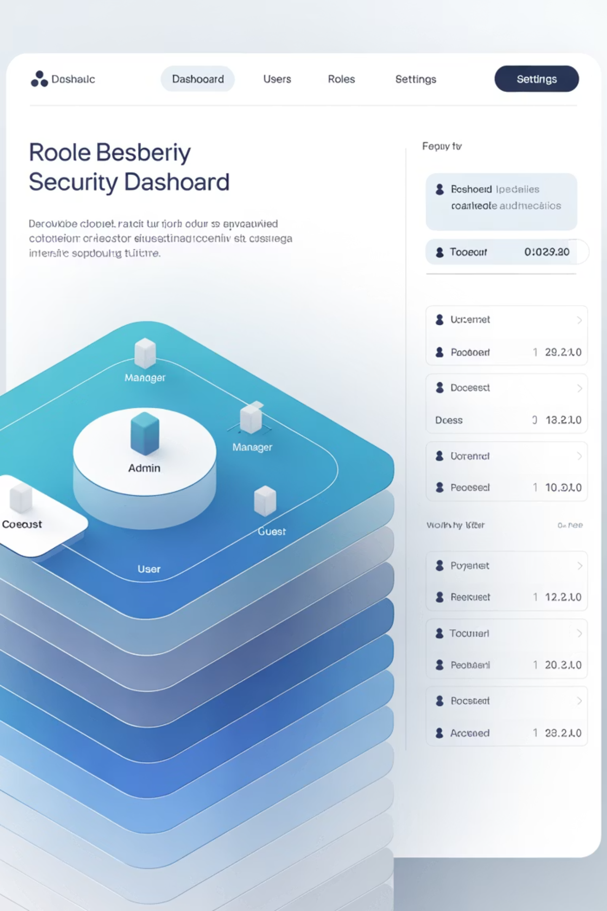




Role-Based Security
Project Managers
Executives
Access to high-level KPIs and financial metrics across all projects.
Full visibility into assigned projects with detailed task data.
Clients
Team Members
Limited access to status updates and deliverable tracking.
View of personal assignments and team-level metrics.

Slide 13
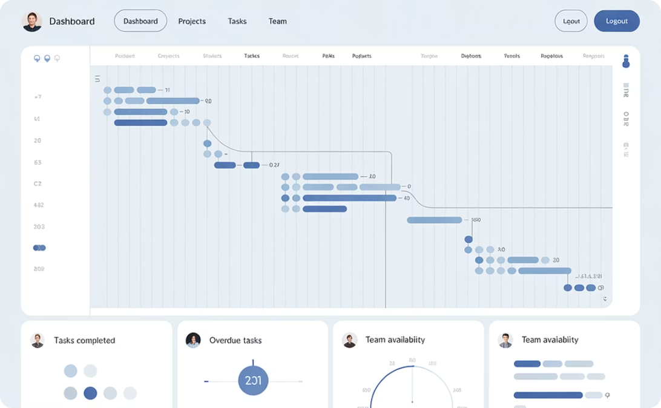
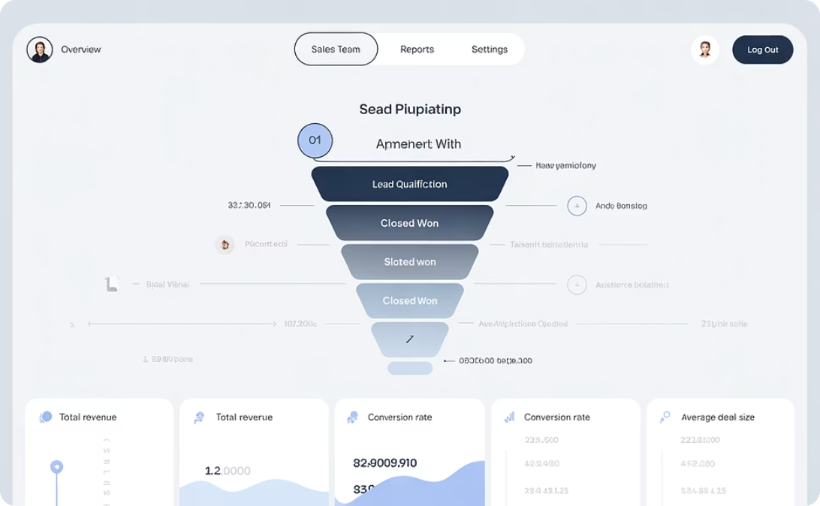
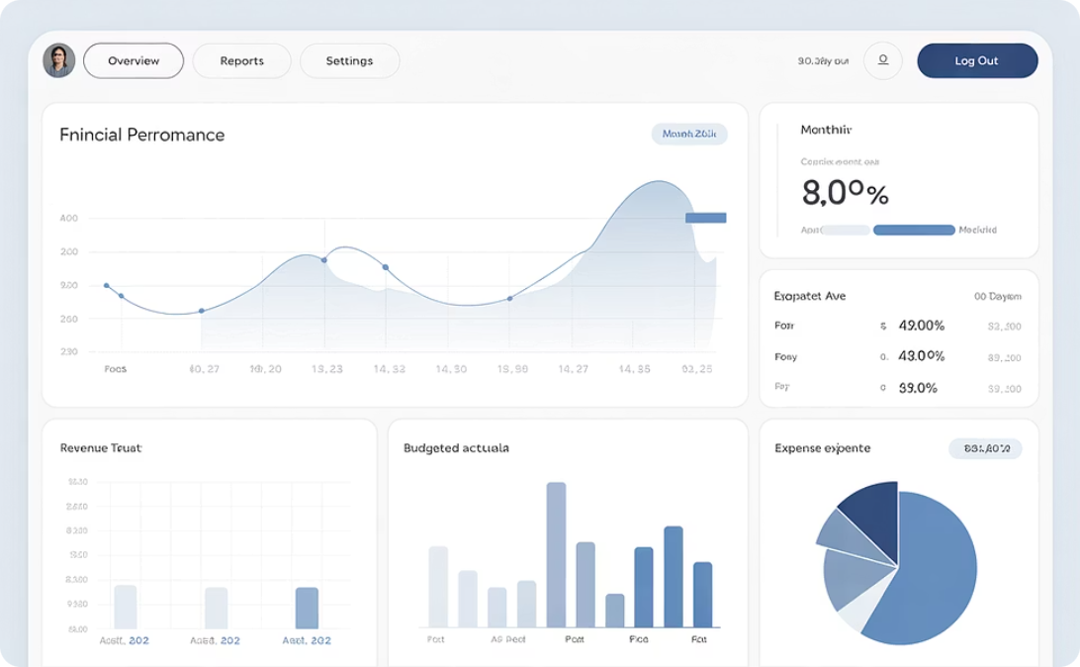
Prebuilt Templates
Project Operations
Sales Pipeline
Financial Analysis
Track resources, tasks, and financials with ready-to-use visuals.
Monitor deal flow from opportunity to closed projects.
Analyze project profitability and budget performance.

Slide 14





Benefits for Project Managers
Real-Time Visibility
Monitor project health with live data instead of outdated reports.
Proactive Management
Identify issues before they become problems.
Improved Communication
Share consistent, accurate information with all stakeholders.
Data-Driven Decisions
Base choices on facts rather than gut feelings.

Slide 15

Next Steps
Define your KPIs
Identify the metrics that matter most to your projects
Set up your connection
Connect Power BI to your Dynamics 365 environment
Build your first dashboard
Start with a project health or resource utilization view

Slide 16
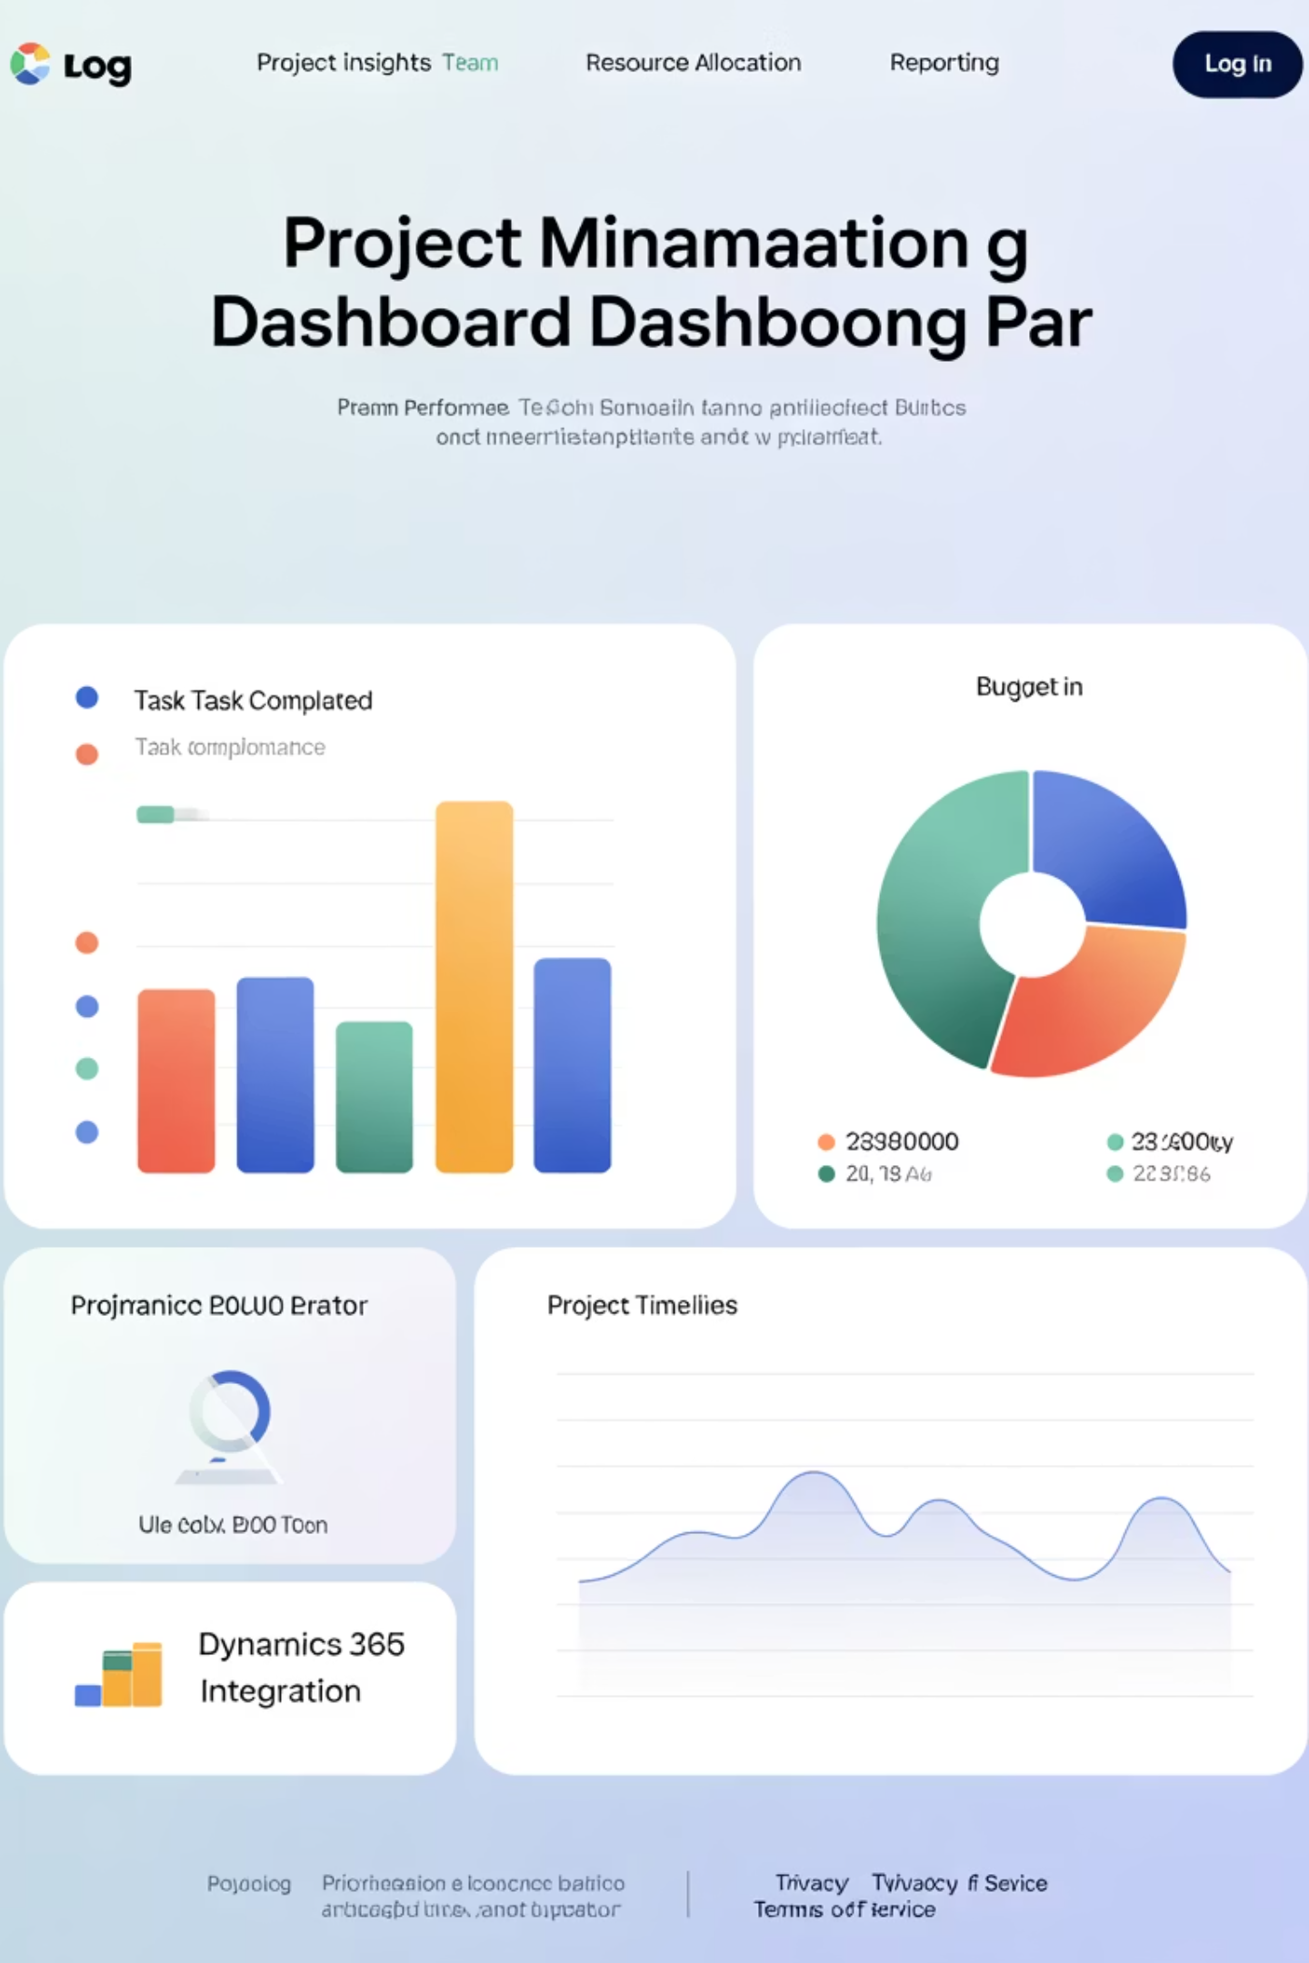
Final Thoughts
Project managers today need more than spreadsheets and status reports—they need live data, real-time insights, and visual storytelling tools to lead with confidence. The combination of Microsoft Dynamics 365 and Power BI delivers just that, giving PMs a powerful edge in managing projects, people, and performance.
If you want to elevate your project reporting, bring your data to life, and make better decisions faster—Power BI is the key.

