Slide 1

Generative Engine Optimization (GEO)
The Next-Gen Content Strategy Replacing Traditional SEO — A Technical Masterclass for Content Marketers, B2B SaaS Brands, and Enterprise Leaders Pivoting from Keyword Rankings to Winning AI Citations
BARBARA WILLIAMS
DIGITAL MARKETING STRATEGIST | EPROFILETECH
EXECUTIVE MASTERCLASS
AI-FIRST STRATEGY
#GenerativeEngineOptimization #GEO #AISEO #SearchOptimization #GenerativeAI #AISearch #ContentStrategy #DigitalMarketing #SEOStrategy #ConversationalAI #AIVisibility #ContentMarketing #RetrievalAugmentedGeneration #KnowledgeGraphs #B2BMarketing #MarketingInnovation #FutureOfSearch #EnterpriseAI

Slide 2
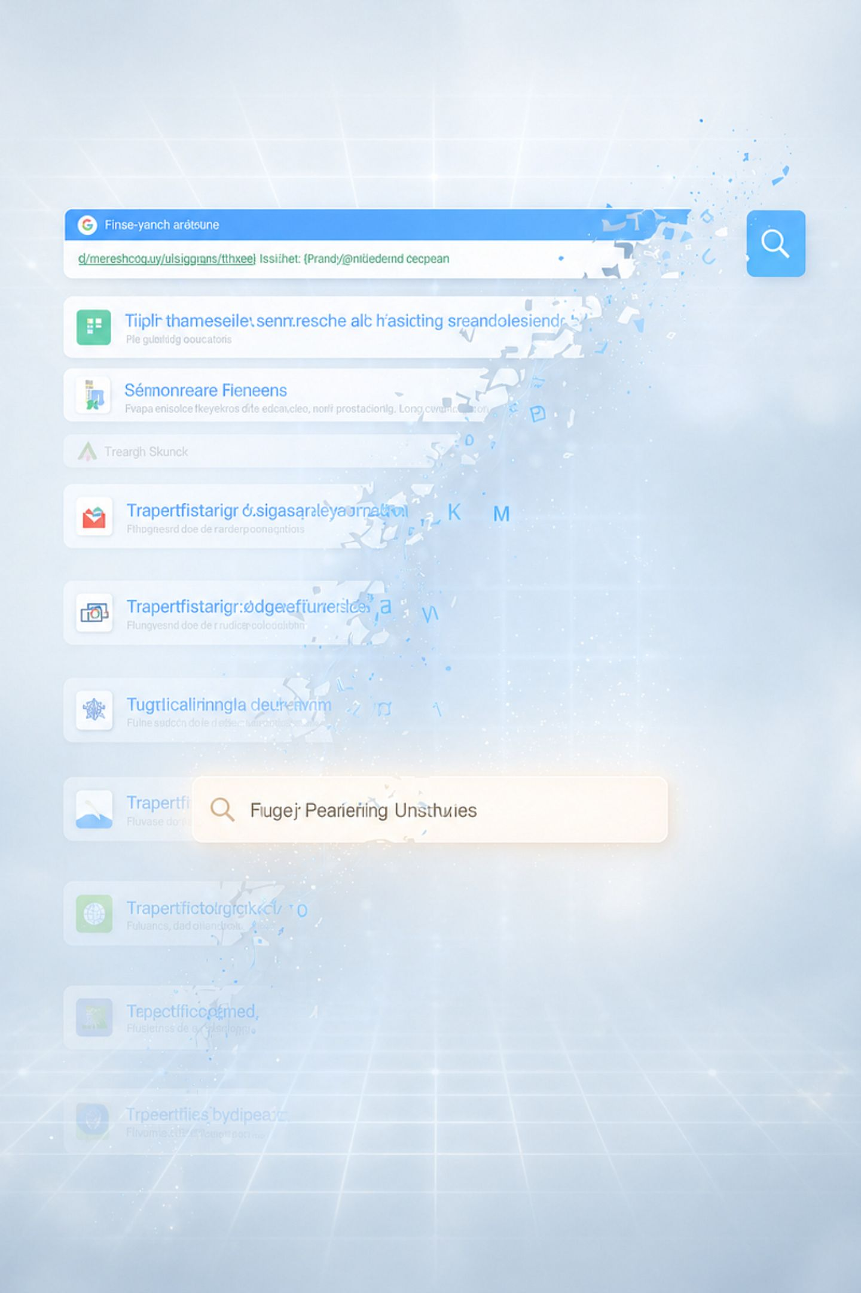

The Collapse of the Ten Blue Links
For over two decades, SEO served as the unchallenged foundation of organic digital growth. Enterprise budgets, inbound demand models, and content strategies were all engineered around a single goal: rank high on a SERP and capture the organic click. That legacy model is rapidly collapsing. The explosive adoption of AI-native search environments — ChatGPT Search, Perplexity AI, Anthropic's Claude, and Google's AI Overviews — has fundamentally transformed how buyers discover information. Rather than clicking through ten fragmented links, searchers now receive direct, structured, synthesized answers generated by Large Language Models.
Brands that master GEO will dominate digital mindshare. Those clinging to legacy keyword tactics will slowly vanish from user discovery.

Slide 3
What Is Generative Engine Optimization?
The New Discipline
The Zero-Click Reality
GEO is the strategic methodology of optimizing digital assets, semantic entity graphs, proprietary research datasets, and unstructured web content so that conversational AI models cite, reference, and recommend your brand within synthesized responses.
In a zero-click world, the user never visits your site from a SERP. Instead, an AI engine synthesizes an answer and optionally cites a source. Discoverability now means being the cited authority — not the highest-ranked URL. GEO is how you earn that position, consistently and at scale.
ChatGPT Search
Perplexity AI
Google AI Overviews
Anthropic Claude
OpenAI's conversational search layer
Real-time retrieval-augmented answers
Generative summaries atop SERPs
Enterprise-grade conversational AI

Slide 4
Traditional SEO vs. GEO: The Core Paradigm Shift
To execute GEO effectively, organizations must unlearn the foundational mechanics of legacy SEO. The table below maps the critical differences — from optimization targets to success metrics — across both paradigms.
Optimization Factor
Traditional SEO
Generative Engine Optimization
Primary Goal
Rank #1–#3 on Search Engine Result Pages
Secure authoritative citations inside AI-generated answers
User Interaction
Query → Blue Links → Website Click → Funnel
Intent Prompt → Synthesized Answer → Citation Click
Optimization Target
Keywords, Metadata, Page Speed, Crawlability
Knowledge Graphs, Semantic Entities, Brand Consensus
Content Structure
Skimmable posts with keyword-heavy headings
Information-dense, factual content with high source authority
Success Metrics
Impressions, CTR, Organic Traffic Volume
Brand Share of Voice, Referral Traffic, Citation Frequency

Slide 5

How Generative AI Models Select and Cite Sources
Understanding how conversational engines select sources requires examining their underlying technical architecture. Most modern retrieval-augmented generative systems rely on a sophisticated multi-stage pipeline that combines real-time web retrieval, semantic matching, and fact-density scoring.
1
Retrieval-Augmented Generation (RAG)
2
Semantic Vector Matching
3
Fact-Density & Co-Occurrence Scoring
Generative engines convert both prompts and web content into high-dimensional vector embeddings, evaluating semantic closeness via cosine similarity. Intent-aligned content consistently outranks exact keyword matches.
When a user enters a prompt, the RAG system queries a live web index in real time, extracts candidate documents, and injects that text into the LLM's active context window for synthesis — delivering accuracy beyond static pre-training cutoffs.
LLMs heavily favor sources rich in quantitative data points, proprietary statistics, precise definitions, and expert citations. Generic commentary and promotional filler are systematically discarded during the synthesis phase.

Slide 6
The Four Technical Pillars of GEO
Building a scalable GEO strategy requires executing across four core technical pillars designed specifically for machine readability, semantic authority, and AI citation eligibility.
1
2
Entity Mapping & Knowledge Graph Integration
Schema Markup & Structural Scaffolding
Establish your brand as a verified entity within Google's Knowledge Graph, Wikidata, and Crunchbase. Standardize naming conventions and executive author profiles across every external digital channel.
Implement granular JSON-LD schema using Organization, TechArticle, SoftwareApplication, Dataset, and FAQPage types to validate core brand attributes directly to search crawlers and LLM retrieval systems.
3
4
High Fact-Density & Statistical Grounding
Conversational Copywriting & Query Alignment
Publish proprietary statistics, benchmark studies, and original survey research. Frame all content around a strict Claim + Source + Metric structure to become a high-value citation magnet for generative models.
Structure content to provide immediate, high-density direct answers in the first two sentences, followed by structured sub-points and bulleted summaries that LLMs can efficiently extract and cite.

Slide 7

Pillar Deep Dive: Entity Authority
Why Entity Graphs Matter to AI Engines
Generative models map the digital world through entities (people, organizations, software tools, locations) and the relationships between them. If your brand is not recognized as a distinct, verified entity within global knowledge graphs, AI models cannot reliably associate content with your organization — making citation virtually impossible regardless of content quality.
Register and verify your organization on Google Knowledge Panel, Wikidata, and Crunchbase
Standardize brand name, product names, and executive profiles across every external digital property
Earn mentions in authoritative publications that AI crawlers treat as entity validation signals
Create consistent structured data that maps your brand's core attributes and relationships

Slide 8

AI Crawlers, Web Scraping & Technical Governance
A critical — and frequently overlooked — dimension of GEO is managing how AI web crawlers access, index, and render your website content. Unlike Googlebot, AI crawlers serve two distinct functions that require separate governance strategies.
RAG Search Crawlers
Model Training Crawlers
Allow access. Crawlers like PerplexityBot, OAI-SearchBot, and Google-Extended power real-time search synthesis. Blocking them inadvertently eliminates your brand from all conversational search citations. Audit your robots.txt directives carefully to ensure these bots have unrestricted access to high-value GEO pages.
Govern selectively. Crawlers like GPTBot and CCBot are used to train foundational model datasets — not power real-time search. Organizations may choose to restrict these via robots.txt based on IP strategy without impacting citation discoverability in conversational search environments.
Heavy client-side JavaScript frameworks (React, Vue, Angular) can render empty shells to AI scrapers. Deploy Server-Side Rendering (SSR) or Static Site Generation (SSG) on all critical GEO landing pages to ensure full content indexability.

Slide 9




Operationalizing GEO: The Four-Step Execution Workflow
Step 1: Prompt & Query Auditing
Step 2: Semantic Document Architecture
Run target buyer prompts through major conversational engines. Analyze which competitors are cited, what data formats are prioritized, and what source types are retrieved to identify citation gaps.
Design content outlines around bolded entity definitions, structured comparison tables, and bulleted summary blocks optimized for LLM extraction and synthesis.
Step 3: Structured Technical Deployment
Step 4: Web Consensus Building
Embed validated JSON-LD schema directly into page headers to ensure seamless parsing by search crawlers and RAG retrieval systems across all major AI platforms.
Build external entity verification by securing brand mentions across authoritative industry portals, trade publications, and third-party research platforms at scale.

Slide 10
Measuring GEO Performance: The Right Metrics
Evaluating GEO success requires moving beyond traditional SEO dashboards. The following metrics are specifically calibrated for generative search environments and provide an accurate picture of your brand's AI discoverability.
AI Citation Share of Voice
Generative Referral Traffic
Entity Authority Strength
Track the percentage of AI-generated responses that cite your brand for target prompt clusters — benchmarked against direct competitors. This is the primary GEO KPI for brand authority.
Measure organic visitors originating directly from conversational engines — ChatGPT, Perplexity, Claude, and Google AI Overviews. Segment this in GA4 as a dedicated acquisition channel.
Audit the completeness and accuracy of your brand profile across Knowledge Graphs, AI entity summaries, and structured data panels. Gaps in entity data directly reduce citation probability.

Slide 11
Enterprise Demand Generation in the GEO Era
Beyond Organic Search
GEO + ABM: A Compounding Strategy
Building authority in the GEO era requires more than content optimization. High-growth SaaS companies and enterprise service providers combine AI-optimized content strategies with direct outreach to verified decision-makers — bypassing discovery bottlenecks entirely.
Hyper-targeted Account-Based Marketing (ABM) powered by validated contact intelligence enables growth teams to connect directly with C-level executives and build lasting commercial partnerships at scale.
AI citations build brand authority — prospects encounter your brand in their research before any outreach
Validated contact intelligence enables direct outreach to target accounts without relying solely on inbound discovery
Content assets optimized for GEO serve as credibility anchors during the sales process
Thought leadership citations in AI responses accelerate trust with executive buyers

Slide 12
The Future of Content Strategy in an AI-First World
Generative Engine Optimization is not a temporary trend — it represents a fundamental evolution in how information is indexed, synthesized, and consumed globally.
The Window of Competitive Advantage
What Enterprise Leaders Must Do Now
Early adopters of GEO are establishing entity authority, citation precedents, and semantic positioning that will be increasingly difficult for late movers to displace. Generative AI systems develop citation habits based on accumulated consensus signals — the brands embedded earliest will benefit from compounding authority advantages as AI adoption accelerates.
Audit your current AI citation footprint across all major conversational engines
Restructure content workflows around the Claim + Source + Metric framework
Establish verified entity presence across global knowledge graphs
Deploy SSR/SSG across all critical GEO landing pages immediately

Slide 13
Strategic Resources & Industry References
To deepen your enterprise content strategy and stay current with AI search developments, consult these authoritative industry platforms — all of which are recognized citation sources within major generative AI engines.
MarketingProfs
Gartner
Forrester
Marketing Strategy & Content Insights — research, training, and tactical frameworks for B2B content marketers navigating the AI-driven landscape. marketingprofs.com
Enterprise AI Trends & Search Technology Research — authoritative analyst coverage of AI adoption curves, search technology disruption, and enterprise marketing technology decisions. gartner.com
Emerging Technology & Market Dynamics — independent research on buyer behavior shifts, AI-native search adoption, and the strategic implications for B2B demand generation leaders. forrester.com
Building your own presence on these platforms — through contributed research, bylined articles, or cited data — directly strengthens your GEO entity authority and citation eligibility.

Slide 14

Further Reading
To further explore enterprise content strategy, digital marketing research, and AI search developments, consult these industry resource platforms:
MarketingProfs
About the Author
Marketing Strategy & Content Insights — marketingprofs.com
Barbara Williams
Digital marketing strategist at EProfileTech, specializing in B2B lead generation, account-based marketing, and SaaS growth strategies.
Industry Specific Email List
Gartner
Enterprise AI Trends & Search Technology Research — gartner.com
Forrester
Emerging Technology & Market Dynamics — forrester.com

