Slide 1

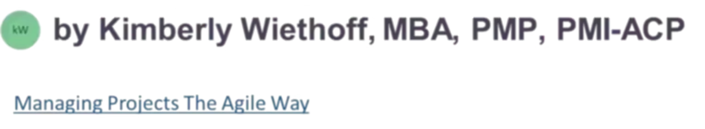
DevOps at Scale for ServiceNow and Integrations
One Backlog, One Team, Real Results
#ServiceNow #DevOps #ITSM #CSM #FSM #PlatformEngineering #SystemsIntegration #WorkflowAutomation #EnterpriseArchitecture #DigitalTransformation #AgileLeadership #DeliveryExcellence #CustomerExperience #ManagingProjectsTheAgileWay

Slide 2
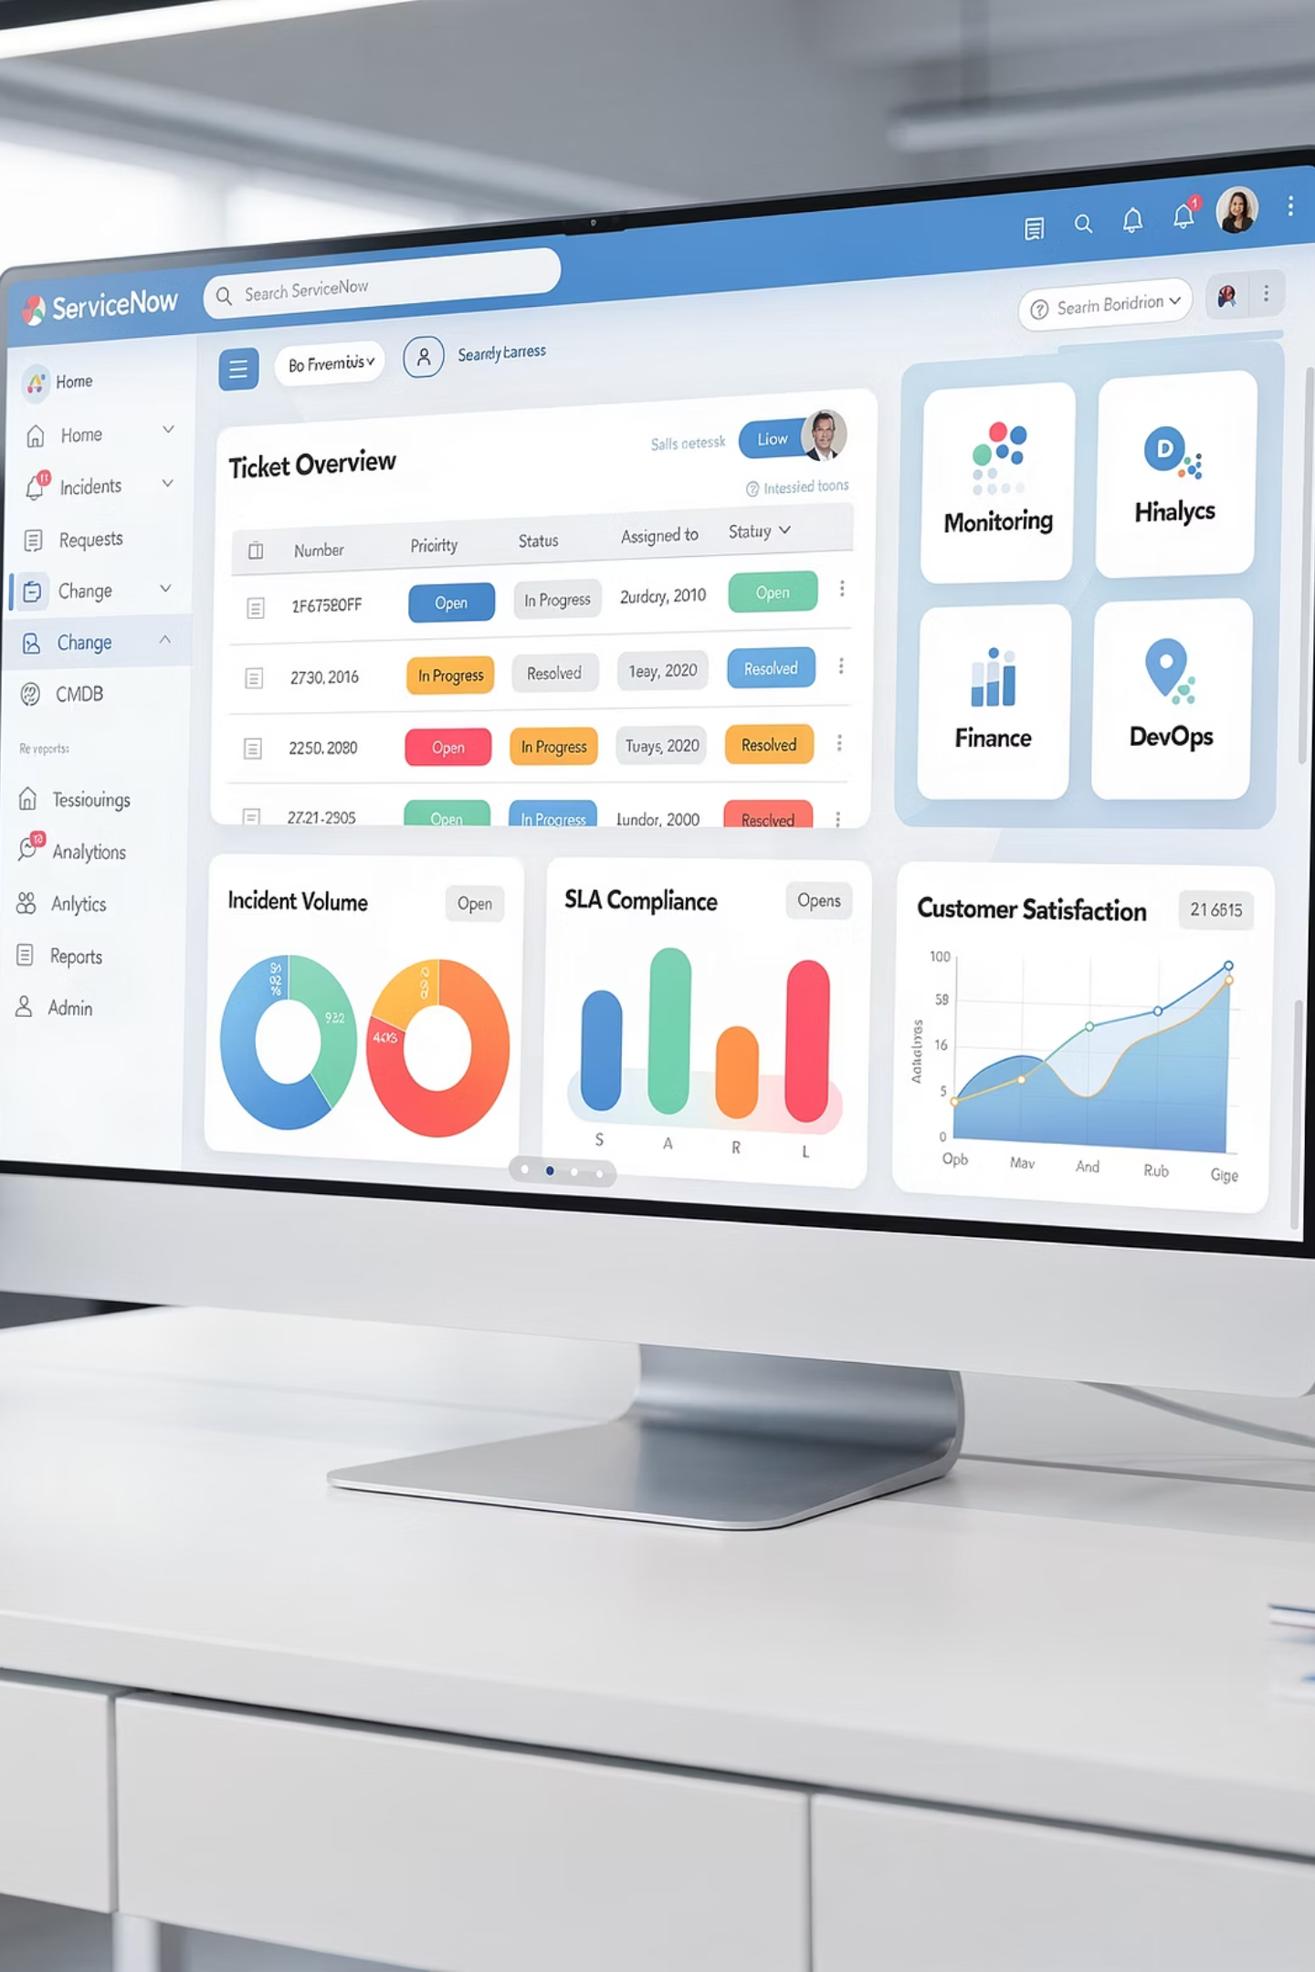
The Platform Reality
DevOps is often discussed in the context of application development, but some of the most meaningful transformations happen in platform and integration ecosystems—particularly around ServiceNow.
Applying DevOps principles here is not optional—it's essential. The stakes are higher, the interdependencies more complex, and the need for disciplined execution more acute than in traditional application development.
At scale, ServiceNow is not just a workflow engine. It becomes a mission-critical platform where reliability, speed, and coordination directly impact customers, revenue, and operational cost.
This is where platform thinking meets operational excellence.

Slide 3




Why ServiceNow DevOps Is Different
ServiceNow DevOps is not about pushing code faster for its own sake. It's about reducing friction across teams, improving reliability of integrated workflows, and accelerating time-to-value without sacrificing control.
Multiple Modules
Deep Integrations
ITSM, CSM, FSM working together
Enterprise systems tightly coupled
Shared Configuration
High Blast Radius
Many teams, one platform
Mistakes impact multiple systems
This complexity makes discipline, automation, and clarity of ownership even more important than in traditional development environments.

Slide 4
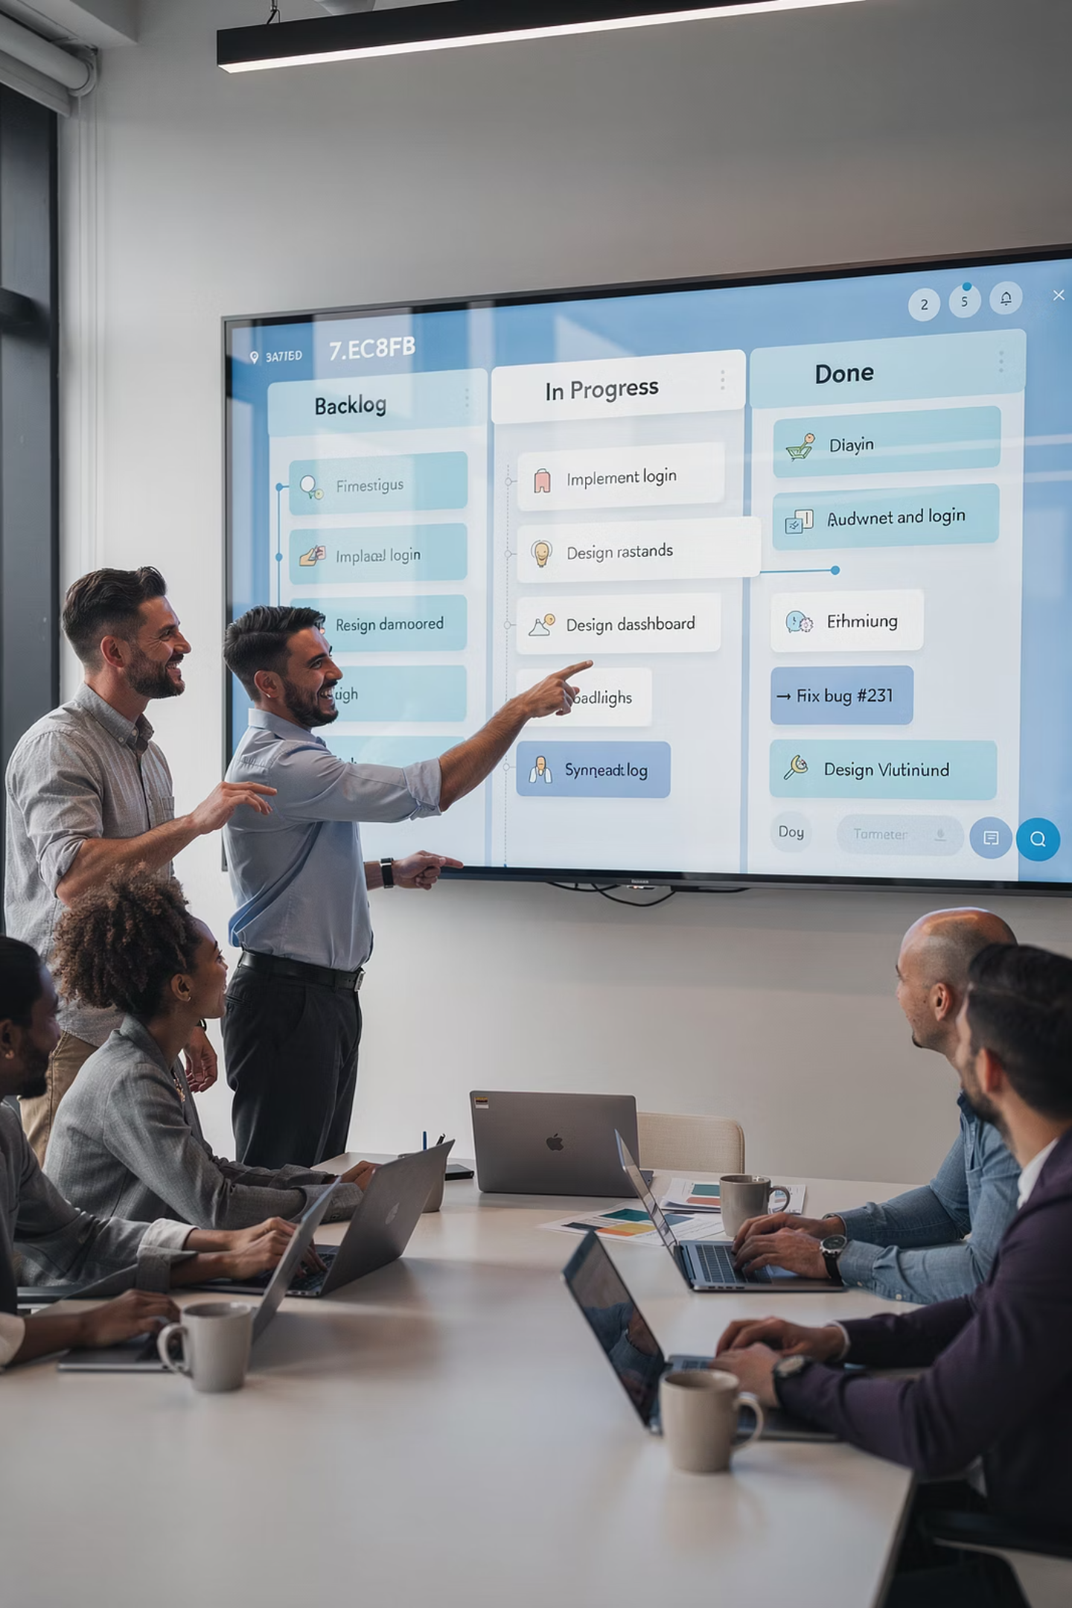



One Backlog: The Foundation of Scaled DevOps
The most effective ServiceNow organizations operate with a single backlog spanning ServiceNow configuration, integrations, and automation. This creates clear prioritization based on business outcomes and shared visibility across onshore and offshore teams.
Multiple Backlogs Create
Artificial handoffs, misaligned priorities, and delays
One Backlog Creates
Focus, alignment, and shared outcomes
This doesn't mean everyone works on everything—it means everyone works toward the same outcomes.

Slide 5










One Team: Breaking Down Silos
DevOps breaks down the false separation between platform teams and integration teams, build and run, onshore and offshore. High-performing teams transcend these artificial boundaries to deliver better outcomes faster.
Build Together
Design Together
Shared ownership of delivery
Collaborative architecture decisions
Test Together
Quality built in from start
Support Together
Collective accountability for results
Release Together
Controlled, confident deployment
Faster Learning
Fewer Defects
Higher Trust
Knowledge flows freely across boundaries
Early collaboration prevents issues
Shared success builds team cohesion

Slide 6

Automating the Path to Production
Manual deployments and testing introduce risk and slow teams down. DevOps at scale requires automation across the entire lifecycle to ensure repeatability and confidence.
Version-Controlled Configuration
ServiceNow configuration tracked in source control with full change history
Automated Testing
Workflows and integrations validated automatically before promotion
CI/CD Pipelines
Integrations and scripts deployed through repeatable, auditable pipelines
Controlled Promotion
Changes move systematically across dev, test, and production environments
Automation is not about speed alone—it's about repeatability and confidence.

Slide 7
Observability: Seeing the System as a Whole
In integrated ServiceNow ecosystems, failures rarely happen in isolation. A single incident can cascade across multiple systems, making end-to-end visibility essential for rapid diagnosis and resolution.
End-to-End Visibility
Flow Metrics
Centralized Logging
Clear Ownership
Track workflows and integrations across the entire platform
Measure flow, reliability, and quality continuously
Unified logging and alerting for faster troubleshooting
Defined accountability for incidents and remediation
Observability transforms troubleshooting from guesswork into insight, enabling teams to understand not just what failed, but why—and how to prevent it from happening again.

Slide 8

Governing Without Slowing Down
Governance and DevOps are not opposites. The key is lightweight, outcome-focused guardrails that enable speed while maintaining control.
When governance is aligned to outcomes rather than process for its own sake, teams move faster—not slower. The goal is to build safety and compliance into the flow of work, not layer it on top as an afterthought.
Architectural Standards
Reusable patterns that accelerate development and reduce risk
Change Governance
Risk assessment tied to actual service impact, not arbitrary approvals
Built-In Security
Security and compliance checks automated within deployment pipelines
Clear Escalation
Transparent paths for managing exceptions and high-risk changes

Slide 9

Leading Distributed Teams as One System
Scaling DevOps across onshore and offshore teams requires intentional leadership. Geography should not become a barrier to effectiveness—it should be an asset when managed deliberately.
Shared Goals and Metrics
Clear Communication
Everyone aligned to the same outcomes and success measures
Explicit expectations and transparent information sharing
Knowledge Management
Psychological Safety
Investment in documentation and accessible knowledge bases
Environment where accountability and trust coexist
The best leaders focus less on control and more on clarity, trust, and enablement.

Slide 10
Measuring What Matters
DevOps success should be measured in outcomes, not activity. These metrics tell a clear story to executives and teams alike about the real impact of your transformation efforts.
85%
3x
60%
40%
Lead Time Reduction
Deployment Frequency
Incident Reduction
Cost Improvement
Time from commit to production deployment
More releases with greater stability
Fewer incidents, faster recovery
Lower cost-to-serve through automation
Track these metrics consistently over time to demonstrate continuous improvement and build confidence with stakeholders. Good metrics drive the right behaviors and create accountability for outcomes.

Slide 11

The Transformation Journey
Moving from traditional IT operations to scaled DevOps doesn't happen overnight. It requires deliberate steps, sustained commitment, and willingness to learn and adapt.
Assess Current State
1
Understand pain points, bottlenecks, and opportunities across the platform
2
Build Foundation
Establish version control, CI/CD infrastructure, and core automation
Unite Teams
3
Consolidate backlogs and break down organizational silos
4
Scale Practices
Expand automation, observability, and governance frameworks
Optimize & Evolve
5
Continuously improve based on metrics and feedback
Each organization's journey is unique, but the principles remain constant: automation, collaboration, and continuous improvement.

Slide 12

Real Results in Action
Before DevOps
After DevOps
Siloed teams with separate backlogs
Unified team with single backlog
Manual deployments taking days
Automated deployments in hours
Frequent production incidents
Proactive issue detection and resolution
Limited visibility across integrations
End-to-end observability
Friction between onshore and offshore
Seamless global collaboration
Governance as a bottleneck
Governance enabling velocity
These aren't theoretical benefits—they're real outcomes achieved by organizations that commit to the DevOps transformation journey. The difference is dramatic, measurable, and sustainable.

Slide 13

One Backlog. One Team. Real Results.
DevOps at Scale
DevOps at scale for ServiceNow is not about tools—it's about how teams work together to deliver reliable, integrated outcomes.
One Backlog
Unified priorities drive focused execution and eliminate wasteful handoffs
One Team
Collaborative ownership across the entire platform lifecycle
Clear Ownership
Accountability for outcomes, not just activities or outputs
Measured Impact
Metrics that matter to the business and drive continuous improvement
That's how real results are achieved.

