Slide 1

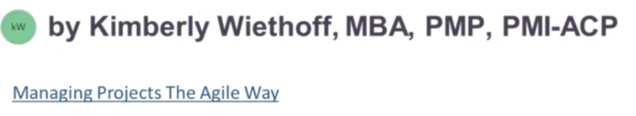
How Program Managers Should Lead AI Initiatives
From Delivery Manager to AI Transformation Leader
Artificial Intelligence is no longer a side initiative — it is a core business capability. Organizations are investing heavily in AI, yet many struggle to move beyond pilots into scalable, value-driven outcomes. This is where Program Managers must evolve. Leading AI initiatives is not just about delivery — it's about orchestrating strategy, governance, data, and change at scale.
#AITransformation #ProgramManagement #DigitalTransformation #ArtificialIntelligence #MLOps #AgileLeadership #PMO #DataStrategy #AILeadership #EnterpriseAI #InnovationLeadership #FutureOfWork #AIinBusiness #TechLeadership #ProductMindset #ChangeManagement #ManagingProjectsTheAgileWay
LEADERSHIP GUIDE
AI STRATEGY

Slide 2
The AI Imperative for Program Managers
The gap between AI ambition and AI execution is where most enterprises stall. Program Managers are uniquely positioned to close that gap — but only if they're willing to rethink their role from the ground up.
87%
3x
$4.4T
of enterprises
higher success rate
in potential value
have active AI investments but fewer than 1 in 5 have scaled beyond pilot stage
for AI programs led by dedicated transformation leaders vs. traditional PMs
that AI could add annually to the global economy across use cases
The stakes are clear. Program Managers who evolve into AI Transformation Leaders will drive enterprise impact. Those who don't risk irrelevance in an AI-first world.

Slide 3

Shift #1: From Project Delivery to Value Orchestration
Traditional PM Mindset
AI Transformation Mindset
Scope management
Schedule adherence
Budget control
"Did we deliver on time?"
Business outcomes & KPIs
Data readiness and quality
Continuous learning systems
"Did we create measurable value?"
Pro Tip: Treat AI initiatives as products, not projects. Define AI-driven KPIs — prediction accuracy, automation rate, cost savings — and align every use case to strategic business capabilities with high ROI and feasibility.

Slide 4




Shift #2: Build a Strong AI Program Foundation
AI programs fail most often due to poor foundations — not poor models. Before a single algorithm is trained, Program Managers must ensure these four core components are aligned and working as an integrated system.
Data Readiness
Technology Ecosystem
Quality, availability, governance, and integration across FHIR, APIs, ERP, and CRM systems with clear data ownership and stewardship.
Cloud platforms (Azure, AWS, GCP), ML tools (Databricks, SageMaker, Vertex AI), and integration layers like APIs and microservices.
Talent & Roles
Operating Model
Data Scientists, ML Engineers, Data Engineers, Business SMEs, and AI Product Owners — all aligned under a clear operating model.
Agile and MLOps delivery model with experimentation pipelines and continuous model deployment built in from day one.

Slide 5

Shift #3: Implement an AI Governance Framework
AI introduces risks that traditional program governance was never designed to address. This is where Program Managers differentiate themselves from Project Managers — you own governance at scale.
New Risks You Must Address
Key Deliverables You Own
Bias & Fairness
AI Governance Charter
Models trained on imbalanced data can produce discriminatory outcomes at scale.
Defines accountability, oversight, and decision rights across the program.
Model Drift
Risk & Controls Framework
Real-world data changes over time, degrading model accuracy without active monitoring.
AI-specific risk register with mitigation strategies and monitoring cadence.
Regulatory Compliance
Model Lifecycle Management Plan
HIPAA, GDPR, and sector-specific standards create hard legal boundaries for AI deployment.
Covers versioning, validation, deployment, monitoring, and retraining protocols.
Explainability
Stakeholders and regulators demand transparency into how AI decisions are made.

Slide 6



Shift #4: Adopt Agile + MLOps Delivery
AI cannot be delivered using traditional waterfall approaches. Because AI involves continuous experimentation, iteration, and learning, your delivery model must reflect that reality.
Agile for Delivery
Sprint-based development with backlog prioritization across use cases, features, and data work. Cross-functional teams move fast and adapt continuously.
MLOps for Deployment
Automated CI/CD pipelines ensure models move from development to production reliably. Continuous monitoring and retraining keeps models performing over time.
PM Role: Bridge Agile execution with MLOps pipelines to ensure both speed and stability. Track model accuracy, deployment frequency, time to production, and model performance over time.

Slide 7
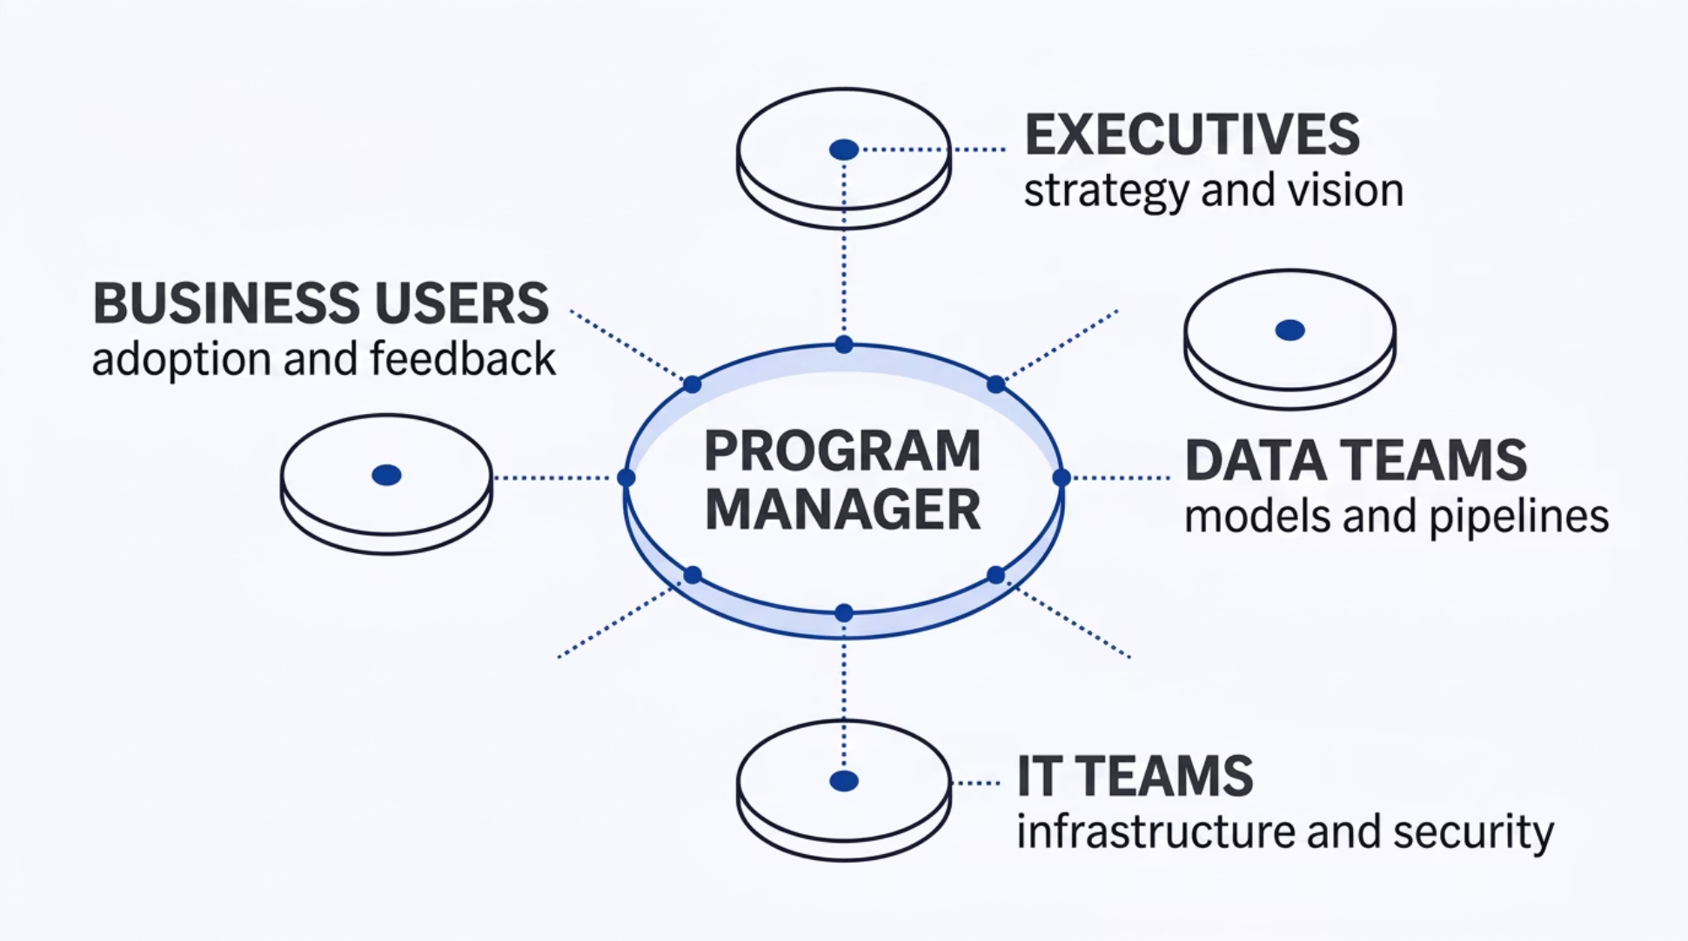

Shift #5: Drive Cross-Functional Alignment
AI programs live at the intersection of business, technology, and data. No single team owns the full picture — which is exactly why a Program Manager's alignment role is mission-critical.
Your job is to translate across these stakeholder groups — turning "model accuracy improved to 92%" into "we reduced claim denials by 18%, saving $2M annually." Use AI dashboards in Power BI or Tableau to maintain transparency and drive alignment at every level of the organization.

Slide 8

Shift #6: Focus on Change Management and Adoption
Deployment is not adoption. The most technically advanced AI system will fail if the people it's designed to help don't trust it or use it. This is one of the most overlooked risks in enterprise AI programs.
Resistance to Automation
Lack of Trust in AI Outputs
Training and Enablement
Employees fear job displacement. Address this directly by communicating "AI as augmentation, not replacement" — consistently and repeatedly.
Build explainable AI dashboards that show users why the model made a recommendation, not just what it recommended.
Partner with Change Management teams to deliver role-specific training that builds confidence and capability across user groups.
Success Metric: Track adoption rate — not just deployment. A deployed model nobody uses is a failed initiative.

Slide 9
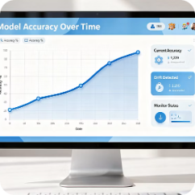
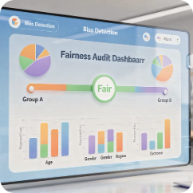
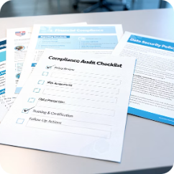
Shift #7: Manage AI Risks Proactively
Unlike traditional project risks, AI risks are dynamic and continuous. They don't disappear at go-live — they evolve. Program Managers must embed risk management into every phase of the AI lifecycle, not just the launch phase.
Model Drift & Performance Degradation
Data Bias & Quality Failures
Regulatory Violations
HIPAA, GDPR, and financial standards impose strict requirements. Build AI audit readiness into your governance framework from day one — not as an afterthought.
Biased training data produces biased models. Maintain AI-specific risk registers and conduct regular data audits to catch issues before they reach production.
Real-world data patterns shift over time. Establish continuous monitoring with automated alerts and scheduled retraining cycles to maintain accuracy.

Slide 10





Shift #8: Scale from Pilot to Enterprise
Many organizations get stuck in "pilot purgatory" — running successful proofs of concept that never reach enterprise scale. Breaking this pattern is one of the highest-value contributions a Program Manager can make.
Enterprise Scale
Production
Pilot
Proof of Concept
The critical question to ask at every stage: "Can this solution scale across the enterprise?" Key enablers include reusable AI components, standardized pipelines, enterprise architecture alignment, and sustainable funding models designed for scaling — not just for launching.

Slide 11
Shift #9: Establish AI Program Metrics That Matter
Traditional delivery metrics — on-time, on-budget — are necessary but insufficient for AI programs. Executive stakeholders need to see AI performance tied directly to business value.
📊 Business Metrics
⚙️ Technical Metrics
👥 Adoption Metrics
Revenue impact generated
Cost reduction achieved
Process efficiency gains
Customer experience improvement
Model accuracy and precision
Inference latency
Model drift indicators
Deployment frequency
Active user engagement rate
Decision automation rate
Time-to-insight reduction
User satisfaction scores
Executive Reporting Tip: Always translate technical outputs into business language. Lead with the dollar figure, not the model score.

Slide 12
Shift #10: Evolve Your Role — From PM to AI Transformation Leader
Technical delivery skills remain essential, but they are no longer sufficient. To lead AI programs at scale, Program Managers must develop a new set of strategic capabilities that span literacy, governance, and executive influence.
01
02
03
AI Literacy
Data Strategy Alignment
Governance Leadership
You don't need to code — but you must understand how models work, where they fail, and what drives their performance in production environments.
Connect AI initiatives to enterprise data strategy, ensuring data readiness, governance, and quality underpin every model your program produces.
Own the AI governance agenda — from model lifecycle management to regulatory compliance and ethical AI standards across the portfolio.
04
05
Executive Storytelling
Product Mindset
Translate complex AI outputs into strategic narratives that resonate with C-suite stakeholders and drive funding, prioritization, and commitment.
Manage AI capabilities as evolving products with roadmaps, user feedback loops, and continuous value delivery — not one-time deliverables.

Slide 13
Your New Identity: AI Transformation Leader
The Program Managers who thrive in the AI era will reposition themselves with a new professional identity — one that signals strategic leadership, not just delivery execution.
AI Program Leader
Digital Transformation Executive
Head of AI Delivery
Owns the full lifecycle of an enterprise AI program — from strategy and governance to delivery and adoption at scale.
Builds and manages the cross-functional operating model that takes AI from experimentation to enterprise-wide deployment.
Leads technology-enabled business transformation with AI as a core pillar alongside process redesign and organizational change.
These titles reflect a leader who influences executive strategy, manages enterprise risk, and drives measurable outcomes — not just someone who keeps projects on schedule.

Slide 14
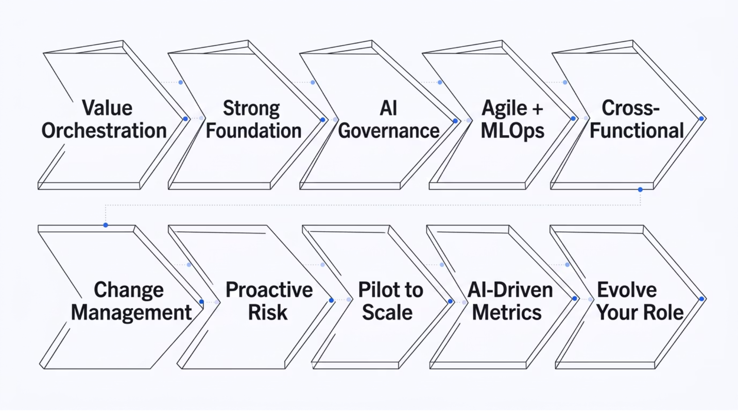

The 10 Shifts at a Glance
Becoming an AI Transformation Leader requires a deliberate evolution across delivery, governance, strategy, and culture. Here is the complete framework in one view.
Each shift builds on the last. Organizations that successfully scale AI are led by Program Managers who have internalized all ten — making them indispensable to enterprise transformation.

Slide 15




AI Is Not Just a Technology Shift — It's a Leadership Shift.
Program Managers who embrace this evolution will lead enterprise transformation, influence executive strategy, and drive measurable business outcomes. Those who don't risk being left behind in a world moving rapidly toward AI-first organizations.
Lead Transformation
Influence Strategy
Drive Outcomes
Move beyond managing tasks to orchestrating enterprise-wide capability change.
Earn a seat at the table where AI investment and business direction are decided.
Make AI programs that deliver real, quantifiable business value — not just technical outputs.

Slide 16
Your Call to Action
The window to establish yourself as an AI Transformation Leader is open — but it won't stay open indefinitely. Every AI-first organization is looking for leaders who can bridge strategy, governance, and delivery at scale. The question is whether you'll be ready when they come looking.
"Am I managing projects… or leading transformation?"
Ask yourself this question today. Then take one deliberate step — build your AI literacy, lead a governance initiative, reframe your metrics in business value terms. The journey from PM to AI Transformation Leader begins with a single, conscious shift in how you see your role.
Start This Week
Build Your Narrative
Expand Your Network
Audit your current AI program against the 10 shifts. Identify your biggest gap and own it.
Rewrite your program's status report in business value language. Lead with outcomes, not activities.
Connect with AI leaders, data scientists, and governance experts. Transformation is a team sport.

