Slide 1


Top 12 Essential KPIs for Project Management Success
Discover the 12 critical KPIs that transform good project managers into great ones. These metrics will help you deliver exceptional results consistently.
#ProjectManagement #KPI #ProjectMetrics #ProjectSuccess #AgileMetrics #PMO #ScheduleVariance #CostPerformance #ProjectTracking #AgileProjectManagement #ProgramManagement #EarnedValueManagement #ProjectDashboard #PowerBI #TeamVelocity #CSAT #ProjectROI #ManagingProjectsTheAgileWay

Slide 2





Why KPIs Matter
Drive Clarity
KPIs provide objective data points to assess progress and performance.
Mitigate Risks
Early identification of issues helps prevent project derailment.
Ensure Alignment
Metrics keep projects aligned with strategic organizational goals.
Enable Decisions
Data-driven insights lead to better project management decisions.

Slide 3
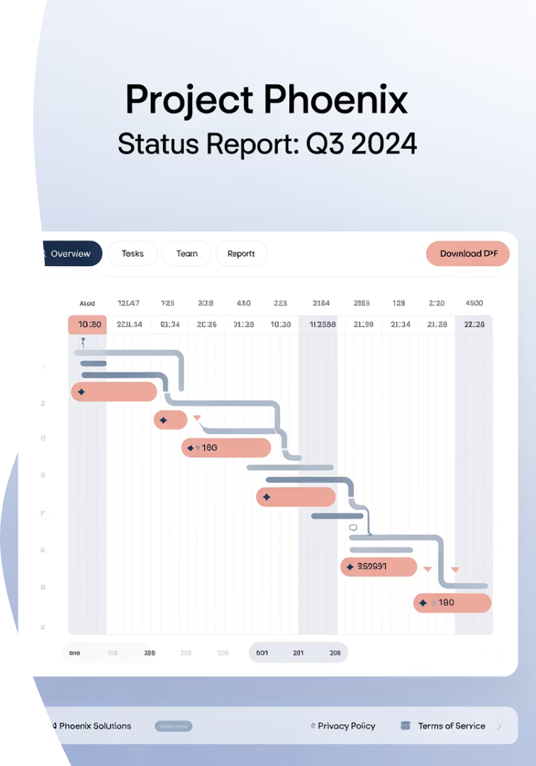
Schedule Variance (SV)
Schedule Variance (SV) is a metric for schedule performance on a project. It is used as a measure of the variance analysis that forms an element of the earned value management techniques. SV is the difference between the earned value (EV) and the planned value (PV) of a project. An alternative but less common classification of this technique is earned schedule management or analysis. A positive value is a favorable condition, while a negative value is unfavorable.
What It Measures
How To Calculate
Whether your project is ahead of or behind schedule based on earned value principles.
SV = Earned Value (EV) – Planned Value (PV)
Warning Signs
Negative SV values indicate schedule delays requiring immediate attention.

Slide 4
Cost Performance Index (CPI)
Cost performance refers to a key indicator that measures how effectively a project or business utilizes its resources to deliver value. It is defined as the ratio of the actual cost of a product or service to its planned or budgeted cost, helping to assess the efficiency and effectiveness of resource management in achieving project objectives.
Definition
Formula
CPI measures cost efficiency by comparing earned value to actual costs spent.
CPI = Earned Value (EV) / Actual Cost (AC)
A CPI below 1.0 indicates the project is over budget.
It reveals whether you're getting good value for money spent on the project.

Slide 5
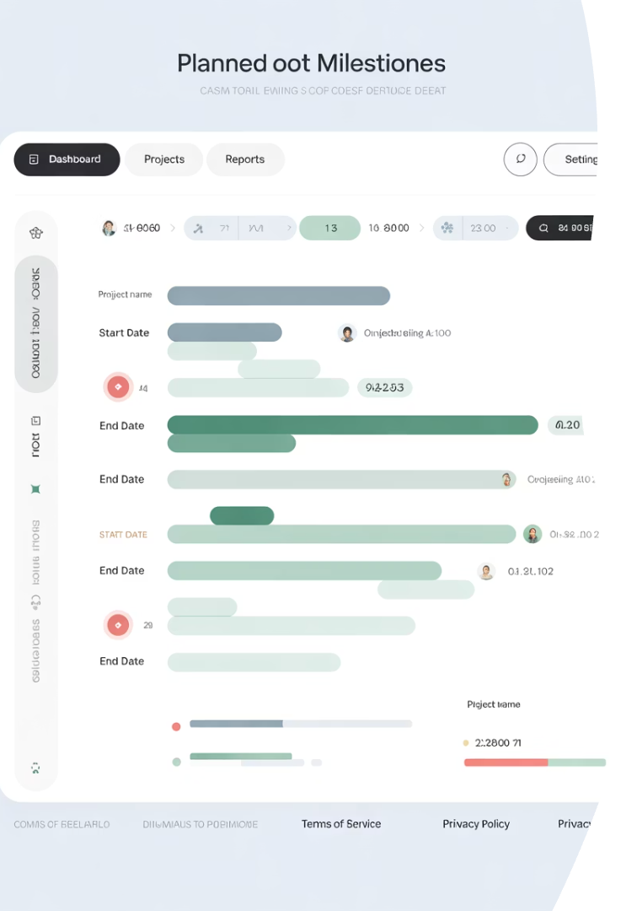
Planned vs. Actual Progress
Planned Progress: This represents the anticipated progress based on the original project plan. It is calculated using the planned weightage and SI Milestone % assigned to tasks scheduled for a specific period. Actual Progress: This reflects the actual work completed during a given period.
1
Requirements Phase
Planned: 2 weeks | Actual: 2.5 weeks
2
Design Phase
Planned: 3 weeks | Actual: 4 weeks
3
Development Phase
Planned: 8 weeks | Actual: 10 weeks
4
Testing Phase
Planned: 3 weeks | Actual: 3 weeks

Slide 6
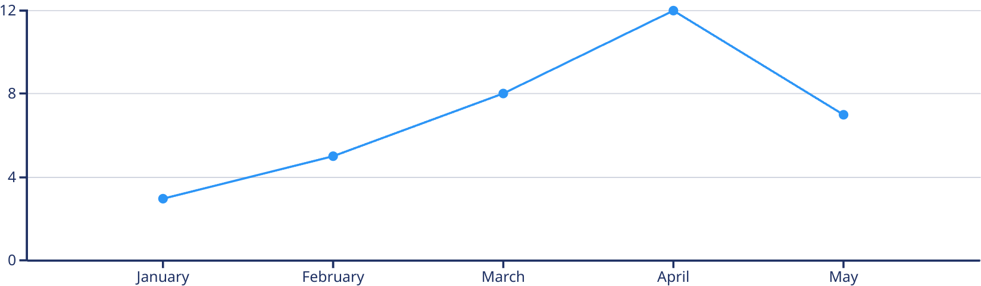
Scope Changes
Tracking scope change requests provides critical insight into project stability and potential risks. Our project experienced significant fluctuation in change requests during the first half of the year.
The peak in April (12 requests) signals a critical intervention point where project scope was at risk of significant drift. Successful scope management measures implemented in May reduced change requests by 42%, bringing the project back toward stability.

Slide 7




Resource Utilization
Resource utilization is a metric that measures the management and optimization of resources over time. Its main objective is to help organizations achieve maximum efficiency and productivity while completing a project.
Development Team
Design Team
QA Team
Current utilization: 87%
Current utilization: 65%
Current utilization: 45%
Target: 80-90%
Target: 75-85%
Target: 70-80%

Slide 8
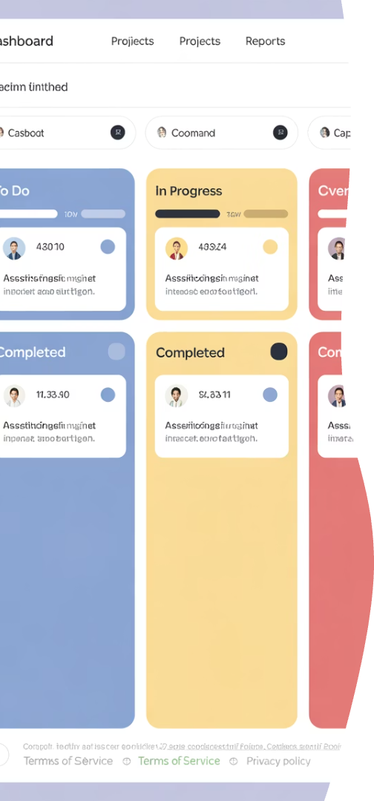
On-Time Task Completion Rate
Task Completion Rate (TCR) measures the percentage of tasks finished within a set timeframe. It’s a simple way to evaluate productivity and efficiency. For example, completing 40 out of 50 tasks in a sprint means an 80% TCR.
73%
85%
92%
Current Rate
Target Rate
Best Month
Of tasks completed by deadline
Industry benchmark
March performance

Slide 9








Budget Variance
Budget variance is the difference between budgeted and actual financial results. It helps organizations assess financial performance, identify overspending or underspending, and improve cost management through variance analysis.
Monitor
Track actual vs. planned expenses regularly
Analyze
Identify causes of significant variances
Adjust
Revise forecasts and implement corrective actions
Document
Record learnings for future project planning

Slide 10








Risk Mitigation Effectiveness
Risk mitigation is the action you take to reduce threats and ensure resiliency. When you mitigate risk, you are taking steps to reduce adverse effects. It is important to remember that mitigating risk is not just about fixing vulnerabilities—it’s also about reducing the impact of any potential threat.
Identified Risks
Resolved Risks
Total project risks identified: 37
Successfully mitigated: 21 (57%)
Materialized Risks
Active Risks
Became issues: 4 (11%)
Currently monitoring: 12 (32%)

Slide 11




Issue Resolution Time
Time to Resolution encapsulates the total time taken to address and resolve a customer's issue or a system malfunction from the moment it is reported until the problem is completely resolved. This metric is essential in evaluating the performance and efficiency of an IT support team.
Identify
Document issue within 24 hours of discovery
Assign
Allocate resources within 48 hours
Resolve
Fix within target time based on priority
Verify
Confirm resolution with stakeholders
A structured four-step approach to resolve issues efficiently, with defined timeframes for each stage from identification to verification.

Slide 12
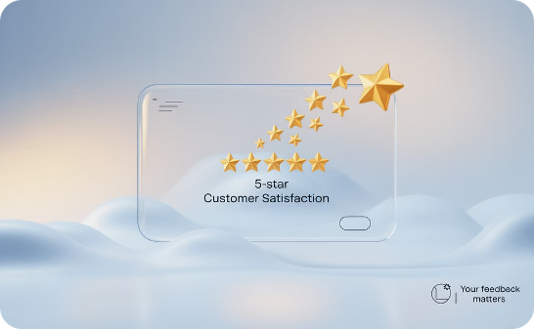


Customer Satisfaction Score (CSAT)
CSAT measures client happiness with project delivery and requires regular assessment, prompt response to feedback, and pattern monitoring for continuous improvement.
Measure Regularly
Act on Feedback
Track Trends
Conduct surveys at key project milestones and after delivery.
Address concerns quickly to improve satisfaction scores.
Monitor satisfaction patterns across multiple projects.

Slide 13
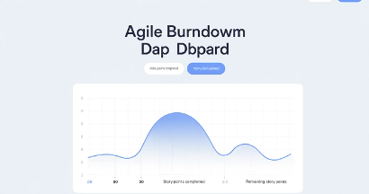
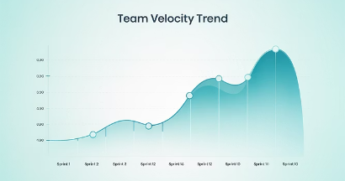


Team Velocity
Team velocity measures the amount of work completed during a sprint, providing crucial insights into productivity trends and helping forecast future delivery timelines.
Tracking velocity helps teams identify bottlenecks, optimize workflows, and improve sprint planning accuracy. Consistent velocity indicates a stable, well-functioning team, while significant fluctuations may signal underlying process issues requiring attention.
For maximum effectiveness, measure velocity over multiple sprints to establish reliable patterns, rather than focusing on individual sprint performance.

Slide 14





Return on Investment (ROI)
ROI quantifies project value by comparing financial benefits to costs, expressed as a percentage to demonstrate business impact.
Calculate Investment
Total all project costs, including labor, materials, and overhead.
Measure Returns
Quantify financial benefits and cost savings from the project.
Compute ROI
ROI = (Net Benefit / Project Cost) × 100
Report Results
Share ROI metrics with stakeholders to demonstrate value.

Slide 15

Key Takeaways
Select Relevant KPIs
Measure Consistently
Act on Insights
Communicate Results
Use KPI data to make informed decisions and course corrections.
Choose metrics that align with your project goals and organizational strategy.
Track KPIs regularly throughout the project lifecycle for meaningful trends.
Share KPI insights with stakeholders to build trust and transparency.

Slide 16
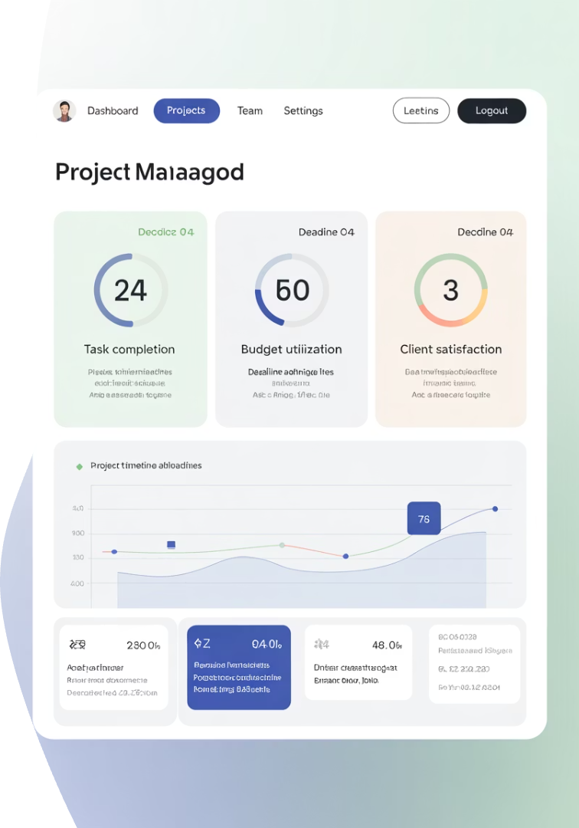
Final Thoughts
Project KPIs are more than just numbers—they're tools for decision-making, early warning indicators, and communication vehicles with stakeholders. By tracking the right KPIs at the right time, project managers can transform chaos into clarity and ensure that every project delivers value, not just deliverables.

