Slide 1

Kaizen in the Daily Standup: Small Changes That Drive Big Results
Transform your daily standups from routine check-ins into powerful catalysts for team learning, process refinement, and performance growth with the Japanese principle of continuous improvement.
#ManagingProjectsTheAgileWay #Kaizen #AgileStandups #ContinuousImprovement #AgilePractices #TeamPerformance
kW
by Kimberly Wiethoff
Managing Projects The Agile Way

Slide 2

What Is Kaizen?
Kaizen translates to "change for better" and emphasizes:
Ongoing, incremental improvements
Participation from everyone—not just leadership
A mindset of curiosity, not criticism
Reflecting on how we work, not just what we do
While retrospectives often get the spotlight for continuous improvement, your daily standup is a goldmine for real-time micro-adjustments.

Slide 3




The Problem with Traditional Standups
Robotic Status Updates
Checkbox Mentality
Missed Opportunities
Team members mechanically report what they did without meaningful engagement or reflection.
The standup becomes just another Agile ritual to complete rather than a valuable opportunity for improvement.
Teams overlook daily chances to make small adjustments that could prevent bigger problems later.

Slide 4
Traditional vs. Kaizen-Enhanced Standup
Traditional Questions
Kaizen-Enhanced Questions
What did I do yesterday?
What did I accomplish yesterday and did anything slow me down?
What am I doing today?
What am I doing today and is there a small tweak we could try?
Do I have any blockers?
What blockers do I have and have we improved on yesterday's blockers?
[No equivalent]
What patterns are we noticing as a team?
You're not extending the meeting—you're deepening the insight. Just 1–2 minutes of reflection can surface process issues before they become sprint killers.

Slide 5

Small Changes, Big Impact
1
Monday
Developer mentions slow test environment for the second day in a row
2
Tuesday
Team discusses small improvement: creating a shared QA sandbox
3
Wednesday
Two team members implement the sandbox solution
4
Friday
Team celebrates: testing blockers reduced by 40%

Slide 6
Real-World Kaizen Success Stories
Kaizen Opportunity
Action Taken
Result
Devs frequently blocked waiting on test data
Created a shared QA sandbox with fresh datasets
Reduced blockers by 40%
Stories kept rolling over sprint to sprint
Limited WIP and added clear "Definition of Ready"
Increased completion rate by 25%
Standups lacked energy and focus
Rotated facilitation weekly
Boosted engagement and team ownership
Repetitive blockers in tooling
Logged blockers in Jira with weekly trend review
Identified and escalated systemic issues earlier

Slide 7

Spotting Kaizen Moments in Your Standup
Listen for these signals of improvement opportunities:
Repeated mentions of the same blocker
Work items that keep getting delayed
Tasks that jump backward in the workflow
Unclear priorities or scope creep
Silence or disengagement from team members
These aren't just updates—they're signals for change.

Slide 8
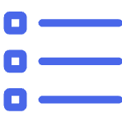





Pro Tips to Make Kaizen Stick
Track Improvements
Empower Everyone
Keep a running list of micro-improvements suggested in standup and review them in the retrospective.
Ensure every team member feels authorized to suggest process tweaks, not just senior roles.
Celebrate Small Wins
Rotate Facilitators
When a tweak works, call it out and acknowledge the improvement to reinforce the behavior.
Change who leads the standup weekly so everyone owns the process and brings fresh perspectives.
Kaizen of the Week
Encourage Questions
Designate one small habit the team agrees to try together for improved collaboration.
Create psychological safety for team members to question current processes without blame.

Slide 9
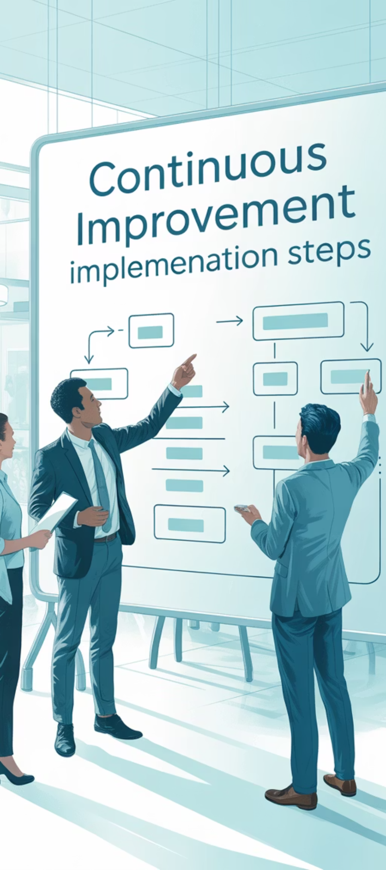
Implementing Kaizen: Step by Step
1
Introduce the Concept
Explain Kaizen to your team and how it can enhance daily standups without adding time.
2
Start Small
Add just one Kaizen-inspired question to your standup for one week and observe the difference.
3
Visualize Improvements
Create a simple "Kaizen board" near your team space to track small improvements suggested and implemented.
4
Review and Adapt
In your next retrospective, discuss how the Kaizen approach to standups is working and refine as needed.

Slide 10
Common Challenges and Solutions
Challenge
Kaizen Solution
"Our standups are already too long."
Start with just one Kaizen question per week; use a timer to keep focus.
"Team members don't speak up."
Create a rotating "improvement spotter" role to encourage participation.
"We identify issues but don't fix them."
Implement a "one improvement per sprint" rule with dedicated capacity.
"Management wants just status updates."
Track and showcase the measurable impact of Kaizen improvements on delivery.
"We forget what we discussed previously."
Keep a visible "Kaizen corner" on your team board to track improvement ideas.

Slide 11

Why This Matters: The Bigger Picture
Kaizen turns your team from task-doers to process-owners. When continuous improvement becomes a daily habit—not just a retro ritual—you unlock:
1
Higher team engagement and satisfaction
2
Fewer recurring blockers and frustrations
Team members feel empowered to shape how they work, increasing motivation and ownership.
Problems get addressed when they're small, preventing them from becoming major impediments.
3
Faster delivery with less stress
4
A culture of continuous learning
Small efficiency gains compound over time, leading to smoother workflows and more predictable delivery.
Teams develop the habit of questioning assumptions and seeking better ways to work together.

Slide 12

Next Steps: Start Tomorrow
Today
Share this concept with your team
Select one Kaizen question to add to tomorrow's standup
Create a simple tracking method for improvement ideas
This Sprint
Implement one small improvement idea from your standups
Measure the impact of the change
Celebrate the first Kaizen win as a team
You don't need a big meeting to make big improvements. You just need 15 minutes and a team that's willing to try something better—today.

Slide 13

Final Thoughts
The power of Kaizen lies in its simplicity—small, thoughtful changes that compound over time. By weaving continuous improvement into your daily standups, you're not just managing tasks—you're building a culture of reflection, adaptability, and shared ownership. It doesn't take a massive overhaul to make a meaningful difference.
One blocker addressed. One process improved. One conversation shifted. That's the Kaizen way—and it starts with your next standup.

