Slide 1


Kanban Rules of Engagement
Kanban stands out in Agile project management for its simplicity, flexibility, and emphasis on visualizing work and optimizing flow.
These six rules of engagement help teams unlock Kanban's full potential.
#ManagingProjectsTheAgileWay #Kaizen #AgileStandups #ContinuousImprovement #AgilePractices #TeamPerformance

Slide 2
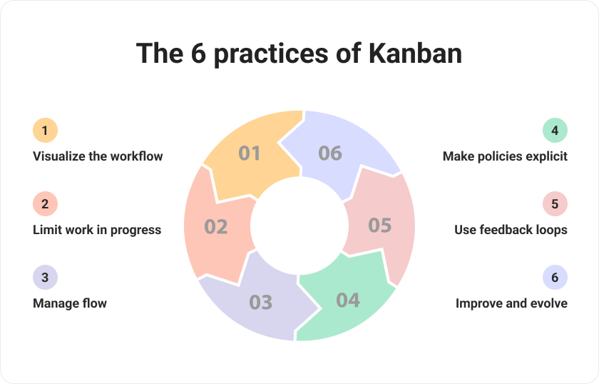

Slide 3





Visualize Your Workflow
Create Visual Representation
Display work items moving through different process stages on a Kanban board.
Organize by Stages
Divide board into columns representing workflow stages.
Track Individual Items
Use cards or sticky notes for individual work items.
Gain Insights
Identify bottlenecks and make informed decisions to improve flow.

Slide 4

Limit Work in Progress (WIP)
Focus on Completion
Complete existing work before taking on new tasks.
Prevent Overloading
Avoid multitasking to maintain quality and efficiency.
Maintain Steady Flow
Reduce lead times and improve predictability.
Optimize Productivity
Adjust WIP limits based on team capacity and throughput.

Slide 5





Manage Flow
Prioritize Work
Base priorities on customer value and urgency.
Monitor Progress
Track cycle times and visualize queues.
Address Bottlenecks
Identify and resolve blockers promptly.
Deliver Value Faster
Improve predictability and customer satisfaction.

Slide 6





Make Process Policies Explicit
Define Rules
Establish Criteria
Document guidelines governing how work is done.
Set standards for prioritizing work and quality.
Clarify Definitions
Promote Transparency
Create clear definitions of "done" for tasks.
Foster consistency and alignment within the team.

Slide 7








Implement Feedback Loops
Regular Retrospectives
Daily Stand-ups
Reflect on process and identify improvements.
Share progress and address immediate issues.
Metrics Analysis
Customer Feedback
Review analytics to guide decision-making.
Gather input from end users and stakeholders.

Slide 8




Improve Collaboratively, Evolve Experimentally
Identify Opportunities
Collaborate to find areas for improvement.
Test Hypotheses
Experiment with process changes.
Implement Incrementally
Make small, manageable changes.
Adapt Continuously
Respond to changing needs and challenges.

Slide 9
Kanban Board Structure
New
1
Problems/issues added as user stories. Reviewed during backlog grooming.
2
Backlog
Prioritized items. Higher priority listed first.
In Progress
3
Developer assigns story to themselves. Tasks added as checklist.
4
Peer Review
Another developer reviews completed work.
Testing
5
QA ensures acceptance criteria are met.
6
Done
Story has passed testing and review.

Slide 10










Benefits of Kanban
Sharper Focus
Clear priorities guide work.
Complete Transparency
Everyone sees current work status.
Improved Resource Utilization
Teams work at optimal capacity.
Flexible Planning
Adapt to shifting priorities.
Continuous Delivery
Ideal for operational teams.

Slide 11

Managing the Kanban Board
Review and Prioritize Regularly
Add New Stories Properly
Hold backlog grooming meetings to estimate and prioritize. Size stories using T-shirt sizing or Fibonacci sequences.
Maintain Consistent Structure
Any team member can add stories. Use format: "As a [user], I want [goal], so that [benefit]." Include acceptance criteria.
Once team agrees on stage lanes, make minimal changes. Only project manager or product owner should modify columns.

Slide 12





Story Workflow Process
Developers select highest priority stories, complete them, then move through peer review, testing, and product owner approval before marking as done.

Slide 13



Handling Blocked Items
Identify Blockers
Team Collaboration
Gather Information
Move blocked stories to dedicated lane. Clearly note why the story is blocked.
Encourage team members to assist in unblocking stories.
Collect details from stakeholders about issues preventing task completion.

Slide 14
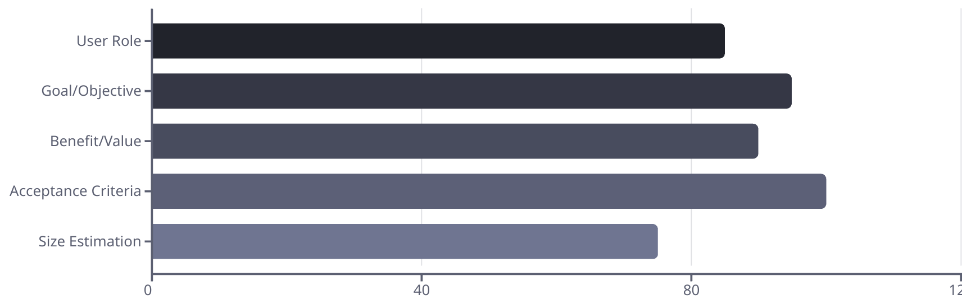
User Story Format
Effective user stories follow the format: "As a [type of user], I want [a goal], so that [benefit]." Acceptance criteria are essential for completion verification.

Slide 15

Estimation and Prioritization
2-4
5-8
Weeks
Stories
Typical sprint duration for Kanban teams
Optimal WIP limit for average team
13
3-5
Fibonacci
Sizes
Common sizing sequence (1,2,3,5,8,13)
T-shirt sizing options (S,M,L,XL,XXL)

Slide 16

Mastering Kanban:
Visualize Workflow
Create visual representation of work stages
Limit WIP
Focus on completing existing work first
Manage Flow
Prioritize based on value and address bottlenecks
Make Policies Explicit
Document rules and guidelines clearly
Implement Feedback
Use retrospectives and metrics to improve
Improve Collaboratively
Experiment and evolve as a team

Slide 17
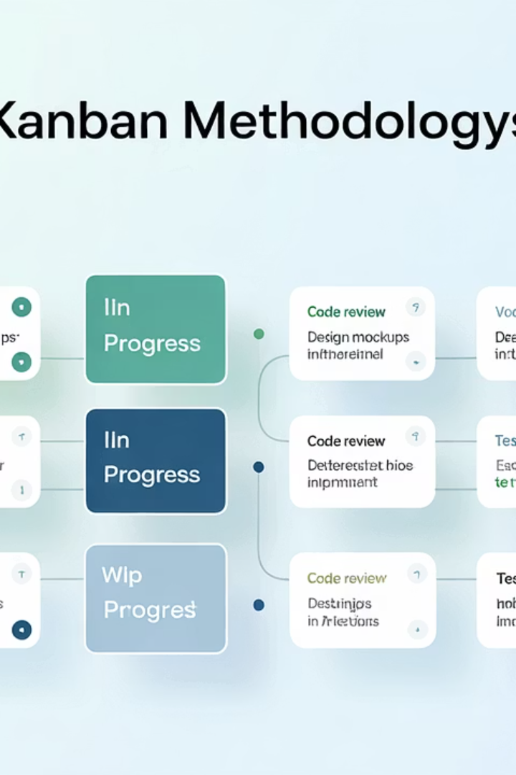
Final Thoughts
In conclusion, mastering Kanban requires understanding and adhering to its rules of engagement. By visualizing workflow, limiting WIP, managing flow, making process policies explicit, implementing feedback loops, and embracing a culture of collaborative improvement and experimentation, teams can harness the power of Kanban to optimize their processes, deliver value to customers, and achieve their goals with greater efficiency and effectiveness.

