Slide 1
Is Your Medical Billing Process Bleeding Money?
In today's healthcare environment, every dollar counts. Yet many providers don't realize how much revenue silently disappears through inefficient billing processes.
This presentation highlights five warning signs your practice may be losing money and offers practical solutions to stop the financial hemorrhage.
kW
by Kimberly Wiethoff

Slide 2
The High Cost of Billing Inefficiency
30%
25%
Average Revenue Loss
Claim Rejection Rate
From inefficient billing processes
For poorly managed practices
45+
Days in A/R
Signaling serious cash flow issues
These numbers represent significant financial leakage that directly impacts your practice's bottom line. Let's explore the warning signs in detail.

Slide 3
Warning Sign #1: High Days in Accounts Receivable
Identify Current A/R Days
Calculate average time between service and payment
Set Benchmarks
Aim for less than 30 days based on specialty
Analyze Patterns
Look for specific payers or claim types causing delays
Implement Solutions
Address bottlenecks with targeted process improvements
Extended A/R indicates cash flow problems. Your money sits with insurance companies instead of funding your practice.

Slide 4
Warning Sign #2: Rising Denial Rates
Coding Errors
Incorrect or outdated codes trigger automatic rejections
Insufficient Documentation
Missing information leads to denied claims
Missed Deadlines
Late submissions result in payment refusal
Duplicate Billing
System inefficiencies cause redundant claim submissions
A denial rate above 5-10% signals serious revenue leakage. Each rejected claim costs both time and money to resolve.

Slide 5
Warning Sign #3: Excessive Operational Costs
Audit your billing department's total cost. Compare it to industry benchmarks. Consider if your expenses exceed 8-10% of collections.
Staff Salaries
Software/IT
Clearinghouse Fees
Training
Overhead
Other

Slide 6
Warning Sign #4: Poor Metrics Tracking
Clean Claim Rate
Denial Rate
Percentage of claims accepted on first submission
Percentage of claims rejected by payers
Collection Ratio
Days in A/R
Amount collected versus amount billed
Average time to receive payment
Without tracking these essential KPIs, you're flying blind. Regular monitoring identifies problems before they become costly.

Slide 7
Warning Sign #5: Uncollected Patient Balances
Point-of-Service Collection
Collect co-pays and estimates before service
Payment Plans
Offer affordable automated payment options
Follow-Up Process
Implement systematic balance collection procedures
With high-deductible plans now common, patient payments represent a growing portion of your revenue. Uncollected balances directly reduce profitability.

Slide 8
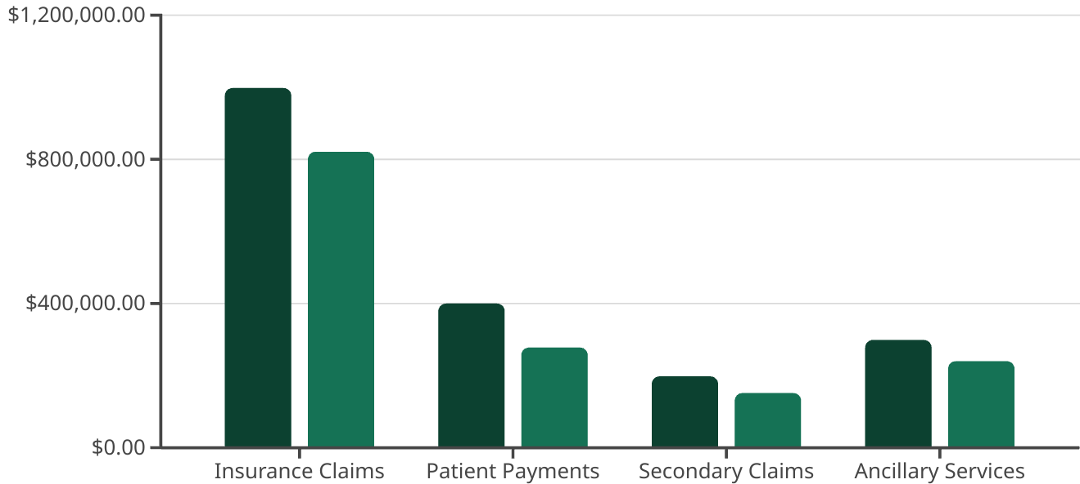
Financial Impact of Billing Issues
The gap between potential and actual revenue represents money your practice should be earning. These losses compound over time.
Potential
Actual

Slide 9
Solution: Comprehensive Billing Audit
Action Plan Development
Gap Analysis
Process Mapping
Compare your processes against industry best practices.
Create specific, measurable improvements with responsible parties and deadlines.
Baseline Assessment
Document every step from patient registration to payment posting.
Collect current metrics and identify pain points in your billing workflow.
A thorough audit reveals where money is lost. It provides a roadmap for recapturing that revenue.

Slide 10
Solution: Technology Optimization
Practice Management System
Clearinghouse Integration
Patient Financial Tools
Choose a clearinghouse with robust rejection analysis tools and payer-specific claim rules.
Implement systems for online bill pay, automated payment plans, and cost estimators.
Update your PM system to one that offers automated eligibility verification and claim scrubbing.
Ensure it offers real-time claim status updates and electronic remittance advice processing.
Consider text-to-pay solutions to increase collection rates from younger patients.
Look for systems with built-in denial management workflows and patient payment portals.
Modern technology reduces manual tasks while increasing accuracy. The right tools pay for themselves through improved collections.

Slide 11
Solution: Staff Training and Specialization
Coding Certification
Payer-Specific Knowledge
Support CPC or CPMA certification
Assign staff to specific insurers
Build relationships with provider reps
Maintain continuing education
Develop specialty-specific expertise
Track changing payer policies
Patient Communication
Train in financial counseling
Role-play difficult conversations
Develop scripts for common scenarios
Well-trained staff catch problems before they become denials. Specialized knowledge leads to faster resolutions.

Slide 12
Next Steps: Reclaiming Your Revenue
This Week
Pull your key metrics and identify your biggest pain points.
Within 30 Days
Schedule a billing process audit with internal team or external consultant.
Within 60 Days
Implement top three process improvements identified in your audit.
Quarterly
Review KPIs and adjust strategies based on data.
Don't let inefficient billing limit your practice's potential. Small improvements can yield significant financial gains.
Your patients deserve your medical expertise. Your practice deserves to be paid for it.

Slide 13
Final Thought
Don't let a broken billing process limit your practice's potential.
Assess Your Process
Find the Bottlenecks
Grow Your Revenue
Take time to thoroughly evaluate your current billing workflow and identify inefficiencies.
Identify where your money is getting stuck in the revenue cycle.
Strategic changes to your billing process can result in significant financial gains.

