Slide 1
10 Essential KPIs for E-Commerce Success
Data drives e-commerce success. As project managers, you need more than schedules—you need metrics that prove business impact. Project managers are no longer just schedule-keepers—they’re strategic decision-makers responsible for ensuring online stores meet performance, customer satisfaction, and revenue goals. One of the most powerful tools in an e-commerce PM’s toolkit? Key Performance Indicators (KPIs).
Let's explore the top KPIs that will help you deliver measurable results for your next e-commerce project.
kW
by Kimberly Wiethoff

Slide 2
Why KPIs Matter in E-Commerce
Align Technical Work with Business Goals
KPIs bridge the gap between project delivery and business outcomes.
Quantify Success Beyond Launch
Move past "on time, on budget" to measure actual customer impact.
Justify Investment
Prove ROI to stakeholders with concrete metrics.
Inform Future Decisions
Use data to prioritize features that drive real results.

Slide 3
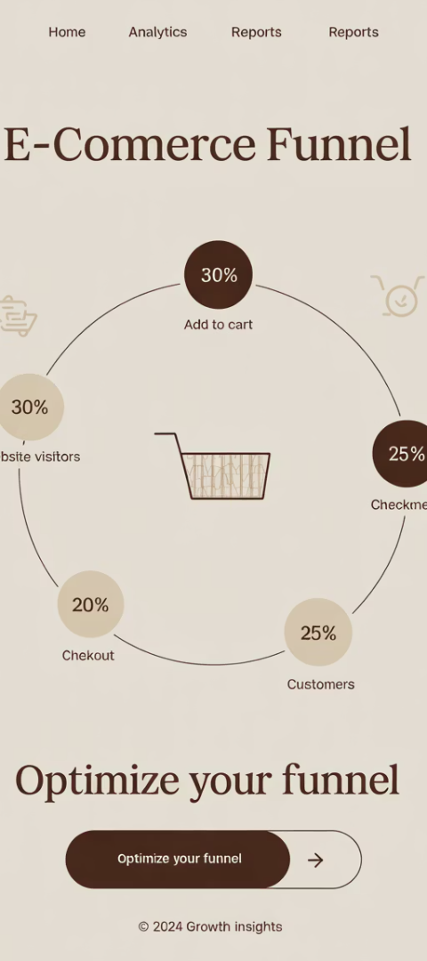
Conversion Rate: The Ultimate Success Metric
What It Is
Why It Matters
When to Watch Closely
The percentage of visitors who complete a purchase on your site.
Directly measures how effectively your site turns traffic into revenue.
After site redesigns, checkout changes, or product page updates.
Formula: (Transactions ÷ Sessions) × 100
Industry average: 1-4% for e-commerce
Seasonally and during promotional periods

Slide 4
Cart Abandonment Rate: Finding the Leaks
Identify Checkout Problems
High abandonment signals UX issues or hidden fees
Measure Improvement Impact
Track before and after checkout optimizations
Drive Recovery Campaigns
Use data to fuel abandonment email workflows
Industry average: 70%. Even small improvements can dramatically increase revenue.

Slide 5
Average Order Value: Growing Revenue Per Transaction
Premium Upsells
Offer quality upgrades at checkout
Product Bundles
Create packages with complementary items
Free Shipping Thresholds
Set minimum order value for free delivery
Formula: Total Revenue ÷ Number of Orders
Tactical projects like "Add complementary products" can directly improve this KPI.

Slide 6
Customer Acquisition Cost: Efficiency Matters
Formula: Marketing Spend ÷ New Customers Acquired
Track this during campaign launches to determine which channels deliver customers most efficiently.

Slide 7
Customer Lifetime Value: The Long Game
First Purchase
Retention
Acquisition is complete
Build ongoing relationship
Advocacy
Repeat Purchases
Customer refers others
Increase frequency and value
Formula: Average Order Value × Purchase Frequency × Average Customer Lifespan

Slide 8
Bounce Rate: First Impressions Count
Visitor Lands
Quick Decision
Stay or Leave
User arrives from search or ad
They decide if content is relevant
If they leave without clicking, that's a bounce
Healthy range: 26-40% for e-commerce sites
High bounce rates on landing pages can nullify your marketing spend.

Slide 9
Site Speed: The Need for Speed
47%
7%
Abandonment
Conversion Drop
Visitors leave if pages take >2 seconds to load
For every 1s delay in load time
53%
Mobile Users
Leave sites that take >3 seconds to load
Tools to use: Google PageSpeed Insights, GTmetrix, Lighthouse

Slide 10
Return Rate: The Post-Purchase Reality Check
Product Quality Issues
Sizing or Description Accuracy
Customer Expectations
High returns may indicate product problems requiring vendor management.
Ensure marketing aligns with the actual product experience.
Improve product pages with better descriptions, photos, and sizing guides.
Industry average: 20-30% in fashion, 8-10% in general merchandise

Slide 11
Traffic Sources: Know Your Channels
Paid Media
Organic Search
Traffic from ads and sponsored content
Visitors finding you through search engines
Social Media
Visitors from social platforms
Referral
Visitors from other websites
Email
Traffic from email campaigns

Slide 12
Net Promoter Score: The Loyalty Indicator
Promoters (9-10)
Passives (7-8)
Detractors (0-6)
Loyal enthusiasts who drive growth through referrals.
Satisfied but unenthusiastic customers vulnerable to competitors.
Unhappy customers who can damage your brand through negative word-of-mouth.
Formula: % Promoters - % Detractors = NPS

Slide 13
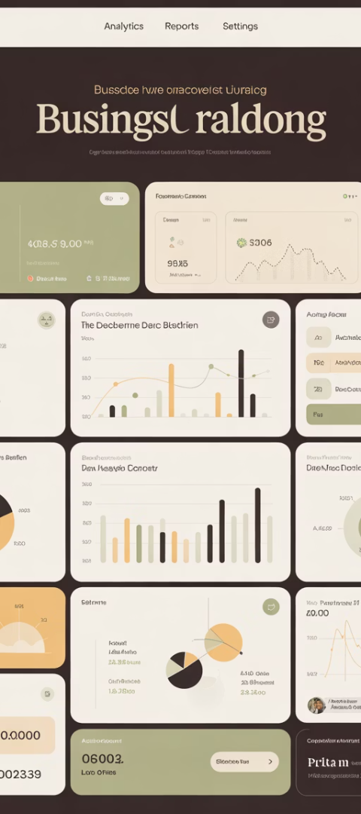
Building Your KPI Dashboard
Align With Business Goals
Select KPIs that connect directly to company objectives. Not all metrics matter equally.
Establish Baselines
Gather 3-6 months of historical data. Know where you're starting from.
Set Realistic Targets
Use industry benchmarks and past performance. Aim for meaningful improvement.
Create Visual Reports
Build automated dashboards that stakeholders can understand at a glance.

Slide 14
Project-Specific KPI Focus
Project Type
Primary KPIs
Secondary KPIs
Site Redesign
Conversion Rate, Bounce Rate
Time on Site, Pages per Session
Checkout Optimization
Cart Abandonment, Conversion Rate
Average Order Value, Mobile Conversion
Platform Migration
Page Load Time, Conversion Rate
Error Rate, Organic Traffic
Product Page Redesign
Product Page Conversion, Return Rate
Time on Page, Click-through Rate
Focus on the metrics most relevant to your specific project goals.

Slide 15
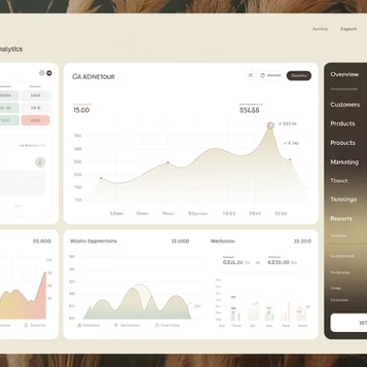
Next Steps: Implementing KPI-Driven Management
Great e-commerce project managers don’t just launch features—they drive results. These KPIs help translate business strategy into measurable outcomes. Whether you’re launching a Shopify store, managing an Adobe Commerce upgrade, or optimizing checkout flows, tracking these KPIs will keep you aligned with the bottom line.
Remember: Don't track everything. Track what matters to your stakeholders and use it to guide decisions.

