Slide 1
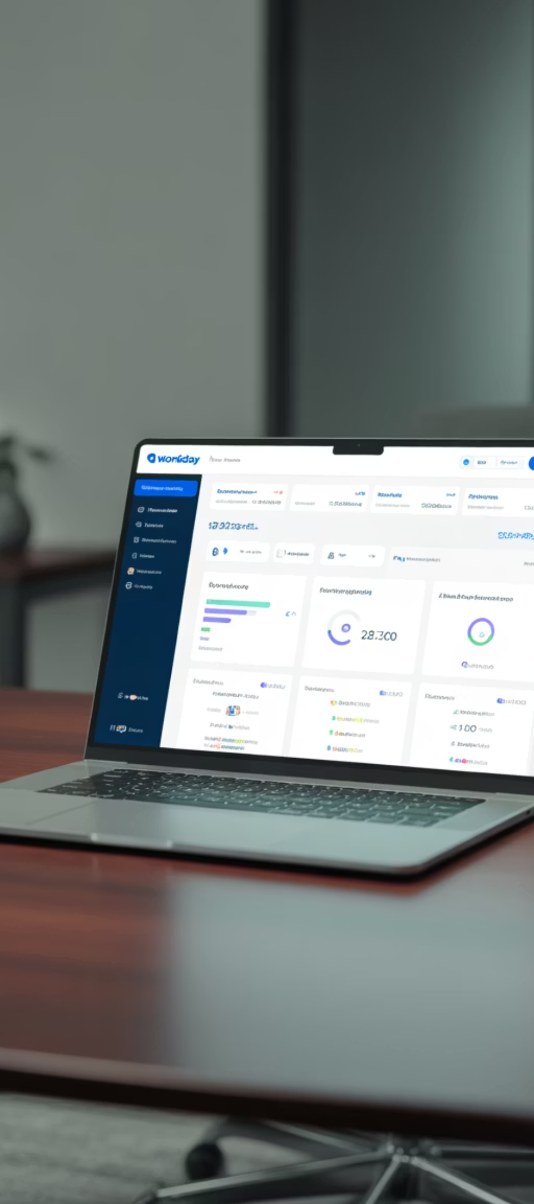
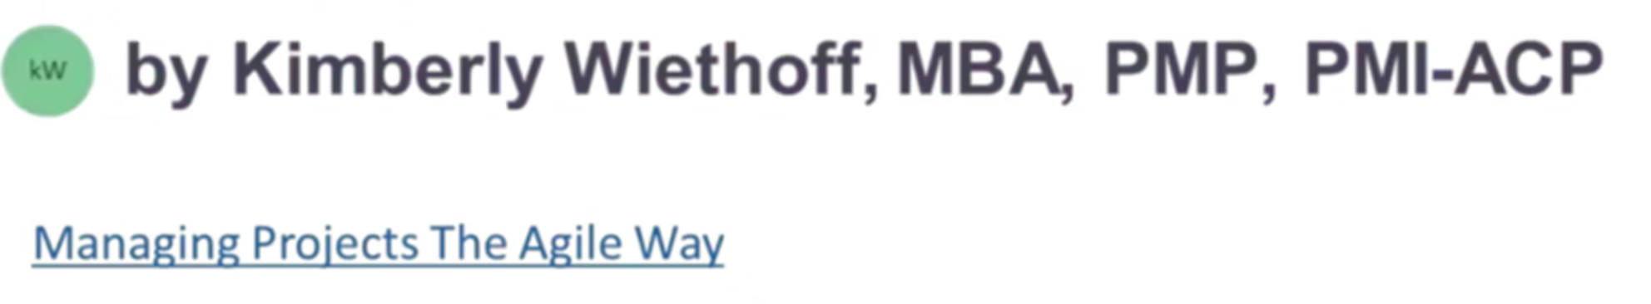
Workday Project Manager Certification: Your Gateway to Implementation Excellence
As cloud platforms dominate HR and finance technology, Workday continues to lead with integrated, scalable solutions. For project managers in enterprise SaaS implementation, the Workday Project Manager Certification demonstrates domain expertise and leadership readiness for transformation projects.
This certification validates your ability to drive delivery, manage risks, and collaborate with cross-functional teams using Workday's structured methodology, whether you're managing HCM, Financials, or full-suite implementations.
#ManagingProjectsTheAgileWay #Workday #WorkdayImplementation #WorkdayProjectManager #EnterpriseTransformation #SaaSDelivery #ERPImplementation #AgileLeadership #ChangeManagement #DigitalTransformation #ProjectManagement #ProgramManagement #PMOLeadership #AgileAtScale #CloudTransformation #HRTransformation #FinanceTransformation #ImplementationExcellence #LeadershipInAction

Slide 2








Understanding the Workday PM Certification
The Workday Project Manager Certification equips professionals with essential tools, frameworks, and methodology needed to lead deployment projects from planning through stabilization.
Offered exclusively to consultants and partner employees involved in Workday implementations, this certification isn't publicly available. You must be sponsored through an authorized Workday partner or customer organization undergoing deployment.
Launch Methodology
Project Governance
Structured approach to Workday implementations with defined phases and deliverables
Stakeholder management and decision-making frameworks for successful deployments
Risk Mitigation
Change Management
Techniques specific to cloud implementations to address potential challenges
Strategies for organizational adoption and transition to new systems

Slide 3
Core Certification Components
Technical Foundations
1
Data Conversion
The certification provides deep coverage of Workday's technical architecture, ensuring project managers understand the platform's capabilities and limitations. This knowledge helps PMs make informed decisions about configuration strategies and implementation approaches.
Strategies for migrating data from legacy systems to Workday with validation protocols
2
Testing Frameworks
You'll gain insights into Workday's multi-tenant cloud model and how it impacts deployment schedules, testing requirements, and environment management strategies.
End-to-end testing methodologies including unit, integration, and user acceptance testing
3
Cutover Planning
Detailed transition procedures for moving from legacy systems to Workday
4
Configuration Oversight
Approaches to managing tenant builds and environment planning

Slide 4
Certification Process Overview
Enrollment
Training Program
Candidates must be sponsored by Workday or an authorized partner organization to begin the certification process. This typically requires internal approval and registration through Workday's learning portal.
Participants engage in multi-day training sessions that include interactive workshops, case studies, and hands-on exercises. These sessions cover all aspects of the Workday implementation methodology.
Knowledge Assessment
Ongoing Access
Candidates must pass comprehensive evaluations that test theoretical knowledge and practical application. This includes scenario-based assessments and role-play exercises that simulate real project challenges.
Certified project managers receive continued access to Workday Community resources, updated methodologies, and best practices to maintain their expertise as the platform evolves.
The certification process is rigorous and designed to ensure that only qualified professionals can lead Workday implementations. Participants typically spend 3-5 days in formal training before completing their assessments.

Slide 5




Ideal Candidates for the Certification
The Workday Project Manager Certification is particularly valuable for professionals who already have project management experience and are looking to specialize in Workday implementations.
Implementation Partners
Internal PMs
Certified PMs
Project managers working for consulting firms like Deloitte, Accenture, and Collaborative Solutions who need to demonstrate expertise to clients
Corporate project managers at organizations implementing Workday who will oversee the transition from legacy systems
Professionals with PMP®, PMI-ACP®, or SAFe® certifications seeking to specialize in enterprise cloud implementations
Ideal candidates typically have 3+ years of project management experience, particularly in SaaS implementations, change management, and stakeholder leadership. Familiarity with HR and financial business processes is also highly beneficial.

Slide 6
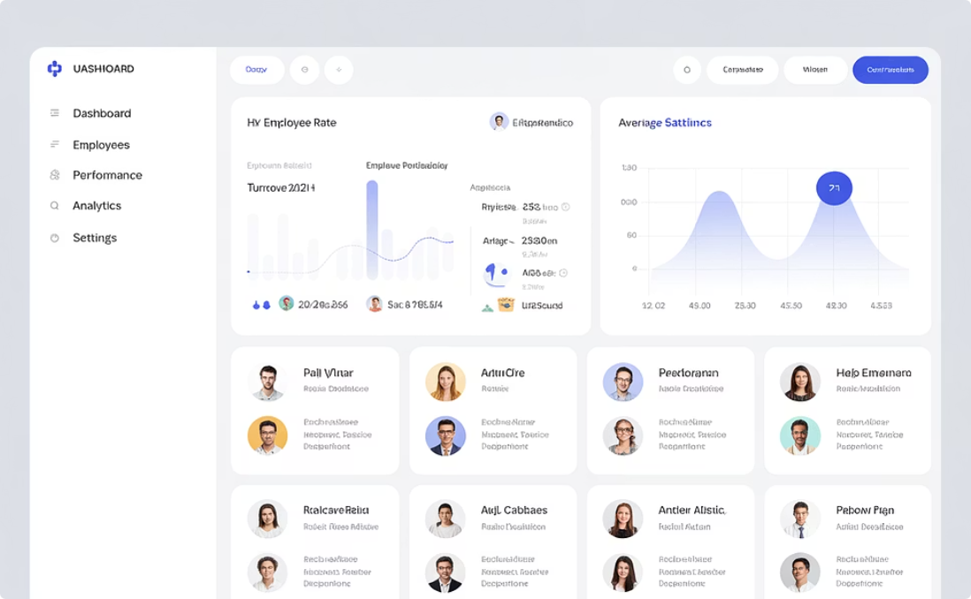
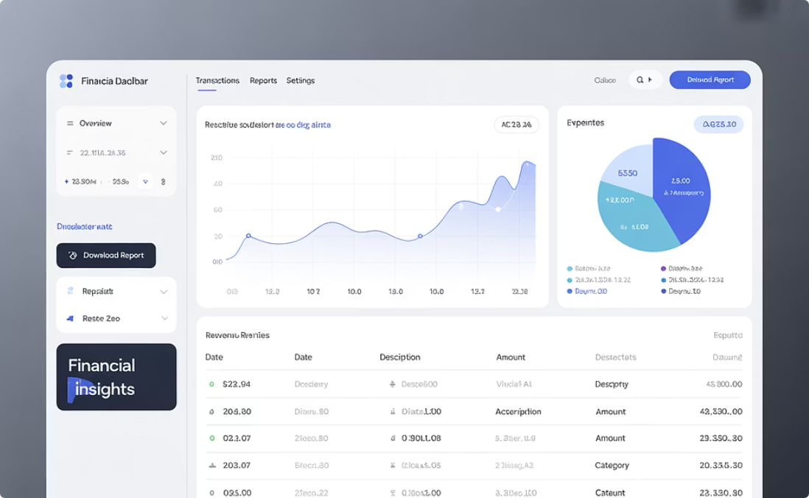
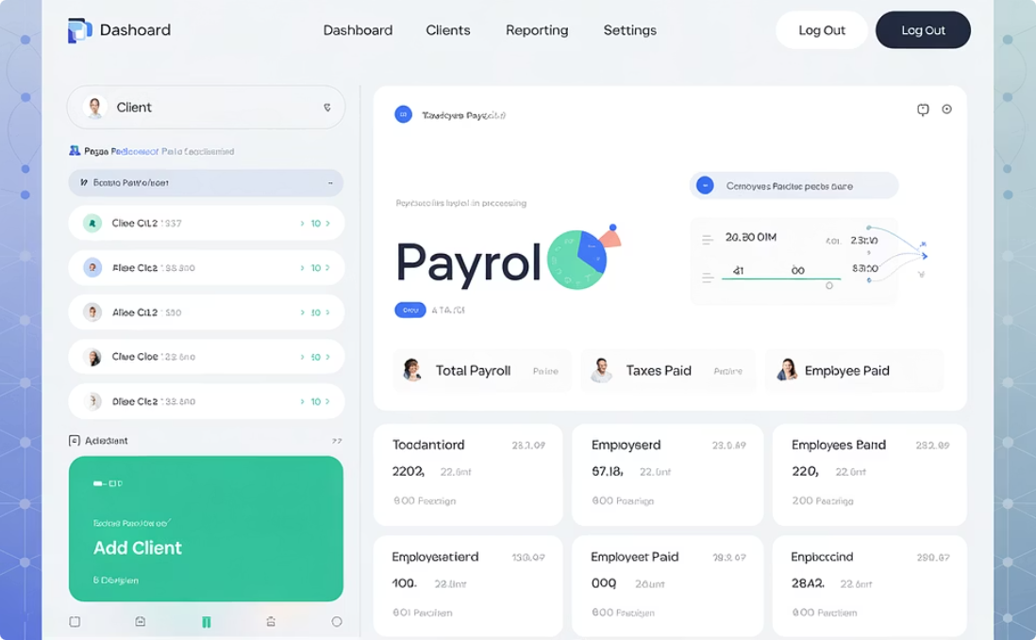
Implementation Modules Covered
The certification prepares project managers to lead implementations across Workday's comprehensive suite of applications. Each module presents unique challenges and requirements that certified PMs must understand.
Human Capital Management
Financial Management
Payroll
Core HR, talent management, recruiting, and employee self-service implementations requiring deep understanding of organizational structures and workforce processes
General ledger, accounts payable/receivable, assets, and procurement implementations requiring knowledge of accounting principles and financial reporting
Complex implementations involving tax calculations, deductions, and compliance with regional regulations that vary by country and jurisdiction
The certification also covers integrations between these modules and with third-party systems, ensuring project managers can orchestrate seamless data flows across the enterprise.

Slide 7
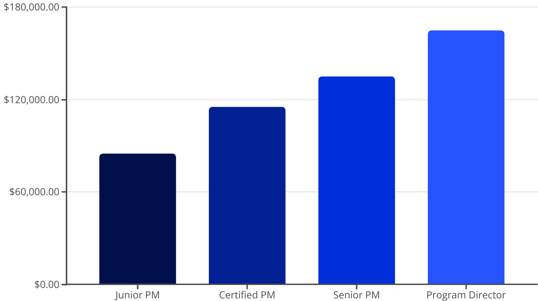
Career Impact and Benefits
Key Career Benefits
Positions you as a qualified leader for enterprise Workday initiatives
Increases credibility with HRIS, Finance, and IT stakeholders
Opens opportunities to work with global clients and partners
Strengthens your ability to navigate complex transformations
Provides access to an exclusive network of Workday professionals
The certification also creates pathways to specialized roles in change management, integration architecture, and program governance within the Workday ecosystem.
Workday-certified project managers typically command higher salaries than their non-certified counterparts, with opportunities for advancement to senior roles.

Slide 8




Real-World Application Scenarios
Certified Workday Project Managers lead some of the most complex enterprise transformations. Their expertise is applied across various scenarios that require both technical knowledge and strong leadership skills.
Global HCM Rollout
Data Migration
Leading multi-phase deployments across 40+ countries with diverse regulatory requirements and localization needs
Orchestrating complex data conversion from legacy systems while ensuring data integrity and validation protocols
System Integration
Agile Deployment
Managing integrations with SAP, Salesforce, ServiceNow and other enterprise platforms for seamless data exchange
Implementing phased go-lives or module-by-module execution using adaptive project management approaches
These scenarios require certified PMs to balance technical considerations with change management strategies to ensure successful adoption and business continuity throughout the transformation.

Slide 9
Implementation Methodology Focus
The certification provides deep coverage of Workday's proprietary Launch methodology, which guides the entire implementation lifecycle. Understanding this framework is essential for effective project leadership.
1
Plan Phase
2
Architect Phase
3
Configure & Prototype Phase
Initial scoping, resource planning, and project kickoff activities that establish the foundation for success
Business process analysis and system design activities that shape the implementation approach
System configuration and iterative testing to validate design decisions and gather feedback
Tenant configuration
Project charter development
Business process workshops
Prototype reviews
Stakeholder alignment
Configuration strategy
Configuration validation
Resource planning
Integration planning
4
Test Phase
5
Deploy & Support Phase
Comprehensive testing to ensure system functionality, integration, and performance meet requirements
Cutover activities, go-live execution, and post-production support to ensure adoption and stability
Unit testing
Cutover planning
End-to-end testing
Go-live execution
User acceptance testing
Hypercare support
Certified PMs learn to tailor this methodology to different organizational contexts while maintaining governance and quality standards throughout the implementation lifecycle.

Slide 10
Key Considerations Before Pursuing
Eligibility Requirements
1
Experience Prerequisites
The certification is not publicly available—you must be sponsored through a Workday partner or customer organization. This restriction ensures that only professionals actively involved in implementations can become certified.
Experience with SaaS implementations, change management, and stakeholder leadership is essential to succeed in both the certification process and real-world delivery.
Most successful candidates have at least 3-5 years of project management experience before pursuing this specialized certification.
Most candidates need to be employed by a Workday partner firm or by an organization that has purchased Workday and is planning an implementation. This controlled access maintains the quality and exclusivity of the certification.
2
Ongoing Commitment
You must maintain Workday Community access to stay current on tools, templates, and methodologies as they evolve with each Workday release.
Expect to invest time in continuous learning to maintain your expertise as the platform introduces new features and capabilities.

Slide 11
Skills Required for Success
Successful Workday Project Managers blend technical knowledge with leadership capabilities. The certification builds on foundational skills that candidates should already possess.
Technical Acumen
Leadership
Process Knowledge
Understanding of enterprise SaaS platforms, data structures, integration patterns, and system architecture principles
Ability to guide cross-functional teams, influence stakeholders, and drive decisions in complex organizational environments
Familiarity with HR, financial, and operational business processes that Workday will automate and transform
Communication
Adaptability
Exceptional skills in translating technical concepts for business audiences and facilitating productive discussions
Flexibility to adjust approaches based on changing requirements, organizational constraints, and emerging best practices
The certification program enhances these foundational skills with Workday-specific knowledge, methodologies, and tools. Candidates who already excel in project management will find the certification builds naturally on their existing capabilities.

Slide 12
Learning Resources and Preparation
Official Training Materials
Workday Community
Workday provides comprehensive training materials to certification candidates, including methodology guides, implementation toolkits, and case studies. These resources are only available through the official certification program.
Access to forums, knowledge base articles, and implementation guides that document best practices and lessons learned from previous deployments
The training combines instructor-led sessions with hands-on exercises in sandbox environments, allowing candidates to apply concepts in realistic scenarios. Partner organizations often provide supplementary training to prepare their teams.
Partner Enablement
Internal training programs offered by consulting firms to prepare their project managers for certification and real-world implementation challenges
Preparation typically takes several months, including formal training, self-study, and shadowing experienced project managers on active implementations. This comprehensive approach ensures candidates develop both theoretical knowledge and practical application skills.
Peer Mentoring
Learning from experienced Workday PMs who can provide guidance, share experiences, and offer practical advice on implementation strategies

Slide 13
Advancing Your Career with Workday Certification
The Workday Project Manager Certification is more than a credential—it's an entryway into leading enterprise cloud transformations. For PMs with experience in ERP, SaaS, or Agile delivery, it's a strategic way to specialize in one of the most in-demand platforms in the market.
94%
25%
62%
Implementation Success Rate
Salary Premium
Career Advancement
Projects led by certified PMs have higher success rates compared to those without certified leadership
Average compensation increase for project managers after obtaining Workday certification
Percentage of certified PMs who report receiving promotions within two years of certification
If you're ready to lead strategic HR and Finance transformations and gain credibility with Fortune 500 clients, this certification could be your next career milestone. The investment in becoming certified pays dividends through enhanced marketability, expanded professional opportunities, and the ability to deliver successful enterprise-scale Workday implementations.
Take the next step in your project management career by exploring sponsorship opportunities through your organization or Workday partner network.

