Slide 1

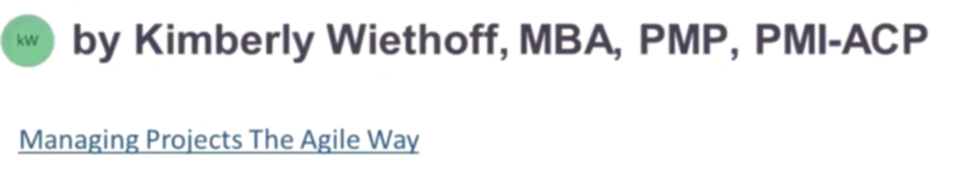
Beyond Payroll: How ADP Digital Transformation Modernizes Every Business Function
A successful ADP digital transformation impacts nearly every business function, streamlining processes, improving compliance, enhancing employee experiences, and equipping leaders with the data they need to make confident, informed decisions. Rather than simply replacing legacy software, an ADP implementation is an opportunity to redesign how work gets done across the enterprise.
#ADP #DigitalTransformation #HumanCapitalManagement #HRTechnology #Payroll #ProgramManagement #BusinessTransformation #PMO #ChangeManagement #EnterpriseTechnology #HRIS #Leadership #WorkforceManagement #DigitalWorkplace #ManagingProjectsTheAgileWay

Slide 2

Comprehensive HCM Ecosystems
When people hear the name ADP, they often think of payroll. But today's ADP platforms have evolved far beyond that single function — they are comprehensive Human Capital Management (HCM) ecosystems that transform how organizations manage their workforce.
Payroll
HR
Benefits
Talent
Workforce Management
Compliance

Slide 3

Human Resources: Building a Single Source of Truth
Human Resources sits at the center of any ADP transformation. Instead of maintaining employee information across disconnected spreadsheets, siloed systems, and paper files, organizations consolidate their entire workforce into one secure, authoritative platform — eliminating redundancy and reducing error.
Core Data
Onboarding
Self-Service
Employee records management
Organizational charts
Position management
Document management
Digital onboarding workflows
Policy acknowledgments
Electronic forms
New hire orientation
Employee self-service portal
Manager self-service tools
Profile updates
On-demand HR support
By consolidating workforce data, HR teams spend significantly less time on administrative tasks — and far more time supporting strategic initiatives that drive business growth.

Slide 4

Payroll: Automating One of the Most Critical Business Processes
Why It Matters
Core Payroll Capabilities
Payroll accuracy directly affects employee trust. Errors create frustration, erode confidence in leadership, and introduce legal risk. Modern ADP payroll solutions automate time-consuming manual activities while helping organizations stay ahead of constantly evolving tax and labor regulations.
Automated payroll processing
Multi-state tax management
Wage garnishments handling
Direct deposit configuration
Payroll auditing and reconciliation
Comprehensive payroll reporting
Off-cycle payroll runs
Payroll corrections and adjustments
Automation reduces processing time while simultaneously improving accuracy, auditability, and transparency across the organization.

Slide 5
Benefits Administration
Benefits enrollment has traditionally been one of the most paper-intensive, manually complex processes in HR. ADP simplifies benefits management by integrating enrollment directly into the employee experience — reducing friction for employees and administrative burden for HR teams alike.
Health & Welfare
Financial Benefits
Life Events & Open Enrollment
Medical, dental, and vision elections with real-time eligibility tracking and seamless carrier integration.
Retirement plans, Flexible Spending Accounts, and Health Savings Accounts — all managed within a single platform.
Guided open enrollment workflows and life event management that keep employees informed and in control of their elections.

Slide 6




Talent Acquisition
Recruiting has become increasingly competitive. Organizations that fail to provide a seamless candidate experience risk losing top talent before an offer is even extended. ADP integrates recruiting workflows end-to-end — from the moment a job requisition is created to the day a new hire completes onboarding.
Requisition & Posting
Job requisitions, career portals, and resume management
Selection
Candidate tracking, interview scheduling, and background checks
Offer & Hire
Offer management and electronic onboarding for a seamless start
A smoother hiring process creates a better candidate experience, strengthens employer brand, and measurably accelerates time-to-fill across all roles.

Slide 7
Talent Management
Beyond the Hire
Talent Management Capabilities
Hiring employees is only the beginning. Organizations must also develop, engage, and retain their talent to realize long-term business value. ADP's talent management capabilities create a continuous development loop — connecting performance, learning, and career growth in one unified experience.
These tools help organizations retain high performers, identify future leaders, and build a resilient workforce that is ready for tomorrow's challenges.
Performance Reviews
Goal Management
Structured, consistent review cycles aligned to business goals
Individual and team goals tracked in real time
Learning Management
Succession Planning
Courses, certifications, and skills tracking in one place
Identify and develop your next generation of leaders

Slide 8



Workforce Management
As organizations grow, managing employee schedules, attendance, and labor costs becomes exponentially more complex. ADP workforce management solutions give managers the visibility and control they need to optimize labor utilization without sacrificing compliance or employee satisfaction.
Time & Attendance
Scheduling & Shifts
Leave Management
Accurate time tracking, attendance policy enforcement, and overtime monitoring reduce payroll errors and labor disputes.
Intelligent scheduling tools and shift management help managers balance coverage needs with employee preferences and labor law requirements.
Streamlined leave requests, approvals, and labor forecasting ensure teams remain appropriately staffed at all times.

Slide 9

Finance
Although ADP is often viewed as an HR platform, Finance teams benefit significantly from accurate, real-time workforce data. Payroll is one of the largest line items in any organization's budget — and seamless integration between HR and Finance creates the accuracy and transparency that CFOs demand.
GL Integration
Labor Cost Reporting
Automated payroll journal entries and General Ledger integration eliminate manual reconciliation and reduce month-end close time.
Real-time cost center allocations and labor cost reporting give Finance precise visibility into workforce spend by department, location, or project.
Budget Forecasting
Workforce analytics support more accurate headcount planning and financial forecasting tied directly to business objectives.

Slide 10
Information Technology
IT as a Strategic Partner
Core IT Responsibilities
IT plays a critical and often underestimated role throughout an ADP implementation. From infrastructure setup to ongoing integrations and security governance, IT teams are essential to a successful and sustainable transformation.
Modern ADP platforms are built to integrate with ERP systems, CRM applications, finance platforms, identity providers, and third-party vendors — making IT coordination essential from day one.
System integrations and API management
Single Sign-On (SSO) configuration
Identity and access management
Security configuration and role governance
Data migration and validation
Environment management (dev, test, production)
Disaster recovery and business continuity planning

Slide 11

Compliance and Risk Management
Compliance requirements continue to grow in complexity across every industry. ADP's built-in compliance capabilities help organizations navigate a landscape of constantly shifting federal, state, and local obligations — reducing risk without adding administrative headcount.
Tax & Labor Compliance
Regulatory Reporting
Audit Readiness
Automated multi-state tax management and labor law reporting ensure organizations stay current with evolving regulatory requirements.
ACA reporting, OSHA reporting, and EEO compliance reporting are streamlined and audit-ready within the platform.
Electronic audit trails, security permission logs, electronic signatures, and configurable record retention policies protect organizations during audits and investigations.
Automated compliance reduces organizational risk while dramatically simplifying the audit process — freeing compliance teams from reactive firefighting.

Slide 12



Employee Experience
Today's workforce expects digital experiences that rival the consumer applications they use every day. When employees face friction navigating benefits, pay, or time-off requests, engagement suffers. ADP delivers an intuitive, mobile-first experience that empowers employees to manage their own information — on any device, at any time.
Mobile-First Access
Personalized Dashboards
Learning & Self-Service
Employees access pay statements, PTO balances, benefits information, and company announcements from any device — no desk required.
Tailored dashboards surface the information each employee needs most, reducing time spent searching and increasing engagement with the platform.
Access to learning resources, policy documents, and HR support tools helps employees grow and resolve questions independently.

Slide 13
Managers and Leadership
From Gut Feel to Data-Driven Decisions
Leadership Analytics
Executives and managers cannot lead effectively without accurate, timely workforce information. ADP equips leaders at every level with the dashboards and analytics they need to move from reactive management to proactive, strategic decision-making.
Headcount & Turnover
Compensation & Labor
Track workforce size, voluntary attrition, and retention trends by team or department
Analyze total compensation, labor cost trends, and overtime against budget targets
Real-time workforce insights enable faster, more confident decisions — reducing reliance on manual reports and outdated spreadsheets.
Workforce Planning
Diversity metrics, hiring velocity, and productivity trends inform strategic workforce plans

Slide 14
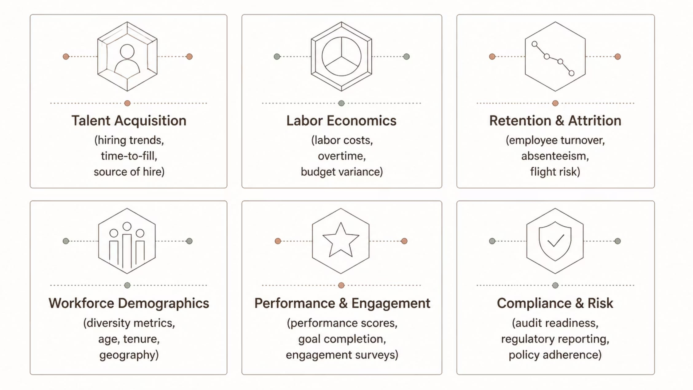
Data Analytics and Business Intelligence
One of the most transformative advantages of an ADP implementation is the visibility it creates into workforce data. Rather than reacting to workforce challenges after the fact, leaders can proactively identify trends, surface risks early, and seize opportunities for improvement — all powered by a single, trusted data source.

Slide 15
Organizational Change Management
Technology alone does not deliver transformation. The most sophisticated platform in the world will underperform if people are not prepared, supported, and genuinely engaged in the change. Successful ADP implementations pair technical delivery with structured change management — building the human foundation that sustains long-term adoption.
Align Leadership
1
Executive sponsorship, stakeholder engagement, and communication planning establish the vision and build organizational buy-in from the top down.
2
Prepare the Organization
Readiness assessments, role-based training programs, and targeted communications equip employees for new ways of working before go-live.
Activate & Sustain
3
Adoption monitoring, feedback collection, and continuous improvement cycles ensure the transformation delivers lasting value well beyond the launch date.
Organizations that invest in change management consistently experience faster adoption, higher platform utilization, and stronger long-term outcomes than those that treat it as an afterthought.

Slide 16
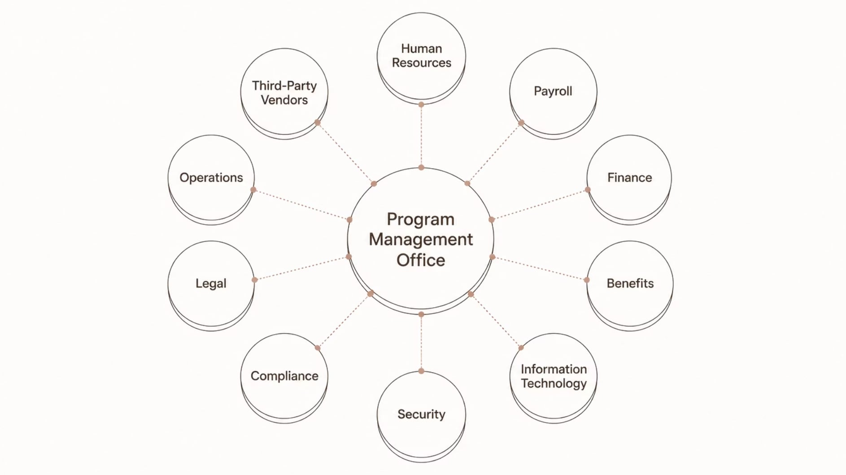
Why Program Management Is Essential
Because an ADP transformation touches nearly every corner of the organization, these implementations demand coordinated, disciplined leadership. Program managers serve as the connective tissue — aligning cross-functional workstreams, managing dependencies, mitigating risks, and ensuring the transformation delivers measurable business value rather than just a software go-live.
Strong governance structures, clear decision rights, and consistent cross-functional communication ensure that each workstream moves forward together — rather than in isolation — toward a unified set of business outcomes.

Slide 17
Final Thoughts
An ADP digital transformation is far more than a payroll modernization project. It is an enterprise-wide initiative that reshapes how organizations recruit, hire, pay, develop, support, and retain their workforce.
Operational Efficiency
Compliance Confidence
Unified workflows eliminate redundancy, reduce manual effort, and free teams to focus on higher-value work.
Automated compliance tools reduce organizational risk and simplify regulatory reporting across every jurisdiction.
Smarter Decisions
Better Experiences
Real-time workforce analytics give leaders the insight they need to act with speed and confidence.
Intuitive, mobile-first tools create engaging experiences for employees, managers, and HR professionals alike.
The organizations that realize the greatest value are those that approach ADP as a strategic business transformation — supported by strong program governance, thoughtful change management, and a relentless focus on business outcomes.

